Slide 1
Subject: Design of Steel Structure
Topic: welding and riveting
Presented by: Atul Setya

Slide 2
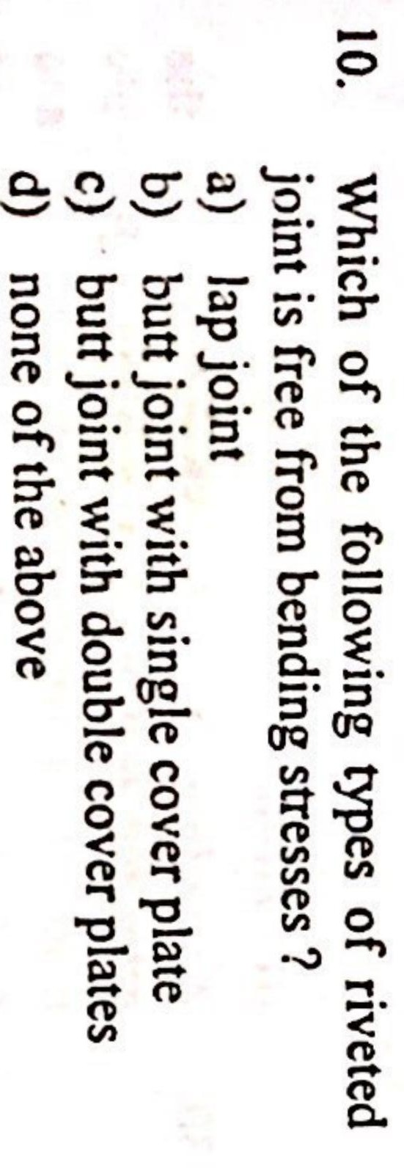

Slide 3
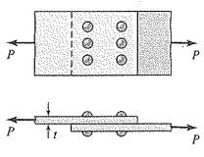
Answer C
The process by which two plates are joints together by use of rivet is called riveting.
Two types of rivet joints.
1. Lap joint:-
When the two members to be connected together by
overlapping, and rivet inserted in overlap section.

Slide 4
2. Butt joint:-
When the two members are to be connected by placing the members end to end and additional plate/plates provided on either one or both sides to attach them properly, then this joint is called butt joint.And the additional plate is called cover plate.

Slide 5
Provide a butt joint rather than a lap joint for main two reasons:
In the case of a double cover butt joint,the total shear force to be transmitted by the members is split into two parts and the force acts on each half.
In the case of a double cover butt joint,eccentricity of forces does not exist and hence bending is eliminated, whereas it exists in the case of a lap joint.

Slide 6
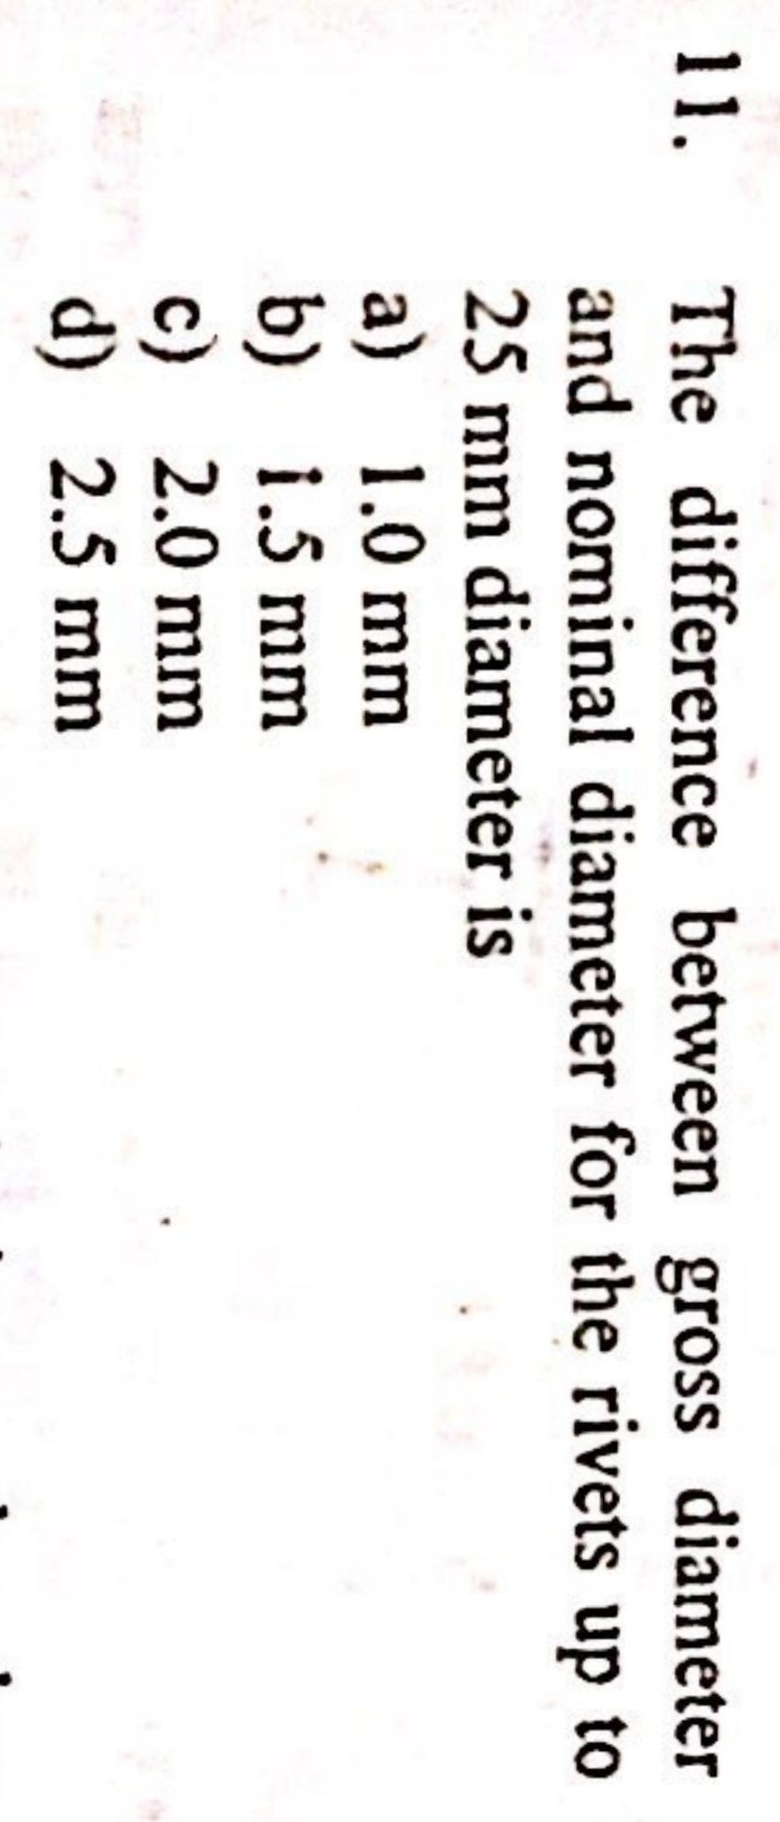

Slide 7
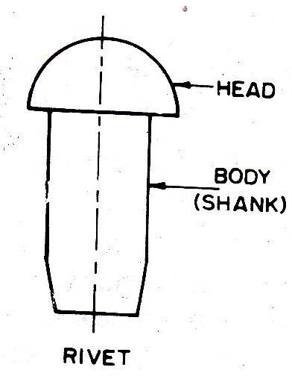
Answer B
Nominal diameter of rivet (d):-
Diameter of the cold shank before driving.
Gross diameter of rivet (D):-
The diameter of the hole is slightly
greater than the diameter of the rivet shank.
As the rivet is heated and driven, the rivet fills the hole fully.
Gross diameter = Nominal diameter + 1.5 (If d ≤ 25 mm)
Gross diameter = Nominal diameter + 2.0 (If d > 25 mm)
Pradeep Rathore (Lecturer, DTE MP)

Slide 9
Answer A
Shop rivet:- a rivet driven in place in a shop.
Field rivet:- a rivet driven in place on work in the field.
Hot driven rivet:- For driving the rivets, they are heated till they become red hot and are then placed in the hole.
Keeping the rivets pressed from one side, a number of blows are applied and a head at the other end is formed.
When the hot rivet so fitted cools it shrinks and presses the plates together.
Cold driven rivets:- are driven at atmospheric temperature.
The cold driven rivets need larger pressure to form the head and complete the driving.

Slide 10
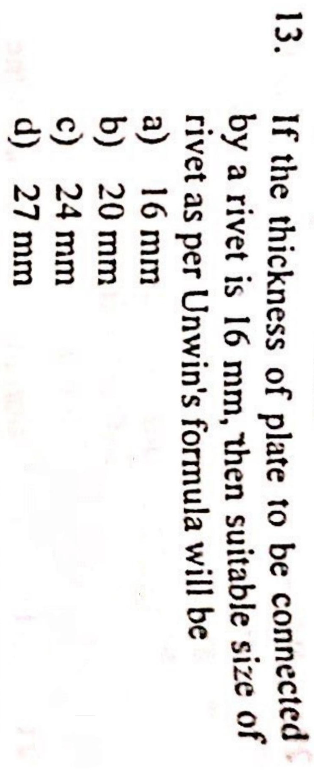

Slide 11
Answer C
Unwin’s formula
Diameter of the hole (d) = 6.05 √t ≈ 6 √t
= 6 √16
= 24 mm
Where, t is thickness of the plate.

Slide 12
