Slide 1
DIFFERENT ROOF TYPES
ADVANTAGES AND DISADVANTAGES
ATUL SETYA

Slide 2
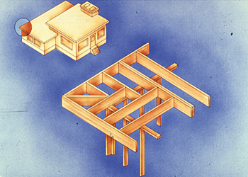
FLAT ROOF
Its not perfectly flat, slightly slope which is less than 10°.
This roof is been used in hot climates
where water accumulation is not a
problem. (less rain)

Slide 3
ADVANTAGES OF FLAT ROOF
Less material is being used than in a sloped roof
The rooftop is potentially useful as a terrace or sleeping porch
Potentially pleasing appearance
Easier to build than a sloped roof
WATERPROOFING THE FLAT ROOF
The flat roof relied on some kind of membrane for keeping moisture out.
The slight slope of flat roof directs standing moisture to drains at edges.

Slide 4
DISADVANTAGES OF FLAT ROOF
Roof elements can’t overlap, hence waterproofing must be more complex and more thorough.
Drainage isn’t automatic. Unless properly designed & constructed, pools of water will collect on the surface causing local variations in temperature. This will result in deterioration of the covering finally leading to high maintenance cost.
It have little or no space below roof
to accommodate services
It have limited capacity for insulation

Slide 5
PITCHED ROOF
Roof whose angle of slope to the horizontal lies between 10° - 70°.
Construction cost for pitched roof is higher than flat roof and more material is needed.
There’s bigger space below the roof than flat roof can be made as attic.

Slide 6
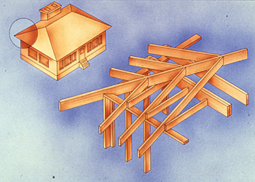
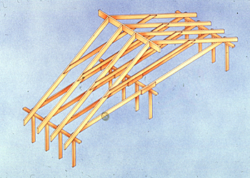
PITCHED ROOF DESIGN
The slope for pitched roof depends on the rain (how heavy the rain is, frequency of the rain) in a year.
In Malaysia, the roof built at West Coast Malaysia & East Coast Malaysia is different due to the factor of wind and rain.

Slide 7
TERMINOLOGY IN PITCHED ROOF STRUCTURE
Roof - The entire covering assembly
Pitch – Rise over run
Substrate – The decking that carries the
roof material
Eaves – Roof overhang
Ridge – The peak of 2 or more slopes
Valley – An inverse ridge
Ceiling – The finish material that is attached to the underside of the roof

Slide 8
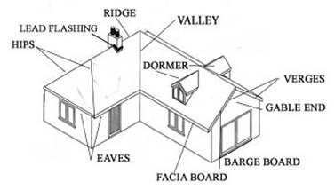

Slide 9
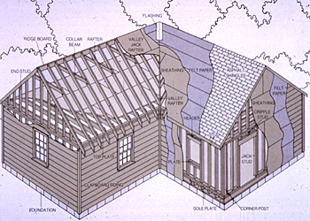
2
3
5
4
1
Some Of The Roof Elements

Slide 10
This are the names of some of the
pitched roof elements which been labeled
on previous slide
1. Asphalt Shingles
2. Rafter
3. Ridge
4. Valley Rafter
5. Collar Beam

