Slide 1
Trade Unions: Uniting Workers for a Stronger Future!

Slide 2
Introduction
Trade unions play a viitall rolle iin representing workers' interests and iimproving workiing conditions. Thiis presentation wiillll explore the signiiﬁcance of trade uniions, their key features, as well as the advantages and disadvantages they briing to the labor market..

Slide 3
What is Trade Unions?
Trade unions are organizations formed by workers to protect thei r rights andiimprove workiing condiitions. They negotiiate wiith emplloyers on behalf of the workers and proviide support iin times of conﬂict..

Slide 4
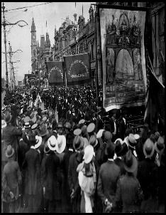
History of Trade Unions
1. Long time ago:
2. Worker’s problems:
3. Joining together:
4. Talking together:
5.Laws and recognition:
6.Fighting for fairness
7.Working together globally:
8. Important changes:

Slide 5
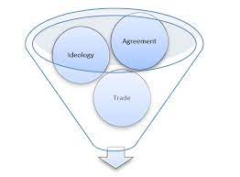
Types of Trade Unions
2.Industrial union
1. Craft union
3.Professional association

Slide 6
The Role of Unions Today
1. Representation:
2. Legal Assistance:
3. Advocacy and Lobbying:
4. Member Services:
5. Collective Action

Slide 7
Advantages of Trade Unions
1. Right Pay Demand:
2. Improved working conditions:
3.Guaranteed Job Security:
4.Reduced Economic Inequality:

Slide 8
Disadvantages of Trade Unions
1. Costs for workers:
2. Strikes and disruptions:
3. Limited flexibility:
4. Unrepresentative decisions:
5. Job loss risk

Slide 9
Global Impact of Trade Unions
1. Collective bargaining power:
2. International solidarity:
3. Improving global labour standards:
4. Addressing inequality:
5. Advocacy for fair trade:

Slide 10
Collective bargaining
1. Definition:
2. Strength in numbers:
3. Negotiating objectives:
4. Strikes and lockouts:

Slide 11
Impact on Workers' Rights
1. Collective Bargaining Power:
2. Legal protection:
3. Representation and support:
4. Strengthening Worker Solidarity:

Slide 12
Conclusion
Trade unions play a vital role in uniting workers and advocating for their rights. As we look to the future,, it's clear that the strength of unions lies in their ability to adapt and represent the diverse needs of the modern workforce.

