Slide 1



Explore Now

Slide 2

Introduction To
Performance Management
System

Slide 3
Meaning

Slide 4
The introduction to a Performance Management System (PMS) serves as a foundational step in establishing a structured approach to optimize employee performance within a workplace. This process involves several key components:

Slide 5
1. Purpose and Objectives: Clearly articulating the purpose of the Performance Management System and its alignment with the overall goals of the organization. This may include improving productivity, aligning individual goals with organizational objectives, and fostering a culture of continuous improvement.
2. Communication: Effectively communicating the introduction to all stakeholders, including employees and managers. This involves explaining the benefits of the system, addressing any concerns, and emphasizing the positive impact it can have on personal and organizational growth.
3. Expectations and Accountability: Setting clear expectations for employees regarding performance standards, goals, and behaviors. Highlighting the link between individual performance and organizational success helps establish a sense of accountability among employees.
4. Processes and Tools: Introducing the specific processes and tools that will be used within the Performance Management System. This may include regular performance reviews, goal-setting processes, feedback mechanisms, and performance measurement metrics.

Slide 6
5. Training and Support: Providing necessary training and support to both employees and managers to ensure they understand how to effectively use the Performance Management System. This could involve workshops, training sessions, and access to resources that facilitate a smooth implementation.
6. Feedback and Recognition: Emphasizing the role of constructive feedback and recognition within the system. Establishing a culture where feedback is valued as a tool for improvement and recognizing achievements contributes to a positive and motivating work environment.
7. Continuous Improvement: Conveying that the Performance Management System is not static and will evolve over time. Encouraging a mindset of continuous improvement ensures that the system remains relevant and effective in addressing changing organizational needs.

Slide 7

Uses and Purpose of Performance Management

Slide 8
The uses and purposes of Performance Management within the Introduction to Performance Management System are crucial for fostering organizational success. Here's an elaboration:

Slide 9
1. Alignment with Organizational Goals: Performance Management ensures that individual and team objectives align with the broader goals of the organization. This alignment contributes to overall organizational success by ensuring everyone is working towards common objectives.
2. Enhanced Employee Performance: The primary purpose is to improve and optimize individual and collective employee performance. By setting clear expectations, providing feedback, and offering development opportunities, Performance Management encourages employees to excel in their roles.
3. Feedback and Development: Performance Management provides a structured framework for ongoing feedback. Regular assessments and discussions help employees understand their strengths, areas for improvement, and developmental needs. This, in turn, facilitates continuous learning and professional growth.
4. Recognition and Rewards: It serves as a basis for recognizing and rewarding high-performing individuals or teams. Acknowledging and rewarding accomplishments not only motivates employees but also reinforces positive behaviors that contribute to organizational success.

Slide 10
5. Identification of Training Needs: Through performance evaluations, organizations can identify skill gaps and training needs. This information enables targeted training and development initiatives, ensuring that employees have the necessary skills to fulfill their roles effectively.
6. Succession Planning: Performance Management aids in identifying high-potential employees and grooming them for leadership roles. This supports succession planning, ensuring a pipeline of capable individuals who can step into key positions when needed.
7. Communication and Transparency: It fosters transparent communication between employees and managers. Clear expectations, ongoing feedback, and open dialogue contribute to a positive work culture where everyone understands their role in achieving organizational objectives.
8. Employee Engagement: By actively involving employees in the performance management process, organizations can enhance employee engagement. When employees feel valued and see a clear connection between their efforts and organizational success, their commitment to their work increases.

Slide 11

Performance Management and its Challenges in Current Scenario

Slide 12
In the Introduction to Performance Management System, it's crucial to acknowledge the challenges associated with implementing and maintaining effective performance management, especially in the current business landscape. Here are some challenges

Slide 13
1. Remote Work and Hybrid Models:
- Challenge: The rise of remote work and hybrid models poses challenges in monitoring and assessing performance without traditional in-person interactions.
- Solution: Implementing technology solutions, clear communication strategies, and outcome-based performance metrics can help address this challenge.
2. Continuous Feedback:
- Challenge: Providing timely and constructive feedback regularly can be challenging due to competing priorities and busy work environments.
- Solution: Encouraging a culture of continuous feedback through regular check-ins, real-time communication tools, and training managers in effective feedback techniques.
3. Goal Alignment:
- Challenge: Ensuring that individual and team goals align with organizational objectives can be challenging, especially in dynamic and rapidly changing business environments.
- Solution: Regularly reviewing and adjusting goals, fostering open communication, and ensuring that employees understand the broader organizational strategy.

Slide 14
4. Technology Integration:
- Challenge: Integrating performance management tools and technology seamlessly into existing systems can be complex.
- Solution: Investing in user-friendly technology, providing training, and ensuring that the technology aligns with the organization's goals and processes.
5. Employee Engagement:
- Challenge: Keeping employees engaged in the performance management process, especially when it becomes perceived as bureaucratic or disconnected from daily work.
- Solution: Involving employees in goal-setting, emphasizing the developmental aspect, and recognizing and rewarding achievements can enhance engagement.
6. Bias and Fairness:
- Challenge: Ensuring that performance evaluations are fair and free from bias can be a significant challenge.
- Solution: Implementing standardized evaluation criteria, providing training on unconscious bias, and promoting transparency in the evaluation process.

Slide 15
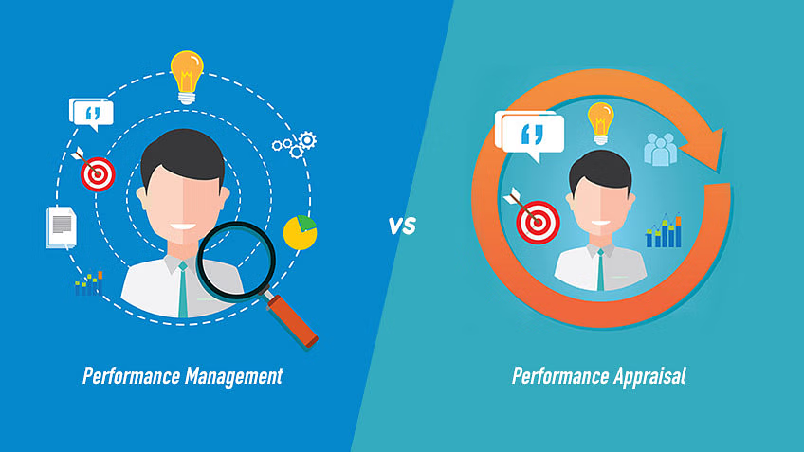
Performance Management
Performance Appraisal
vs

Slide 16
1. Performance Management:
- Definition: Performance Management is a comprehensive and ongoing process that involves planning, monitoring, developing, and evaluating employee performance.
- Purpose: It aims to align individual and team performance with organizational goals, enhance employee effectiveness, and contribute to overall organizational success.
- Key Components: Performance Management includes setting expectations, providing regular feedback, goal-setting, continuous development, and creating a culture of ongoing improvement.
- Continuous Process: Performance Management is a continuous and dynamic process that involves regular communication and collaboration between employees and managers.

Slide 17
2. Performance Appraisal:
- Definition: Performance Appraisal, often referred to as a performance review or evaluation, is a specific event within the broader Performance Management process.
- Purpose: It is a formal assessment conducted periodically (usually annually) to evaluate an employee's performance over a specific period.
- Key Components: Performance Appraisal typically involves reviewing achievements, providing feedback, discussing strengths and areas for improvement, and may include setting new goals for the upcoming period.
- Snapshot in Time: Unlike Performance Management, which is ongoing, Performance Appraisal provides a snapshot of performance at a specific point in time.

Slide 18
Relationship:
- Performance Appraisal is a component of the broader Performance Management system. It is a structured evaluation within the overall framework of managing performance.
- The data and insights gathered during Performance Appraisal contribute to the ongoing Performance Management process by informing development plans, identifying training needs, and recognizing high performers.
Summary:
- Performance Management is the overarching process that encompasses various activities to manage and enhance employee performance continuously.
- Performance Appraisal is a specific, periodic event within the Performance Management process, focusing on assessing and evaluating an employee's performance over a specific period.

Slide 19
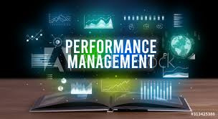
Performance Management as a System and Process

Slide 20
In the Introduction to Performance Management System, it's essential to highlight Performance Management as both a system and a process, emphasizing its holistic nature in managing and enhancing employee performance. Here's an overview:

Slide 21
1. Performance Management as a System:
- Definition: Performance Management System refers to the structured framework, tools, and technology that organizations use to manage and optimize employee performance.
- Components: This system includes various interconnected elements such as goal-setting, continuous feedback mechanisms, performance reviews, employee development plans, recognition and rewards, and data analytics.
- Integration: The system integrates these components to create a comprehensive approach that aligns individual and team performance with organizational goals.

Slide 22
2. Performance Management as a Process:
- Definition: Performance Management Process is the ongoing, cyclical series of activities and interactions between managers and employees aimed at improving performance.
- *Key Steps:*
- Goal Setting: Establishing clear and SMART (Specific, Measurable, Achievable, Relevant, Time-bound) goals aligned with organizational objectives.
- Continuous Feedback: Providing regular, constructive feedback to employees to guide their performance and development.
- Performance Reviews: Conducting formal evaluations periodically to assess achievements, strengths, areas for improvement, and aligning future goals.
- Development Planning: Collaboratively planning and implementing strategies to address skill gaps and support career growth.
- Recognition and Rewards: Acknowledging and rewarding high performance to motivate and retain valuable employees.
- Data Analysis: Using data and analytics to derive insights into overall performance trends, identify patterns, and inform decision-making.

Slide 23
3. Interconnected Nature:
- Mutual Reinforcement: The system and process are mutually reinforcing. The structured system supports the effective execution of the ongoing process, while the cyclical process contributes to the refinement and improvement of the system over time.
- Continuous Improvement: Both aspects emphasize the importance of continuous improvement, learning, and adaptation based on feedback and changing organizational needs.

Slide 24



Thank You!

