Slide 1
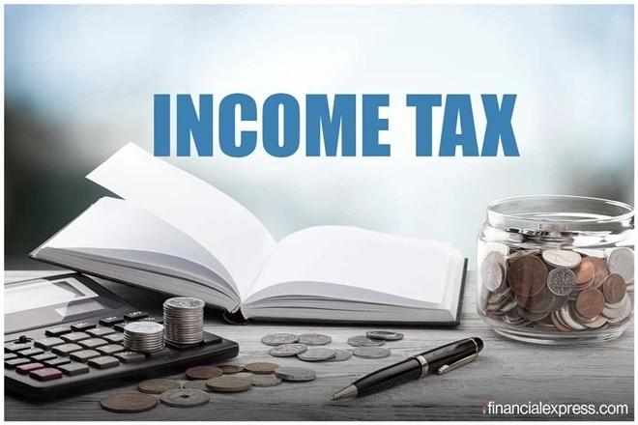
Income tax , tax return , exemption and deduction.

Slide 2
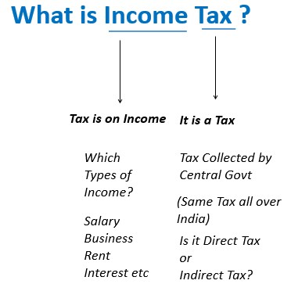

Slide 5
Introduction
An income tax is a tax imposed on individuals or entities (taxpayers) in respect of the income or profits earned by them (commonly called taxable income).

Slide 6
Understanding income tax
Paying your income tax for the first time is a milestone in any citizen’s life. However, the process can seem too daunting and tedious for a first-timer, and some of the terms tend to go right over your head. This needn’t be so. To help you understand the tax implications of your income (based on your income source), here is a compilation of basics of income tax for beginners

Slide 7
Income tax return
Income tax return is the form in which assessee files information about his/her income and tax thereon to Income Tax Department. Various forms are ITR 1, ITR 2, ITR 3, ITR 4, ITR 5, ITR 6 and ITR 7. When you file a belated return, you are not allowed to carry forward certain losses.

Slide 8
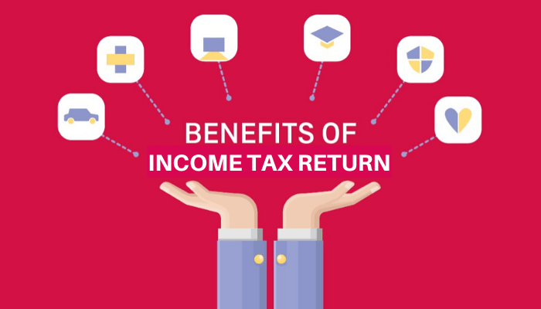

Slide 9
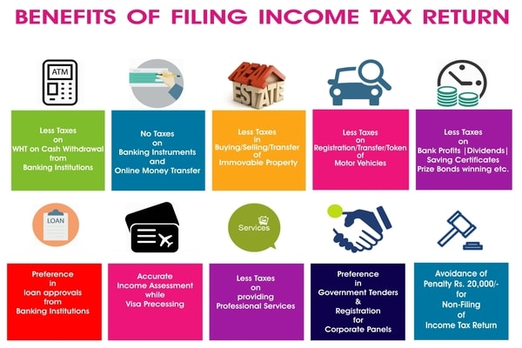

Slide 10
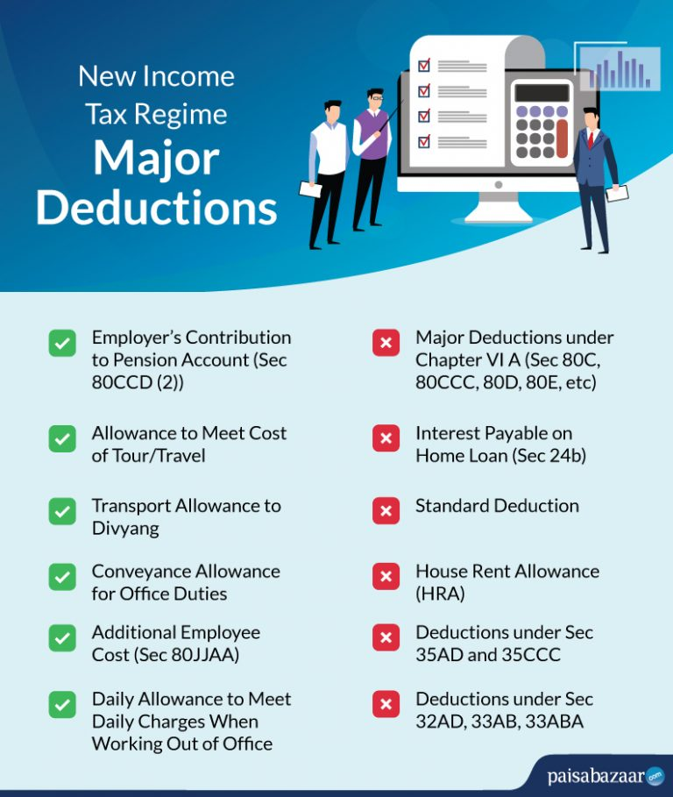

Slide 11
Thank you

