Slide 1
Authority

Slide 2
The legitimate power of a person to use and allocate resources and make decisions, and/ or give orders so as to achieve the organizational objectives. Following are some examples of Authority: Managers are authorized to make hiring and termination decisions. Managers are authorized for spending money on certain fields.

Slide 3
responsibility and accountability
Authority is the power delegated by senior executives to assign duties to all employees for better functioning. Responsibility is the commitment to fulfill a task given by an executive. Accountability makes a person answerable for his or her work based on their position, strength, and skills.
Accountability means
Authority is the granting of power. Responsibility is the fulfillment of an obligation, and accountability is answering for one's work. Authority can be delegated. Responsibility can be shared but cannot be delegated

Slide 4
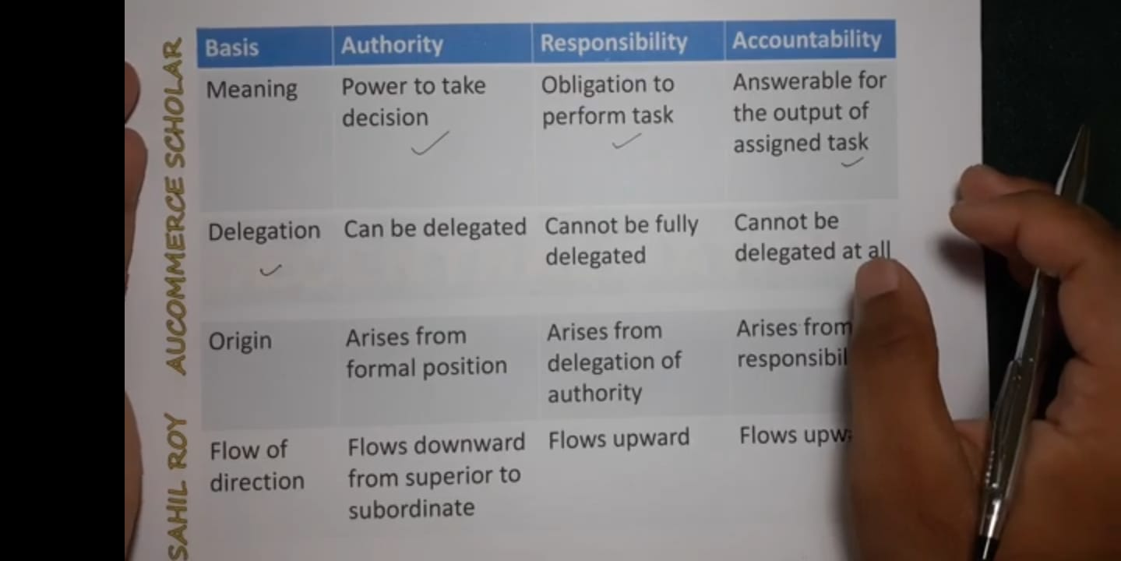

Slide 5
Delegation
The delegation of authority refers to the division of labor and decision-making responsibility to an individual that reports to a leader or manager. It is the organizational process of a manager dividing their own work among all their people.
The delegation of authority allows for the concentration of time on more important activities in an organization. Further, it provides a sense of responsibility, a chance to grow, and exercise initiatives to whom the authority is delegated.

Slide 6
decentralization of authority
Decentralization is referred to as a form of an organizational structure where there is a delegation of authority by the top management to the middle and lower levels of management in an organization. In a decentralized organization, lower levels in the organizational hierarchy can make decisions. An example of a decentralized organization is a fast-food franchise chain. Each franchised restaurant in the chain is responsible for its own operation.
Authority is delegated, responsibility is assured and accountability is imposed. Responsibility is derived from authority and accountability is derived from responsibility.

Slide 7
Thank you

