Slide 1
GIS & REMOTE SENSING
Subject: GIS Studio
Topic: Visualizations 2
Presented by: Pallavi Tiwari

Slide 2
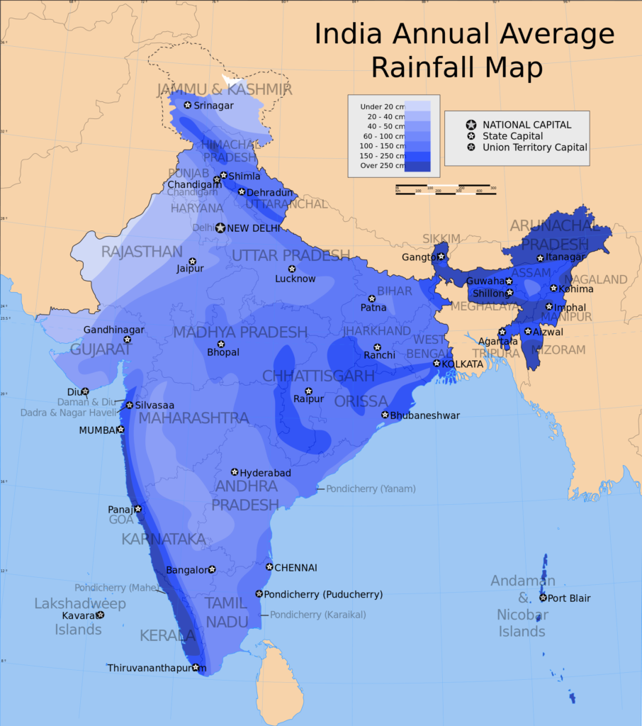
Heat Map
Heat maps are useful when you have to represent large sets of continuous data on a map using a color spectrum (usually red-to-blue or red-to-green).
A heat map is different from a chloropleth map in that the colors in a heat map do not correspond to geographical boundaries.
This map of India shows the average annual rainfall using different shades of blue. The darker the shade of blue, the higher the rainfall.

Slide 3
Heat maps are useful for identifying patterns, especially “hot spots” or regions of high concentration of the variable.
However, heat maps must be used cautiously to keep data accuracy intact.
Building heat maps typically involves using algorithmic extrapolation logic to create a continuous fill of color, often because data sets are discrete.
Therefore, the data at any particular point cannot be 100% reliable.

Slide 4
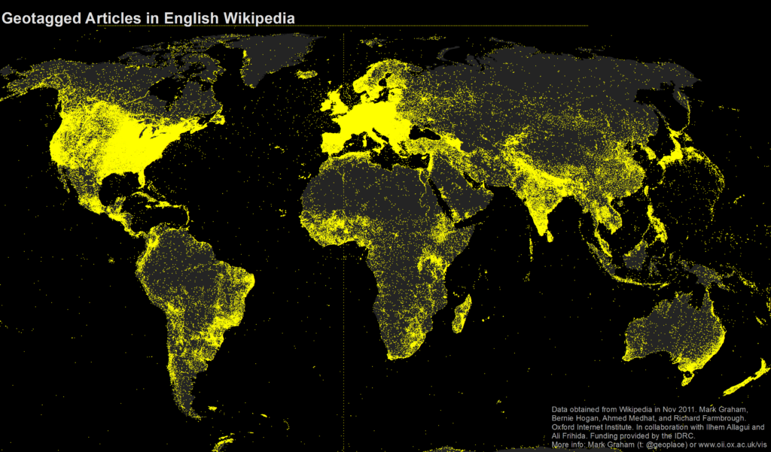
Dot Map
A dot map (also called dot distribution map or dot density map) uses a dot to indicate the presence of a variable.
Dot maps are essentially scatterplots on a map and are useful for showing spatial patterns.
This is a dot map of the world showing nearly 700,000 geotagged Wikipedia articles, each represented by a yellow dot.

Slide 5
A dot map gives an accurate representation of the value of the variable in granular locations on the map.
To ensure location accuracy, it’s important to geocode the data accurately during the data-collection process.

Slide 6
Cluster Map
Cluster maps help represent dense pockets of data points using a single point.
Each cluster is either relatively sized to or labelled with the number of points that have been grouped together.
This map contains clusters (each cluster represents one village) of varying colors and sizes to show the number of households in Vijayawada.
Collect, a mobile data collection tool, was deployed to collect primary household-level data and then create this interactive cluster map with a drill-down to view household-level details on the map.

Slide 7
Clusters are ideal in interactive maps where the user can drill down to see individual data points contained in a cluster.
Cluster maps help reduce clutter when there are many overlapping data points in a small geography.

Slide 8
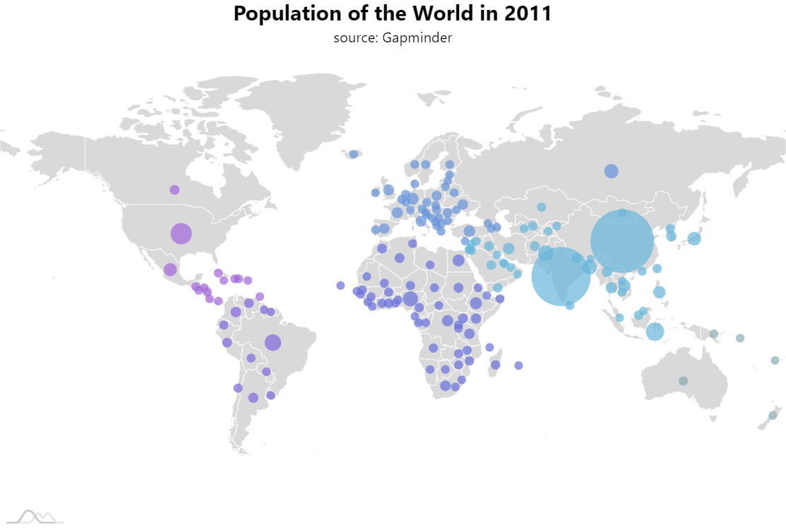
Bubble Map
Bubble maps help represent two variables — one by varying the size of the bubble and one by varying the color —simultaneously in a single visualization.

Slide 9
Bubble maps help viewers makes sense of three parameters at once through the location, size, and color of the bubbles.
However, you must be careful while creating bubble maps that contain many small geographical regions to avoid overcrowding of bubbles.

Slide 10
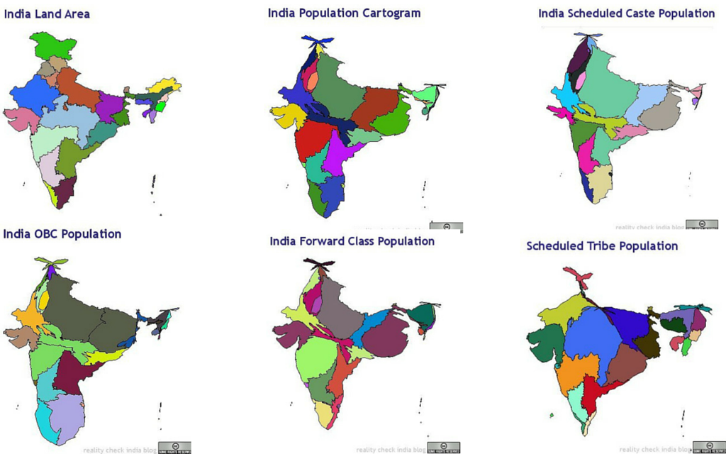
Cartogram Map
In a cartogram, the mapping variable is shown in a diagrammatic form.
The mapping variable often substitutes the land area or distance in the map due to which the map gets distorted in proportion to the mapping variable.
The India social cartogram project maps, for instance, contains cartogram maps representing India’s population for different caste groups.

Slide 11
Cartogram overcomes the limitations of other forms of geospatial visualization in that it represents the mapping variable relative to the corresponding geographical area.
However, cartograms must be used with care because knowledge of the actual land area is essential for the reader to make sense of the distorted version shown in the cartogram.
It is a good practice to show the actual map before introducing the cartogram.

Slide 12
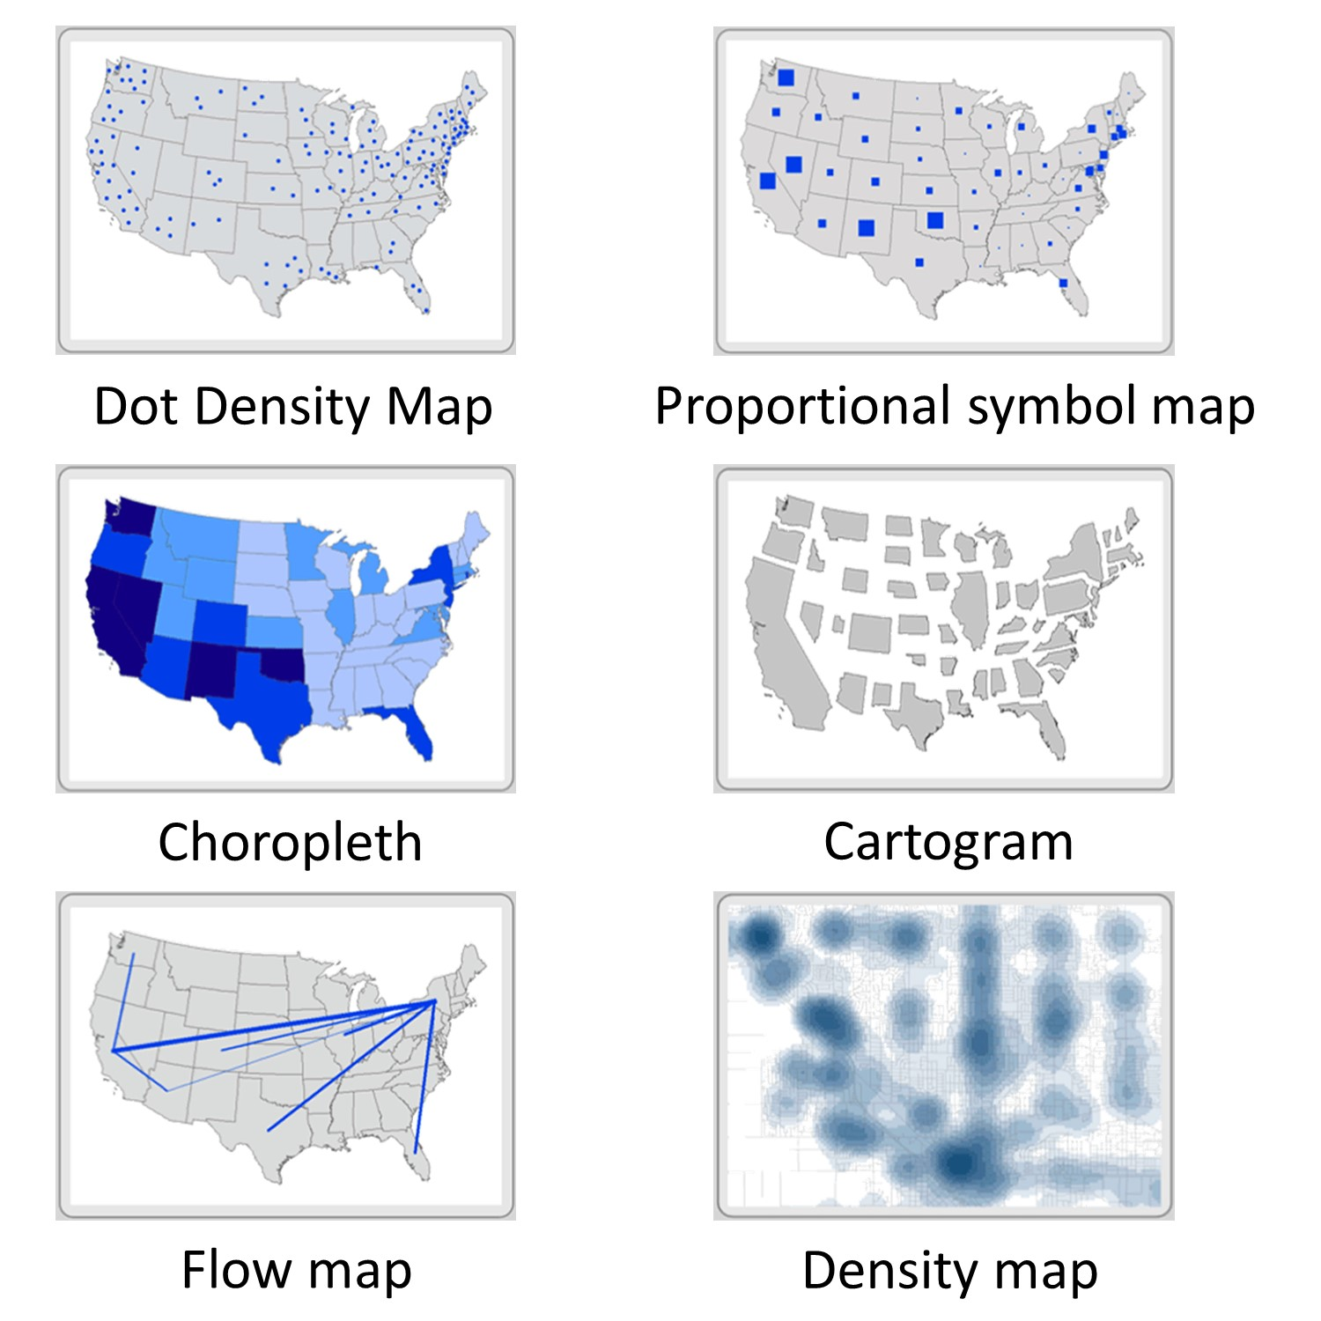

Slide 13
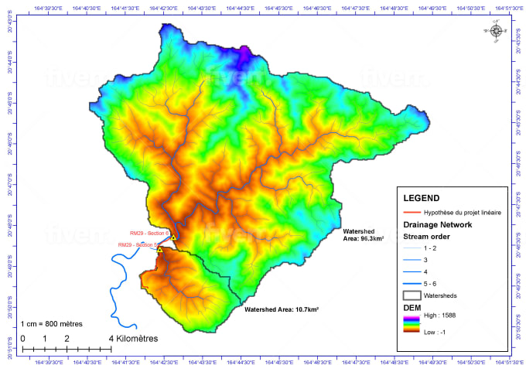
Topographic Maps

