Slide 1
Subject: Design of Steel Structure
Topic: Truss
Presented by: Atul Setya

Slide 2
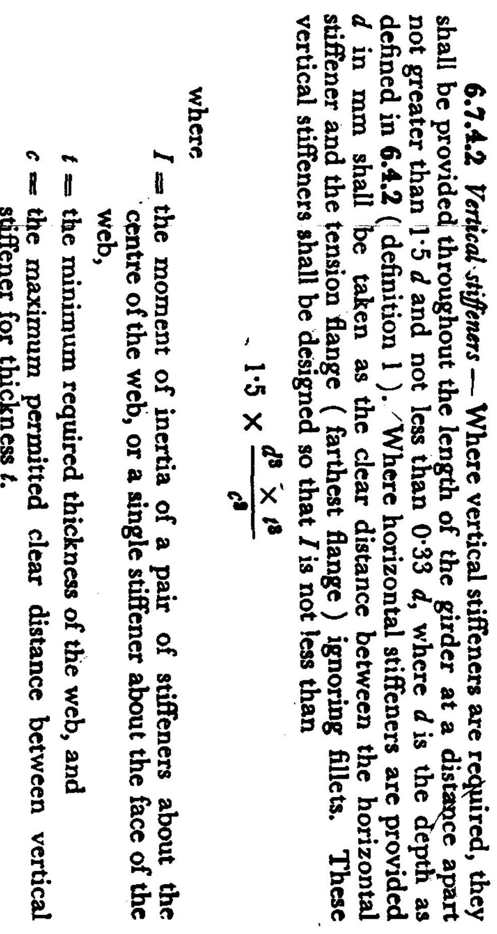

Slide 3
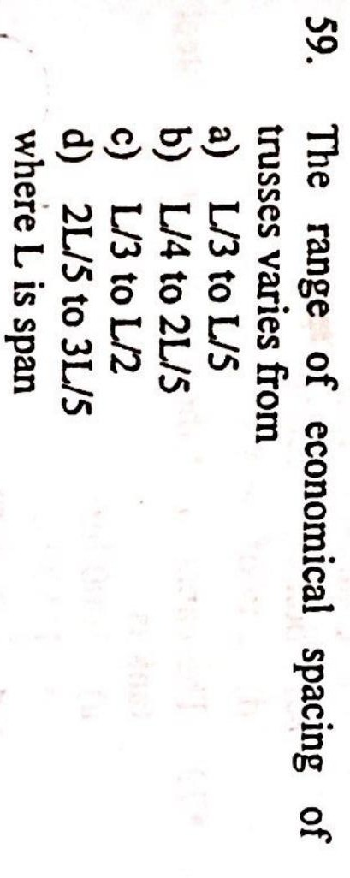

Slide 4
Answer A
Spacing of Trusses:
Is determined by the spacing of the columns.
The spacing of the trusses may be such as to minimize the cost of roofing.
The spacing of trusses may be about 1/3 to 1/5 of the span.

Slide 5
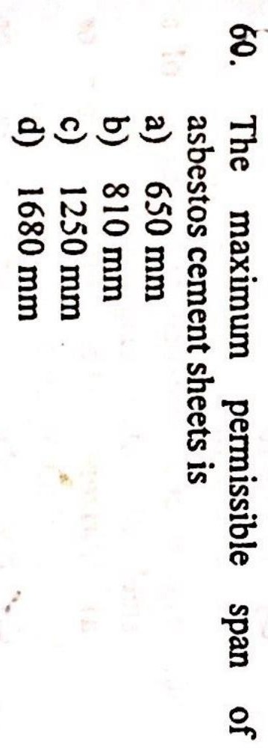

Slide 6
Answer D
The maximum permissible span of AC sheets 1680 mm

Slide 7
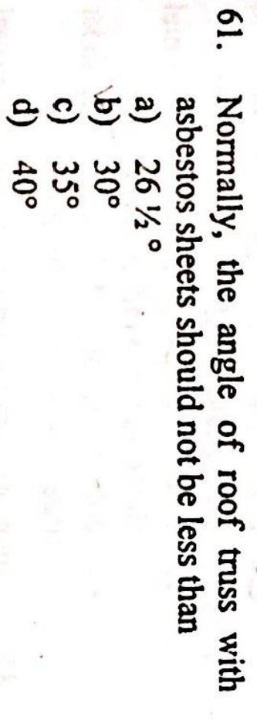

Slide 8
Answer B
Pradeep Rathore (Lecturer, DTE MP)

Slide 9
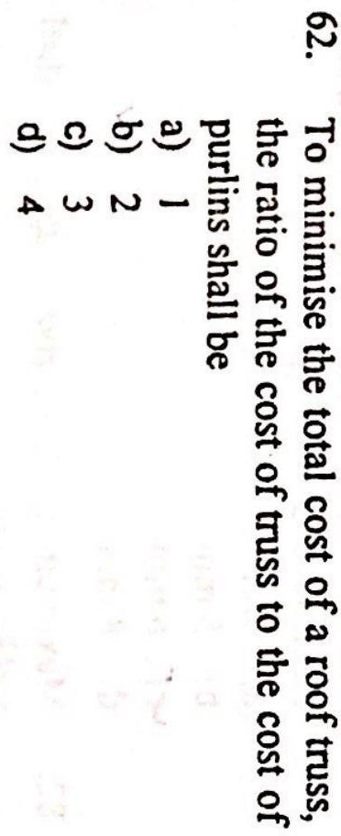

Slide 10
Answer B
S is the spacing of the trusses,
C_{t} is the cost of trusses/unit area, C_{p} is the cost of purlins/unit area,
C_{t} 𝖺 1/S → C_{t} = k₁/S C_{p} 𝖺 S² → C_{p} = k₂S²
C_{r} 𝖺 S → C_{r} = k₃S
C_{r} is the cost of roof coverings/unit area, and
C is the overall cost of the roof system/unit area.
Total cost C = C_{t} + C_{p} + C_{r}
= k₁/S + k₂S² + k₃S
For the overall cost is to be minimum, dC/dS should be zero. dC/dS = -k₁/S² + 2k₂S + k₃
0 = -k₁/S + 2k₂S + k₃S
0 = -C_{t} + 2C_{p} + C_{r}
C_{t} = 2C_{p} + C_{r}

Slide 11
