Slide 1
GIS & REMOTE SENSING
Subject: GIS Studio
Topic: Topography and GIS 2
Presented by: Pallavi Tiwari

Slide 2
Digital Elevation Models
Using elevation data in raster format in a GIS

Slide 3
Basic storage of data
Digital representation of topography
Cell based with a single elevation representing the entire area of the cell
340 | 335 | 330 | 340 | 345
337 | 332 | 330 | 335 | 340
330 | 328 | 320 | 330 | 335
328 | 326 | 310 | 320 | 328
320 | 318 | 305 | 312 | 315
DEM as matrix of elevations with a uniform cell size

Slide 4
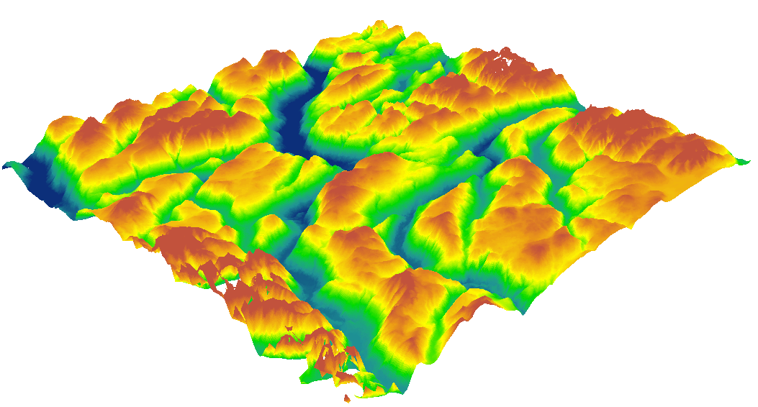

Slide 5
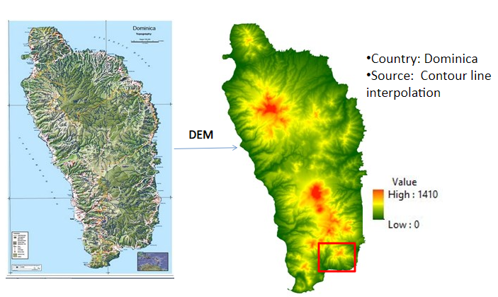

Slide 6
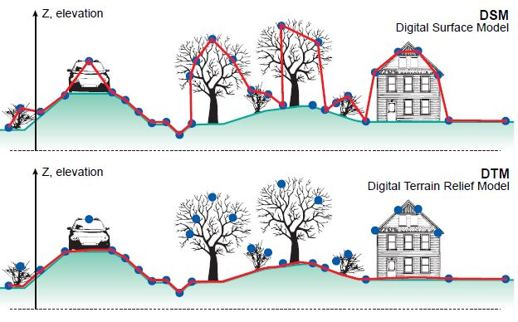
Digital Terrain Model (DTM) is a DEM of the shape of the ground surface. Digital Surface Model (DSM) is a DEM of the shape of the surface, including vegetation, infra-structures etc.
Both a DTM and DSM can be a DEM and, moreover, “elevation” would not have to relate to terrain but could relate to some subsurface layer such as groundwater layers, soil layers or the ocean floor.

Slide 7
Different sources of elevation data
Point elevation data
Contour and stream-line data
Space-borne and air-borne remotely sensed elevation data

Slide 8
As topography is one of the major factors in most types of hazard analysis, the generation of a Digital Elevation Model (DEM) plays a major role.
Digital Elevation Models (DEMs) can be derived through a variety of techniques, such as digitizing contours from existing topographic maps, topographic levelling, EDM (Electronic Distance Measurement), differential GPS measurements, (digital) photogrammetry, Radar remote sensing (InSAR), and Light Detection and Ranging (LiDAR).
Many derivate maps can be produced from DEMs using fairly simple GIS operations.
These days a wide range of data sources can be selected for the generation of DEMs.
The selection depends on the data availability for a specific area, the price and the application.

Slide 9
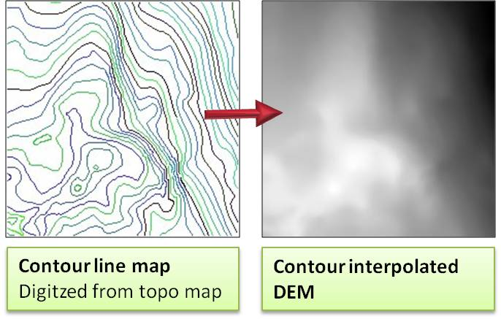

Slide 10
Uses of DEMs
Determine characteristics of terrain
Slope, aspect
Watersheds
drainage networks, stream channels

Slide 11
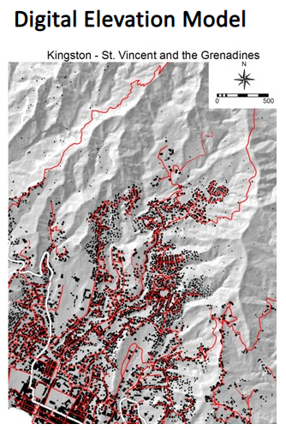
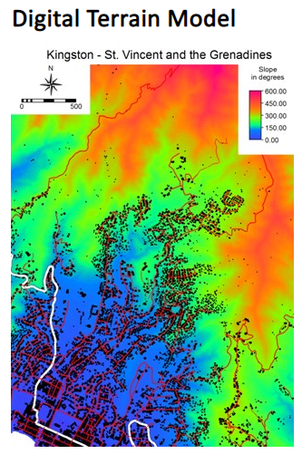
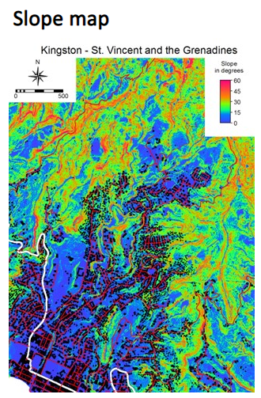

Slide 12
