Slide 1
Basics of Colour
Presented by: Vivek Painuli

Slide 2
WHAT IS COLOR?
A ray of light is the source of all color
It is perceived by the eye and interpreted by the
brain
It is an internal sensation expressed when colored light waves stimulate the eye

Slide 3
WHAT IS COLOR THEORY?
A system of rules and guidance for mixing various colors, in order to:
Create visually pleasing designs
Produce maximum readability & clarity
Use cultural associations to effect meaning

Slide 4
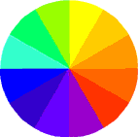
THE COLOR WHEEL
The basic tool we use when working with color

Slide 5
PRIMARY COLORS
Red, Yellow & Blue

Slide 6
SECONDARY COLORS
Orange, green and purple
Made by mixing equal amounts of two primary
colors

Slide 7
TERTIARY COLORS
Red-orange, red-violet, blue-green, blue- violet, yellow-green, and yellow-orange
Made by mixing an equal amount of a primary color and a secondary color

Slide 8
NEUTRAL COLORS
Are colors not found on the color wheel
White, black, grey, brown, beige, tan, and cream

Slide 9
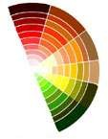
WARM COLORS
Reds, yellows, and oranges
Create feelings of warmth, activity, and excitement

Slide 10
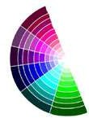
COOL COLORS
Blues, purples, and greens
Create feelings of coolness, calmness, and
relaxation

Slide 11
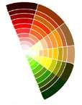
WARM AND COOL COLORS

Slide 12
COLOR HARMONY
Harmony can be defined as a pleasing arrangement of parts, whether it is
music, poetry, color, or even an ice cream sundae.
Something pleasing to the eye
Engages the viewer and creates a sense of order – balance
If it’s not harmonious – it’s boring!
However, too much can be chaotic – the viewer can’t stand to look at it!

Slide 13
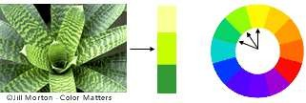
ANALOGOUS COLORS
Any three colors which are side by side on the 12 part color wheel
Usually one of the color predominates

Slide 14
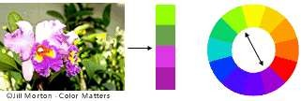
COMPLEMENTARY COLORS
Any two colors which are directly opposite each other, such as red and green and red-purple, and yellow-green.
Here there are several variations of yellow-green in the leaves and several variations of red-purple in the orchid. These opposing colors create maximum contrast and maximum stability.

