Slide 1
Environmental Planning and Housing
(Sustainable Site Planning)
Presented by: Ruchi Saxena

Slide 2
Site Selection

Slide 3
Site Selection
Considerations
Limit development within/on
100 year floodplains
Prime farmland as defined by the USDA
100' of wetlands
50' of high quality bodies of water
Habitat for endangered or threatened species

Slide 4
Site Selection
Considerations
Select previously developed sites
Greyfields
Brownfields
Select sites that encourage
Non-motorized tranportation
Use of public transportation

Slide 5
Site Layout

Slide 6
Site Layout
Building Orientation
Energy savings of 25% +
8⁰ can make a significant difference
Elongate on East/West axis
Maximize N & S exposure for daylighting
Minimize East & West facing windows
Orient most populated areas to N & S

Slide 7
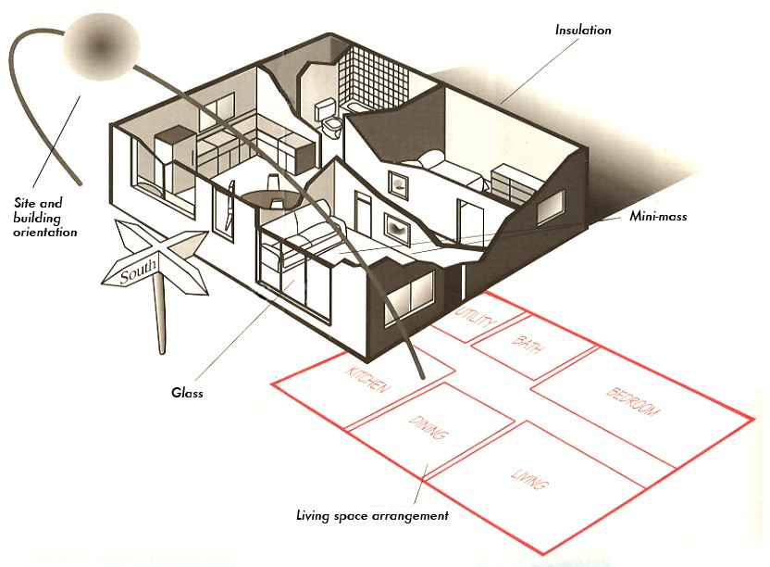
Site Layout
Building Orientation

Slide 8
Impervious Surfaces

Slide 9
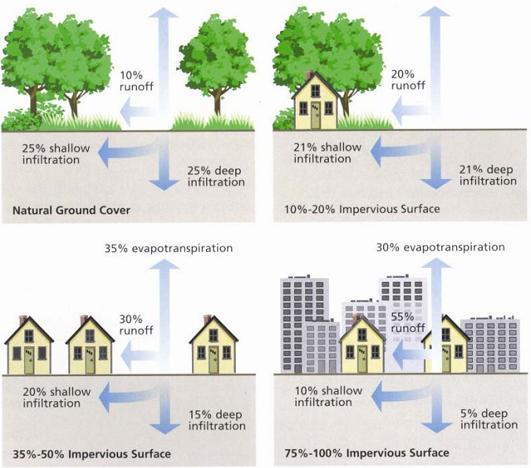
Impervious Surfaces
□Limit groundwater recharge
Increase polutant load
Increase runoff
Create heat island effect

Slide 10
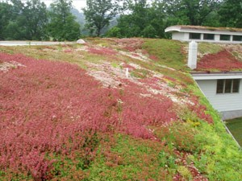
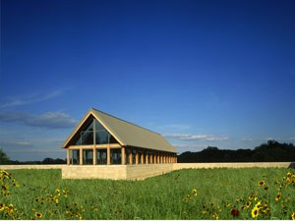
Impervious Surfaces
Minimize parking areas
Zoning code minimum or less
Incorporate compact car spaces when possible
Reduce lane sizes
Plantings in and around parking areas
Green Roofs

Slide 11
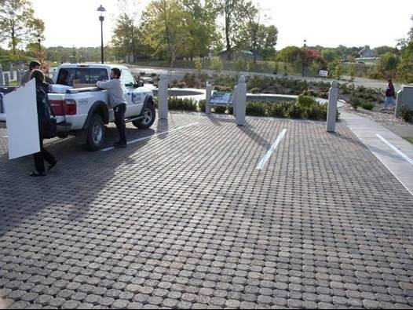
Impervious Surfaces
Pervious paving options
Pervious pavement
Pervious concrete
Permeable pavers
Grasspave systems

