Slide 1
Environmental Planning and Housing
(Sustainable Site Planning)
Presented by: Ruchi Saxena

Slide 2
Sustainable Site Planning
Typical Process
Architect
Preliminary Design
Engineer
Final design
Preferred Process
Architect + Engineer
Preliminary Design
Engineer + Architect
Final design

Slide 3
Sustainable Site Planning
Basic Tool box for site planning
Explain green methods and techniques
Facilitate green techniques
Create better designs/facilities

Slide 4
Sustainable Site Planning
" A site plan that that has the least environmental impact while still meeting the clients project goals."
" Green design is only sustainable if it makes sense financially as well."

Slide 5
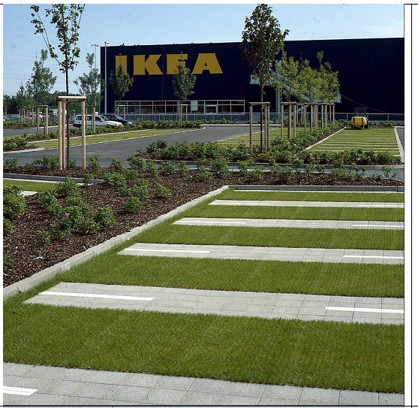
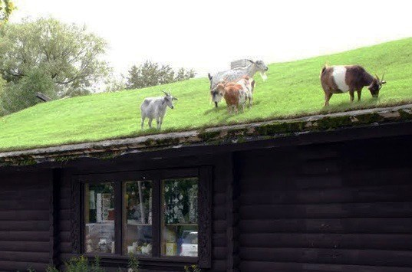
Sustainable Site Planning
WHY NOT??!!

Slide 6
Sustainable Site Planning
Site selection is environmentally responsible
Building orientation is optimized
Impervious surfaces are minimized
Site disturbance is minimized
Stormwater quantity and quality is considered
Landscaping is water efficient and active

Slide 7
Sustainable Site Planning
Site Selection
Site/Building Layout
Impervious Surfaces

