Slide 1
Stone Masonry
Ar. Vivek Painuli

Slide 2
What is stone masonry?
Stone masonry is made of stone units bonded together with / without mortar.

Slide 4
Classification of stone masonry
Stone masonry
Rubble masonry
1. Randam rubble masonry
- Coursed - uncoursed
2. Square rubble masonry
- Coursed - uncoursed
3. Polygonal rubble masonry
4. Flint rubble masonry
5. Dry rubble masonry
1. Ashlar fine masonry
2. Ashlar rough tooled
3. Rock (or) quarry faced
4. Ashlar chamfered
5. Ashlar block in course
Ashlar masonry

Slide 5
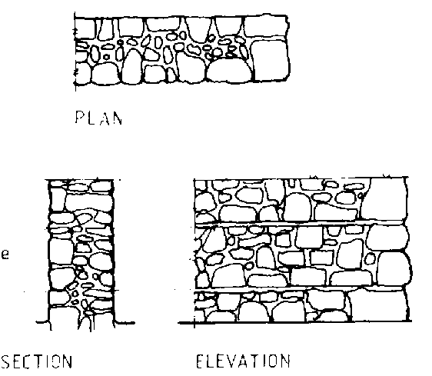
Random rubble masonry
Coursed
In this type of masonry, the stones used are of widely different sizes. This is the roughest and cheapest form of stone masonry.
the stones in a particular course are of equal height

Slide 6
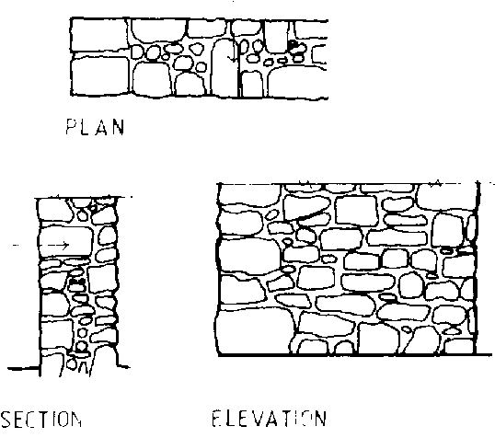
uncoursed
The stones used are of widely different sizes. This is the roughest and cheapest form of stone masonry.
The coarses are not maintained regularly. The larger stones are laid first and the spaces between them are then filled up by means of spalls or sneeks

Slide 7
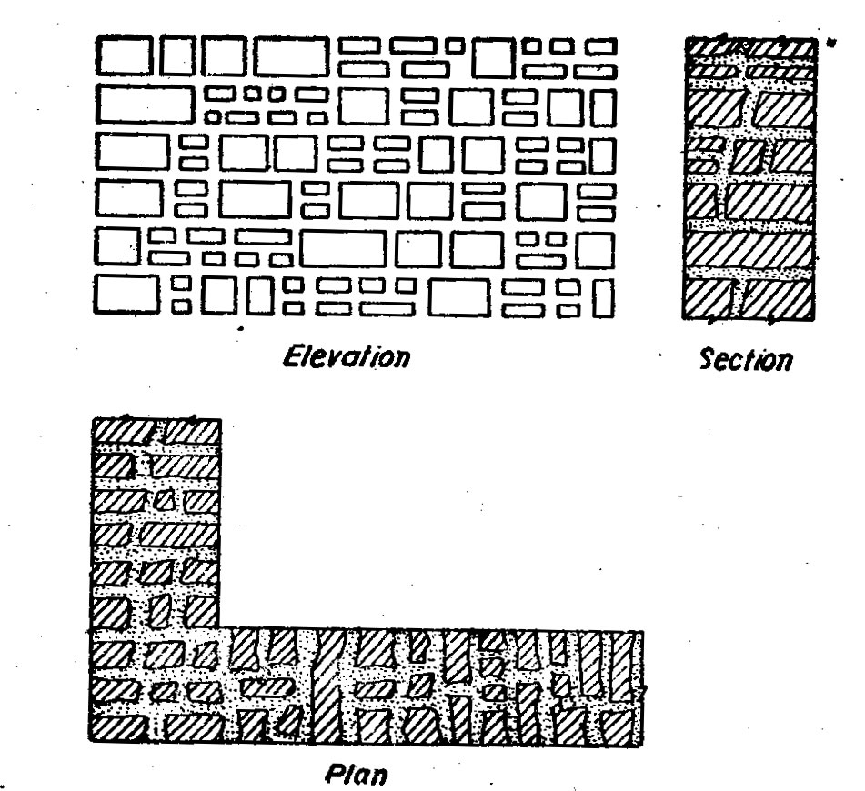
Square rubble masonry
Coursed
Stones having straight bed and sides are used. The stones are usually squared and brought to hammer dressed or straight cut finish.
The work is carried out in courses of varying depth.

Slide 8
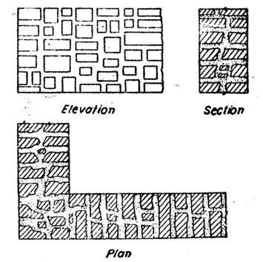
uncoursed
Stones having straight bed and sides are used. The stones are usually squared and brought to hammer dressed or straight cut finish.
The different sizes of stones having straight edges and sides are arranged on face in several irregular patterns

Slide 9
Polygonal rubble masonry
The stones are hammer dressed. The stones used for face work are dressed in an irregular polygonal shape. Thus the face joints are seen running in an irregular fashion in all directions.

Slide 10
Flint rubble masonry
Stone used are flints or cobbles. These are irregularly shaped. The stones are extremely hard. But they are brittle and therefore they break easily

Slide 11
Dry rubble masonry
Mortar is not used in the joints. This type of construction is the cheapest and requires more skill in construction. This may be used for non-load bearing walls such as compound walls, etc…

Slide 12
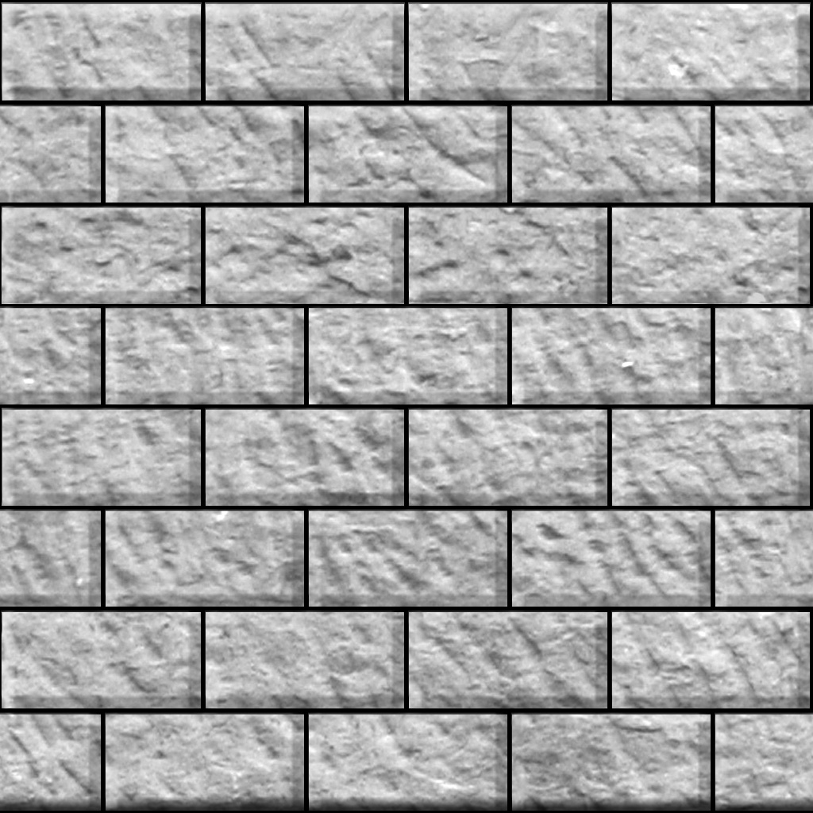
ASHLAR MASONRY
1. ASHLAR FINE MASONRY
Each stone is cut to uniform size and shape with all sides rectangular, so that the stone gives perfectly horizontal and vertical joints with adjoining stone. This type of ashlar masonry is very costly.

Slide 13
Ashlar rough tooled masonry
The beds and sides are finely chisel-dressed. But the face is made rough by means of tools. A strip, about 25mm wide and made by means of chisel is provided around the perimeter of the rough dressed face of each stone

Slide 14
Ashlar rock or quarry faced masonry
A strip about 25mm wide and made by means of chisel is provided around the perimeter of every stone as in case of rough-tooled ashlar masonary. But the remaining portion of the face is left in the same form as received from quarry.

Slide 15
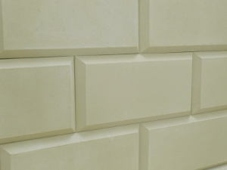
Ashlar chamfered masonry
The strip is provided as below. But it is chamfered or beveled at an angle of 45 degrees by means of chisel for a depth of about 25mm.

Slide 16
Ashlar block in course masonry
This is combination of rubble masonry and ashlar masonry. The face work is provided with rough tooled or hammer dresses stones and backing of the wall may be made in rubble masonry.

