Slide 1

MUNICIPAL AND OTHER WASTES
Subject: Infrastructure and Transport Planning
Topic: Solid Waste Management Part 1
Presented by: Aditi Arora

Slide 2
INTRODUCTION
MUNICIPAL SOILD WASTE
BIO-MEDICAL WASTE
Means any waste, which generated during the diagnosis, treatment or immunization of human being or animals or in research activities and is governed by the Bio- Medical Waste (Management and Handling) Rules, 1998.
Municipal Solid Waste, includes commercial and residential wastes generated in a municipal or notified areas and is governed by the Municipal Solid Wastes (Management and Handling) Rules,2000
INDUSTRIAL SOLID WASTE
The solid waste produced by industries can be both non- hazardous solid waste and hazardous solid waste , where means any waste which by reason of any of its physical, chemical, reactive, toxic, flammable, explosive or corrosive characteristics causes danger or is likely to cause danger to health or environment, and is governed by the Hazardous Wastes (Management and Handling) Rules, 1989 and its amendment in 2003

Slide 3
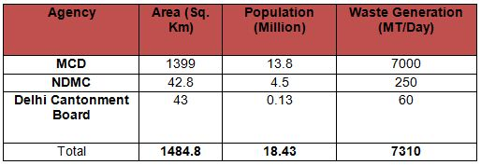
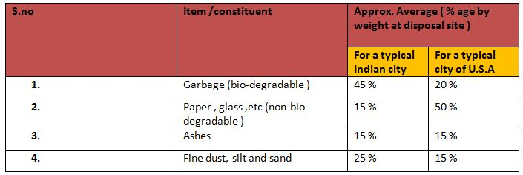
MUNICIPAL SOLID WASTE
Municipal Solid Waste quantity (DELHI ) :
INFERENCE :
The average per capita daily production in Newyork (U.S) is as high as about approx.= 2.8 to 3.0 kg.
And that of city in India (Delhi ) is approx. = 0.4 - 0.5 kg.
INFERENCE :
The quantity of garbage in USA is very small because of use of garbage grinders and use of ready-made packed food as compared to India.
The calorific value of the Indian refuse reduces because of lesser percentage of non –biodegradable item as it is picked up and removed enroute before it reaches to disposal site .
Density of MSW ( INDIA ) – 400 to 600 kg/cubic meter and to USA is 100 to 250 kg/ cubic meter
Waste Generation MSW (Newyork City) = 50,000 MT/Day

Slide 4
BIO- MEDICAL WASTE
Approximately 1.5 kg of waste is generated per patient per day in Indian hospitals
Country | Quantity (kg/bed/day )
U.K | 2.5
U.S.A | 4.5
FRANCE | 2.5
SPAIN | 3.0
INDIA | 1.5
Approximate composition :
Item | By weight (%)
Combustible | 66 %
Non -Combustible | 20 %
Plastic | 14 %
Facilities available :
Incinerators : 17
Autoclaves : 20
Microwaves : 2
About 8.5 T/Day of BMW is treated in Delhi
About 4.0 T/Day of waste is treated on site in
major Govt. Hospitals
INFERENCE :
>20 % of this total waste are found to be hazardous and infected.
It is higher in India because of improper waste segregation practices in all the hospitals .& lesser facilities available
M/s Synergy Waste Management Co. and
M/s Biocare Technologies are given
authorization by DPCC and about 4.5 T/Day
of waste is being treated by these operators.

Slide 5
INDUSTRIAL SOLID WASTE
INDUSTRIAL SOLID WASTE
NON HAZARDOUS SOLID WASTE
HAZARDOUS SOLID WASTE
MAJOR INDUSTRY IN URBAN AREA SUCH AS : FRUIT PROCESSING, COTTON MILLS, PAPER MILLS, SUGAR MILLS, TEXTILE FACTORIES ETC
BIODEGRADABLE
SOME WASTE CONSIDERED HAZARDOUS BECAUSE OF PRESENCE OF CHEMICAL AND TOXIC ELEMENTS IN IT
THESE ARE GENERALLY PRODUCED BY THERMAL POWER PLANTS , IRON AND STEEL PLANTS ETC.
NON- BIODEGRADABLE

Slide 6
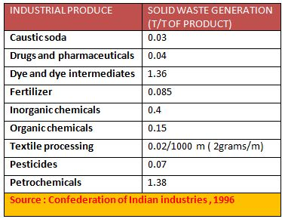
INDUSTRIAL SOLID WASTE
Annual generation of industrial
solid waste in India :
Hazardous waste produced by select industries in tonne/tonne of production.
S.NO | TYPE OF SOLID WASTE | QUANTITY GENERATED IN (MT)
1 | FLYASH | 45.0
2 | SLAG | 8.5
3 | PHOSPHO –GYPSUM | 5.0
4 | LIME SLUDGE | 4.0
5 | RED MUD | 3.5
INFERENCE :
It is estimated that currently the Indian industrial sector generates about 100 MT of non hazardous solid waste and 2 MT hazardous wastes per year

Slide 7
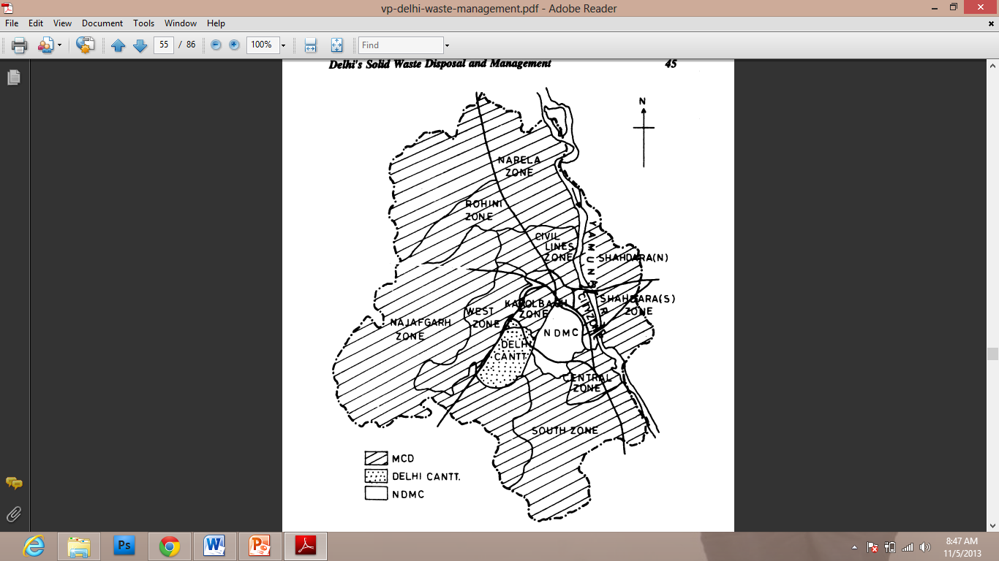
COLLECTION OF SOLID WASTE
Solid Waste Collection Scenario Before Privatization :
Waste was collected in open trucks.
The problems such as waste spillage and odor were common.
The waste in the WSD used to rot for several days.
There was no proper scheduling or tracking of the waste collection vehicles.
Local Bodies which involved in collection of Municipal Waste:
1.MCD (Municipal Corporation of Delhi )
Collection from Dhalao.
Door to door Collection
Segregation from 1.1.2004
Privatization of collection & transportation in some zones (Karol Bagh Zone, West Zone, Central Zone, South Zone, City Zone and SP Zone).
2. NDMC(New Delhi Municipal Council )
Segregation and road side collection of sweeping waste.
Door to Door Collection

Slide 8
COLLECTION OF SOLID WASTE
  3. DELHI CONONMENT
Delhi government signed agreements with private companies for collection, segregation, transportation and disposal of municipal solid waste.
Main aim was increasing efficiency and effectiveness of the waste management activities.
All the wards have been divided into sets of wards each have been put under the governance of a team leader. Under every team leader there is a set of field supervisors.
The collection system has undergone a drastic change since the inception of the private sector in solid waste management:
Waste from the generators such as households, institutions etc. is brought either to the WSD’s or the Street Corner Bins(SCB’s) according to their convenience.
The responsibility of conveying the waste from the point of generation to the WSD’s or the SCBs lies in the hands of the generators.
Usually the street sweepers or the rag pickers are employed by the people for this purpose.
The waste is segregated at the WSD’s by the dhalao workers and the rest is taken away by the vehicles.

Slide 9
COLLECTION OF SOLID WASTE

Slide 10
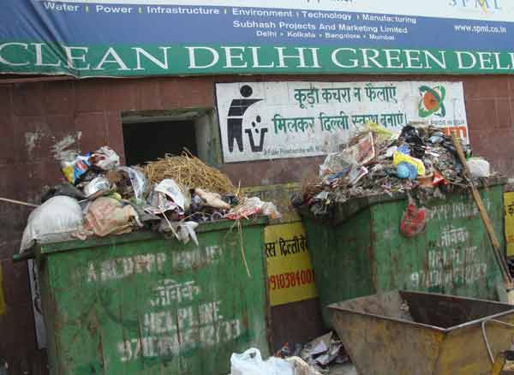
STORAGE FACILITIES OF SOLID WASTE
STREET CORNER BINS- Age-old practices (Dhalaos) are used for storage of waste which are posing serious problems and not acceptable in the present scenario. However, in some selected zones private contractors are engaged for waste storage and transportation.
Provision of litter bins at all public places to discourage littering. Replace dhalao’s/ existing dustbins with mechanized storage facility for deposition of waste. Abolish open sites used for waste disposal. Set up storage facilities for deposition of segregated waste.
Street Corner Bins have been placed for the purpose of waste collection in the residential
colonies, commercial establishments and other institutions. Minimum one SCB has been placed in
area of 1 sq.km.
The bins have been placed after the consultation with the local residents. The bins are properly
looked after and are repaired from time to time according to the requirement. The repair work is done
at the Subhash Nagar central workshop.

Slide 11
TRANSPORTATION OF SOLID WASTE
1. MOTOR VEHICLE TRANSPORT
Where the point of final deposition can be reached by motor vehicle, the most common means used to
trans port solid waste from transfer stations are trailers, semitrailers and compactors. In general
vehicles used for hauling on highways should satisfy the following requirement –
Waste must be transported at minimum cost.
Waste must be covered during the whole operation.
Vehicle must be designed for highway traffic.
Vehicle capacity must be such that the allowable weight limits are not exceeded.
Methods used for unloading must be simple and dependable.
2. TRANSPORT VEHICLE FOR UNCOMPACTED WASTE
The maximum volume that can be hauled in highway
Transport vehicles depends on the regulation in the state in which they are operated. The semitrailers are commonly used for transport of un-compacted wastes in which the weight of the trailer also serves as the frame of the trailer.
Method used to unload the transport trucks, trailers, semitrailers may be classified as-
Self emptying
Requirement for auxiliary equipment

Slide 12
TRANSPORTATION OF SOLID WASTE
3. WATER TRANSPORT
Barges, special boats have been used in the past to transport solid waste to processing locations and to see sight and ocean disposal sites. It should be noted that ocean disposal is no longer practiced by the united states navy for the special cases. In England river barges are used to transport waste.
One of the major problem encounter when ocean vessels are used for the transport of solid waste is that often impossible to move the barges and boats during times of heavy sea. In such cases waste must be stored and then disposed into the sea.
2. RAILROAD TRANSPORT
Railroad transport were commonly used for the transport of solid waste in the past. It is generally used to remote landfill area where highway travel is difficult and railroad lines are exist.

Slide 13
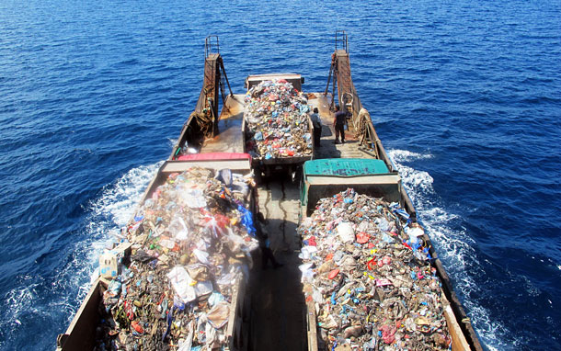
DISPOSAL OF SOLID WASTE
Uncontrolled Dumping
Sanitary Landfill
Composting
Incineration
Gasification
Refuse Derived Fuel (RDF)
Pyrolysis

Slide 14
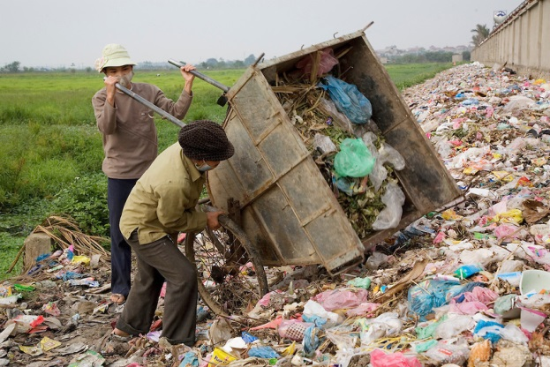
Uncontrolled Dumping:
This is the most common method being practiced all over the world.
Wastes are dumped at a designated site without any measures for environmental control. The site may be in-land or at sea.
This method poses a very high risk of environmental degradation.
Due to the health and environmental hazards associated, this method is unsuitable.

