Slide 1
Subject: Infrastructure and Transport Planning
Topic: Sanitation Part 1
Presented by: Aditi Arora

Slide 2
SANITATION
Sanitation is the hygienic means of promoting health through prevention of human contact with the hazards of wastes as well as the treatment and proper disposal of sewage or wastewater.

Slide 3
CONTENTS-
POINTS OF GENERATION
COLLECTION
TREATMENT
DISPOSAL
DEWATS
GREY WATER DISPOSAL
NORMS & STANDARDS
INSTITUTIONAL ARRANGEMENTS
PLANNING PROVISIONS &MANAGEMENT ISSUES

Slide 4
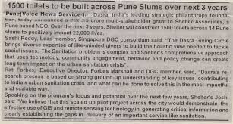
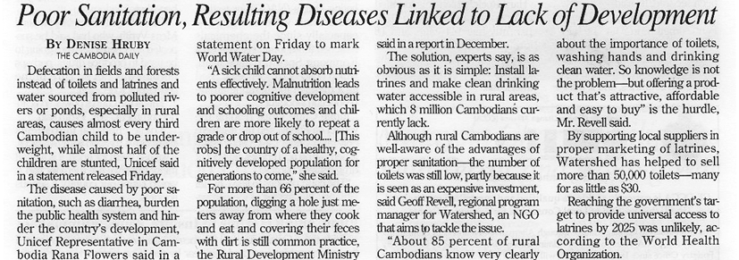
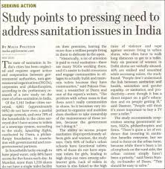
Crucial & Important

Slide 5
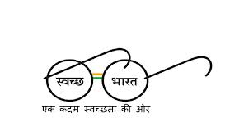
Promises..
Clean and safe drinking water to all citizens.
Access to toilet for each household by 2019.
Awareness programmes to change the behaviour.
No new schools, colleges, bus stands and dispensaries to be built without treatment plant.

Slide 6
Points of Generation
Sewage is generated from
houses,
institute such as college,
school,
office complex,
community toilets,
industrial townships etc.
Waste water generation in Delhi has been assessed at 3,800 million litres a day (MLD), whereas the city’s waste water treatment capacity is 2,460 MLD.

Slide 7
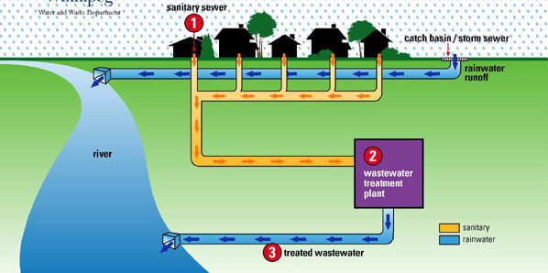
SEWAGE COLLECTION

Slide 8
There are 35 metropolitan cities (more than 10 Lac Population), 15,644 Millions Liter Per Day (MLD) of sewage is generated from these metropolitan cities. The treatment capacity exists for 8040 MLD i.e. 51% is treatment capacity is created.
Among the Metropolitan cities, Delhi has the maximum treatment capacity that is 2460 MLD (30% of the total treatment capacity of metropolitan cities)
As per report submitted to the Supreme Court by Central Pollution Control Board (CPCB) on 4th December 2012, Untreated human waste from nearly 45% of the population in Delhi flows into the Yamuna river as these homes are not connected to the city’s sewage network.
As per August 2004 CPCB report, Out of 3267 mld of treated & untreated sewage, 2365 mld is discharged into the River Yamuna, 661 mld is discharged into Agra Canal & 241 mld is used for irrigation.

Slide 9
TREATMENT
Sewage treatment is the process of removing contaminants from wastewater and household sewage, both effluents and domestic. It includes physical, chemical, and biological processes to remove physical, chemical and biological contaminants.
Its objective is to produce an environmentally safe fluid waste stream and a solid waste suitable for disposal or reuse .
The objective of sewage treatment is to produce a disposable effluent without causing harm to the surrounding environment, and prevent pollution.

Slide 10
IMPORTANCE OF SEWAGE WATER TREATMENT PLANT
It is very important to provide some degree of treatment to wastewater before it can be used for agricultural or landscape irrigation or for aquaculture.
The principal objective of sewage treatment is generally to allow human effluents to be disposed of without danger to human health or unacceptable damage to the natural environment.
According to a research, a large number of people die from water born diseases in most of the developing countries. Therefore, it is very important to get the proper treatment of the water for a healthy living.

Slide 11
SOURCES OF WASTE WATER
Human waste
Washing water
Rainfall collected on roofs, yards, hard-standings
domestic sources
Direct ingress of river water
Highway drainage
Industrial waste

Slide 12
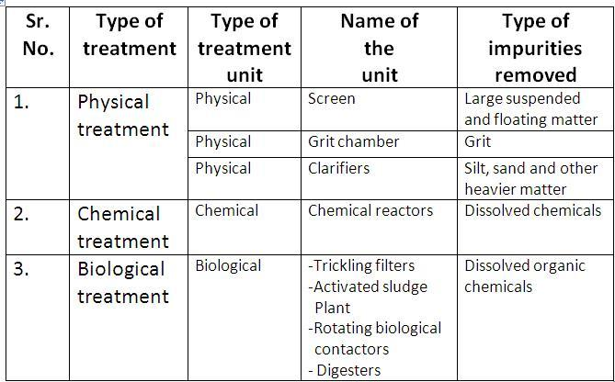
WASTE WATER TREATMENT PROCEDURE
Sewage treatment generally involves three stages, called
PRIMARY TREATMENT
SECONDARY TREATMENT
TERTIARY TREATMENT
TYPES OF THE TREATMENT PROCESS

Slide 13
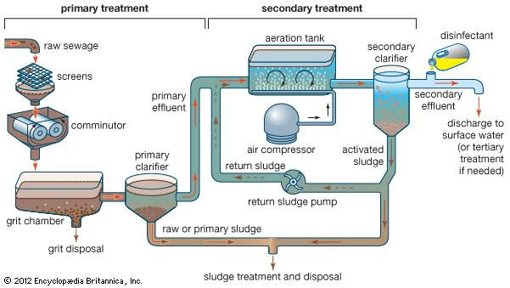
PRIMARY TREATMENT
Primary treatment removes materials that can be easily collected from the raw sewage before they damage or clog the pumps and sewage lines of primary treatment clarifiers trash, tree limbs, leaves, branches etc..
The settled and floating materials are removed and the remaining liquid may be discharged or subjected to secondary treatment.

Slide 14
SECONDARY TREATMENT
Secondary treatment removes dissolved and suspended biological matter. Secondary treatment is typically performed by indigenous, water-borne micro-organisms in a managed habitat.
Secondary treatment may require a separation process to remove the micro-organisms from the treated water prior to discharge or tertiary treatment.
TERTIARY TREATMENT :-
The purpose of tertiary treatment is to provide a final treatment stage to raise the effluent quality before it is discharged to the receiving environment (sea, river, lake, ground, etc.). More than one tertiary treatment process may be used at any treatment plant.
If disinfection is practiced, it is always the final process. It is also called "effluent polishing."

Slide 15
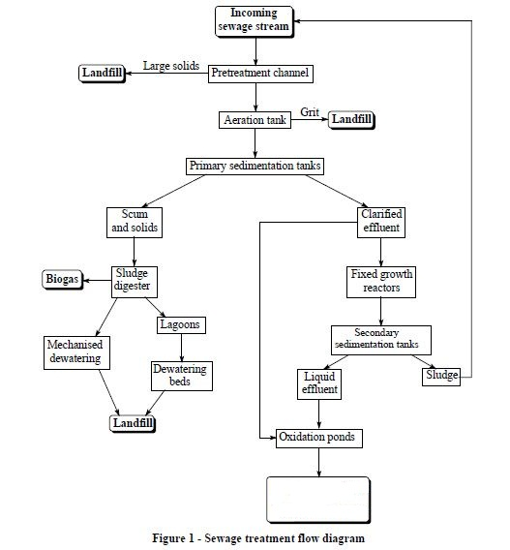
EFFLUENT DISCHARGED IN WATER BODY

