Slide 1
Role of Architect
Ar. Manish Kumar

Slide 2
Architecture
The Art And Science Of Designing And Constructing Buildings

Slide 3
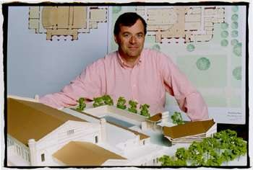
ARCHITECTS:
A Person Who Plans, Designs
Buildings And Advises In Their Constructions.

Slide 4
ROLE OF VARIOUS AGENCIES IN PLANNING OF BUILDING :-
1. ARCHITECT | 35%
2. QUNTITY SURVEYOR | 23%
3. STRUCTURAL ENGINEER | 18%
4. SERVICE ENGINEER | 12%
5. MANAGEMENT CONSULTANT | 4%
6. LANDSCAPE ARCHITECT | 2%
7. SPECIALIST DESIGNER | 2%
8. VARIOUS OTHER CONSULTANTS | 4%
(such as environmentalist,interior designer etc.)

Slide 5
The Expression Of Building Depends Upon Composition Of Plan And Architectural Design Of Structure.

