Slide 1
Building Services
Rain Water HarvestiNG
Ar. Vivek Painuli

Slide 2
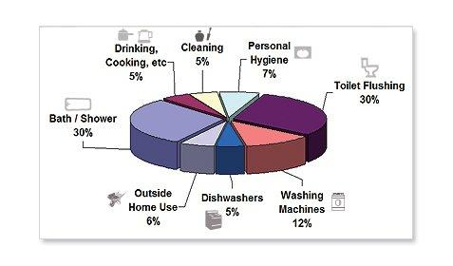
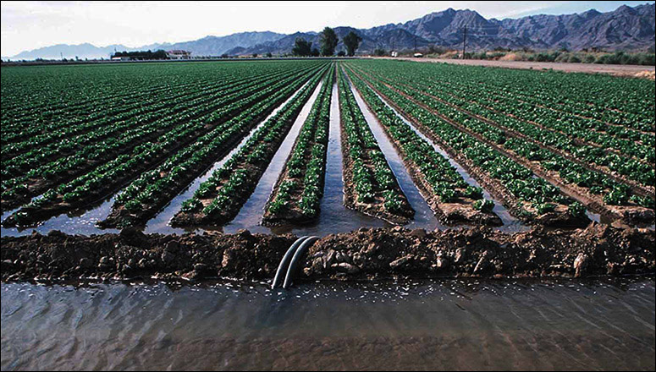
INTRODUCTION
Rainwater harvesting is the accumulation and deposition of rainwater for reuse on-site, rather than allowing it to run off.
Rainwater can be collected from rivers or roofs, and in many places the water collected is redirected to a deep pit (well, shaft, or borehole), a reservoir with percolation, or collected from dew or fog with nets or other tools.
Its uses include water for gardens, livestock, irrigation, domestic use with proper treatment, and indoor heating for houses etc.
The harvested water can also be used as drinking water, longer-term storage and for other purposes such as groundwater recharge.

Slide 3
HARVESTING METHODS
Surface runoff harvesting
In urban area rainwater flows away as surface runoff. This runoff could be caught and used for recharging aquifers by adopting appropriate methods.
Roof Top rainwater harvesting
It is a system of catching rainwater where it falls. In rooftop harvesting, the roof becomes the catchments, and the rainwater is collected from the roof of the house/building. It can either be stored in a tank or diverted to artificial recharge system. This method is less expensive and very effective and if implemented properly helps in augmenting the ground water level of the area.

Slide 4
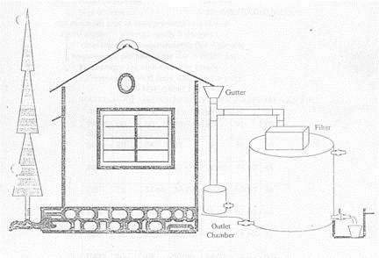
Components of the roof top rainwater harvesting
The system mainly constitutes of following sub components:
Catchments
Transportation
First flush
Filter

Slide 5
Catchments
The surface that receives rainfall directly is the catchment of rainwater harvesting system.
It may be terrace, courtyard, or paved or unpaved open ground.
The terrace may be flat RCC/stone roof or sloping roof.
Therefore the catchment is the area, which actually contributes rainwater to the harvesting system.

Slide 6
Transportation
Rainwater from rooftop should be carried through down take water pipes or drains to storage/harvesting system.
Water pipes should be UV resistant (ISI HDPE/PVC pipes) of required capacity.
Water from sloping roofs could be caught through gutters and down take pipe.
At terraces, mouth of the each drain should have wire mesh to restrict floating material.

Slide 7
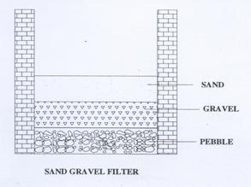
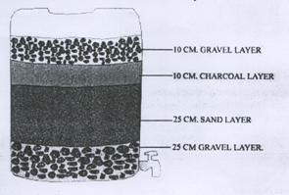
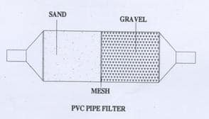
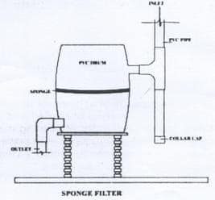
Filter
There are different types of filters in practice, but basic function is to purify water. Different types of filters are described in this section.
Sand Gravel Filter
These are commonly used filters, constructed by brick masonry and filleted by
pebbles, gravel, and sand as shown in the figure. Each layer should be separated
by wire mesh.
Charcoal Filter
Charcoal filter can be made in-situ or in a drum. Pebbles, gravel, sand and
charcoal as shown in the figure should fill the drum or chamber. Each layer should
be separated by wire mesh. Thin layer of charcoal is used to absorb odor if any.
PVC –Pipe filter
Pipe is divided into three compartments by wire mesh. Each component should
be filled with gravel and sand alternatively as shown in the figure.
A layer of charcoal could also be inserted between two layers. Both ends of filter
should have reduce of required size to connect inlet and outlet. This filter could be
placed horizontally or vertically in the system.
Sponge Filter
It is a simple filter made from PVC drum having a layer of sponge in the middle of
drum. It is the easiest and cheapest form filter, suitable for residential units.

Slide 8
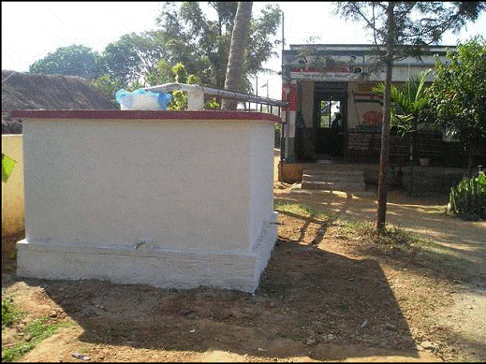
Methods of roof top rainwater harvesting
a) Storage of Direct Use
In this method rain water collected from the roof of the building is diverted to a storage tank. The storage tank has to be designed according to the water requirements, rainfall and catchment availability.
b) Recharging ground water aquifers
Ground water aquifers can be recharged by various kinds of structures to ensure percolation of rainwater in the ground instead of draining away from the surface. Commonly used recharging methods are:-
a) Recharging of bore wells
b) Recharging of dug wells.
c) Recharge pits
d) Recharge Trenches
e) Soak ways or Recharge Shafts
f) Percolation Tanks

Slide 9
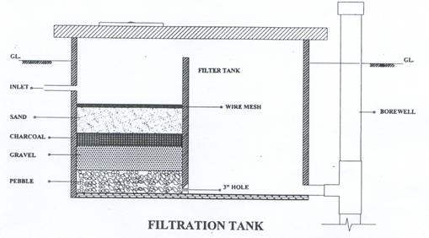
Recharging of bore wells
Rainwater collected from rooftop of the building is diverted through drainpipes to settlement or filtration tank.
After settlement filtered water is diverted to bore wells to recharge deep aquifers.
Abandoned bore wells can also be used for recharge.

Slide 10
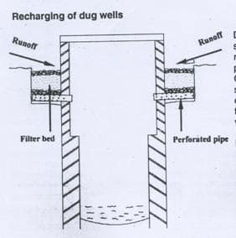
Recharging of dug wells.
Dug well can be used as recharge structure.
Rainwater from the rooftop is diverted
to dug wells after passing it through
filtration bed.
Cleaning and desalting of dug well
should be done regularly to enhance
the recharge rate.
The filtration method suggested for
bore well recharging could be used.

Slide 11
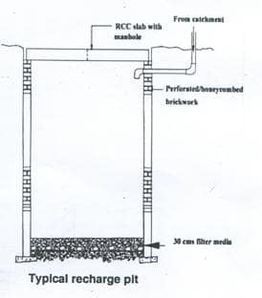
Recharge pits
Recharge pits are small pits of any shape
rectangular, square or circular, contracted
with brick or stone masonry wall with weep
hole at regular intervals.
Top of pit can be covered with perforated
covers. Bottom of pit should be filled with
filter media.
These pits are suitable for recharging of
shallow aquifers, and small houses.

Slide 12
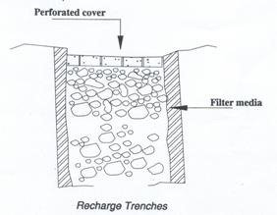
Recharge Trenches
Recharge trench in provided where upper impervious layer of soil is shallow.
It is a trench excavated on the ground and refilled with porous media like pebbles, boulder or brickbats. it is usually made for harvesting the surface runoff.
This method is suitable for small houses, playgrounds, parks and roadside drains.

Slide 13
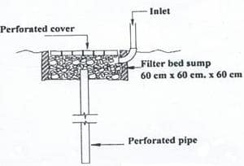
Soak ways or Recharge Shafts
Soak away or recharge shafts are provided where upper layer of soil is alluvial or less pervious.
These are bored hole of 30 cm dia. up to 10 to 15 m deep, depending on depth of pervious layer.
Bore should be lined with slotted/perforated PVC/MS pipe to prevent collapse of the vertical sides.

Slide 14
Percolation Tanks
Percolation tanks are artificially created surface water bodies, submerging a land area with adequate permeability to facilitate sufficient percolation to recharge the ground water.
These can be built in big campuses where land is available and topography is suitable.

Slide 15
Advantages
Rainwater harvesting provides an independent water supply during regional water restrictions and in developed countries is often used to supplement the main supply.
It provides water when there is a drought, can help mitigate flooding of low-lying areas, and reduces demand on wells which may enable groundwater levels to be sustained.
It also helps in the availability of potable water as rainwater is substantially free of salinity and other salts.
Application of rainwater harvesting in urban water system provides a substantial benefit for both water supply and wastewater subsystems by reducing the need for clean water in water distribution system, less generated stormwater in sewer system, as well as a reduction in stormwater runoff polluting freshwater bodies.
Even in periods of low rainfall, enough water is collected in order for crops to grow. Water can be collected from roofs, dams, and ponds can be constructed in order to hold large quantities of rainwater so that even on days where there is little to no rainfall, there is enough available to irrigate crops.

