Slide 1
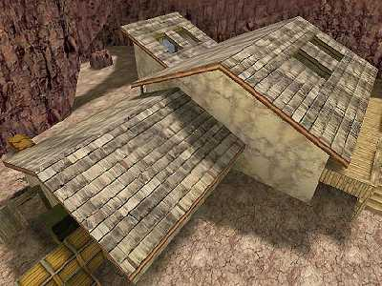
ROOF
ATUL SETYA

Slide 2
FUNCTION
To keep out rain, wind, snow & dust
To prevent excessive heat loss in winter
To keep the interior building cool in summer
Designed to accommodate all stresses encountered
Designed to accept movement due to changes in temperature & moisture content
To provide lateral restraint & stability to adjacent walls
To resist penetration of fire & spread of flame from external sources

Slide 3
TYPES OF ROOF
Flat Roof
Its not perfectly flat
Must have a slight slope for drainage
Shed Roof
A single slope
Gable Roof
2 slope meeting at ridge. 2 walls extends to
the ridge
Hip Roof
2 gable, pyramid should be considered as a
hip roof

Slide 4
Gambrel Roof
4 slopes in one direction, the typical
barn roof
Mansard Roof
2 gambrels
Basically is to the gambrel what the hip is to
gable
Pitched Roof
drains water
insulates main area of heat loss
support snow load

Slide 5
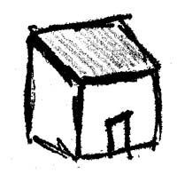
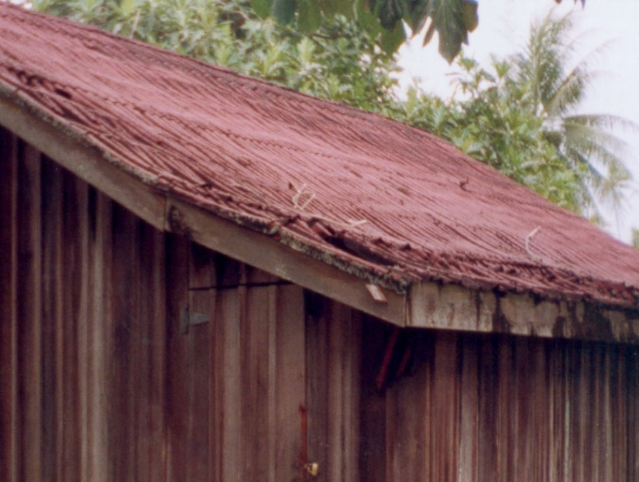
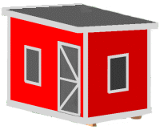
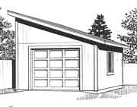
Shed roof

Slide 6
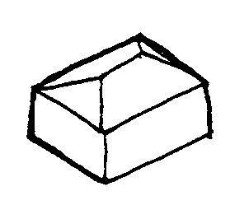
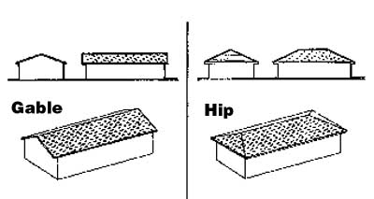
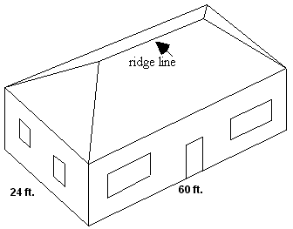
Hip Roof

Slide 7
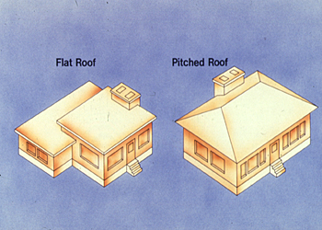
Flat Roof & Pitched Roof

Slide 8
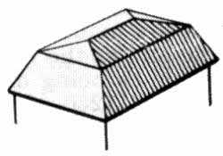
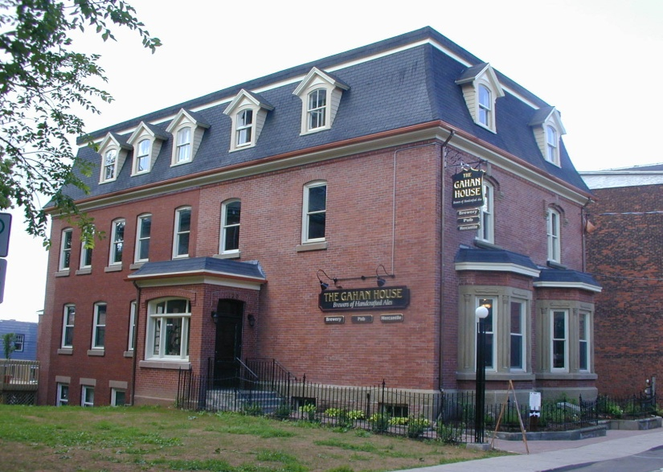
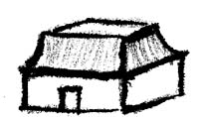
Mansard Roof

Slide 9
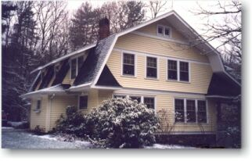
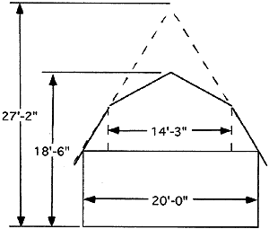
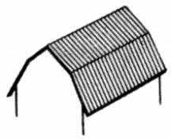
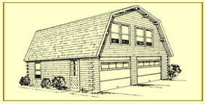
Gambrel Roof

