Slide 1
Principles of Architecture
Ar. Manish Kumar

Slide 2
PRINCIPLES OF ARCHITECTURE :-
UNITY
CONTRAST
MASS COMPOSITION
PROPORTION
SCALE
ACCENTUATION & RHYTHM
CHARACTER

Slide 3
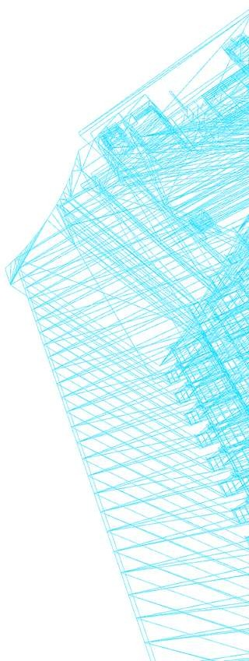
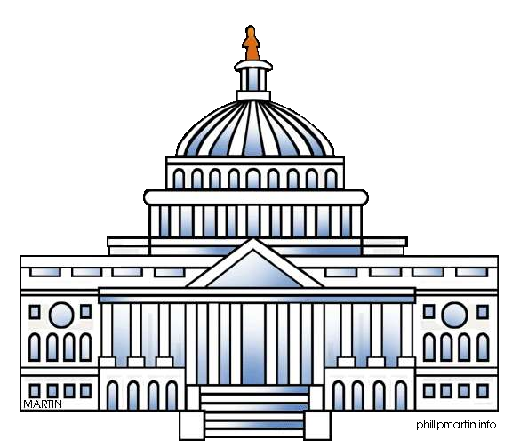
UNITY:-
Unity Means Oneness And Indicates Harmony Among The Different Building Elements. It Imparts Coherence Of The Parts And Integrity Of The Whole.
A dominating mass placed at central or at a convenient place to makes it a point of importance and destroy the duality or competition.

Slide 4
CONTRAST:
It means absence of monotony. It creates interest in humans because our mind carries impressions based on contrast existing in nature.
Care should be taken to not destroy the unity.
Contrast can be created using different shapes, their line of direction. Use of different construction materials, shades of colour creates contrast.

Slide 5
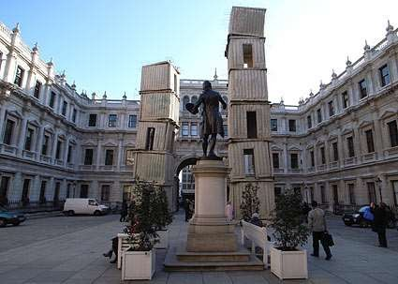
VARIETY - CONTRAST IN SIZE

Slide 6
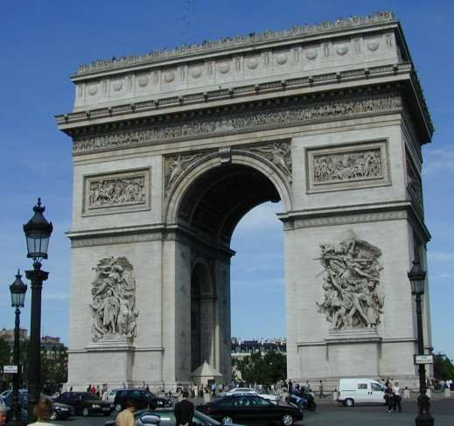
SHAPE
VARIETY - CONTRAST OF SHAPE

Slide 7
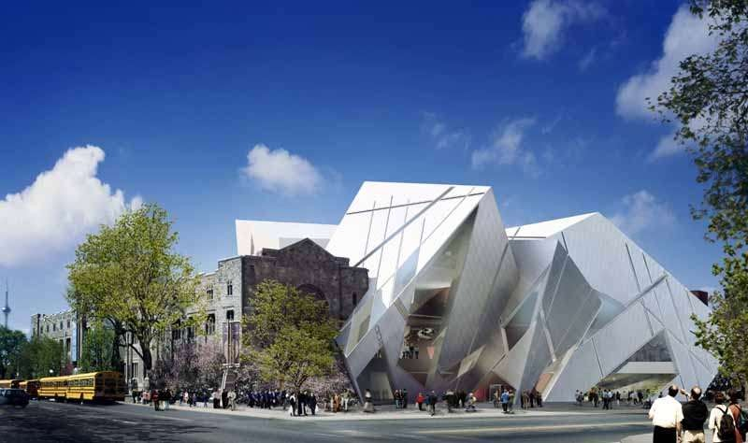
M A S S
VARIETY - CONTRAST OF MASS

Slide 8
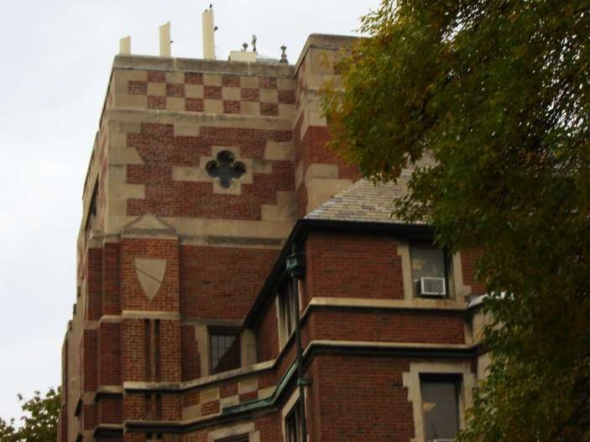
Texture Openings Planes
VARIETY - CONTRAST OF TONE

Slide 9
MASS COMPOSITION:
Mass is a three dimensional shape having definite width, length and height.
Mass arrangement is to be done in such a way that harmonious unity of structure is maintained.
Development of masses is done from both plan and elevation of building.

Slide 10
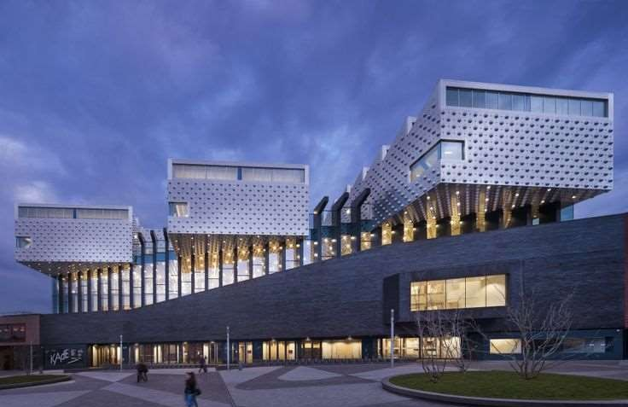
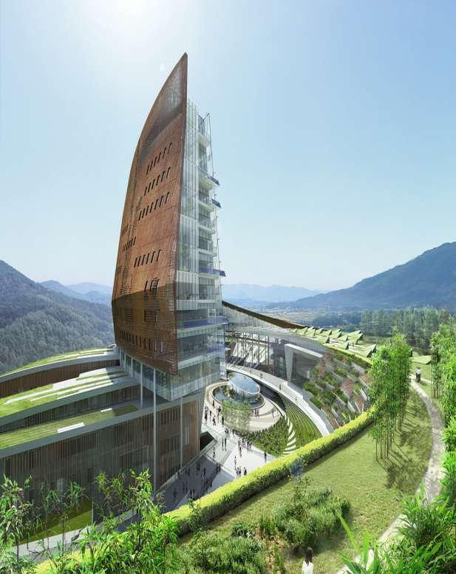
MASS COMPOSITION

Slide 11
PROPORTION:
The dimensions of length, width and height with respect to one another gives a pleasing effect.
A square living room fails to create a good impression but a rectangular one with length about 1.2 to 1.5 times the width gives pleasing effect although a greater ration gives undesirable “tunneling” effect.

Slide 12
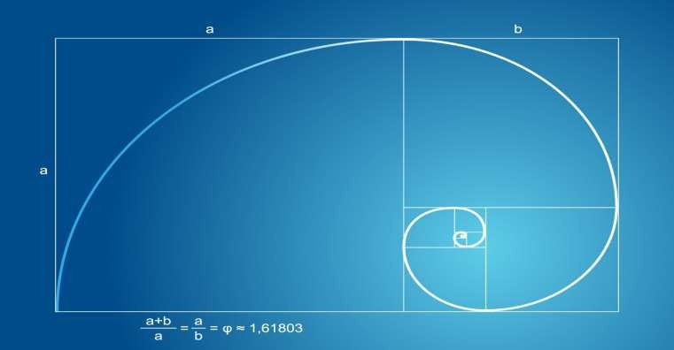
GOLDEN RATIO
It is divine proportion used for beauty and balanced in the design of art.

Slide 13
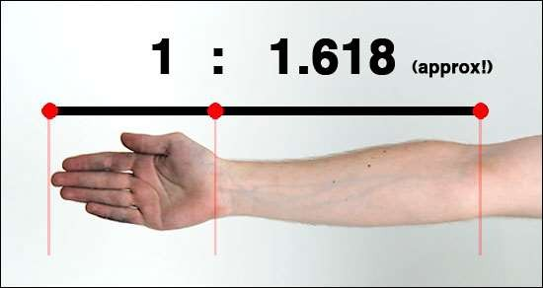
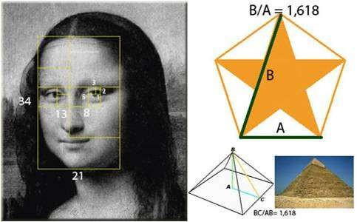
GOLDEN RATIO

Slide 14
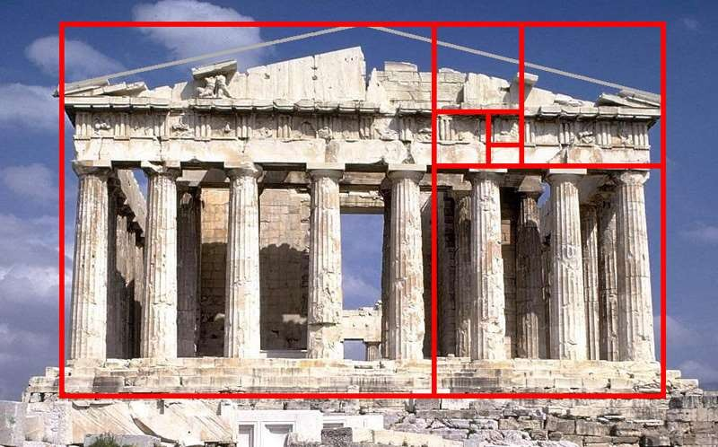
GOLDEN RATIO

Slide 15
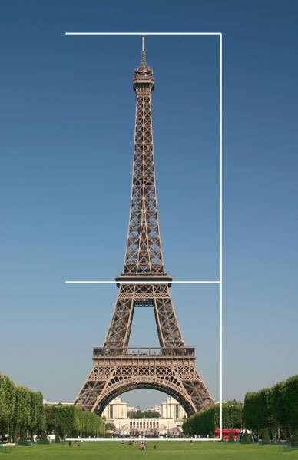
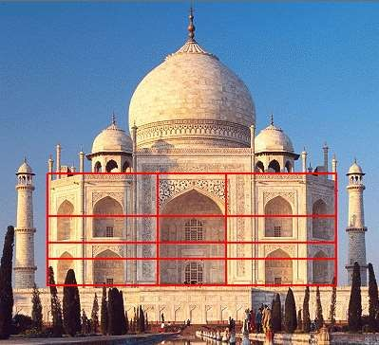
GOLDEN RATIO

Slide 16
SCALE
The scale in architectural composition means proper relation of different elements to one another and to whole. The scale is considered with respect to surroundings.
The sizes of doors, windows and staircase are different for residential building when compared to monumental or public building.
The proper scale is essential for better and qualitative results of
proportion.
The size of doors,windows and step(rise&tread) and handrail height should suit the users and creates feeling of comfort.

Slide 17
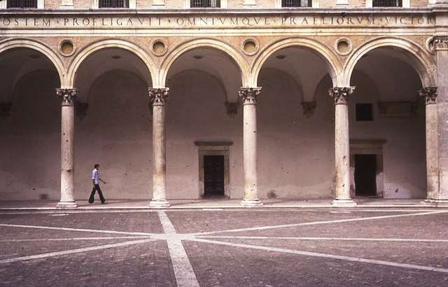
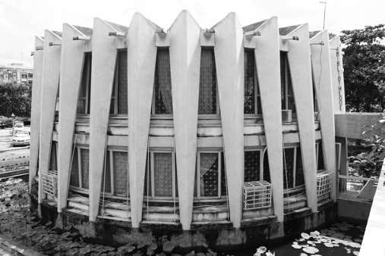
RHYTHM
Rhythm in architectural composition is repetition of certain patterns at regular interval such as columns fixed at a fixed intervals.
It is pleasing and attractive.

Slide 18
CHARACTER
It refers to the styles of the building.
The character is related to functional aspect of the building and evolves from proper combination of unity, mass composition, proportion, scale etc. which constitutes the basic principles of Architectural composition.

Slide 19
TYPES OF CHARACTER
Functional Character
Traditional Character
Personal Character

Slide 20
FUNCTIONAL CHARACTER
That show the purpose of the building or the reason for its erection.
The external appearance plays an important role in determining the
purpose and the function of the structure.
Examples:1) A school building must containmany windows to admit the necessary side light and to offer an interesting contrast with the possible monotony of the class-room walls.
2) A factory expresses the efficient operation of the manufacturing within in.
Designing skylights instead of windows can indicate a museum.

Slide 21
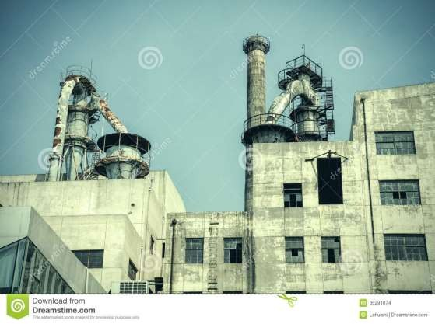
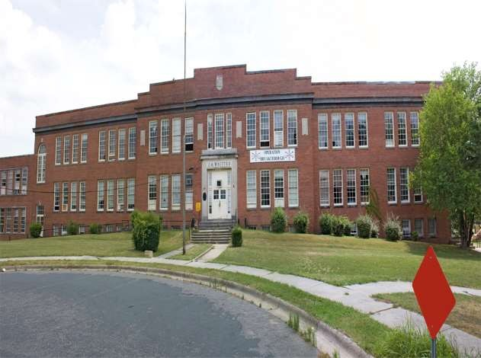
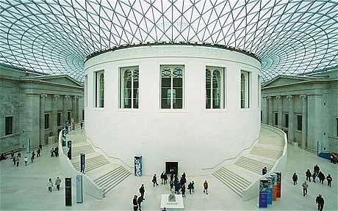

Slide 22
TRADITIONAL CHARACTER
The character of some buildings is expressed through elements associated with certain influences. Such influences often go thousands of years back in history and culture.
Cultural aspects play an important role in determining the Associated Character of a particular structure.
Examples:-1) a spire on a tower by the side of a spacious building
indicates a church.
2) A gopuram depicts a Hindu Temple.
3) a crescent and a white dome is the symbol of a mosque.

Slide 23
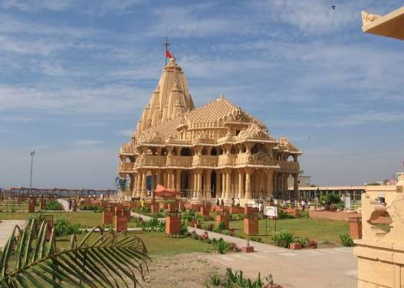
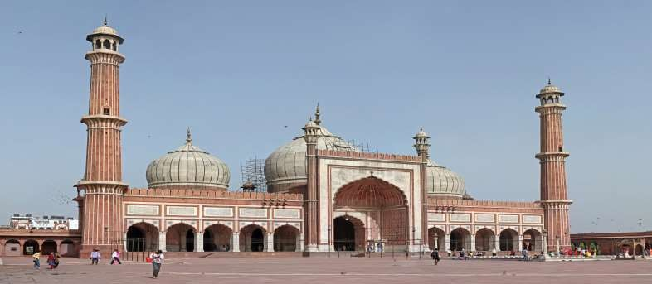

Slide 24
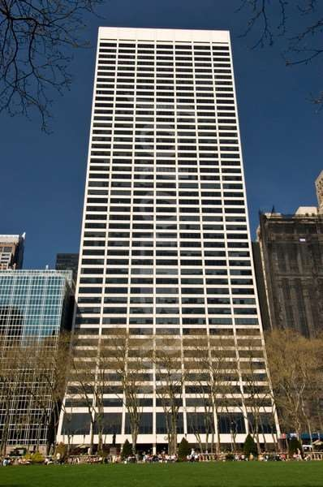
PERSONAL CHARACTER
If a building is designed in the proper spirit, personal characteristics such as grace, dignity and vitality can be expressed as an integral part of the structure.

