Slide 1
Principles of Composition
Presented by: Vivek Painuli

Slide 2
Principles of Composition
UNITY / DUALITY RHYTHM / REPETITION SCALE
PROPORTION CONTRAST
BALANCE / HARMONY VITALITY
DYNAMISM
RESTRAINT / REPOSE DEFINITION / STRENGTH ACCENTUATION HIERARCHY
GRADATION

Slide 3
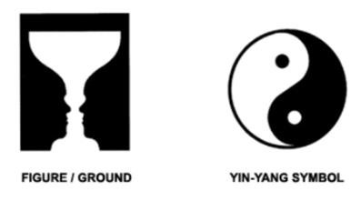
Contrast

Slide 4
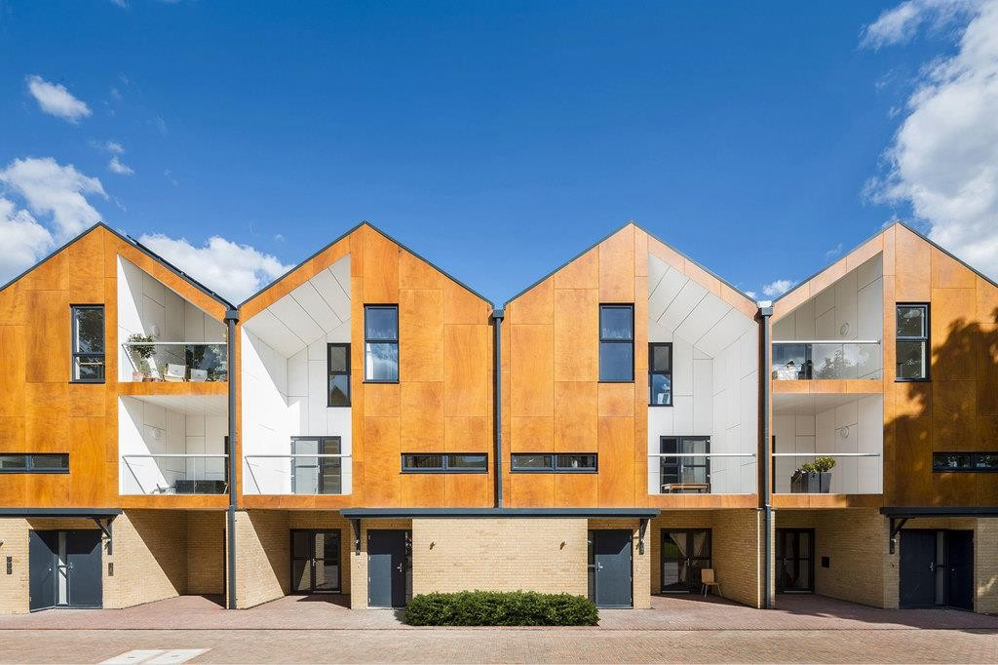
Contrast
Opposition or dissimilar elements in a work of design to intensify
each element’s properties and produce a more dynamic expression.
The interdependency of the elements is achieved by the tension of their opposite characteristics.
Contrast creates a visual variety, excitement and interest to the building and can be achieved in one building or a group of buildings on the scale of streetscape.
Contrast can be recognized in a building, when two adjacent parts are different from one another, different materials, colors and textures. Light, shade and shadow of masses also create contrast.
In the above building the contrast is observed in
Texture , colour, solid and void.
Even on the scale of streetscape, adjacent old and modern buildings create and interesting contrast.

Slide 5
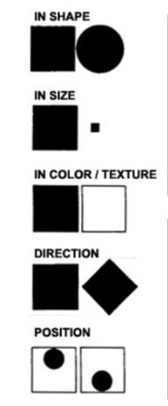
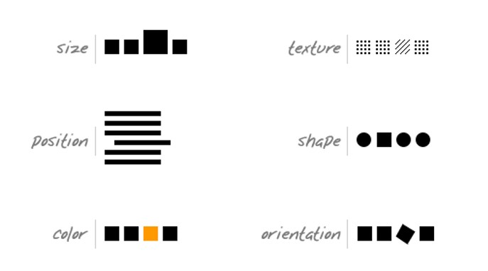
PURPOSE OF CONTRAST IN A DESIGN
avoid monotony
create diversified effect.
give emphasis and thus hold attention
produce variety
METHODS OF PRODUCING CONTRAST IN A DESIGN
combine elements of different characteristics
one element dominating others to give
emphasis or interest
variations in materials, forms, sizes, directions, colors and other qualities
TYPE OF CONTRAST
contrast as to MASS :
form
proportion
direction
size
height ,
Solid and void.
2. contrast as to SURFACE :
shape
texture of material
tone
color
area

Slide 6
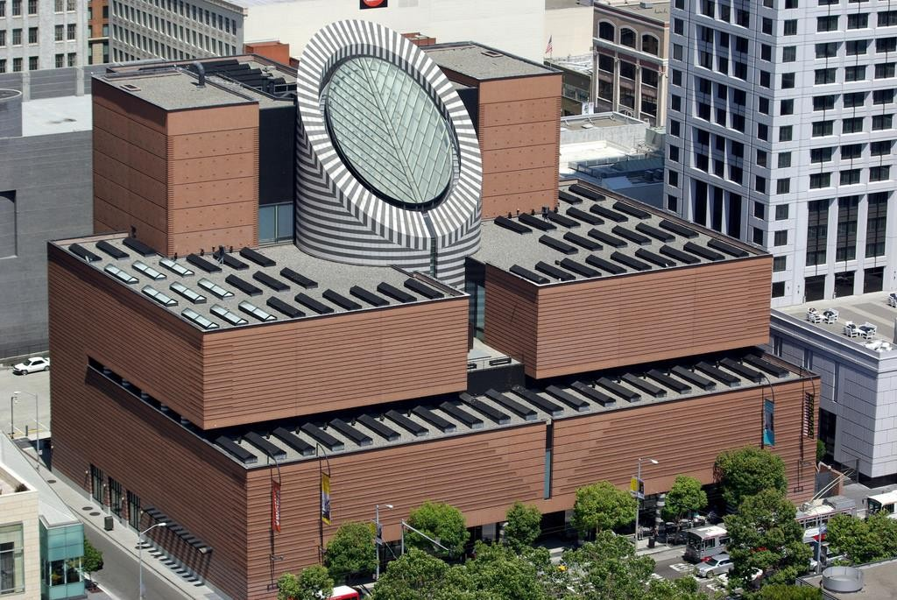
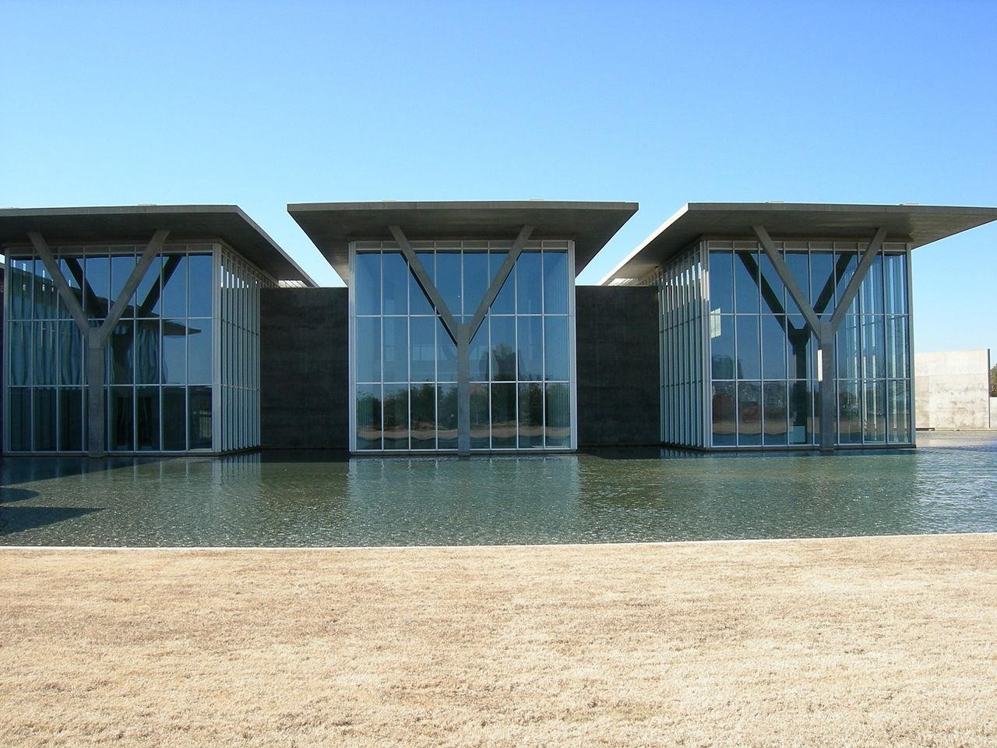
Museum of modern Art –San Fanscisco., Mario Botto
Modern Art Museum of Fort Worth, Texas, -Tadao Ando
The centre Atrium which is form of truncated cylinder raise above the gallery space creates visual focus. We notice Atrium is in contrast in term of form , color and surface treatment compared to rest of the building.
Contrast through wet and dry spaces Contrast in positive and negative space.
Contrast in material, glass and concrete cantilever slabs.

Slide 7
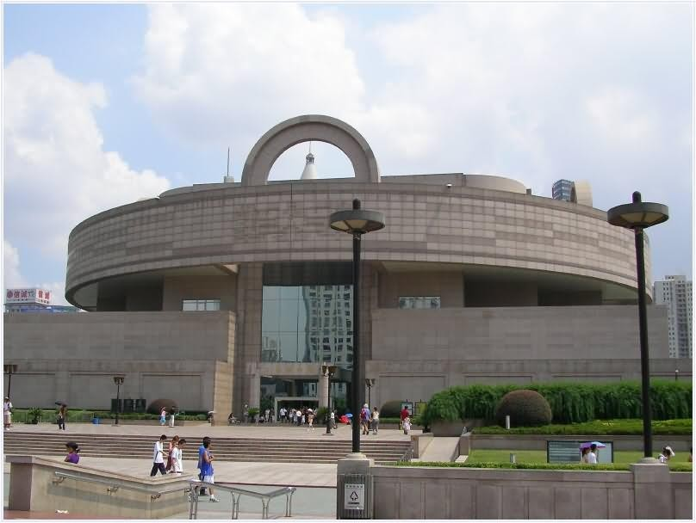
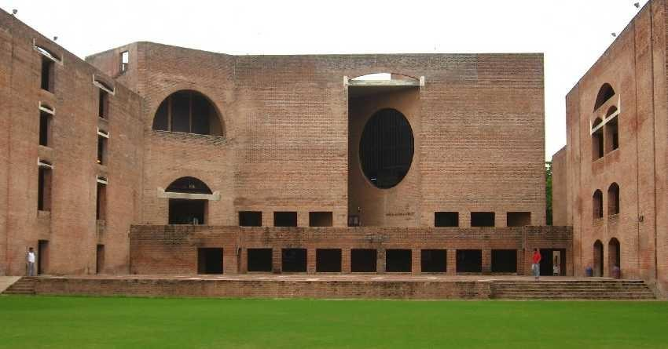
Shanghai Howard Johnson Plaza Hotel At People's Square where contrast in form is achieved.
Two contrasting forms-The base rectangular and top circular mass are combined in single composition which together acts as unified composition.
Indian Institute of Management Ahmedabad (IIMA)
Contrast in massing where solid and void is well balance in facade

Slide 8
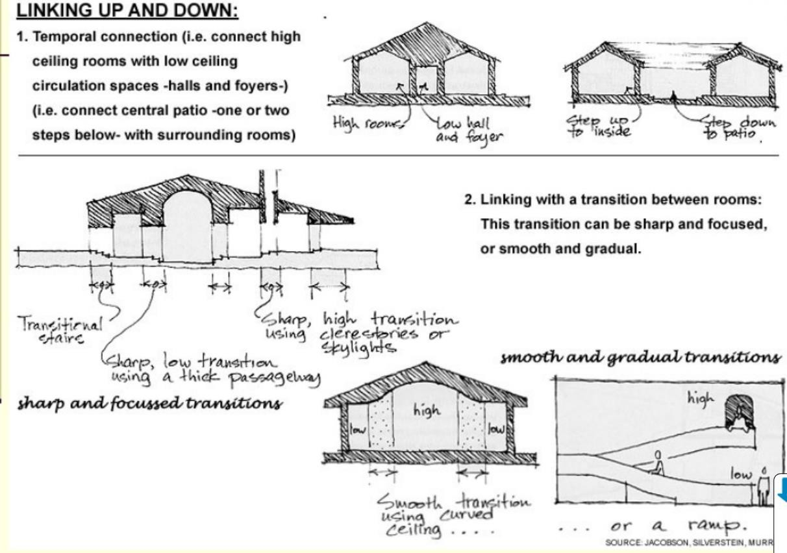

Slide 10
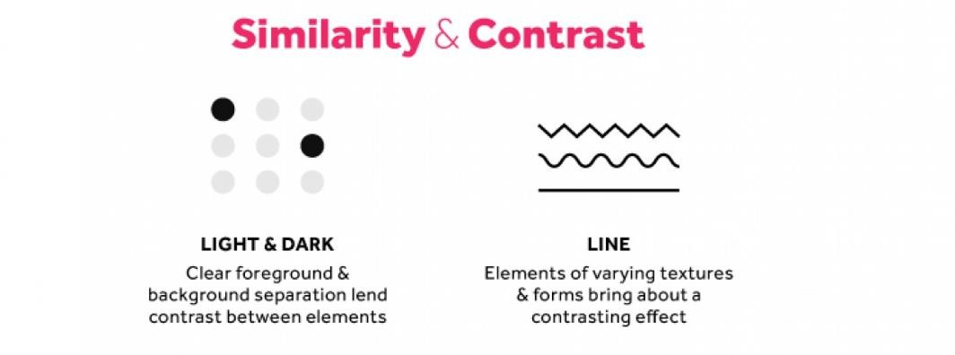

Slide 11
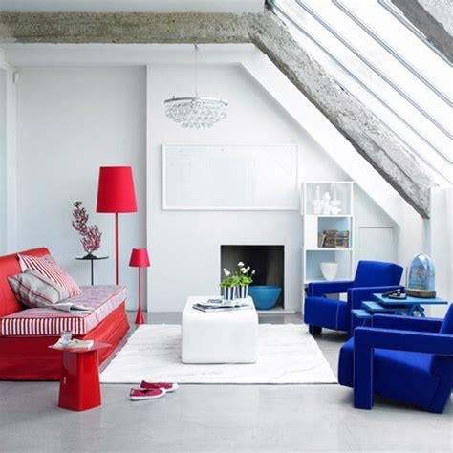
Contrast in color in interior

Slide 12
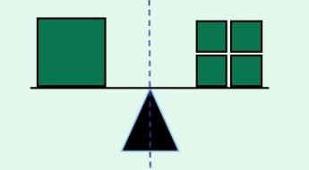
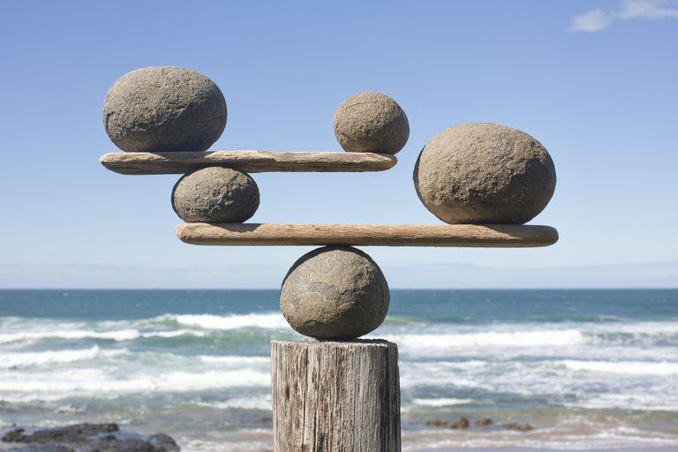
Balance
Balance (symmetry / asymmetry):
Balance creates a state of equilibrium of the visual forces as well as feeling of stability in the composition.
In a balanced design, visual forces of equal strength pull in opposite directions towards the opposite sides of an axis or a central pivot.
Balance is a psychological sense of equilibrium. A balanced design has a unity of composition.
Balance could be symmetrical or asymmetrical as long as the building
expresses and maintains a sense of equilibrium.

Slide 13
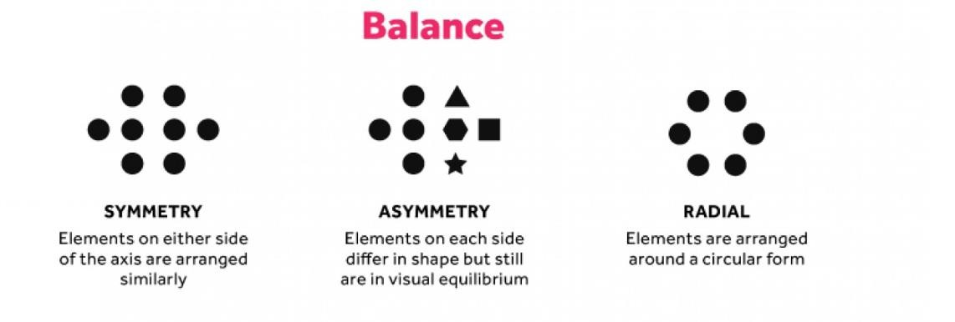

Slide 14
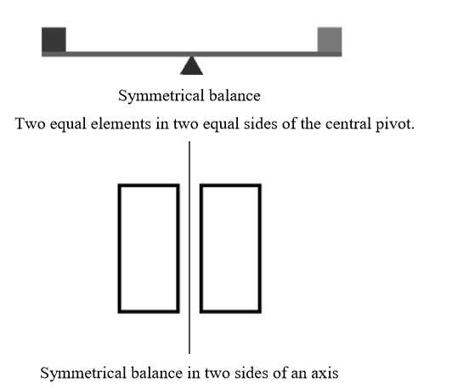
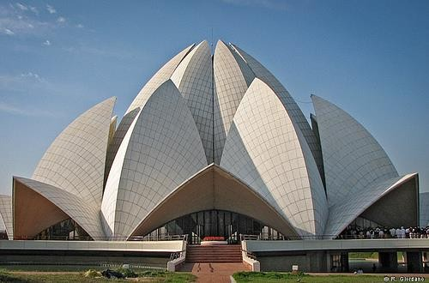
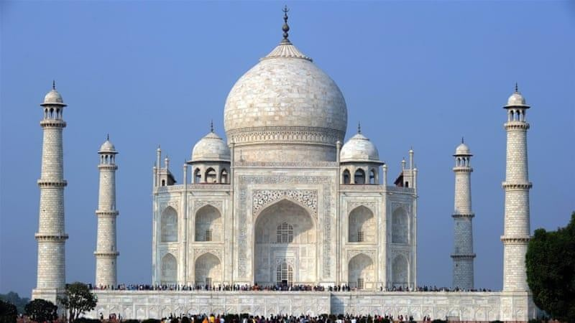
Symmetrical Balance (formal/passive) :
The Lotus Temple, located in Delhi,
If the elements are of equal weight and value on either side of axis we refer to this as symmetrically balanced. Usually when one or more elements are mirrored on either side we refer to this as a stable or more formal composition.
symmetry is static and demands attention and impose a strict formality
Taj Mahal- Agra

Slide 15
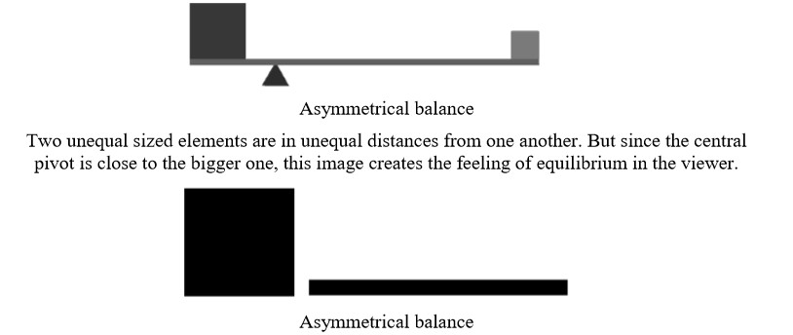
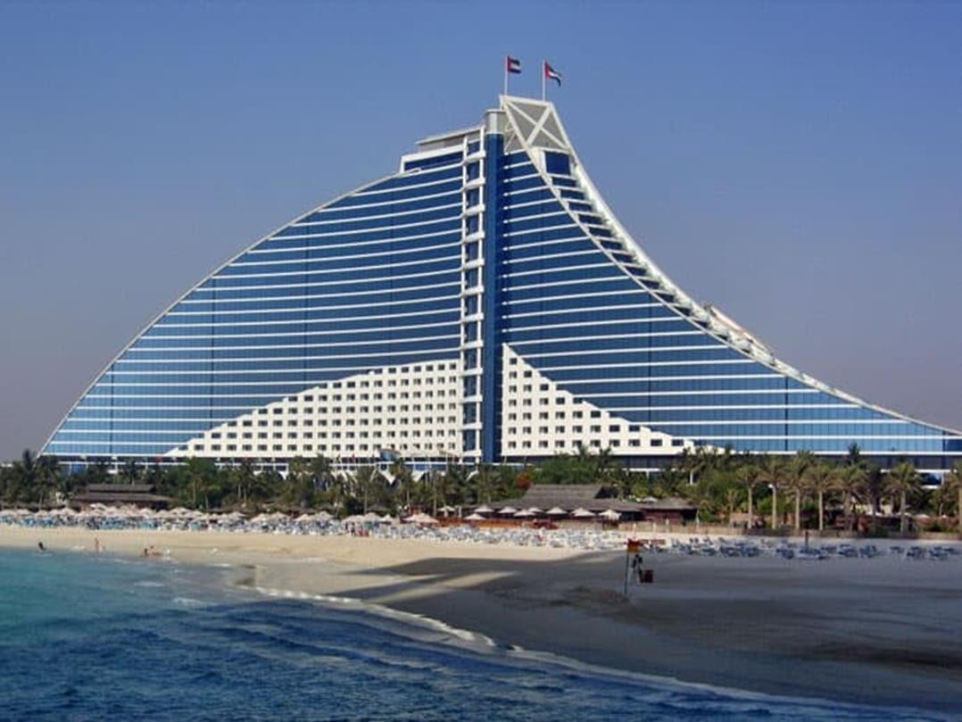
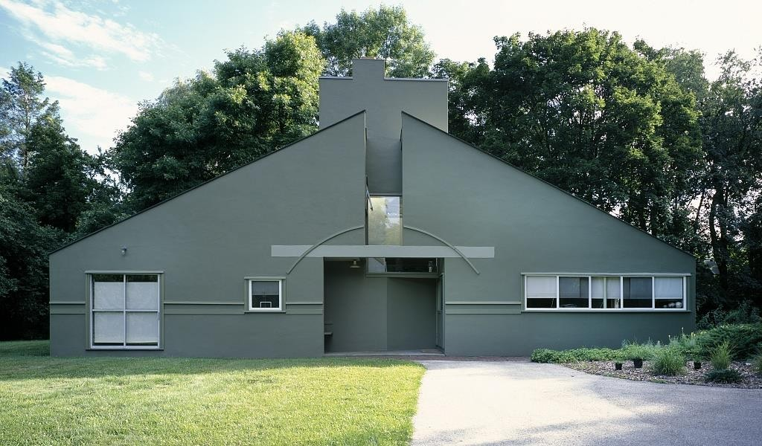
Asymmetrical Balance
Asymmetrical balance is when both sides of the central axis are not identical, yet appear to have the same visual weight. There is a balance between a number of items of smaller size on one side and a larger one on the other.
Asymmetric balance is more dynamic than symmetric balance.
Venna venturi House
Jumeirah Beach Hotel, Dubai 2007

Slide 16
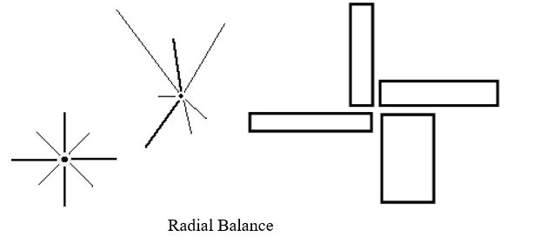
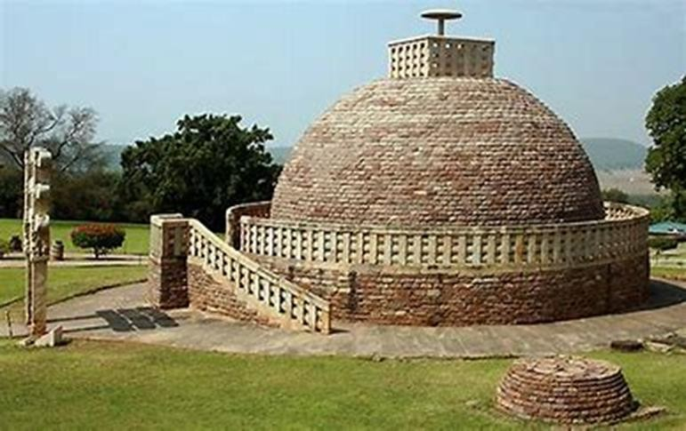
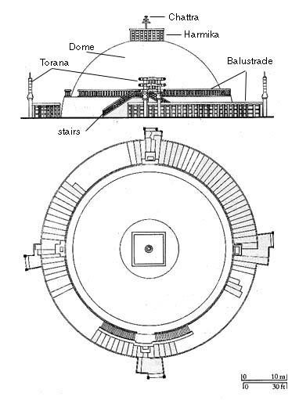
Radial balance:
Radial balance is arranged around a central element. The elements placed in a radial balance seem to 'radiate' out from a central point in a circular fashion.
Creates focal point at centre of the composition.

Slide 17
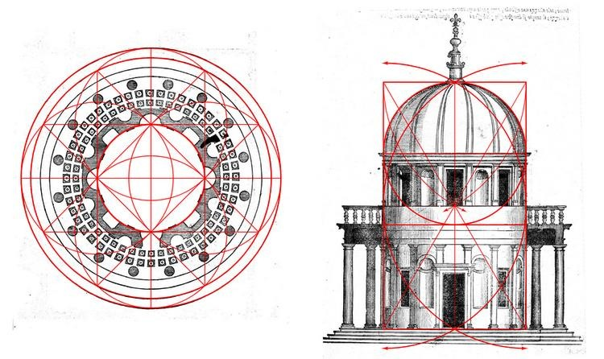
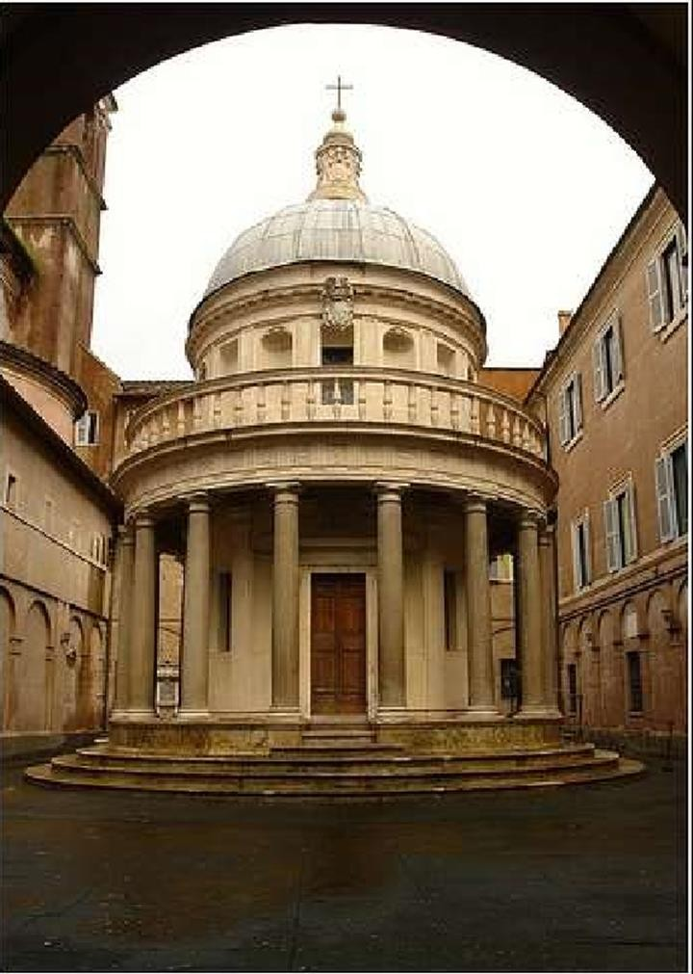
Radial balance:
Bramante's Tempietto, St peters, Florence

Slide 18
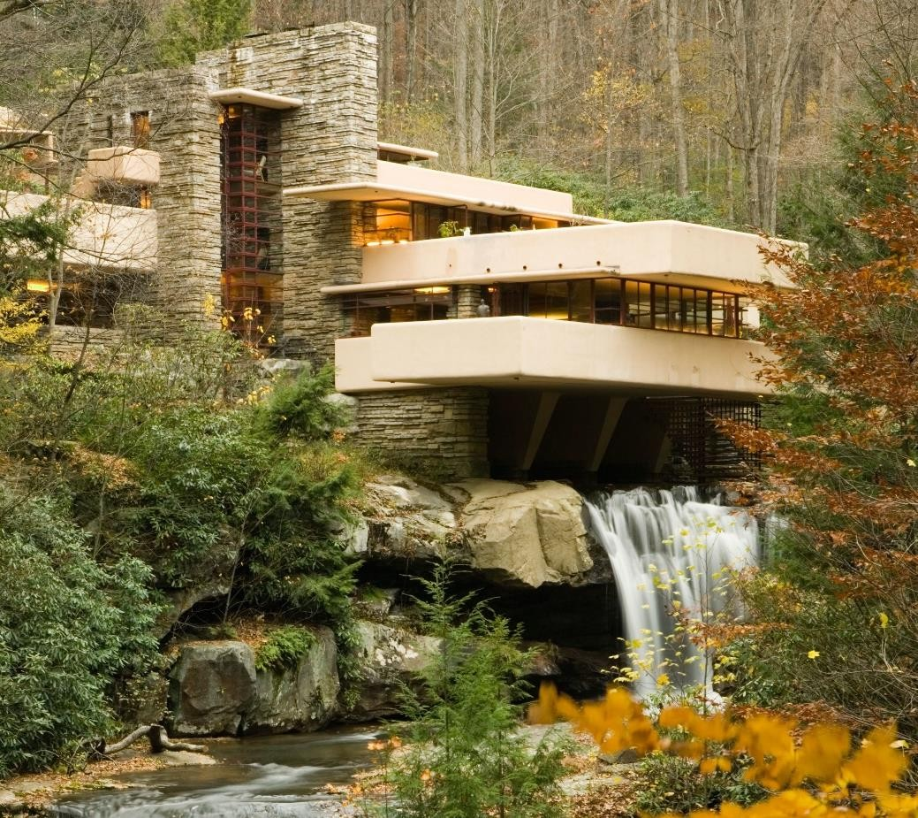
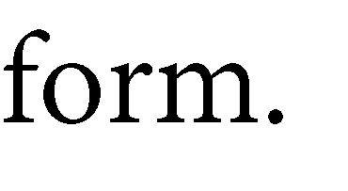
Harmony
Harmony between building and site
Harmony:
The pleasing agreement of parts or combination of parts in a composition.(belonging of one thing to other)
Harmony can be achieved:
Harmony between building and site
Harmony between a building and surrounding structures Harmony between different part of the same building.
Falling Waters-

Slide 19
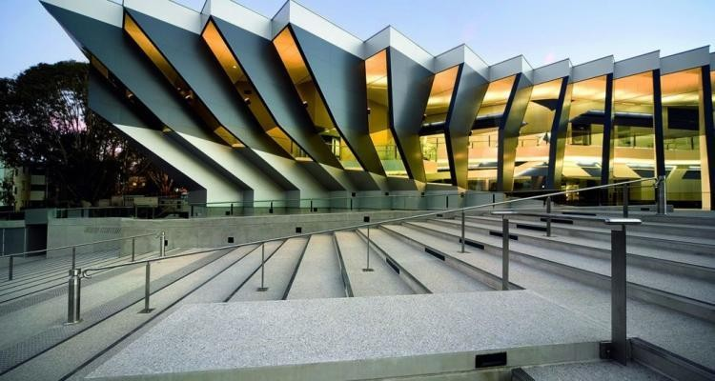
Harmony
Harmony involves the selection/design of elements that share a common trait, however, Harmony becomes monotony without Variety.
The repetition of design element like colour texture , shape and form is one of the easiest way to achieve Harmony.
Repetition of form can be used to produce rhythm and
Harmony.
Common traits can be orientation
colors or values shape/size materials
variety: the extent of the differences in design elements.
John Curtin School of Medical Research building, by Lyons Architecture, in Australian National University campus .
Shows Harmony through Rhythm and Repetition.

Slide 20
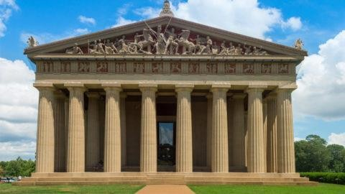
Parthenon, Greece
The Lotus Temple, located in Delhi,
The repetition of design element like colour texture , shape and form is one of the easiest way to achieve Harmony.
Where every element is in agreement with other and make unified composition.
Harmony by –composition Texture
Geometry direction and proportion

Slide 21
Vitality
Vitality Mean Life or Life force.
Vitality signifies liveliness in buildings. It is obtained by varying proportion of solid and void. Accentuated by cantilevers, curves, slope, colour, façade treatment.
Vitality express life ,bold, and dynamism. It can be achieved by contrast.
Contrast can be of color , tone ,texture , direction , proportion , solid , void.
But too many contrasting elements or too much of contrast Will impair harmony and tend to produce a
multiplicity of equal interests.

Slide 22
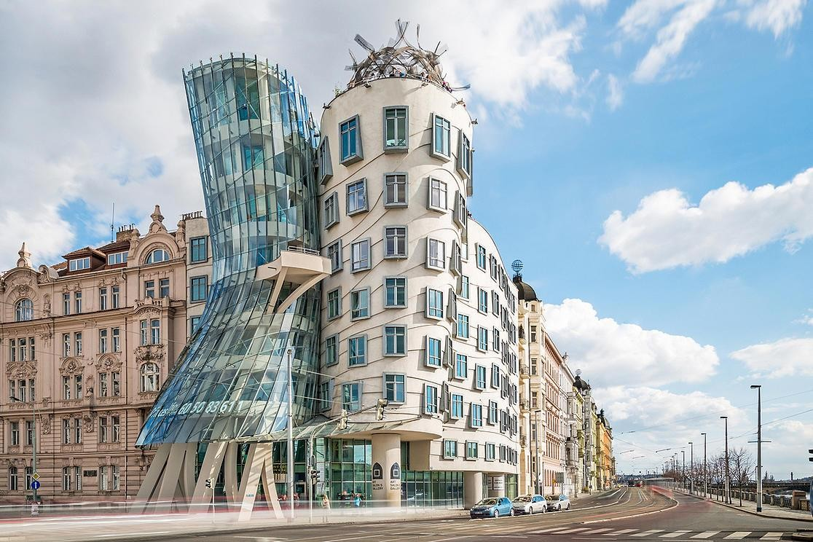
The dancing building in Prague, give sense of dynamism and vitality.
The curvilinear forms and irregular placed window creates a visual interest.

Slide 23
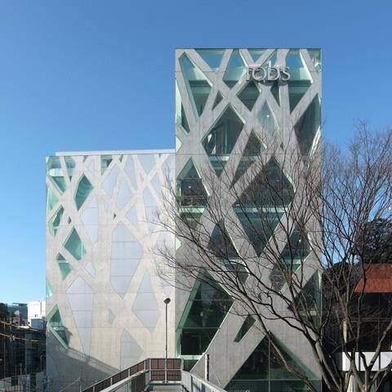
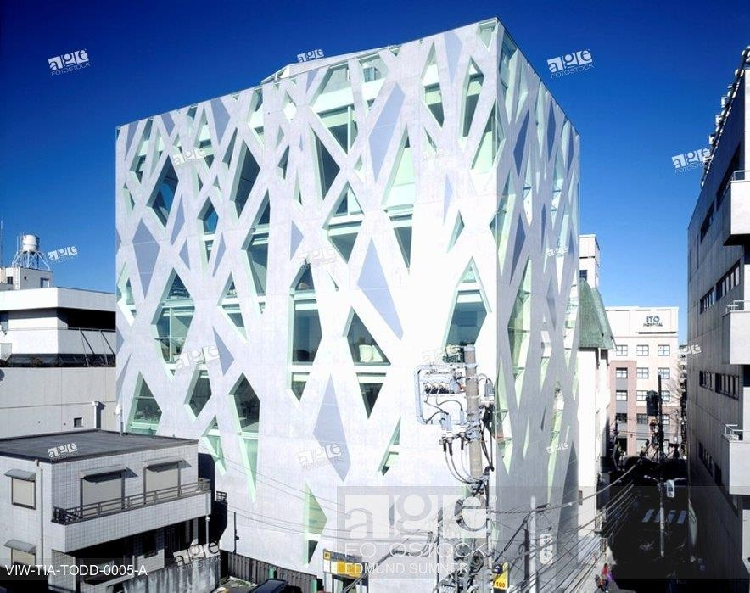
Tod’s Omotesando Building-Tokyo by Toyo Ito
Irregular structural frames creates visual interest and movement . Draws eye upward creates dynamism.
Vitality achieved through contrast of material and solid and void.

Slide 24
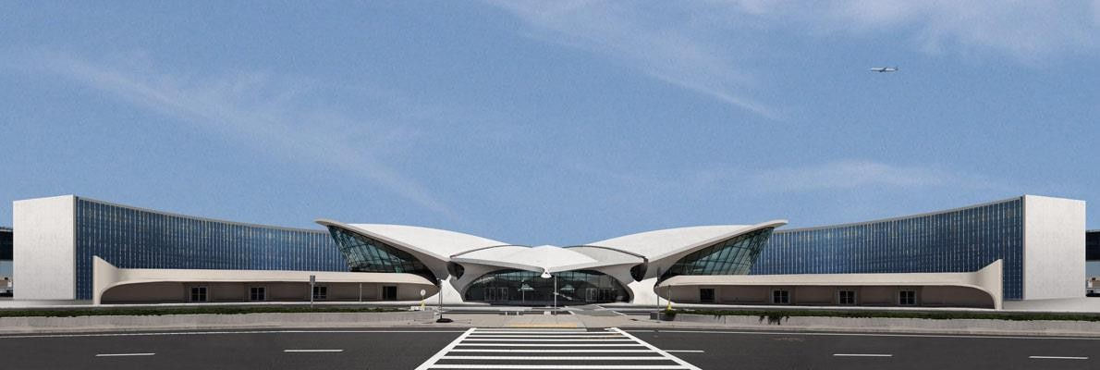
TWA Terminal by Eero Saarinen, New York
The build form is inspired by Bird flight. The unusual form creates a interest gives a sense of motion and vitality.

Slide 25
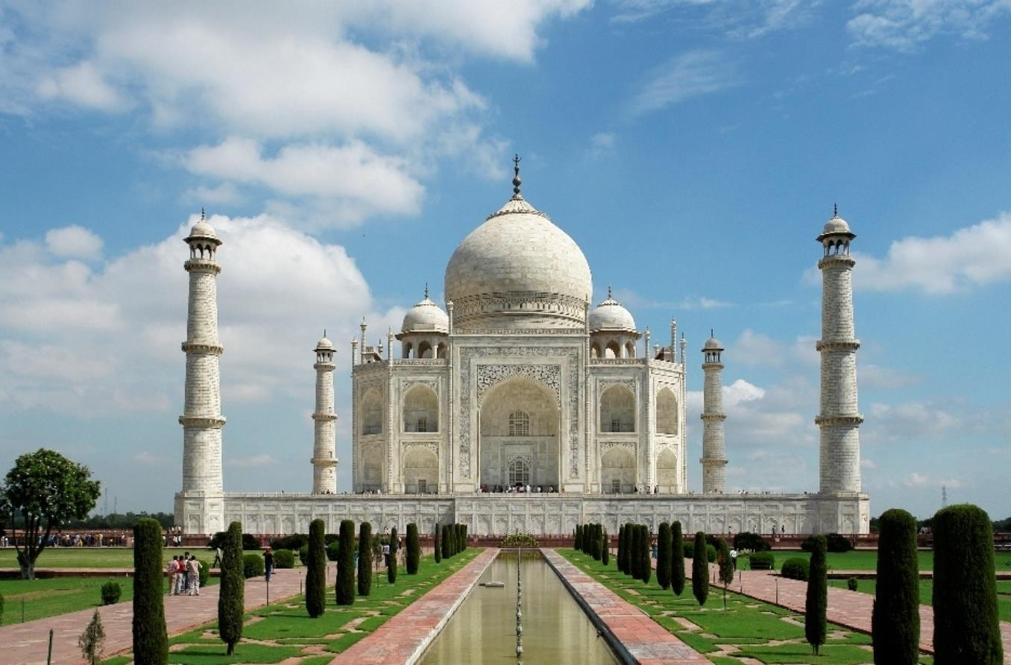
REPOSE
Repose refer to Rest, tranquillity and quietness.
Its is opposite to vitality, creating a sense of pleasant and peacefulness.
Repose can be achieved in form, shape, materials ,
colour.
Carefully introduce landscape and waterbody in design can exemplify repose.
material honesty and structural integrity exemplify
repose and restrain.
The use of white marble, the blue sky, lush green landscape
and still water personify repose and tranquillity.
The structure with dome and minarets frames the image and brings calmness.

Slide 26
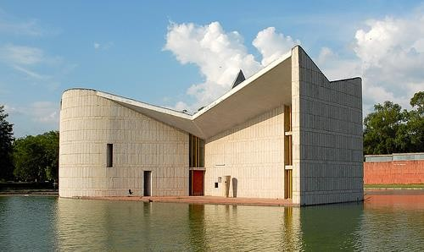
The bold solid mass, absence of contrast , reflecting pool personify repose and restraint.
The minimalistic design of a building and the surrounding landscape together brings in peace and calmness to observer.
The Gandhi Bhawan is a major landmark of the city of Chandigarh, India. It was designed by the architect Pierre Jeanneret, a cousin of Le Corbusier

Slide 27
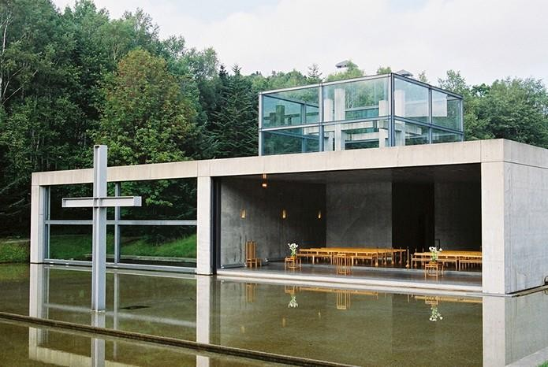
Church on water by Tadao Ando
The low rise concrete structure minimalistic design and reflecting pool , view through lush green creates the sense of calmness and peacefulness.
Church on the Water” maintains a harmonious and spiritual relationship with nature.

Slide 28
Restraint
Restraint means a measure or condition that keeps something under control.
Restraint brings simplicity and elegance in the design.
Restrain characterised by Minimalistic in design, concentrate on the functionality of the building without
additional ornamentation.
Restraint in design is the quality of holding it back and implementing something which solves the problem in the simplest way possible.
Often designers want to show off, imprint their own identity on a piece of work.
Too much of ornamentation, overwhelming colours , too many detail results in lost of focus and destroy the beauty of the building.
Controlled Proportion and minimal design brings in inherited aesthetics in design. It is an architecture based on material honesty and structural integrity.

Slide 29
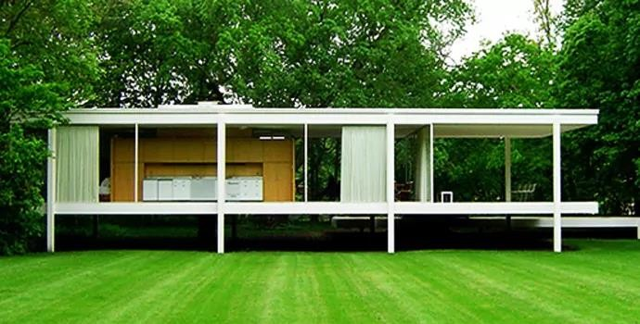
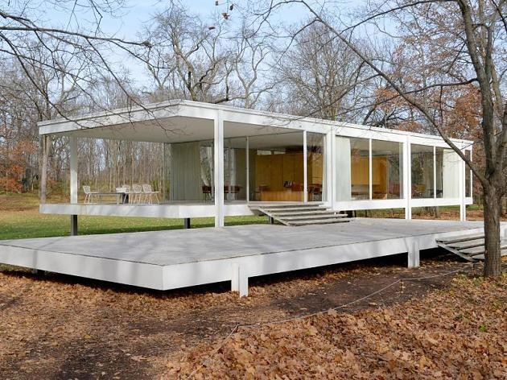
Mies van der rohe’s dictum “less is more” as seen in his work Barcelona pavilion and Farnsworth house are the classic example of simplicity and elegance in design.
In Farnsworth buildings made use of modern materials such as industrial steel and plate glass to define interior spaces. He strived towards an architecture with a minimal framework of structural order balanced against the implied freedom of free- flowing open space. He called his buildings “skin and bones” architecture. He sought a rational approach that would guide the creative process of architectural design.
The Farnsworth House, built by Ludwig Mies van der Rohe in 1951 and located near Plano, Illinois

Slide 30
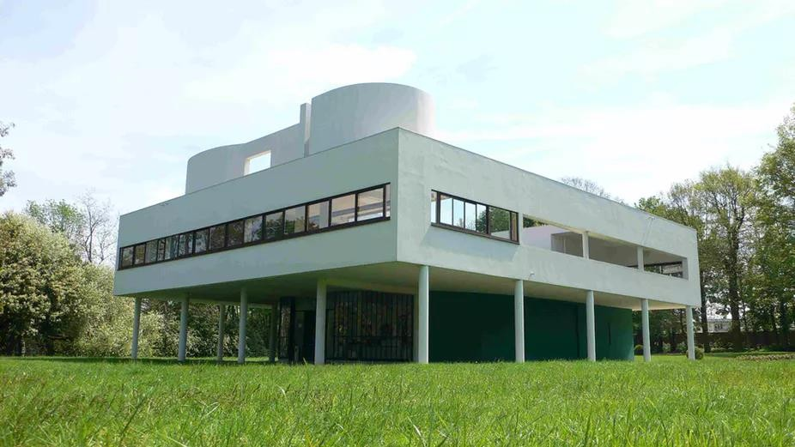
Villa Savoye villa Paris, France. It was designed by Swiss architects Le Corbusier

Slide 31
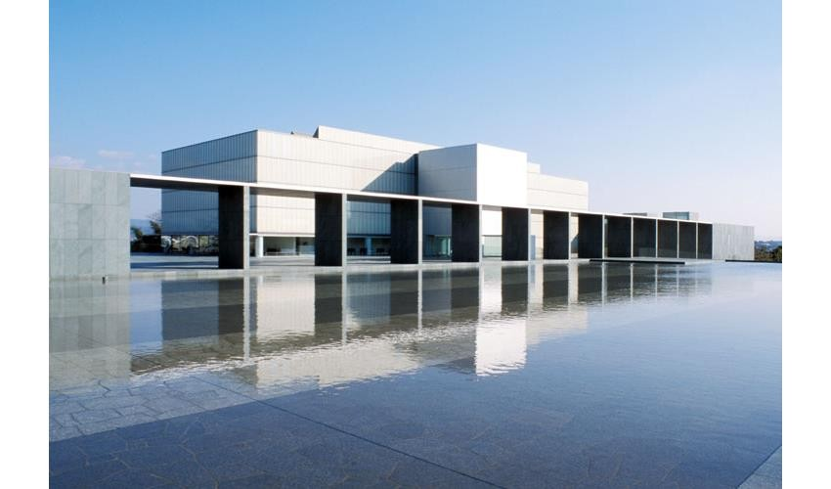
Toyota municipal Museum of Art, Yoshio Taniguchi.
This building design brings in restrain and repose. The use of white frosted glass ,shimmery reflection pool, the bold horizontal mass contrasting black granite arch brings a sense of calmness and tranquillity.

Slide 32
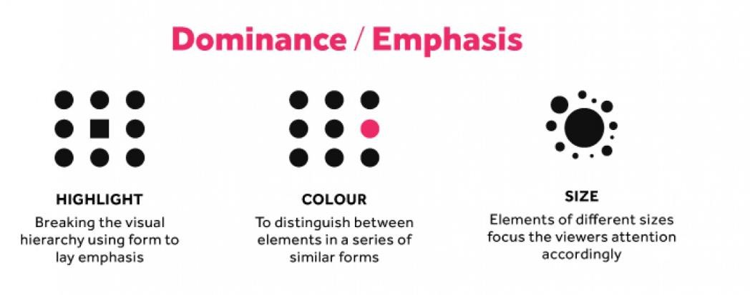
Accentuation/Emphasis
Accentuation means emphasis certain part of the building or highlight certain parts in the building.
This creates visual interest and focus in the composition. Accentuation can be achieved
By contrast
By Massing
By ornamentation By colour
By positioning

Slide 33
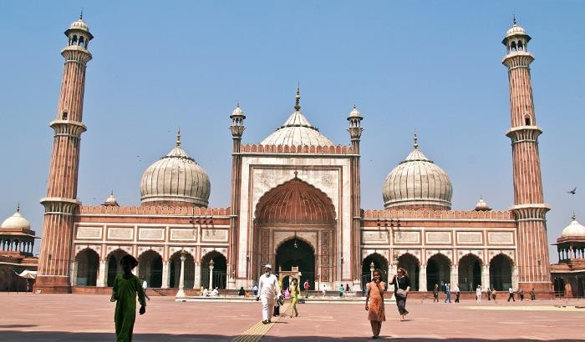
Jama Masjid of Delhi- The entrance gate way is emphasised/ accentuated by
Position- placing at center
Size- the arch opening is prominent in size compare to rest of the building
Contrast- the arch opening is negative space within the solid mass.

Slide 34
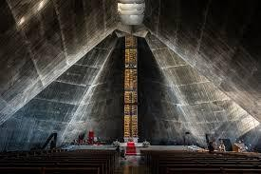
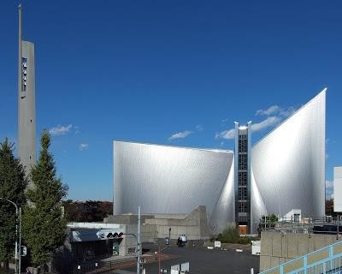

Slide 35
Strength
It is expression of durability and stability in design.
Building visually looks strong and stable. Strenght can be achieved by
Use of material- stone , rough textured
finish
By massing- wide base and narrow tower
By shape- Pyramid and rectangle
By structural element position

Slide 36
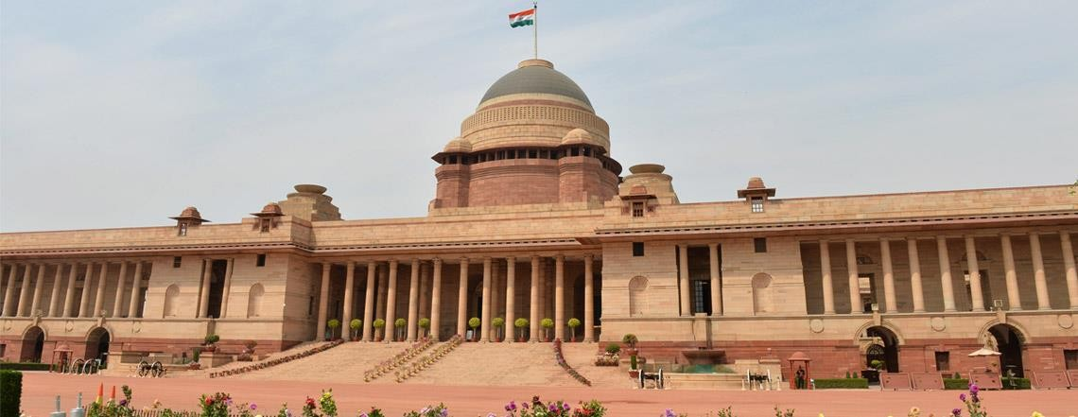
Rashtrapati Bhavan-New Delhi.
Strength is expressed by size or magnitude of structure. Building expresses robustness in its expression.
Strength is also expressed by use of material –red stone and rough texture finish.

Slide 37
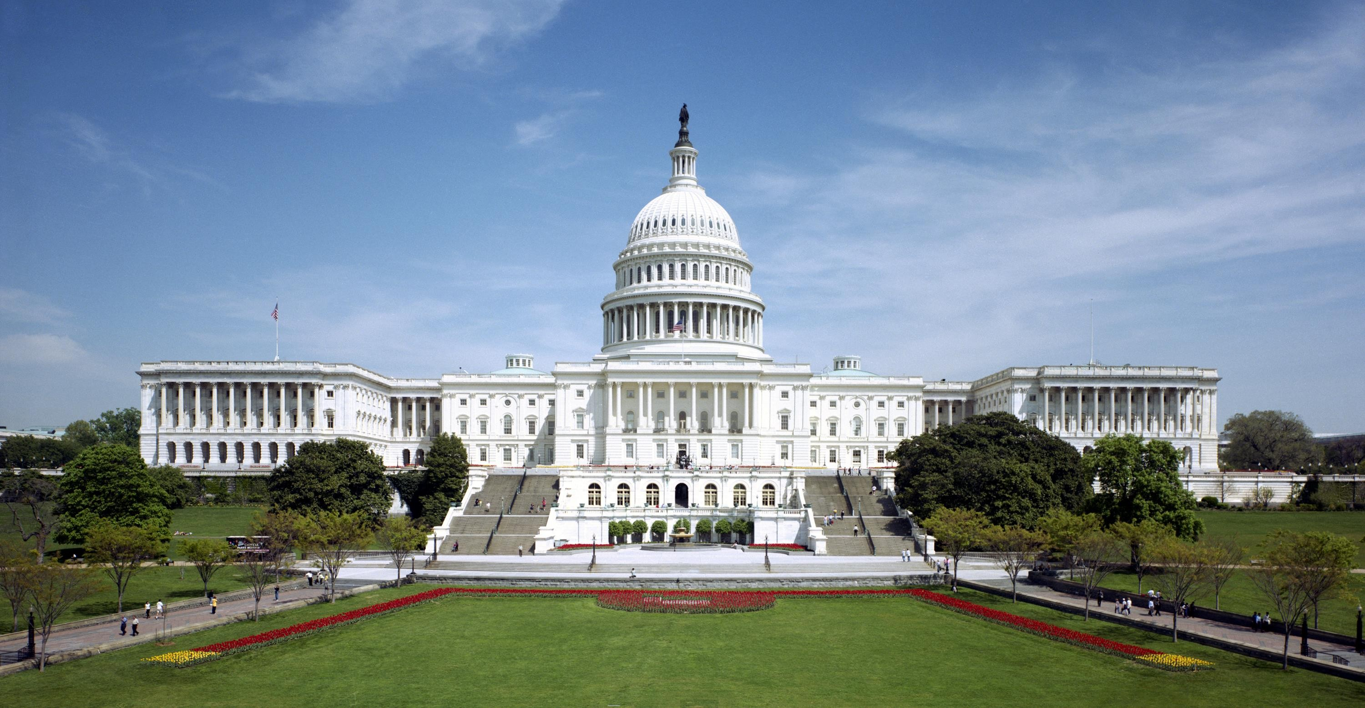
The United state capital-Washington.
Strength is expressed by size or magnitude of structure. Building expresses robustness in its expression.

Slide 38
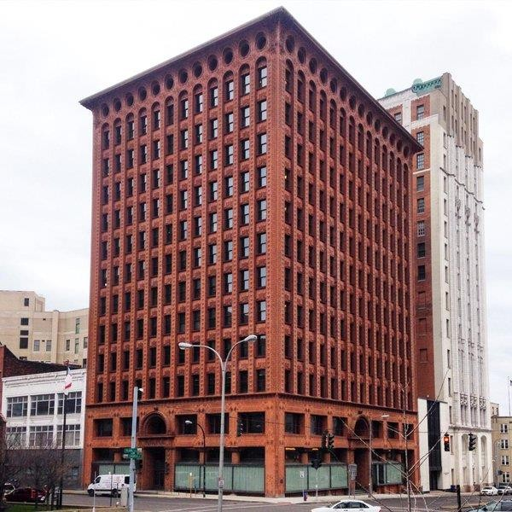
Definition
Clearly defining the outer line or the form of any components of a building or any part of the building.
Example- defining the arch and window opening. Defining various floor in the tall building.
Example:
Architect Loius Sullivan defined architectural expression for
tall buildings in his initial projects.
In Wainwright Building, the base, shaft and the top floors are clearly defined by giving different surface treatment. He argued each floor has different purpose and therefore should be treated differently.
The edge of the building is defined by wide heavy vertical column.
the top floor is treated as capital with wide overhanging.
Wainwright building at St. Louis, Missour, by loius Sullivan

Slide 39
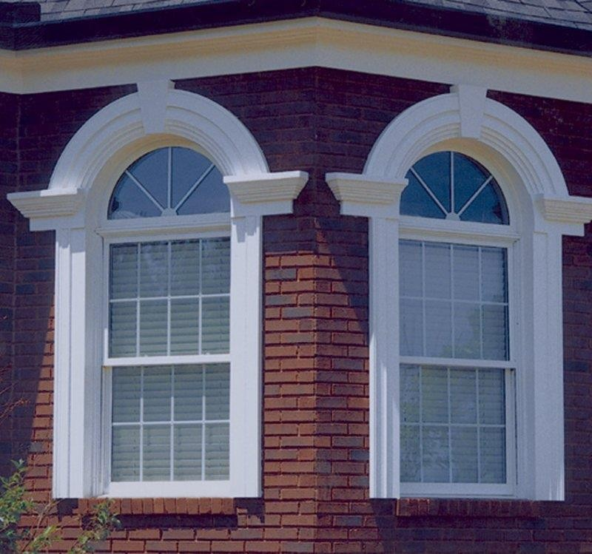
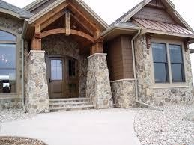
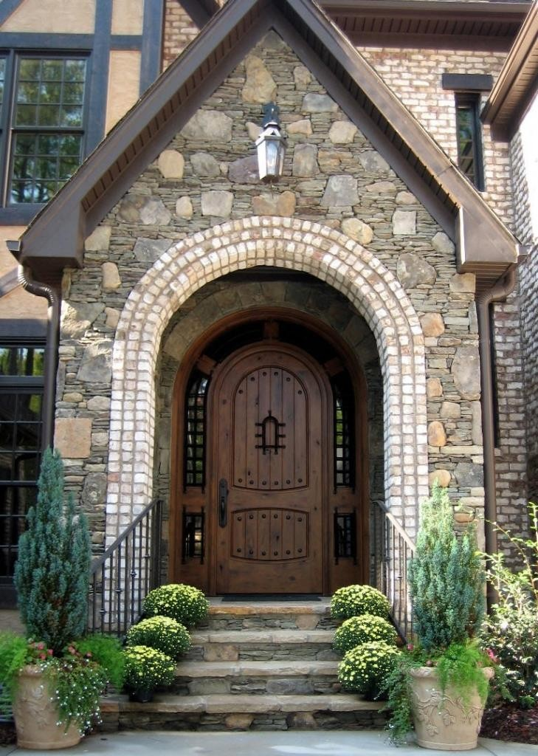
Defining entrance
Defining Opening
Defining edge
Defining Arch

Slide 40
Hierarchy
The articulation of the importance or significance of a form or space by its size, shape, or placement relative to the other forms and spaces of the organization
The value system by which relative importance is measured will of course depend on the specific situation, the needs and desires of the users, and the decisions of the designer.

Slide 41
Hierarchy
Hierarchy by Size
A form or space may dominate an architectural composition by being
significantly different in size from all the other elements in the composition.
In some cases, an element can dominate by being significantly smaller than the other elements in the organization, but placed in a well-defined setting.
Hierarchy by Shape
A form or space can be made visually dominant by clearly differentiating its
shape from that of the other elements in the composition.
A discernible contrast in shape is critical, it can be a change in geometry or regularity. Shape should be compatible with functional use.
Hierarchy by Placement
A form or space may be strategically placed to call attention to itself as being the most important element in a composition.
Hierarchically important locations for a form or space include:
the termination of a linear sequence or axial organization
the centerpiece of a symmetrical organization
the focus of a centralized or radial organization
being offset above, below, or in the foreground of a composition

Slide 42
Hierarchy is created by sequential arrangement of shape, colour, patter and position of the central atrium
San Francisco Museum of Modern Art by Mario Botta

Slide 43
Vidhana Soudha, Bangalore
Hierarchy by Size, Shape and Placement all can been the façade composition of Vidhana Soudha.
In an architectural composition, there can be more than a single dominant element. Secondary points of emphasis that have less attention value than the primary focal point create visual accents.
These distinctive but subordinate elements can both accommodate variety and create visual interest, rhythm, and tension in a composition. If overdone this interest may be replaced by confusion.

Slide 44
The composition illustrates 4 tier hierarchy . There is gradation in size of each tier.
The central dome dominates the composition.
Capital building, Washington DC

Slide 45
Hierarchy by Shape
Legislative Assembly Building, Chandigarh, Capitol Complex of Punjab, India, Le Corbusier

Slide 46
Thank You

