Slide 1
Prehistoric Art
Paleolithic through Neolithic
Manish Kumar

Slide 2
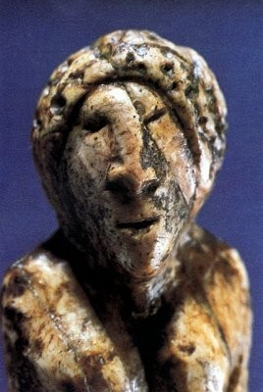
Prehistoric or Stone Age art is the first known period of prehistoric human culture, during which work was done with stone tools. The period began with the earliest human development, about 2 million years ago. It is divided into three periods:
Prehistory- Time period before
writing
Paleolithic – Old Stone Age
Mesolithic – Middle Stone Age
Neolithic – New Stone Age
Head of a Woman (Siberia)
Carved in mammoth ivory, 3 inches long Malta, Central Siberia, middle period The Hermitage, St. Petersburg
©Alexander Marshack

Slide 3
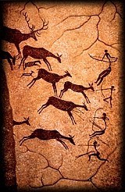
Prehistoric Art - Paleolithic
(2 million years ago-13,000 BC.)
Paleolithic or "Old Stone Age" is a term used to define the oldest period in the human history.
Paleolithic means old stone age
from the Greek paleos=old and lithos=stone. It began about 2 million years ago.

Slide 4
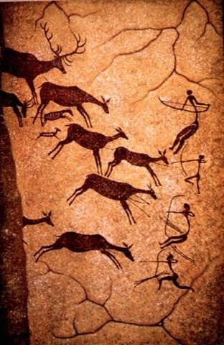
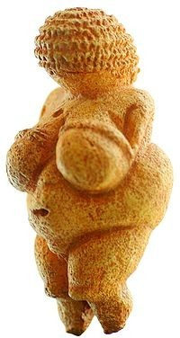
ric Figure
Prehisto
Notice the disproportional dimensions.
What is emphasized in
Venus of Willendorf
Figures are reduced to simple representations.
Movement of figures is poorly represented.
Venus of Willendorf, Found in village in lower Australia, 4 inches, 24,000 B.C.E – 22,000 B.C.E.
Lascaux cave paintings, 14,000 B.C.E.

Slide 5
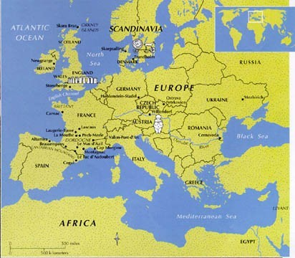
Major Sites of Prehistoric Art
http://www.eyeconart.net/history/ancient/prehistoric.htm

Slide 6
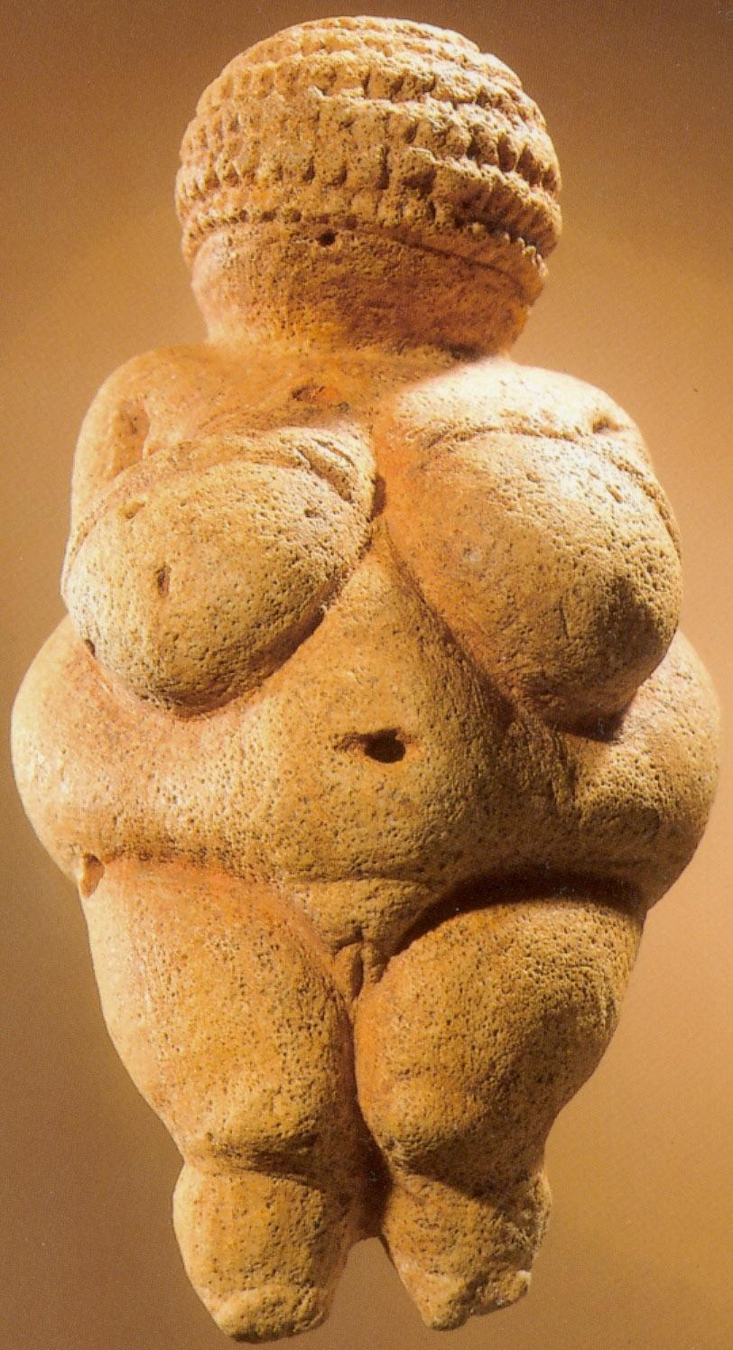
The Venus of Willendorf was carved from oolitic limestone, and was covered with a thick layer of red ochre when found. The figurine was unearthed during the Wachau railway construction in 1908.
Venus of Willendorf
c. 24,000-22,000 BCE
4 3/8 inches (11.1 cm) high
Being both female and nude, she fit perfectly into the patriarchal construction of the history of art. As the earliest known representation, she became the "first woman," acquiring a sort of Ur-Eve identity that focused suitably, from a patriarchal point of view, on the fascinating reality of the female body. Christopher L. C. E. Witcombe

Slide 7
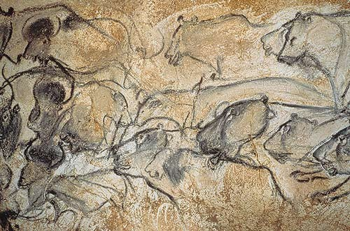
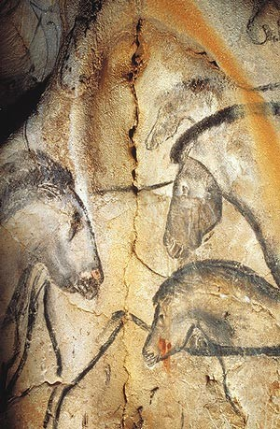
Thirty radiocarbon datings made in the cave have shown that it was frequented at two different periods. Most of the images were drawn during the first period, between 30,000 and 32,000 BP in radiocarbon years. Some people came back between 25,000 to 27,000 and left torch marks and charcoal on the ground. Some human footprints belonging to a child may date back to the second
period.
Chauvet Cave (ca. 30,000 B.C.)

Slide 8
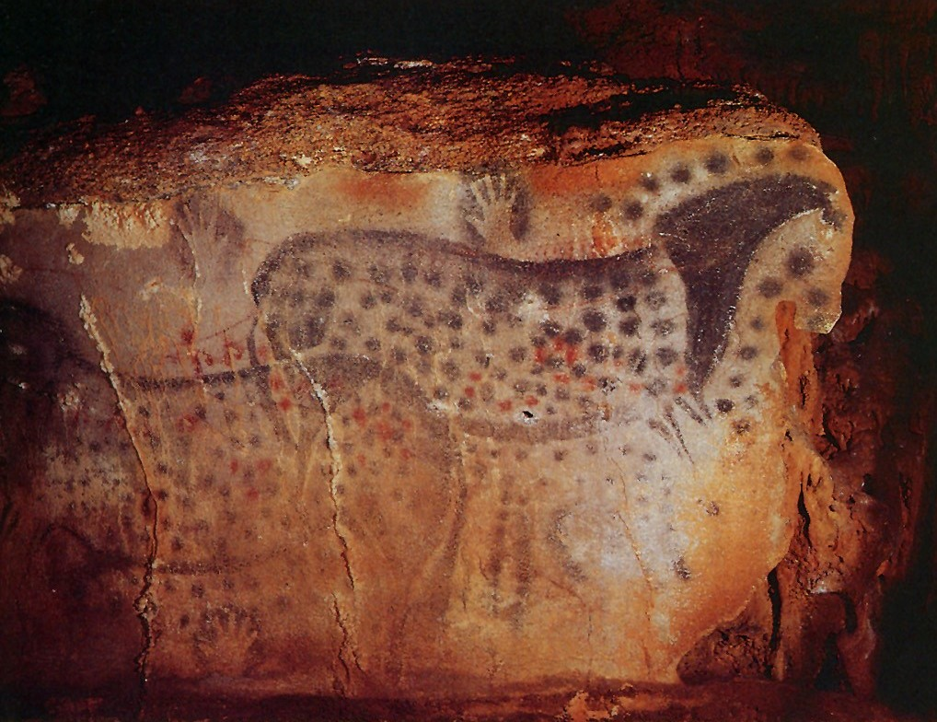
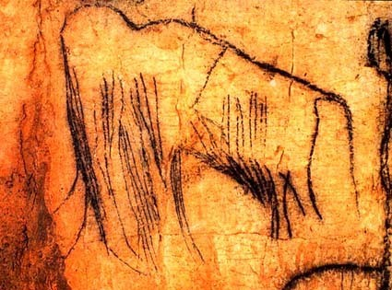
Paleolithic cave paintings were created by applying dry pigment to a wet or damp wall.
Pech-Merle Cave paintings
Lot, France
ca. 22,000 B.C.E.
pigment on stone
Kind of the opposite of what we do today.

Slide 9
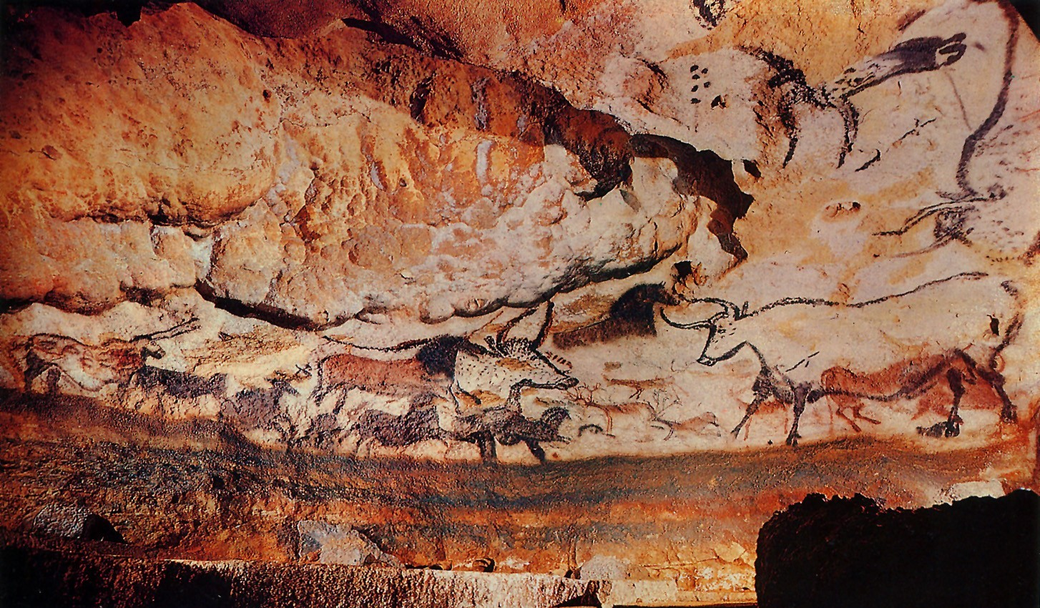

Slide 10
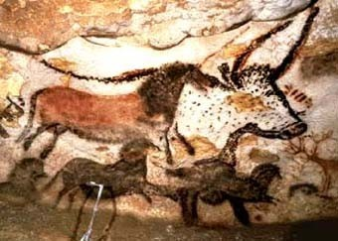
France, c.15,500 BCE
http://www.culture.gouv.fr/culture/arcnat/lascaux/en/

Slide 11
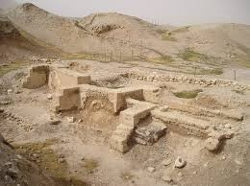
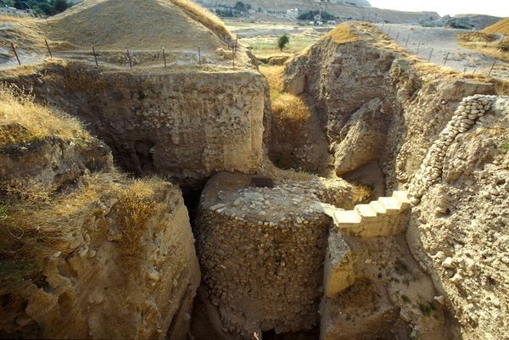
The shift from the Paleolithic time period to the Neolithic time period can be marked by the starting of several things. Mainly
The establishment of civilizations And
The development of farming and storing food.
The earliest known stone fortification, and civilization can be found in Jericho beginning around 10,000 BCE

Slide 12
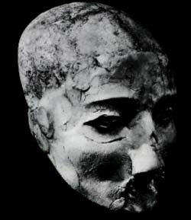
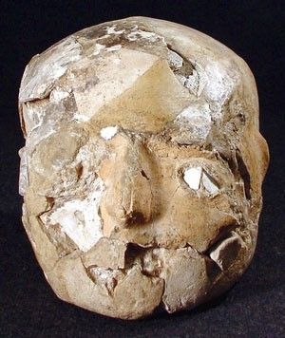
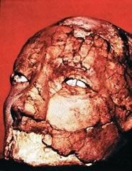
Neolithic Plaster Skulls from Jericho, Israel/Gaza ca. 7,000-6,000 B.C.E.
skulls, plaster, shells
Created by applying plaster to an actual human skull to represent the likeness of the deceased.
Why might a culture create these?

Slide 13
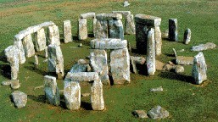
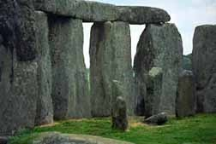
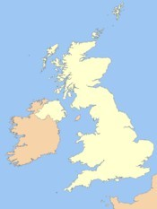
Stonehenge – England - 3200 BCE
Modern theories speculate that the stones were dragged by roller and sledge from the inland mountains to the headwaters of Milford Haven. There they were loaded onto rafts, barges or boats and sailed along the south coast of Wales, then up the Rivers Avon and Frome to a point near present-day Frome in Somerset. From this point, so the theory goes, the stones were hauled overland, again, to a place near Warminster in Wiltshire, approximately 6 miles away. From there, it's back into the pool for a slow float down the River Wylye to Salisbury, then up the Salisbury Avon to West Amesbury, leaving only a short 2 mile drag from West Amesbury to the Stonehenge site.

Slide 14
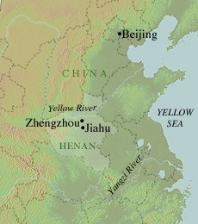
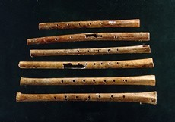
Jiahu (ca. 7000–5700 B.C.)
The Jiahu archaeological site in eastern China.
Institute of Cultural Relics and Archaeology of Henan Province, Zhengzhou, China
Six complete bone flutes excavated from Jiahu.
Fragments of thirty flutes were discovered in the burials at Jiahu and six of these represent the earliest examples of playable musical instruments ever found. The flutes were carved from the wing bone of the red-crowned crane, with five to eight holes capable of producing varied sounds in a nearly accurate octave.

Slide 15
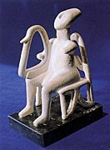
Neolithic (c. 5,000 - 1,500 BC).
Cycladic Harpist Player Aegean Art, c. 2800-2300 BC.

Slide 16
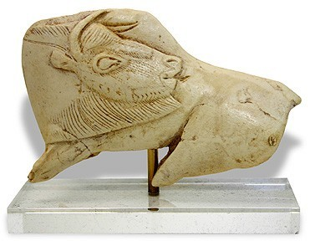
"Neolithic" refers to the "new stone age," generally reflecting the use of stone tools with some use of metals and with people settling into permanent communities, the development of agriculture, and animal husbandry.
http://www.accd.edu/sac/vat/arthistory/arts1303/Neolith1.htm

Slide 17
What are the key characteristics of Neolithic art?
It was still, almost without exception, created for some
functional purpose.
There were more images of humans than animals, and the humans looked more, well, human.
It began to be used for ornamentation.
In the cases of architecture and megalithic constructions, art was now created in fixed locations. This was significant. Where temples, sanctuaries and stone rings were built, gods and goddesses were provided with known destinations. Additionally, the emergence of tombs provided unmoving, "visit-able" resting places for the dearly departed - another first.

Slide 18
Painting, in Western Europe and the Near East, left the caves and cliffs for good, and became a purely decorative element.
The finds of Çatal Hüyük, an ancient village in modern Turkey, show lovely wall paintings (including the world's earliest known landscape), dating from c. 6150 BC.

Slide 19
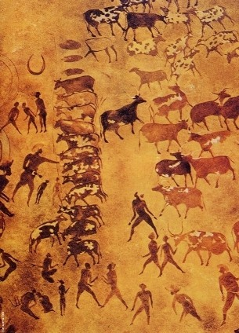
Saharan Neolithic paintings seem to come to life in usual scenes of Eritrean pastoral life

Slide 20
Statuary (primarily statuettes), made a big comeback after having been largely absent during the Mesolithic age. Its Neolithic theme dwelt primarily on the female/fertility, or "Mother Goddess" imagery (quite in keeping with agriculture, this). There were still animal statuettes, however these weren't lavished with the detail the goddesses enjoyed. They are often found broken into bits - perhaps indicating that they were used symbolically in hunting rituals.
Additionally, sculpture was no longer created strictly by carving something. In the Near East, in particular, figurines were now fashioned out of clay and baked.
Archaeological digs at Jericho turned up a marvelous human skull (c. 7,000 BC) overlaid with delicate, sculpted plaster features.

Slide 21
The "new" arts to emerge from this era were weaving, architecture, the construction of megaliths and increasingly stylized pictographs that were well on their way to becoming writing.
The earlier arts of statuary, painting and pottery stuck with (and still remain with) us. The Neolithic era saw many refinements to each.

Slide 22
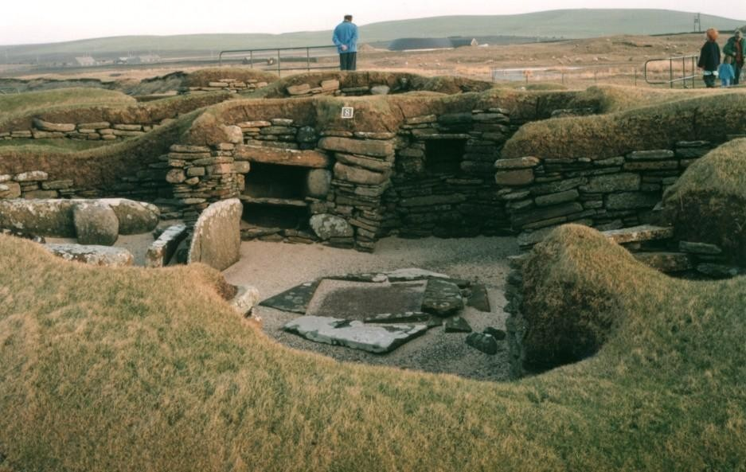
The neolithic village of Skara Brae lies on the shore of the Bay of Skaill on the west coast of Orkney's Mainland.
Stunningly preserved structures containing stone furniture (dressers, beds, cupboards) dating back to 3200BC can be seen here.

Slide 23
