Slide 1
Subject: Principles Of Human Settlements-I
Topic: Planning Works
Presented by: Fazlur Rahman

Slide 2
RADBURN – a town for motor age
programme
Tot Lot
Radburn PreSchool
sports
gymnastics
aerobics
amateur dramatics
library
clubroom facilities
senior citizen club.
-was the first and only attempt at an American Garden City.
CHARACTERISTICS
interior parks in the neighborhood
cul-de-sacs
organized superblocks
separated automotive and pedestrian traffic to make walking safe

Slide 3
PHILOSOPHY- HENRY WRIGHT'S "SIX PLANKS FOR A HOUSING PLATFORM".
1. Plan simply, but comprehensively. Don't stop at the individual property line. Arrange buildings and grounds so as to give sunlight, air and a tolerable outlook to even the smallest and cheapest house.
2. Provide ample sites in the right places for community use: i.e., playgrounds, school gardens, schools, theatres, churches, public buildings and stores.
6. Arrange for the occupancy of houses on a fair basis of cost and service, including the cost of what needs to be done in organizing, building and maintaining the community.
3. Put factories and other industrial buildings where they can be used without wasteful transportation of goods or people.
4. Cars must be parked and stored, deliveries made, waste collected - plan for such services with a minimum of danger, noise and confusion.
5. Bring private and public land into relationship and plan buildings and groups of buildings with relation to each other. Develop collectively such services as will add to the comfort of the individual, at lower cost than is possible under individual operation.

Slide 4
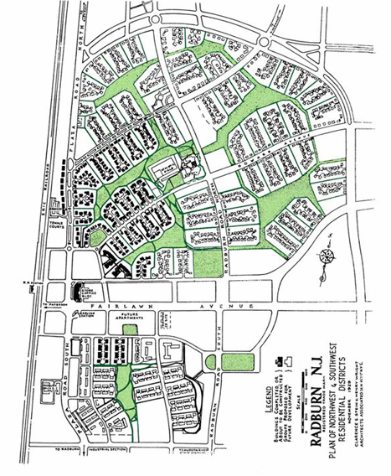
Shopping centre
Super blocks
Tennis court
Green spaces
Radburn school

Slide 5
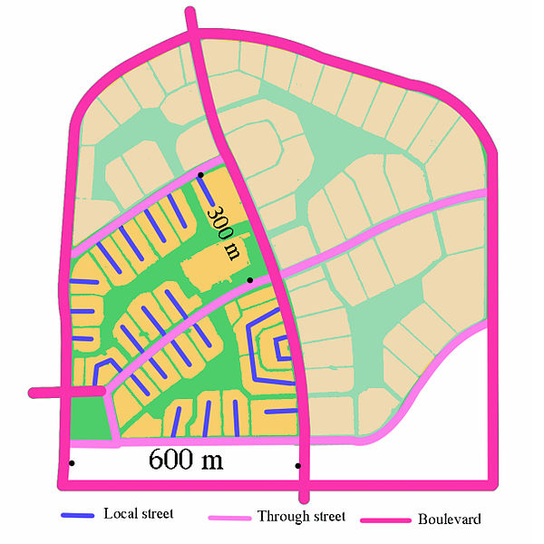
boulevard
Local street
Through street
-Separate pedestrian paths run through the green spaces between the culs-de-sac and through the central green spine
-The impact of Radburn's urban form on energy consumption for short local trips - 47% of its residents shopped for groceries on foot

Slide 6
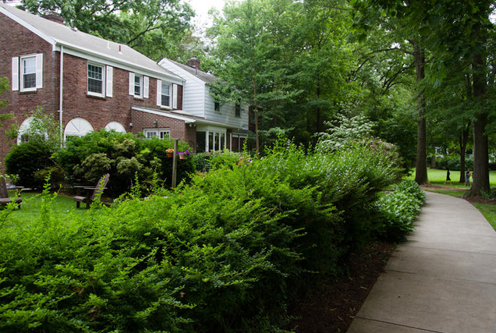
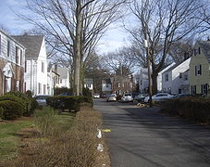
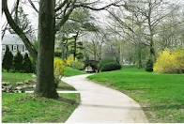
Superblock
.
organized houses faced inward towards other houses and green space
away from automotive traffic
.
most houses of equal and modest means.
orientation is such that their front doors were facing a park or a "walk street" leading to the park
with a secondary entrance on the street side of the home
No major run through- they exist at boundaries.
pathways provided uninterrupted pedestrian access to continous parks.
A view of the building
A Radburn cul-de-sac
green areas

Slide 7
DEFECTS
land allocated to most homes was relatively limited -the emphasis on common areas and an extensive interior park system.
Small home plots - resulted in the construction of relatively small homes by 21st century U.S. standards, homes that couldn't be expanded.
The typical closeness of the houses - less privacy compared to other types of homes built during the same period.
congestion arose on the cul-de-sacs .

Slide 8
.
Mumford’s fullest hopes were not realized for Radburn.
He hoped to introduce civic and cultural institutions on par with major urban centers
the RPAA could not realistically build Radburn in a way that would attract low-income families – could not afford the cost - building was simply too expensive.
The original development plan was to have covered a far larger geographical area - limited actual development of the Radburn idea – due to economic reasons.
Areas that were built

Slide 9
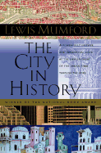
THE CITY IN HISTORY
urges for a world not in which technology reigns, but rather where it achieves a balance with nature.
TECHNOLOGY NATURE
VISION - "organic city," where culture is not usurped by technological innovation but rather thrives with it.
the book is not an attack on the city, but rather an evaluation of its growth, how it came to be, and where it is heading
urged that technology achieves a balance with nature and hoped for a rediscovery of urban principles that emphasised humanity’s organic relationship to its environment.
Yet some of the key ideas promoted by Mumford have increasing resonance with the sustainability and green agenda of the early 21st century.

Slide 10
+veS -organic analysis is synonymous with present day sustainability - technology should be under human control - strong respect for the subjective, vital forces of humanity. - his concept of regional city if applied, can reduce energy consumption and provide less congested living spaces. -ves - he opposed technology blindly - said benign social structures will arise organically as a unique function of urbanisation , has shown itself to be wrong. Instead cities have proven to be concentration of human ill effects like crime , drugs, polllution etc Lewis Mumford was not necessarily a practical man and rarely took a pragmatic approach to problem solving. His suggestions were rarely, if ever, applied entirely.
CRITIQUE

Slide 11
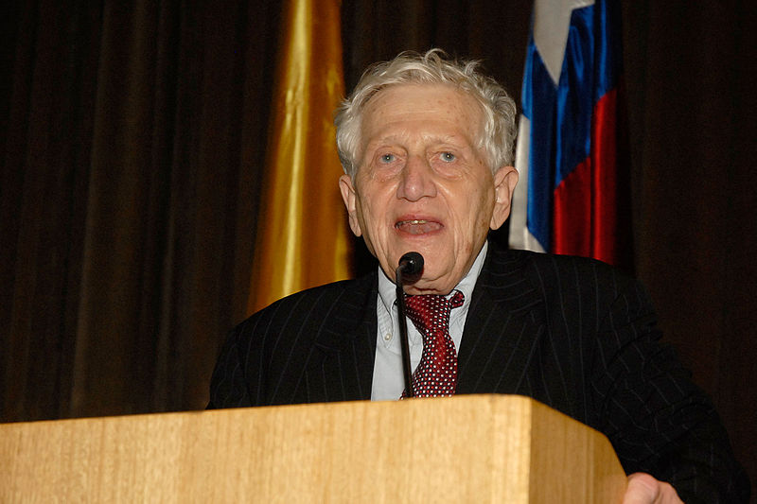
born 19 March 1932 PETER HALL

Slide 12
PLANNING THEORY
SIR PETER HALL
TOWN PLANNER,
URBANIST AND
GEOGRAPHER
PLANNING
MANAGEMENT
DEMOGRAPHIC
CULTURAL
ECONOMIC
CITY
STUDY THE CITIES FROM MULTIPLE ANGLES

Slide 13
URBAN ENTERPRISE ZONES (UEZS)
INTRODUCED BY SIR PETER HALL(HALL 1991), AS A WAY TO REVIVE BRITAIN'S DECLINING INDUSTRIAL CITIES
ENTREPRENEURS AND INVESTORS
LAUNCH BUSINESSES IN POOR NEIGHBORHOODS
LOCATE FREE OF CERTAIN LOCAL, STATE, AND FEDERAL TAXES AND RESTRICTIONS
ECONOMICALLY DEPRESSED URBAN COMMUNITIES
Stimulating economic growth + JOB OPPORTUNITIES
DEVELOPMENT

Slide 14
Sociable Cities (1998), an analysis of the legacy of Ebenezer Howard, whose Garden Cities of To-Morrow (1902), became the most influential and important book in the history of 20th-century city planning.
That same year, Professor Hall published his wide-ranging Cities in Civilization: Culture, Technology and Urban Order, an 1169-page venture into the comparative cultural history of cities, which investigates the exceptional cultural creativity which distinguished the world’s great cities in their golden ages, from ancient Athens to late 20th-century London.

Slide 15
BIBLIOGRAPHY
UNESCO » Culture » World Heritage Centre » The List » World Heritage List
http://www.tel-aviv.gov.il/English
http://www.tel aviv.gov.il/English/Environment.htm
http://www.telavivfoundation.org/
http://en.wikipedia.org/wiki/File:LocationIsrael.svg
http://leadel.net/talks/israel/tel-aviv-history-urban-planning-1920s
http://en.wikipedia.org/wiki/Tel_Aviv
Tel Aviv-Yafo Centennial Year website;
the Ahuzat Bayit collection, which focuses on the founding families of Tel Aviv, and includes photographs and biographies;
and Stanford University's Eliasaf Robinson Tel Aviv Collection
Israel community forum
http://esra-magazine.com/blog/post/israel-sir-patrick-geddes-plan-for-tel-aviv
http://lib.stanford.edu/telaviv
http://en.wikipedia.org/wiki/File:Locationpeterhall.svg

Slide 16
BIBLIOGRAPHY
http://www.nd.edu/~ehalton/mumfordbio.html
http://en.wikipedia.org/wiki/Regional_Planning_Association_of_America
http://mumford.albany.edu/mumford/chronology_lm.htm
en.wikipedia.org/wiki/Radburn,_New_Jersey
www.albany.edu/mumford/About_us/who_is_lm.htmL
web.mit.edu/sts/pubs/pdfs/MIT_STS_WorkingPaper_2_Marx.pdf
www.nd.edu/~ehalton/mumfordbio.html
Invisible Cities: Lewis Mumford, Thomas Adams,
and the Invention of the Regional City, 1925-1929 by Andrew A. Meyers, Department of History ,Columbia University
Lewis mumford- prophet of organicism by lee marx
The City in History - LEWIS MUMFORD

