Slide 1
Subject: Principles Of Human Settlements-I
Topic: Patrick Geddes
Presented by: Fazlur Rahman

Slide 2
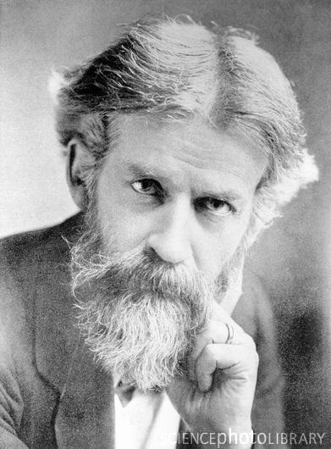
(1854-1932) Patrick Geddes

Slide 3
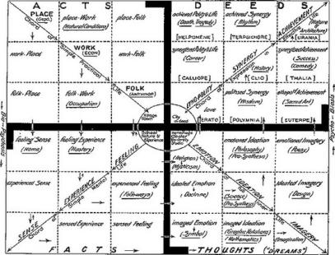
WHO INFLUENCED HIS THOUGHT PROCESS AND HOW
French sociologist Fredric Le Play
SOCIAL LIFE
PATRICK GEDDES
SIR ARCHITECT FRANK MEARS
JOHN RUSKIN
ADAM SMITH
LORD PENTLAND
DARWIN
PLACE
WORK
FOLK
GEOGRAPHY
ECONOMICS
ANTHROPOLOGY
Governor of Madras
CULTURE
ARCHITECT
INFLUENCE OF PLACE SHAPING MAN
MAN GUIDING HIS OWN ACTIONS TO REMAKE PLACE.
EVOLUTION
competition and
the struggle for
existence
SOCIAL PROCESSES
AND SPATIAL FORM
synergy
and co-operation
COMPREHENSIVE VISION BY USING THE LIFE SCIENCES - PARTICULARLY BIOLOGY AND PSYCHOLOGY.
ECONOMICS

Slide 4
WHAT WAS HAPPENING AT THAT TIME
TECHNOLOGICL, INDUSTRIAL, COMMERCIAL ADVANCES OF THE AGE
PEOPLE HAD FORGOTTEN THEIR WELL BEING AND HAPPINESS WAS DEPENDENT ULTIMATELY ON BIOLOGICAL FACTORS.
INDUSTRIALISATION
LATE 19TH AND EARLY 20TH CENTURY
INDUSTRIALISATION
PROGRESS OF WEALTH AND
POPULATION
POSSIBLE TO CHANGE
social processes
spatial form
CHEAP RRESOURCES
CHEAP PRODUCTS
CHEAP LABOR
SWIFT MULTIPLICATION
OF QUANTITY OF LIFE
SWIFT EXHAUTION OF
RESOURCES
RESOURCE EXHAUTION
POVERTY + SLUMS
DULL EXISTANCE
DRAMATICALLY ALTERING THE CONDITIONS OF LIFE.

Slide 5
PLANNING THEORY
Know your city movement
how the problems have been solved before and then educate people to observe the rules of their own culture and develop these methods to deal with the greater problems occasioned by modern urban growth
CITY SHOULD BE STUDIED IN THE CONTEXT OF THE REGION.
INTEGRATION OF CULTURE,
HISTORY AND URBAN FORM
EVOLUTIONARY HISTORY
Indigenous customs
planning objectives
PHYSICAL URBAN FORM
NATURE
Reinterpreted
evaluated
REALISTIC, APPROPRIATE AND SATISFYING ON ECONOMIC AND SOCIAL, AESTHETIC AND SPIRITUAL LEVEL
PARTICIPATORY APPROACH

Slide 6
SITUATION, TOPOGRAPHY AND NATURAL ADVANTAGE
MEANS OF COMMUNICATION
INDUSTRIES , MANUFACTURING AND COMMERCE
SUGGESTIONS AND DESIGNS
POPULATION
TOWN CONDITIONS
Movement, occupation, health, density,well-being,education,anticipate req.
climate, vegetation, geology, soil, water, access to nature
Natural and historic, present state, anticipated development
Native industries, manufacturers, anticipated dev.
Historic, present, local govt

Slide 7
CONSERVATIVE SURGERY
TO DEAL WITH THE SHORT-TERM PROBLEM HE USED THE CONCEPT CALL CONSERVATIVE SURGERY
If the city and its population are an organic whole, then the wholesale demolition and restructuring of areas is similar to amputation of a limb on a living body. May be in extreme cases, it saves the life of the body, but only as a last resort
REGIONAL SURVEY
DEVELOP NEW WAYS OF OBSERVING AND ANALYZING CITIES.
CITY
ORIGIN
HISTORY
CLIMATE
GEOGRAPHY
TRADITIONS
ECONOMIC STRUCTURE
SOCIAL STRUCTURE
insights into urbanization
potential of the city and its region for future development.
storehouse of information
long-term practical strategy for social development

Slide 8
‘Town-planning is not mere place-planning, nor even work-planning. If it is to be successful it must be folk-planning
CONTRAST
CONURBATION
MODERN MEANS
OF
COMMUNICATION
A conurbation is a region comprising a number of cities, large towns, and other urban areas that, through population growth and physical expansion, have merged to form one continuous urban and industrially developed area.
COMMON
INTEREST
- WORK

Slide 9
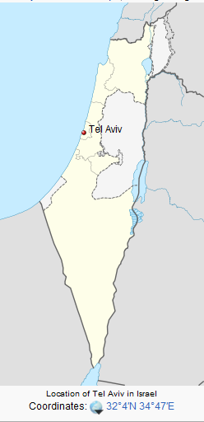
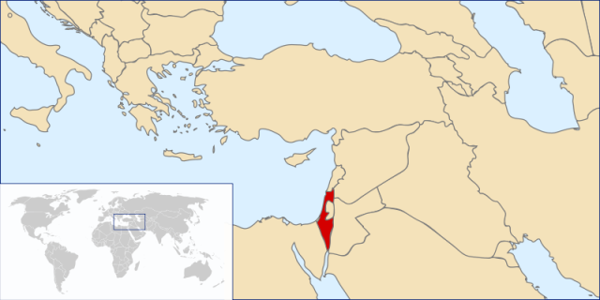
TEL-AVIV
The city of Tel Aviv was founded in 1909 to the immediate north of the walled port city of Jaffa, on the hills along the eastern coast of the Mediterranean Sea.
During the era of British rule in Palestine (1917-1948) it developed into a thriving urban centre, becoming Israel's foremost economic and metropolitan nucleus.

Slide 10
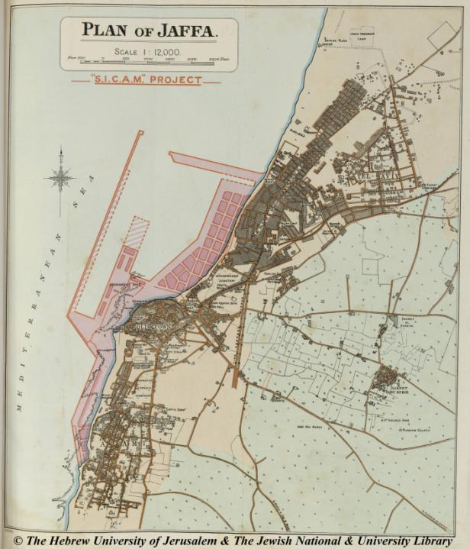
AREA
12acres - 140 ha/51.4 SQKM
POPULATION
plan a city for 100,000
1925 - 25,000.
(immigration – riots)
2010 - 404,400
CONCEPT
GARDEN CITY
ZIONIST MOVEMENT
http://historic-cities.huji.ac.il/israel/jaffa/maps/palmer
_1923_jaffa_d_b.jpg
http://historic-cities.huji.ac.il/israel/jaffa/maps/palmer
_1923_jaffa_d_b.jpg

Slide 11
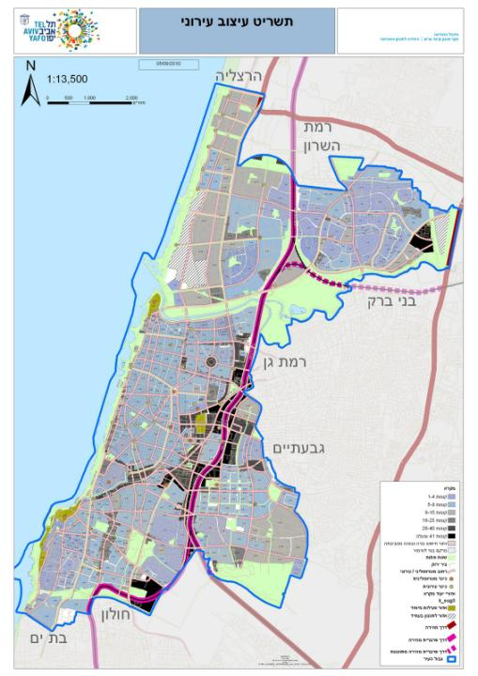
Boundary of Israel - dotted blue line. Existing road - brown line. Proposed road - red line. Railway - broken black line. Agriculture area - light green. Citrus groves - green checkers. Bathing and recreations area - yellow. Afforestation of sand dunes - dark green with yellow triangles. Afforestation in hills - dark green with brown triangles. Open spaces and park areas - green. Green belt round urban area - horizontal green lines. Antiquities areas - blue x.
East-West
boulevards
Wind
direction
NORTH –SOUTH
Large main boulevards

Slide 12
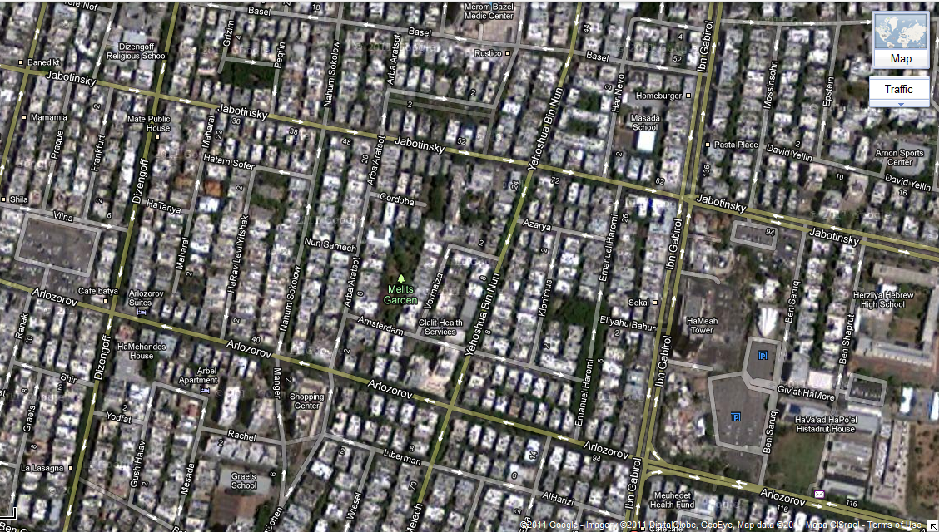
Each block or cluster was of a different design in shape and atmosphere and in planting, so that there was instant recognition of place and home
MORE THAN A SPATIAL SYSTEM – MORE OF A CULTURAL SYSTEM
public buildings or facilities – centre of the blocks
Also approximately at right angles to these main boulevards were small roads leading to “Blocks” as he called them..
plan adapted to the geography and topography of the place and stressing the variety inherent in humans, in locality and in climate.
In the “Blocks”, buildings were erected 4 meters from access roads and only 1.5 meters from the public gardens. This made for relatively high building density. And in the access roads to the blocks there were small commercial neighborhood units.

Slide 13
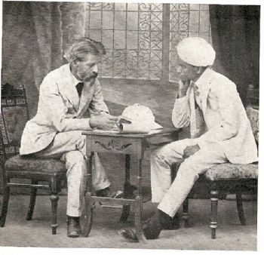
GEDDES IN INDIA
Geddes' connections with India are well known.
He visited four times between 1914 and 1924, staying for two and a half years between 1916 and 1919
NOT PROFESSIONAL
INDIA CUT-OFF FROM EUROPEAN HOLOCAST
hardly representative or even the modern town planning movement in the west.
prepared to operate in the economic and social circumstances
opposed to expensive and unrealistic activities of the British engineers and sanitarians

Slide 14
In India Geddes extended his ideas about regional surveying, cooperation between man and the environment, synthesis of knowledge , historical traditions, involvement of the people in their own betterment and the rediscovery of past traditions of city building.
CITY
ORIGIN
HISTORY
CLIMATE
GEOGRAPHY
TRADITIONS
ECONOMIC STRUCTURE
SOCIAL STRUCTURE

Slide 15
GARDEN INSTINCT – natural and cheap method of waste disposal – ROMAN SPECIAL GOD OF MANURE, tree planting holiday..
TRADITIONAL KNOWLEDGE – water conservation (Lucknow, Chennai)
SURVEY AND RESEARCH into social problems
PRACTICAL REHOUSING SCHEMES

Slide 16
How relevant are his views today?
RETHINKING CITIES
CONTRIBUTIONS - GROUND BREAKING AT THE TIME ARE MORE RELEVANT TODAY
HOLISTIC APPROACH + FUNDAMENTAL IDEA
GREEN POLITICS –
“BY LEAVES DO WE LIVE”
creation of an ecologically sustainable society
rooted in environmentalism, social liberalism
and grassroots democracy
"Think Global, Act Local"
Advocated natural conservation
PEOPLE
connection between the individual and the environment, as described in his last major work, Life Outlines of General Biology, constitutes the core of modern planning.
Grass root efforts
consider the health of the entire planet and to take action in their own communities and cities

