Slide 1
Subject: Infrastructure and Transport Planning
Topic: Norms and Standards
Presented by: Aditi Arora

Slide 2
NORMS AND STANDARDS
Some of the issues emerging from the existing scenario include:
. An appropriate area dispersal factor should be adopted for computing the run off.
The coefficient of run off may be calculated for areas with composite land use pattern on the basis of anticipated land use in the new areas and existing land use pattern for the areas already developed.
Where it is not possible to work out the run off coefficient due to land use policies not indicated, run off coefficient not less than 0.2 may be adopted for rural areas with flat to moderate slopes and 0.4 for steeper slopes. For urban area, run off coefficient not less than 0.6 may be adopted in absence of adequate details of the areas.
Source : National Capital Region Planning Board
( MINISTRY OF URBAN DEVELOPMENT, GOVERNMENT OF INDIA )

Slide 3
INSTITUTIONAL FRAMEWORK
STORM WATER DRAINAGE
IRRIGATION AND FLOOD CONTROL DEPARTMENT
DELHI JAL BOARD
PUBLIC WORKS DEPARTMENT
THREE LOCAL BODIES
It looks after drains with more than 1000 cusec discharge
Municipal corporation of Delhi
New Delhi municipal council
Delhi contentment board – have mandate to look after construction and maintenance of drains n their respective areas
Responsible for construction and maintenance of large drains(natural)
It looks after some drains in some identified areas
Source: CDP- Delhi

Slide 4
PLANNING PROVISIONS IN STORM WATER MANAGEMENT
FUNCTIONAL RELATIONSHIP
RIVER BASIN PLAN
CONSIDER ENTIRE RIVER BASIN
WATER DRAINAGE PLAN
CONSIDERS FUNCTIONAL WATERSHED AREA
SITE IMPLEMENTATION PLAN
CONSIDERS SPECIFIC DEVELOPMENT AREAS
APPROVAL OBTAINED FOR BMPs
MASTER DRAINAGE PLAN
ASSESSMENT OF WATER DEMAND, QUALITY AND SUPPLY
ASSESSMENT OF ENVITONMENTAL CONCERNS
ASSESSMENT OF FUTURE DRAINAGE REQUIREMENTS
ASSESSMENT OF FLOOD PROTECTION LEVELS
ESTABLISHMENT OF ENVIRONMENTAL CONSTRAINTS
ASSESSMENT OF FUTURE DRAINAGE REQUIRWMENTS
ESTABLISH POLICIES AND CRITERIA FOR DRAINAGE
CONSIDERS FUNCTIONAL STORMWATER MANAGEMENT AREA
IDENTIFIES LOCAL ENVIRONMENTAL RESOURCESIDENTIFIES CONTROL LEVELS OF STORM WATER BMPs
IDENTIFIES BMPs AND CONTROL LEVELS FOR STORM WATER BMPs
DETAIL DESIGN OF BMPs
MITIGATE MEASURES FOR ENVIRONMENTAL PROTECTION
CONSTRUCTION OF STORM WATER CONTROL FACILITIES
4
L
E
V
E
L
S
Source : STORMWATER MANAGEMENTGUIDELINES-for the Province of Alberta

Slide 5
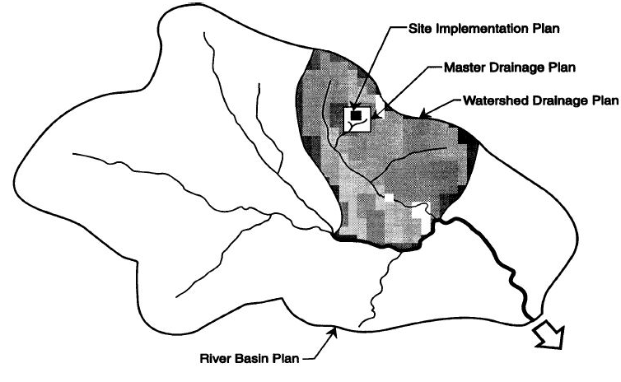
STORM WATER MANAGEMENT PLANNING
Source : STORMWATER MANAGEMENTGUIDELINES-for the Province of Alberta

Slide 6
CASE OF DELHI
The storm water drainage system in city is supported by 350km of natural drains and 1700km of manmade drains. On the basis of topographical characteristics and existing drainage network of city has been divided into five drainage basins namely Najafgarh, Alipur, Shahdara, Khushak nallah and Mehrauli. Three pronged strategy to improve the drainage system of city:
Comprehensive study of drainage systems;
Short Term Improvement Measures
Revival, waste water treatment and landscaping of the main drains
Source: CDP- Delhi

Slide 7
ISSUES
METICULOUS SURVEYS ARE TO BE DONE REGARDING TOPOOGRAPHY OF THE CITY
DRAINS OF MUGHAL PERIOD NEEDS TO BE REVIVED
STRICT INSTRUCTIONS TO THE CONSTRUCTION AGENCIES TO CLEAR ALL DEBRIS AND CONSTRUCTION MATERIAL FROM WITHIN THE DRAINS
PROJECT REPORTS NEED TO BE PREPARED
SIZE OF CITY IS A PROBLEM
IT SHOULD NOT CARRY INDUSTRIAL OR SEWAGE EFFLUENTS
ROADS AND DRAINS NEED TO BE PLANNED, DESIGNED AND CONSTRUCTED TOGETHER
DRAINAGE AUTHORITY OF NCT
Source: CDP- Delhi
Notes:
it is a very complex task to have a detailed overview of the overall drainage situation and translate this into
a workable comprehensive drainage plan.
Detailed information regarding the topography of the whole city, invert
levels of all the natural and man-made drains, invert levels of the
corresponding sewer lines, information about linkage of underground sewer
drains and storm water drains would be required through a meticulous
survey.

Slide 8
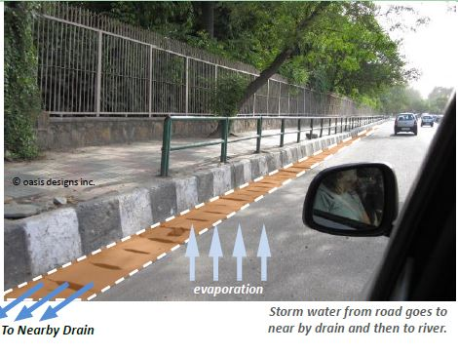
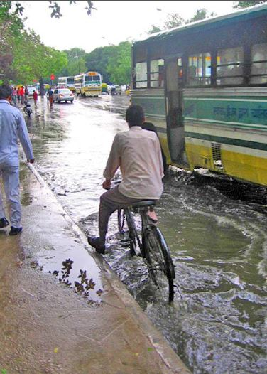
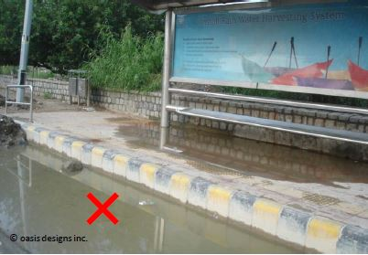
MANAGEMENT ISSUES
LACK OF MAINTAIMANCE LEADING TO CHOCKED DRAINS
LACK OF CO ORDINATION IN PLANNING AND CONSTRUCTION OF ROADS AND DRAINS
RAW AND UNTREATED EFFLUENTS ARE ALLOWED TO FLOW IN STORM WATER DRAINS
Source: CDP- Delhi

