Slide 1
Building Services
Natural Ventilation
Ar. Vivek Painuli

Slide 2
Subject: Building Services – III
Topic: NATURAL VENTILATION SEA WATER AIR CONDITIONING Presented by: Ar. Pankhuri Arya

Slide 3
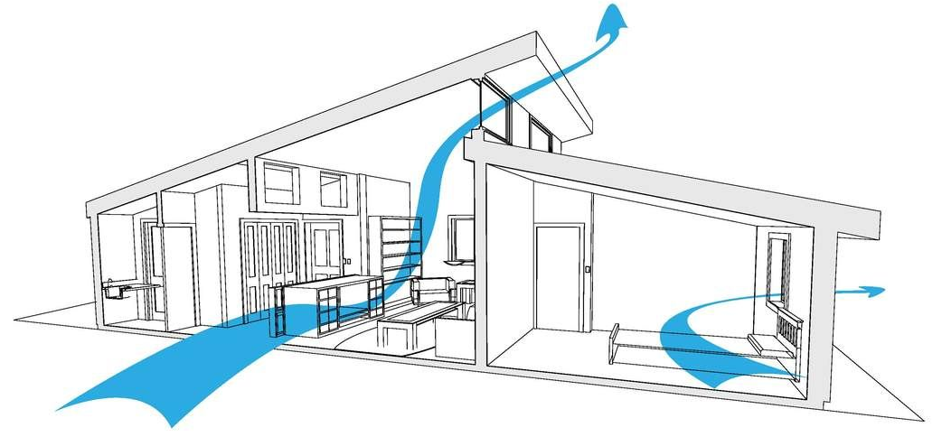
Natural Ventilation
NATURAL VENTILATION IS THE PROCESS OF SUPPLYING AND REMOVING AIR THROUGH A SPACE BY NATURAL MEANS IT CAN BE ACHIEVED WITH OPENABLE WINDOWS OR VENTILATERS.

Slide 4
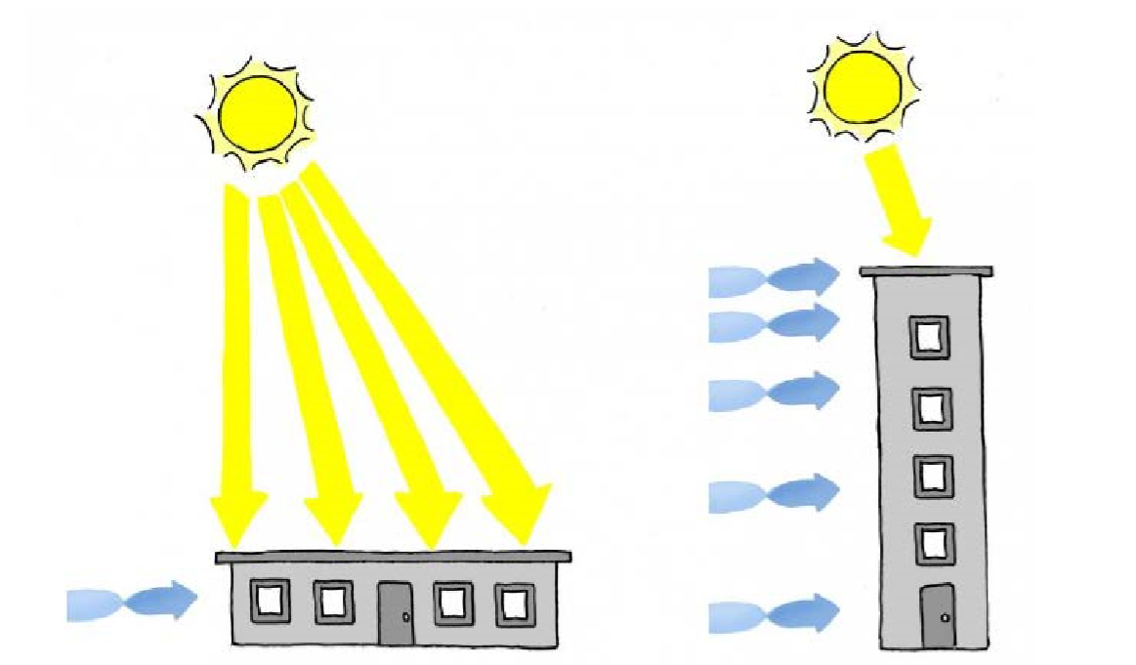
Massing of Building
Tall buildings improve natural ventilation, and lower latitudes reduce sun exposure

Slide 5
Orientation of Building
Orientation of building so that its shorter axis align with prevailing wind will provide the most wind ventilation

Slide 6
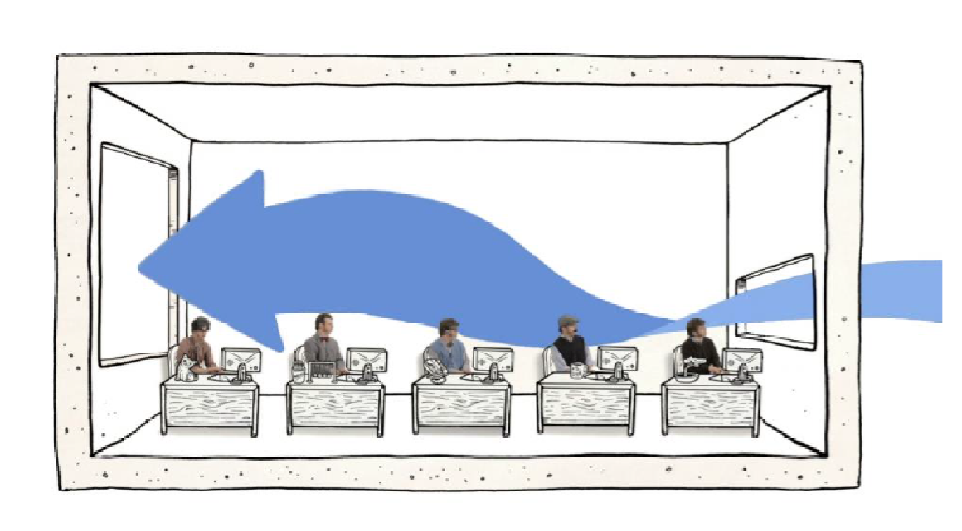
Opening Size
Pairing a large outlet with a small inlet increases incoming wind speed.

Slide 7
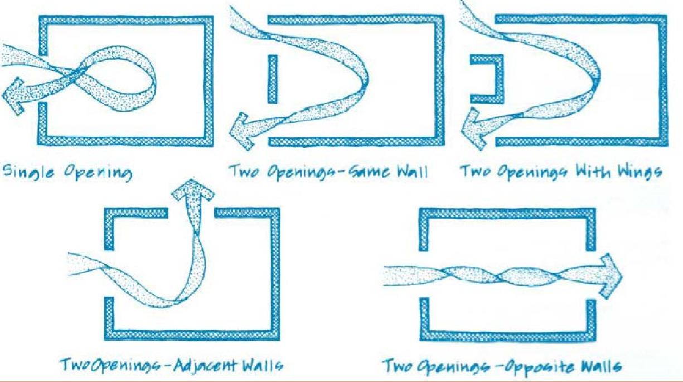
Cross Ventilation
Cross Ventilation is more effective than ventilation that does not pass through the whole space.

Slide 9
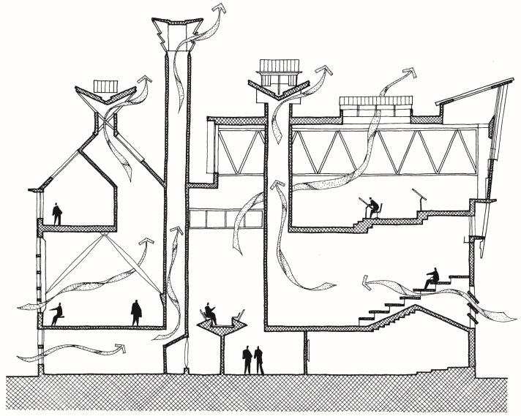
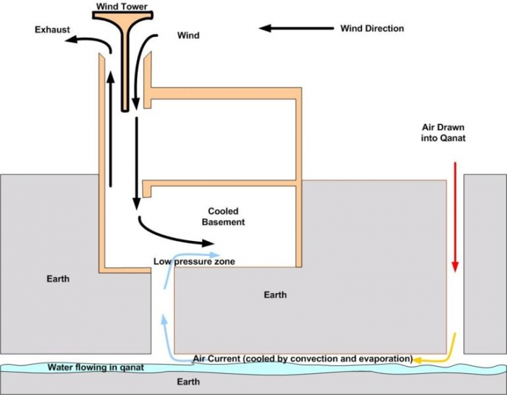
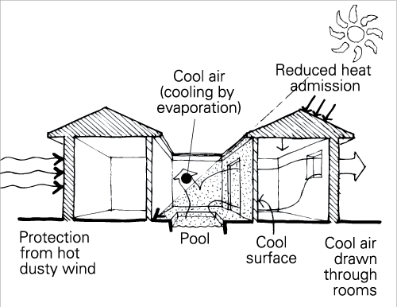
Different Techniques For Natural Ventilation
Stack Effect
Wind Tower
Courtyard Effect

Slide 10
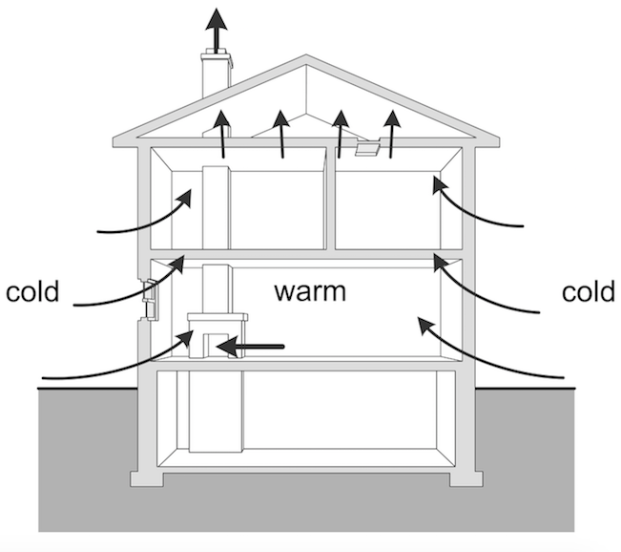
Stack Effect
The warm air rises because it is lighter than cold air. So when it rises, it escapes out of the upper levels of the building through ventilation openings, windows or leakages.
The rising warm air reduces the pressure at the base of the building, forcing cold air to infiltrate through either open doors, windows, or other openings and leakage in lower levels of the building.

Slide 11
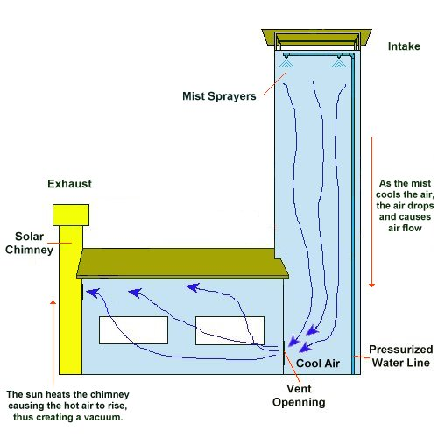
Wind Tower
Air enters in wind tower through openings, cooled down, becomes and heavier and sink down (presence of air movement).
After whole day air exchange the tower become warm in evening.

Slide 12
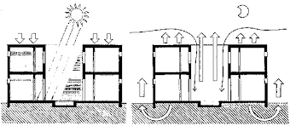
Courtyard Effect
Due tp incidental solar radiation in a courtyard, the air gets warmer and rises.
Cool air from the ground level flows through the louvered opening of rooms surrounding a courtyard, thus producing air flow.

