Slide 1
Mughal Architecture -2
Presented by: Ar. Hiba Gul

Slide 2
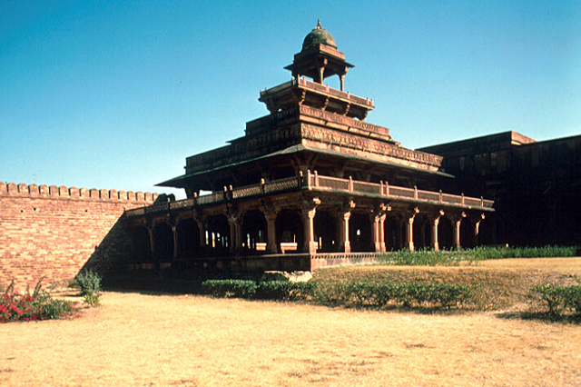
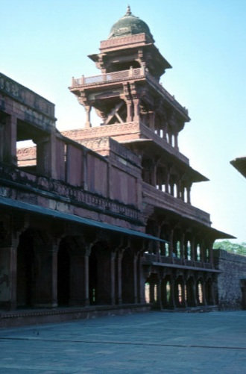
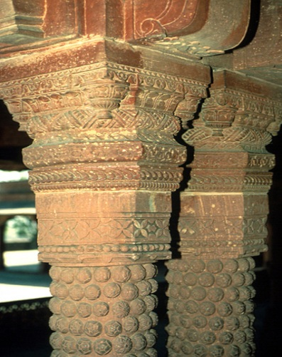
1. Panch Mahal ,Fatehpur Sikri
The Panch Mahal is a rectangular structure open on all sides and built . It is positioned to act as a "transition" building between the semi-public and the more private spaces .
The building has five levels, with the ground floor measuring 22.05 meters north–south by 17.65 meters east–west, and the upper floors decreasing in their horizontal dimensions . The final, fifth level is a domed chhatri. The total height of the structure equals the total length of its ground floor
Interior view of detail of
double-column capital
The Panch Mahal as seen from the courtyard of the Daulat Khana

Slide 3
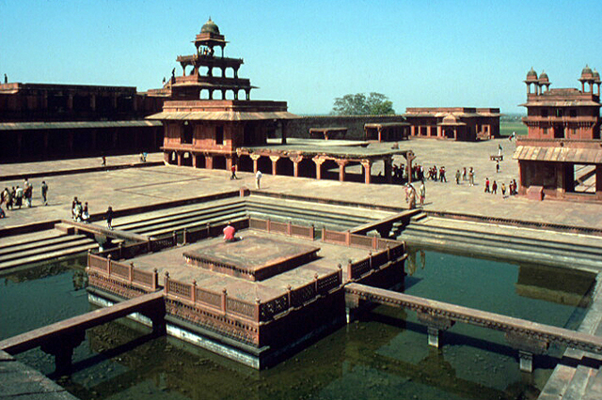
2-Anup Talao
The Anup Talao, or "peerless pool," was completed in 1576 on a wide platform (chabutara) to the north of the Khwabgah (imperial apartments) .
The Anup Talao is a red sandstone masonry tank, square in plan . A square island platform stands in its centre. Stone bridges, 0.61 meters wide and , span 10.06 meters from the center of each side of the platform to the side of the tank. Another name for the Anup Talao, the "Char-Chaman," refers to four bridges.
The tank served to cool the air near the Khwabgah. It formed part of a system of mini-tanks and canals . The tank measures 29.26 meters per side and is 3.66 meters deep. The island platform (9.14 m2) has jaali balustrade, and a raised seat (chabutra, 3.66 m2) in its center
The tank was originally filled via one water channel from the waterworks near the Elephant Gate to the west: the water was carried via a stone duct north of Birbal’s Place, Miriam’s Garden, and the Kothi. A second channel came from the eastern waterworks. Overflow was diverted to the tank found north of the building with a central column , to keep the level of water in the Anup Talao constant.

Slide 4
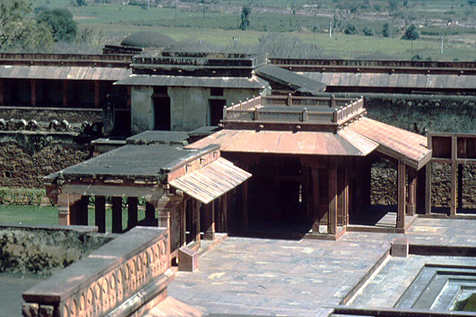
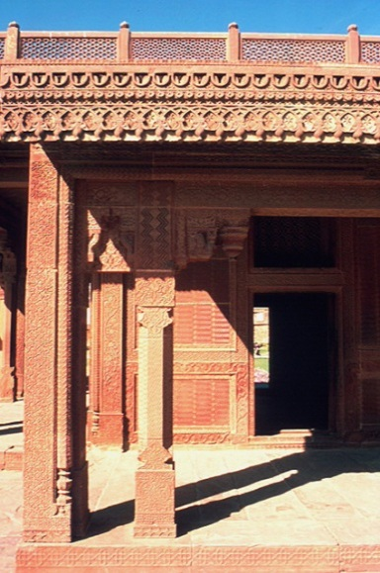
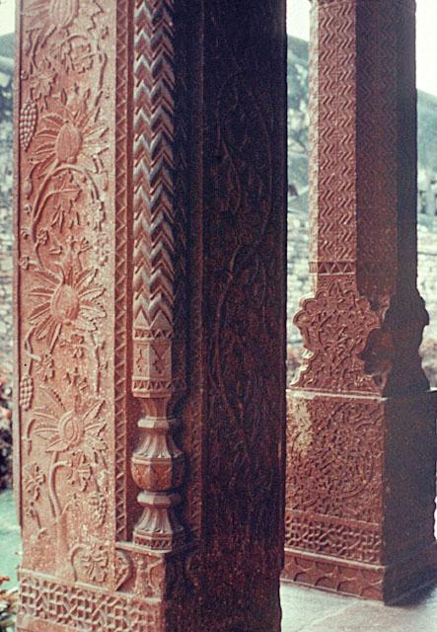
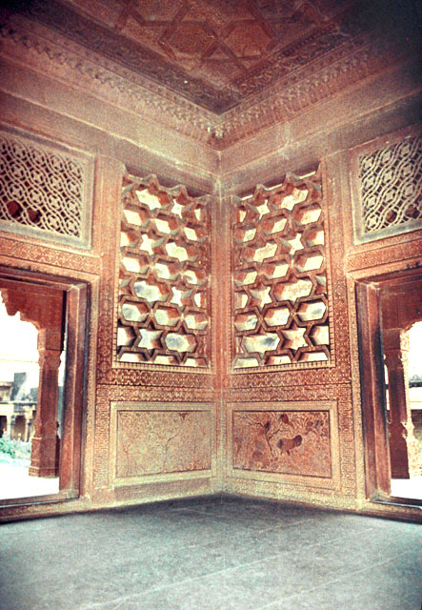
3-Turkish Sultana's House
Detail of ornamentation in carved sandstone on the veranda
Exterior view of close-up of south façade, showing columns and carving on roof edge
Detail of the interior panels, decorated with exotic animals in lush foliage
Northeast of the Anup Talao is ornamented chamber popularly referred to as the "Pavilion
of the Turkish Sultana,"
Square in plan, the pavilion measures 3.96 per side on the interior, and features a khaprel ceiling. Along its west elevation is a rectangular portico, 2.64 by 4.07 meters, with the same floor-ceiling height as the main chamber and octagonal columns.
Carved in floral and geometric patterns, the main chamber is one of the most richly ornamented structures of the entire complex.
The interior dado panel is covered with vegetable and animal motifs with distinctive border. . The pavilion has three windows, each of which are filled with exquisite white marble tracery.

Slide 5
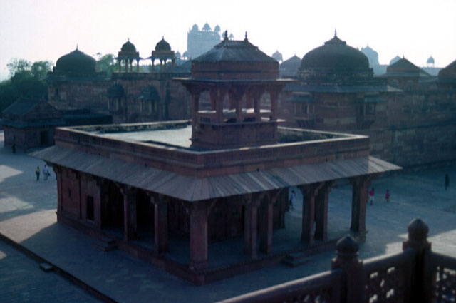
House of Miriam
West of the Anup Talao court and placed in the center of its own courtyard is a red sandstone building known as the Sonahra Makan (Golden House), on account of its rich interior murals. It is also popularly named "Miriam's Kothi" (residence).
Measuring 18.24 by 14.75 meters on the exterior. Divided into 5 bays along the north-south axis, the building has two main parts.
The interior partitioning walls are approximately 1.2 meters thick. The hall is 5.18 meters in height and surrounded on its east, north, and west by a high colonnaded portico that fills the outer 7 bays. From the outside, the entire building appears to be single-storied; however, while the central hall and porticos are single-height, the southern rooms occupy two stories.

Slide 6
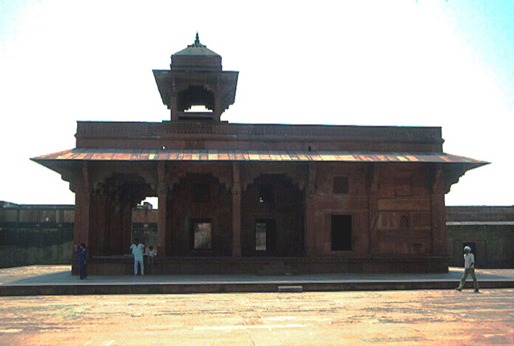
A continuous stone chhajja runs along each elevation, supported on carved brackets. The carvings depict Hindu deities, symbols, and motifs such as rows of elephants, swans.
The building has a flat roof, with a rectangular chhattri . This chhattri is composed of eight columns with bracket capitals, lintels .
Both the interior and exterior walls of the building were entirely painted, mostly in a figurative style, . These paintings depicted elephant fights, hunts, battle scenes, tournaments, and architectural subjects. Within the color scheme, deep blue, red, and gold predominated. Indian flora and fauna, as well as typical clothing, was worked into the design
Exterior view from west showing façade and chatthri

Slide 7
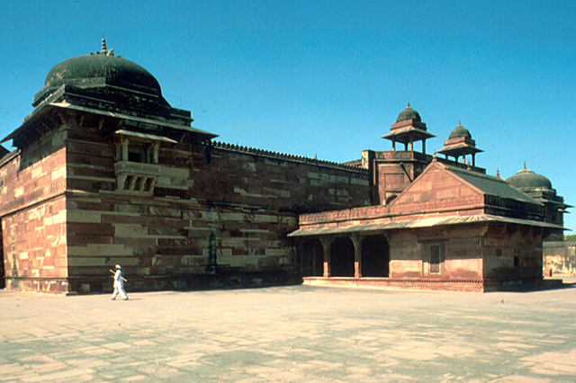
Palace of Jodh Bai
.
it, is the largest and best preserved of the residences of the imperial zenana (harem sara). Its popular name, Jodhbai's Palace,
The haram sara is a double-storied structure composed of rooms arranged around a big open-air courtyard. Rectangular in plan, it measures 211.34 meters east to west and 196.5 meters north to south. .
From the exterior, the palace appears massive; apart from the entry and its guard-towers, the only apertures in the elevations are jharokhas (projecting balconies)
The jharokha balcony is supported on four brackets with a jaali balustrade. Each exterior corner of the palace above the jharokha windows is further protected by a chhajja, which is in turn surmounted by a square base supporting an octagonal drum and a shallow dome.
The exterior enclosing walls - constructed of red and yellow sandstone blocks - are plain but for a continuous intermediary frieze with decorative carvings, which indicates the ceiling level of the rooms on the ground floor within, and decorative merlons along the parapet.

Slide 8
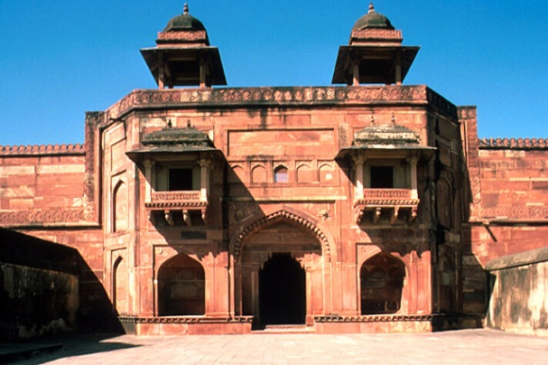
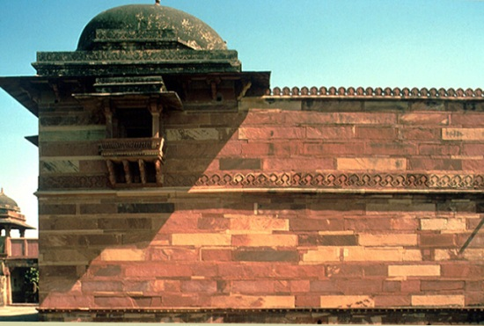
The palace is can only be accessed via a single monumental gateway in the center of its eastern wall
The entrance opening is in the center of the gateway, 3.31 meters high and 2.28 meters wide and flanked by engaged columns that support stone brackets and a massive lintel
Exterior view of east entrance of guard-house, showing bay windows and chatthris
At ground level, the entrance is flanked on either side by a large niche. Above the iwans and to either side of the band of five arches are two jharokha windows supported on brackets
The gateway is protected by a small detached stone guardhouse roofed .
Passing through the gateway, one follows a "Z"-shaped path without a direct view into the inner courtyard
Exterior view of west façade showing dome and bay window supported by corbels

Slide 9
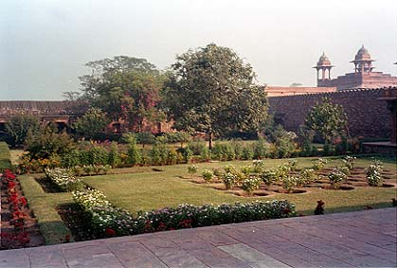
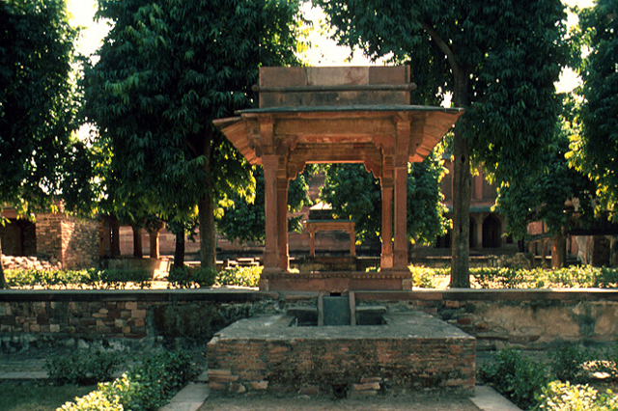
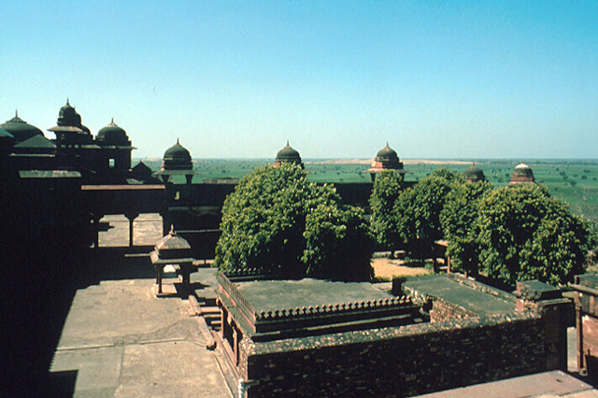
Garden
Exterior view toward south, looking at pavilion in foreground
Exterior aerial view toward west
northwest corner of the courtyard of the Sonahra Makran,a garden known as "Miriam’s Garden," or the zenana garden.
It was completely enclosed via rubble walls faced in cement.
The garden is based on a traditional chahar bagh garden, laid out on two terraces, of which the upper measures 27 by 28.4 meters, and the lower approximately 19 by 37 meters. Each level is divided by orthogonal walls into two quarters; flowers, plants, and shrubs lined their sides. The garden was originally paved in stone.
. The square tank measures 7.31 meters/side and is 1.22 meters deep. It was used as a swimming and bathing pool for the ladies of the court.

Slide 10
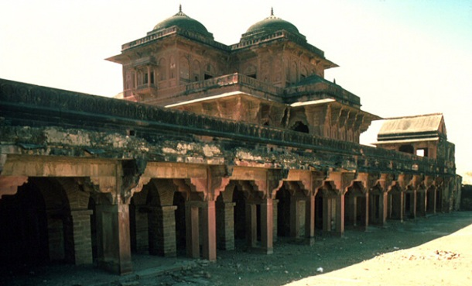
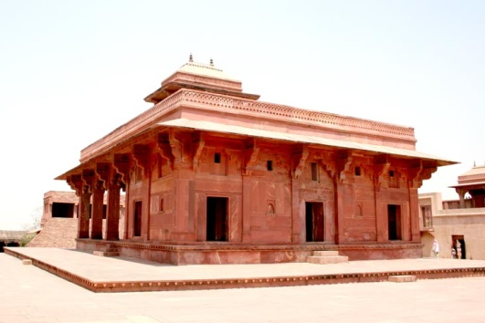
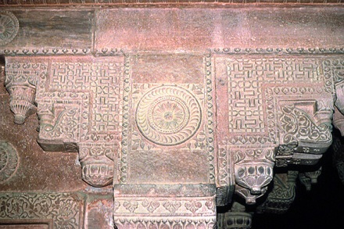
Birbal's House
This building is also known as "Birbal's Palace," and may have once formed part of the haram sara, with its own covered and screened passage connecting .
The house is a two-storied building, with carving, both inside and out. From the construction, it would appear that Hindus were the architects; but the decoration, it is nearly all Arabian or Persian in style,.
Exterior view toward southwest looking at double-column arcade
Interior detail of stone carving

Slide 11
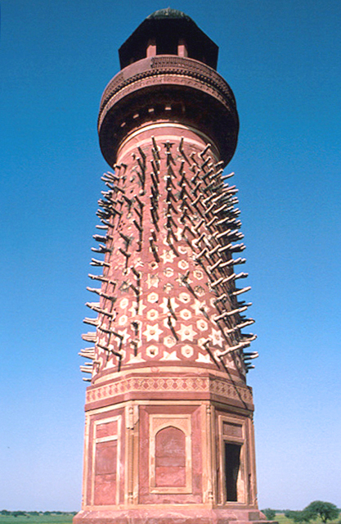
Hiran Minar
The Hiran Minar ("deer tower") is located north and west of the Hathi Pol, outside of the palace complex, just north of the imperial caravanserai.
Measuring twenty-one meters in height, the tower's plan is octagonal at its base, circular after the height of 3.91 meters, and topped with a chhatri.
The circular part of the tower is decorated with stone spikes, and a circular balcony projects on stone corbels from the upper part of the tower.
Exterior close-up view of tower showing surface decorations and projecting elements

Slide 12
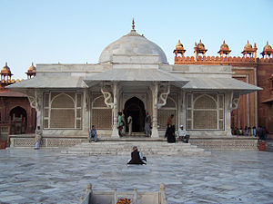
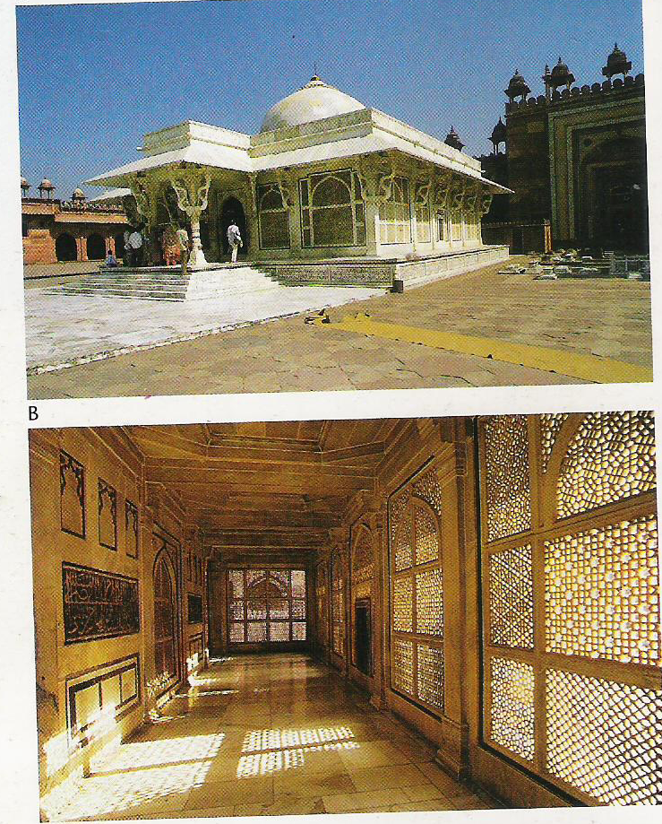
The Tomb of Sheikh Salim Chishti is famed as one of the finest examples of Mughal architecture in India, built during the years 1580 and 1581, along with the imperial complex at Situated near Zenana Rauza and facing south towards Buland Darwaza,
Jama Masjid measures 350 ft. by 440 ft.
-It enshrines the burial place of the Sufi saint, SalimChisti
-The tomb has been constructed on a platform which is about 1 m. high, a flight of five steps leading to the entrance portico.
The main tomb building is enclosed by delicate marble screens on all sides, and the tomb is located in the centre of the main hall, which has a single semi-circular dome. +---The marble building is beautifully carved, and has an ivory-like appearance.
The plinth is ornamented with mosaics of black and yellow marble arranged in geometric patterns.
A wooden canopy incrusted with mother-of-pearl inlay mosaic over it.
-The door to the main chamber is intricately carved with arabesque patterns and bears inscriptions from the Koran. - The carved and painted tomb chamber has a white marble floor, which is inlaid with multicoloured stones.
i

Slide 13
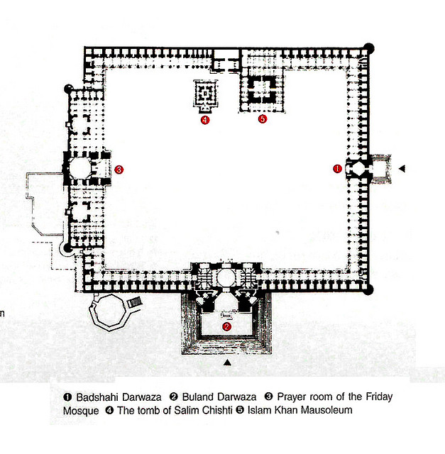
Jami Masjid

Slide 14
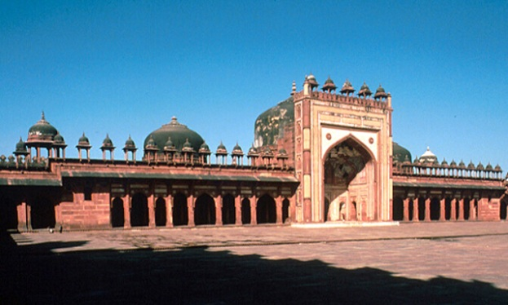
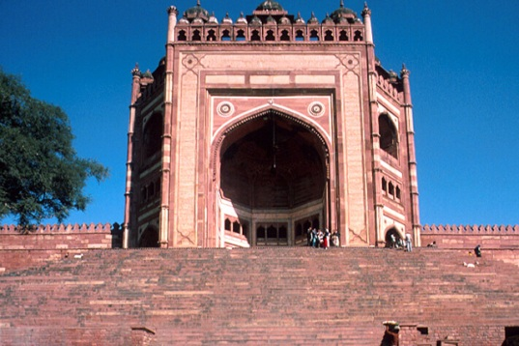
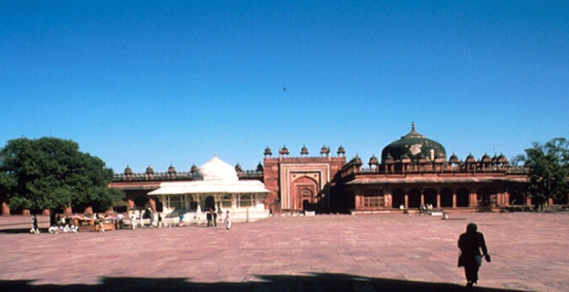
Interior view toward north of courtyard showing white marble tomb of Shaykh Salim Chishti
Exerior view toward west showing arched entryway and colonnade
Exterior view looking up at Bulard Darwasa, steps leading to gateway
The Fatehpur Sikri Friday Mosque complex includes the enclosure of the mosque itself, containing the prayer hall, the tomb of Salim Chishti, and the tomb of Nawab Islam Khan. On the same plateau is the small Nayabad palace, the Stonecutter’s Mosque, and the Rang Mahal.
The main imperial entrance to the mosque complex, called the Badshahi Darwaza ("Emperor’s Gate") is located along its eastern edge, opposite the prayer hall, and was likely used by royal palace residents.
On the southern side of the courtyard, known as the Buland Darwaza ("Lofty Gate").
A multistoried, semi-octagonal structure, it measures about 40 meters east-west and 20 meters north-south and contains large rooms, passages, and stairways. The exterior (southern) elevation of the Buland Darwaza rises to a height of 40 meters above the level of the mosque’s court.

Slide 15
The Buland Darwaza is clad in red and yellow sandstone, while the rest of the mosque complex is clad predominantly in red sandstone.
Within the enclosure wall is a rectangular courtyard, measuring 133 meters east-west and 109 meters north-south. The white marble tomb of Sheikh Salim Chishti occupies a prominent position in the court.
Approximately ten meters to the east of this tomb is the larger tomb of Nawab Islam Khan
The main prayer hall is located along the western side of the courtyard, and measures about 88 north-south and 20 meters east-west. Its entry (eastern) elevation of the hall is dominated by a central gateway composed of a high recessed ogee arch set within a rectangular frame and surmounted by a row of domed chattris.
Rectangular in plan, the gateway is roofed by a semi-dome and contains three arched openings that lead into the prayer hall.
The central archway is clad with bands of red and yellow sandstone, while the smaller arched openings have mosaic inlay work in geometrical patterns.

Slide 16
The interior of the prayer hall is divided into three bays; the central bay is square and measures 12.5 meters per side and is topped by a single dome supported on squinches
The two side bays measure approx. 29 meters north-south by 19 meters east-west. Each is composed of a colonnaded hall with a square domed room (8 meters per side), located centrally within this hall along the western (qibla) wall.
Within each bay, nine mihrabs are found along the qibla wall, for a total of 21 mihrab niches in the entire prayer hall.
The central mihrab niches located within the square domed rooms has been given special attention: set within a larger arch, it is ornamented with inlay stone work, glazed tiles, and carved and painted inscriptions.
The mihrabs located in the colonnade on either side of the square domed rooms occur in a double-story pattern.
These two side bays of the prayer hall display a combination of arcuate domed construction, present in the 2 smaller square rooms, and a trabeated system of tall Hindu-style pillars supporting a flat ceiling, present in the colonnaded halls. In the square room, corbels start low in the corners to form the transition from rectangular plan to octagonal drum. The drum is finished in plaster and articulated with radiating bands.
With the exception of the marble-clad tomb of Salim Chishti, the complex is rendered in red sandstone, with some yellow sandstone accents. Its style and ornamentation owe much to Gujarati architecture

