Slide 1
Mughal Architecture
Presented by: Ar. Hiba Gul

Slide 2
MUGHAL ARCHITECTURE
The main characteristic features of Mughal architecture are :-
The bulbous domes
Minrates with cupolas at four corners.
Large Halls
Massive vaulted gateways and delicate ornamentation.
All the early Mughal except Aurangzeb were great Builders.
Mughals was greatly influenced by Persian styles.
They construct excellent forts, gardens,and cities.
It had a time span of 132 years practically from 1526to 1658 and Agra, Lahrore, Delhi, Ajmer , Ahemdabad are its Major centres.
It begins with Akbar who showed his passion for building construction by planning
During his rein Mughal Architecture Took on New Forms.
He made Free use of Both Hindu and persian Styles.
The use of Red sandstone inlaid with white marble and Painted design on Walls and ceiling are the salient features of Akbar’s Building.
-Akbar constructed numerous Forts Towers, palaces, Mosques and gatewats.

Slide 3
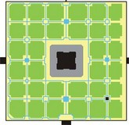
Humayun died in 1556, and his widow Hamida Banu Begam, also known as Haji Begam, commenced the construction of his tomb in 1569, fourteen years after his death.
It is the first distinct example of proper Mughal style, which was inspired by Persian architecture.
Mirak Mirza Ghiyath, a Persian, was the architect employed by Haji Begam for this tomb.
The 94-acre (380,000 m²) fort lies parallel to the river and its walls are seventy feet ht.
The plan of tomb is not the conventional single Chamber. But a complex of octagonal halls comprising a central one surrounded by four corner ones. Inspired by hindu panch tantra Planning.
The tomb proper stands in the centre of a square garden, divided into four main parterres by causeways (charbagh), in the centre of which ran shallow water-channels. with a small square lily ponds at the intersection.
Its main gate was on the South .
The white marble dome avoids the traditional and elaborate Hindu Kalsa
The square red sandstone double-storeyed structure of the mausoleum with chamfered corners rises from a 7-m. high square terrace,
. The grave proper in the centre of this cell-complex is reached by a passage on the south.
Externally each side of the tomb, its elevations decorated by marble borders and panels, is dominated by three arched alcoves, the central one being the highest.
.

Slide 4
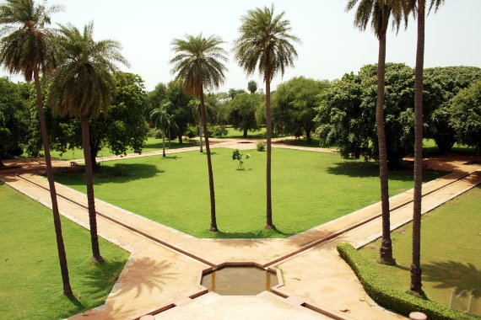
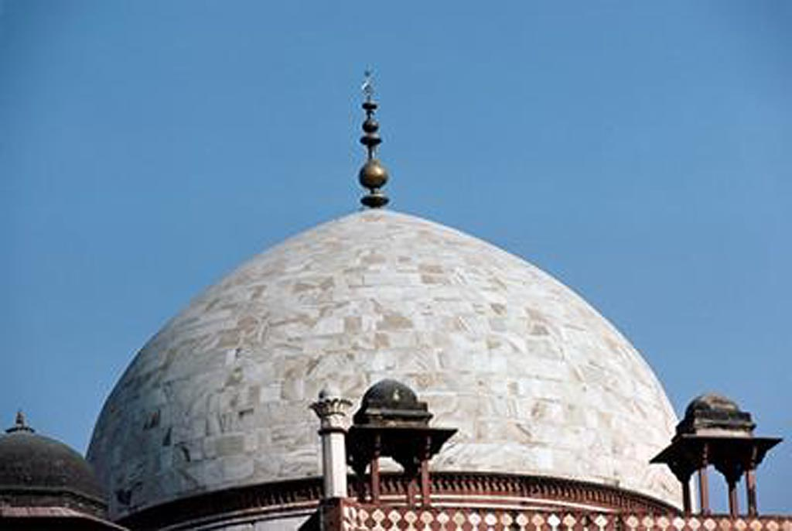
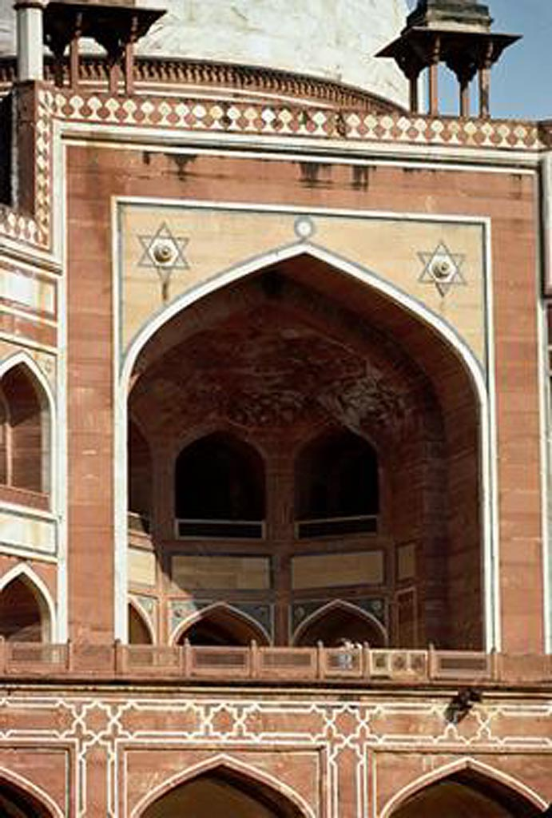

Slide 5
Fatehpur Sikri
Uttar Pradesh, India

Slide 6
The city in northern India founded by the Mughal emperor Akbar in 1571.
Fatehpur Sikri is a palace complex, built by the Mughal Emperor Jalal’ud-Din Muhammad Akbar (reg.1556-1605), son of Humayun and grandson of Babur.
The whole complex is spread on receding levels with respect to the topography of the ridge. The mosque complex is located on the uppermost level of the ridge, and consists of the Great Mosque (Jami Masjid, tomb of Shaykh Salim Chisti ), which dominates the entire architectural composition by means of its size.
The buildings of the complex can be grouped in two main zones. The middle level is the most private, housing the residential buildings.
The palace complex is laid out on the two lower platforms, covering approximately 250 square meters
The lowest level is occupied by the public and semi-public areas of the palace complex, comprising the public audience hall (Diwan-i 'Am), the private audience hall (Diwan-i Khass), the Ank Michauli and Astrologer’s Seat, the Panj Mahal, the imperialapartments (Khwabgah), the royal quarters (Daulat Khana), including the library (Kutubkhana).
The first major structure built at the site was Jami Masjid completed in 1571 the year
At the time of its construction it was the biggest mosque in India measuring 160 m east-west by 130 m north-south. The central courtyard is surrounded by arcades of pointed arches which lead into small cell-like rooms.

Slide 7
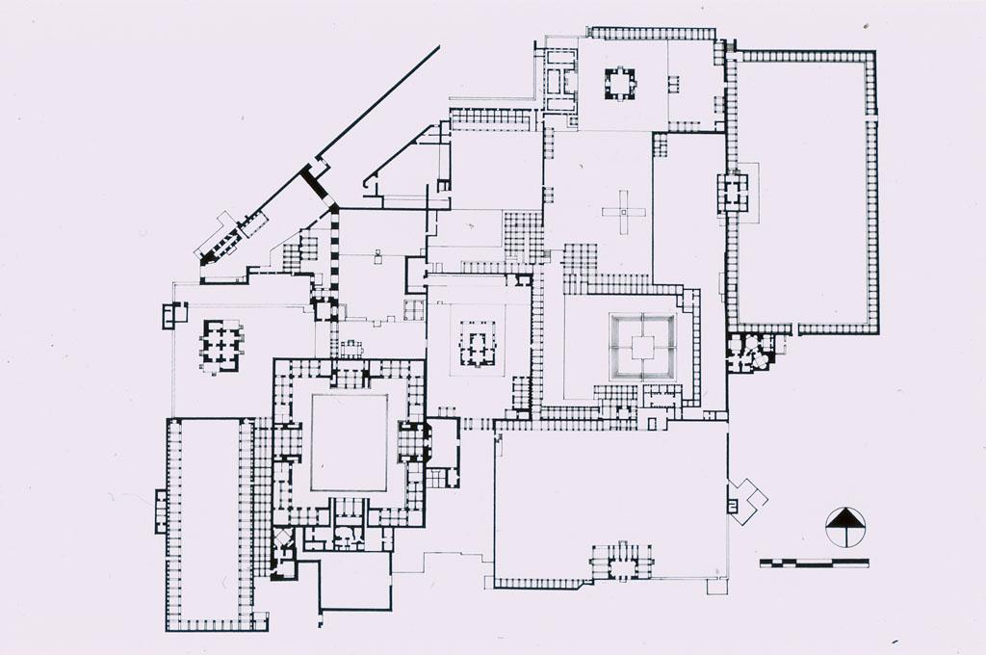
Fatehpur Sikri Live map
1- Entrance (Diwan-i-Amm) 2- Diwan-i-Khass 3- Daulat Khana 4- Astrologer's Seat 5- Panch Mahal 6- Anup Talao 7- House of the Turkish Sultana 8- House of Miriam 9- Palace of Jodh Bai 10- Garden 11- House of Birbal
3
2
4
1
5
10
7
8
6
9

Slide 8
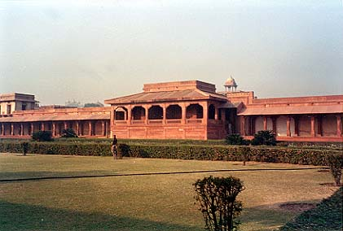
1 . Entrance (Diwan-i-Amm)
The first court of the palace complex towards the Diwan-i Amm, the entrance to Akbar's private residence.
A large quadrangular space, 112.38 meters north-south and 55.20 meters east-west, composed of one hundred and eleven bays
The dalans, constructed from red sandstone, are set on a raised plinth and are composed of square stone columns surmounted by simple brackets supporting stone lintels and chhajja.
The Emperor’s pavilion is a small rectangular structure of red sandstone, measuring 9.27 by 6.65 meters, projecting slightly into the courtyard. In plan, it is a single chamber with stone walls 1.10 meters thick surrounded by a portico, 3.05 meters wide.
The portico is shaded by a stone-tile roof (khaprel) resting upon carved brackets, above which runs the same carved parapet.

Slide 9
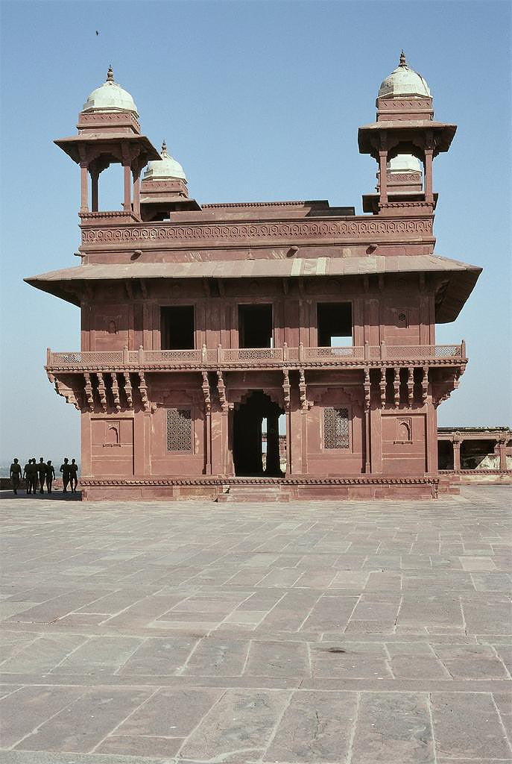
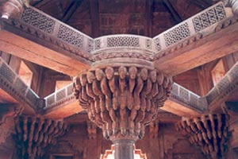
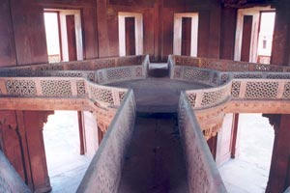
Diwan-i Khass, Fatehpur Sikri
The free-standing structure situated in the center of this courtyard has come to be dentified as the Diwan-i Khass
Built in red sandstone, it is a square, symmetrical building measuring 13.18 meters/side on the exterior. It stands on a paneled plinth, 0.75 meters high.
From without it appears double-storied; its four elevations are identical
On the roof there are domed chatris at each corner
Inside the building consists of a two-storey hall with a gallery at first-floor level. Bridges which run diagonally from the corners of the gallery connect to a balcony supported by a central pillar.
The pillar is richly carved in the Hindu tradition with a mass of heavy corbels supporting the circular balcony above.
The arrangement of a square building with a central pillar may reflect some Hindu mandala whereby the central column represents the axis of the world

Slide 10
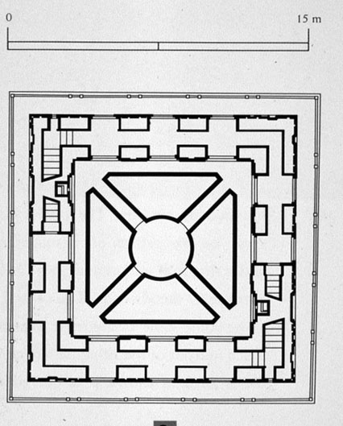
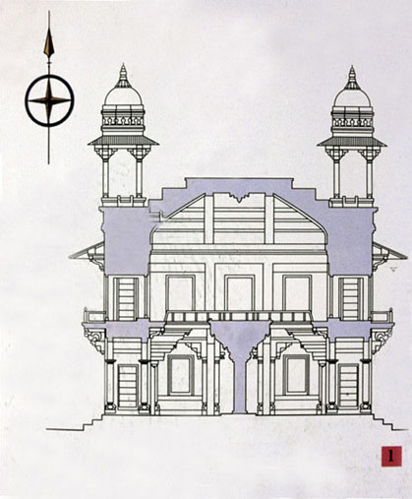
Diwan-i Khass, Fatehpur Sikri
PLAN
SECTION

