Slide 1


Microsoft Word
Ar. Manish Kumar

Slide 2
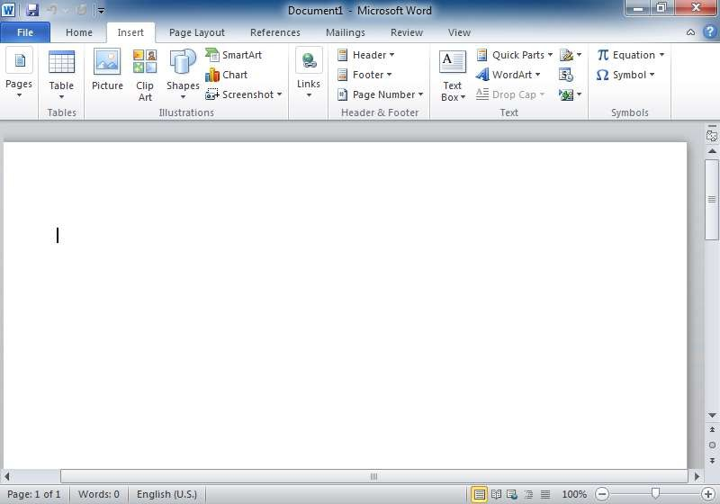
Introduction
Microsoft Word (often called Word) is a graphical word processing program that users can type with. It is made by the computer company Microsoft. The purpose of the MS Word is to allow the users to type and save documents.
Title bar
Menu bar
Document window
Scroll bar

Slide 3
Features of MS Word
Creating and saving a file
Editing and formatting a document
Paragraph formatting
Inserting header and footer and Page number
Checking spelling and grammar
Subscript and superscript
Inserting symbols
Print preview and printing
Inserting clipart, word art, and picture
Page setting
Bullets and number
Border and shading
Searching a word and replacing it by another word
Inserting table

Slide 4
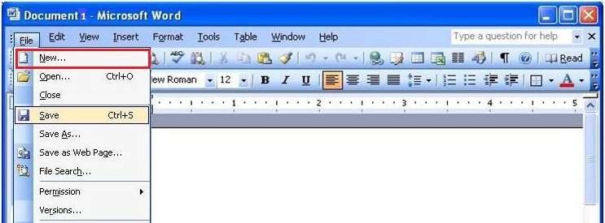
Creating and saving a file
Create new file (ctrl+N)
Save file(ctrl+s)

Slide 5
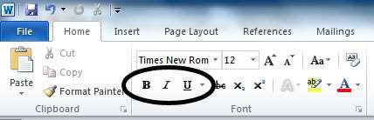
Editing and formating a document
Bold
Italic
Under Line
Normal

Slide 6
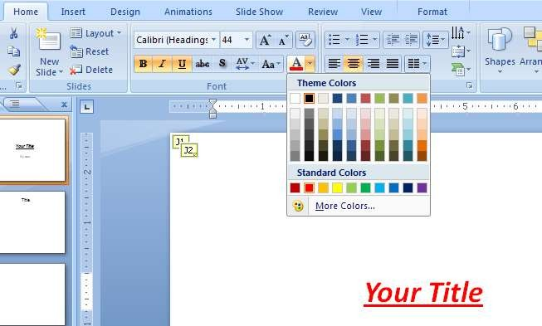
Font Type
Font Size
Font colour
Alignment of text

Slide 7
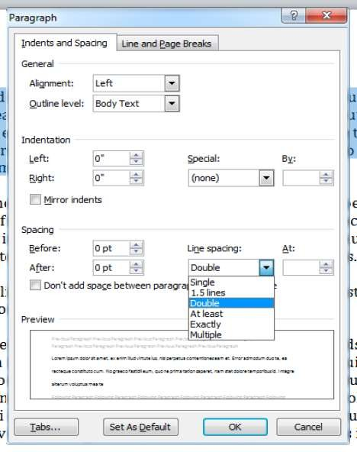
Paragraph formating
Alignment of Paragrap
Line spacing in paragra
Space between Line

Slide 8
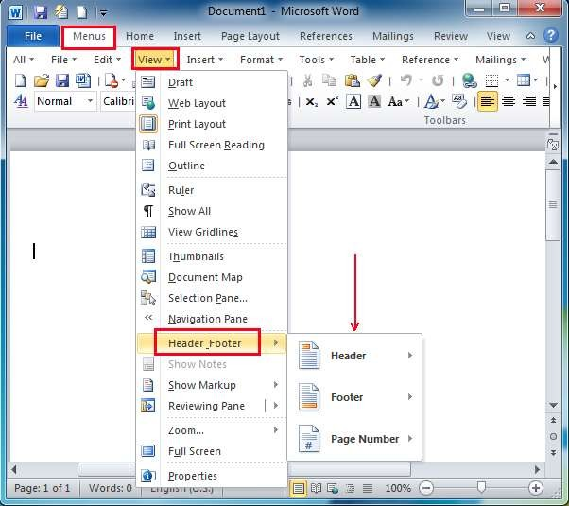
Inserting Header and Footer and page number

Slide 9
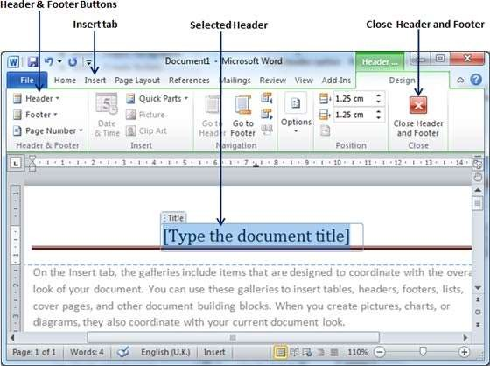

Slide 10
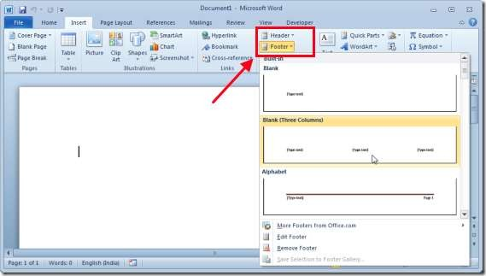
Insert Footer

Slide 11
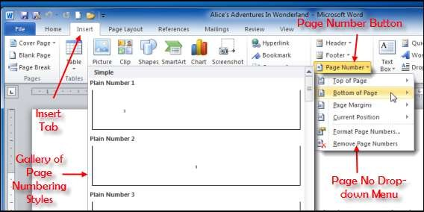

Slide 12
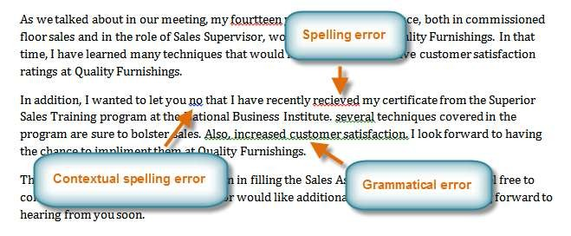
Checking Spelling and Grammer

Slide 13
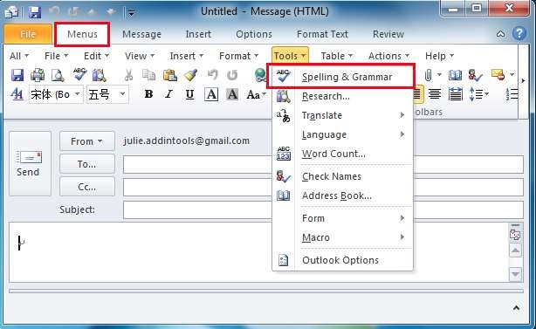

Slide 14
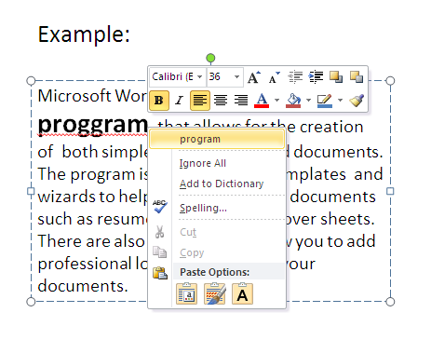

Slide 15
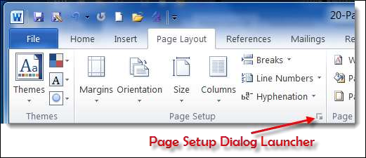
Page Setup

Slide 16
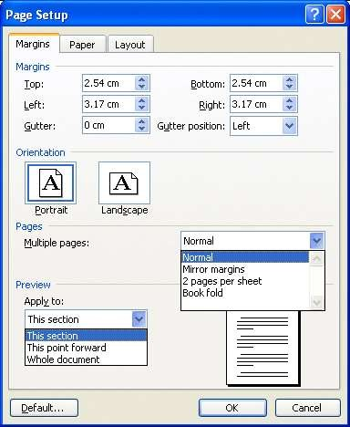
Set Margins
Preview

Slide 17
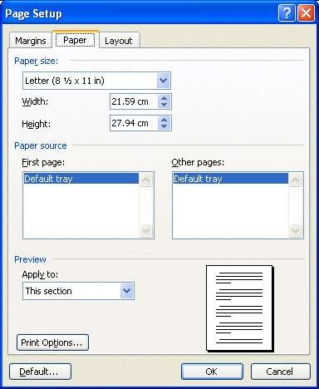
Paper Setup
Preview

Slide 18
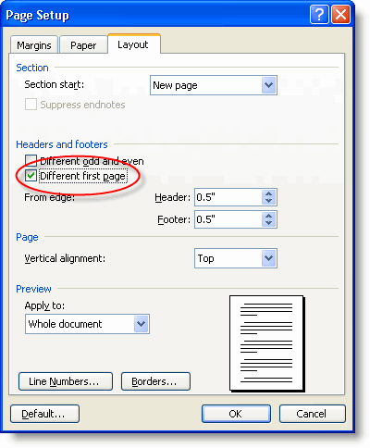
Layout Setup
Preview

Slide 19
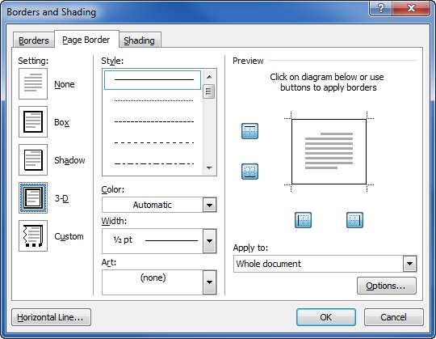
Borders and Shading
Border Prev
Select border width
Select border style
Select border color

Slide 20
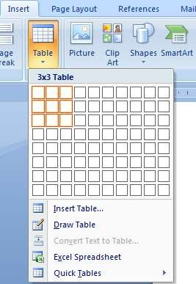
Inserting Table in file
Visually select the size of table
Or click
“ insert table”

