Slide 1
Subject: Principles Of Human Settlements-I
Topic: Patrick Geddes
Presented by: Fazlur Rahman

Slide 2
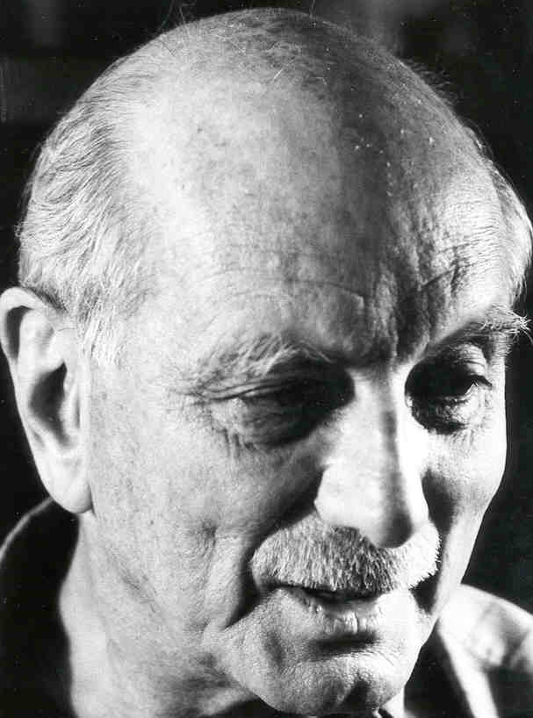
LEWIS MUMFORD
(1895 - 1990)

Slide 3
Urban planner, historian, sociologist, local advocate, and architectural critic, writer
one of the greatest urbanists of the 20th Century.
- embraced a cultural analysis
.
- The City in History - National Book Award - explores the development of urban civilizations
TECHNOLOGY
NATURAL ENVIRONMENT
URBAN ENVIRONMENT
INDIVIDUAL
COMMUNITY

Slide 4
THEORIES
Close disciple of Geddes - biological view of the city and its region as a living organism.
URBAN PLANNING - organic relationship between people and their living spaces.
Well known principle - ORGANICISM
ORGANICISM
VALUES
TECHNOLOGY
INDIVIDUAL PERSONALITY
OBJECTIVE ENVIROONMENT
world of fulfillment
and beauty.

Slide 5
EXAMPLE
MEDIEVAL CITY
IDEAL CITY
MODERN CITY
ROMAN CITY
ENDED IN COLLAPSE
if the modern city carries on in the same vein, then it will meet the same fate as the Roman city .

Slide 6
PHILOSOPHIES
Looked beyond a mere cityscape of buildings and Streets to the vibrant network of HUMAN RELATIONSHIPS that are cities’ very reason for existence
Criticized modern America's TRANSPORTATION NETWORKS as being 'monotechnic' in their reliance on cars.
Mumford instead proposed they build of more ORGANIC ROADWAYS, DISCOURAGE PEOPLE FROM USING THE CONGESTED ROADS DURING MASS TRANSIT HOURS, and provide public transportation.
Books are focused on TECHNOLOGY'S ROLE IN CIVILIZATION
Automobiles - obstacles for other modes of transportation, such as walking, bicycle and public transit -consume so much space and are such a danger to people. automobile accidents - a "ritual sacrifice" the American society makes because of its extreme reliance on highway transport.

Slide 7
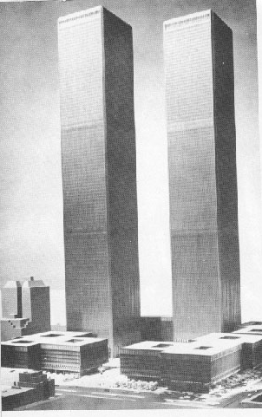
Mumford argues against the LOSS OF PERSONAL AUTONOMY and the organic world by electricity-based computer systems.
-opponent of large-scale public works – WRITINGS - effect of buildings on the human condition and the environment Criticized world trade center -1970- when it was just built - traffic congestion- economic waste- human deterioration - dinosaur with insufficient brains
Warned his readers that technology, left unchecked by human reason, would lead to mass destruction, environmental degradation brought about by industry, the automobile and ineffective planning.

Slide 8
.
Mumford’s ideas on regionalism - regionalist approach to urban planning
.
Hoped to redirect technology’s energies towards the improvement of the individual citizen’s life relieving the city of the unwholesome living conditions and congestion capitalism had produced.
.
According to Mumford, the city is a stage where the drama of human life reaches its summit.

Slide 9
VISION
GOOD LIFE
TOOLS
MACHINE
KNOWLEDGE
ARTS
NATURE
VALUES

Slide 10
Regional Planning Association of America
- establishment of regional cities as an antidote to the metropolitan congestion then increasing at an alarming rate.
REGIONAL CITY
- At that time, most urban planners believed that cities would need to expand in order to account for unavoidable population increase, and would allow the burgeoning population to enter the city to work and shop.
On this point, the RPAA fundamentally disagreed, and instead laid down the REGIONALIST APPROACH.
- reworking of the British “garden city,”
-RESIDENTIAL -CULTURAL COMMERCIAL -INDUSTRIAL -GREEN BELT
SUSTAINABLE SCALE
REGIONAL CITY

