Slide 1
GIS & REMOTE SENSING
Subject: GIS Studio
Topic: Introduction to GIS
Presented by: Pallavi Tiwari

Slide 2
GEOGRAPHIC INFORMATION SYSTEM (GIS)
“A computer - assisted system for the capture, storage retrieval, analysis and display of spatial data, within a particular Organization”.
(Clarke, 1986)
A GIS is a computer-based system that provides the following four sets of capabilities to
handle geo-referenced data:
Input
data management (data storage and retrieval)
manipulation and analysis
Output.
(Aronoff, 1989)

Slide 3
GEOGRAPHIC INFORMATION SYSTEM
Information about the positions on the earths surface.

Slide 4
Information about the positions on the earths surface.
SPATIAL DATA
NON - SPATIAL DATA OR ATTRIBUTES

Slide 5
COMPONENTS OF GIS
Hardware
Software
Data
People
Method
GIS system needs trained manpower to plan, implement and operate the system and make decisions on the basis of output.
The specialized software is required to handle the spatial operations.
The availability of spatial data is another essential component of GIS on which whole superstructure exists. The quality of results and output depends upon the reliable data in the GIS system. Data input and updating are frequently the most expensive and time-consuming part of any GIS project and their importance and complexity should not be underestimated.
Different results can be achieved using different methods thus what method is used for what type of work is important
The hardware component includes high speed processor, sufficient memory capacity to store large. amount of data, high speed processor, sufficient memory capacity to store large amount of data, high resolution color graphic screen data input and output devices such as scanners, digitizers, printers and plotters.
For all these components to work together capital is needed. Initially, the hardware and software were very costly that required heavy capital but with the advancement of technology the cost has come down considerably.

Slide 6
GIS Functions
Data Capture
The input of data into a GIS can be achieved through many different methods of gathering. For example, aerial photography, scanning, digitizing, GPS or global positioning system is just a few of the ways a GIS user could obtain data.
Data Storage
Some data is stored such as a map in a drawer, while others, such as digital data, can be as a hardcopy, stored on CD or on your hard drive.
Data Manipulation
The digital geographical data can be edited, this allows for many attribute to be added, edited, or deleted to the specification of the project.
Query And Analysis
GIS was used widely in decision making process for the new commission districts. We use population data to help establish an equal representation of population to area for each district.
Visualization
This represents the ability to display your data, your maps, and information.

Slide 8
Geographic data = Representation of reality
GIS utilizes a layer approach. Each layer only includes information about one type of phenomenon.

Slide 9
GIS applications
1. MAPPING LOCATIONS: GIS can be used to map locations. GIS allows the creation of maps through automated mapping, data capture, and surveying analysis tools.
2. MAPPING QUANTITIES: People map quantities, like where the most and least are, to find places that meet their criteria and take action, or to see the relationships between places. This gives an additional level of information beyond simply mapping the locations of features.
3. MAPPING DENSITIES: While you can see concentrations by simply mapping the locations of features, in areas with many features it may be difficult to see which areas have a higher concentration than others. A density map lets you measure the number of features using a uniform areal unit, such as acres or square miles, so you can clearly see the distribution.
4. FINDING DISTANCES: GIS can be used to find out what's occurring within a set distance of a feature.
5. MAPPING AND MONITORING CHANGE: GIS can be used to map the change in an area to anticipate future conditions, decide on a course of action, or to evaluate the results of an action or policy.

Slide 10
APPLICATIONS OF GIS
Aid and Development
Business
Defense and Intelligence
Education
Government
Health and Human services
Natural Resources
Public safety
Transportation
Utilities and communications

Slide 11
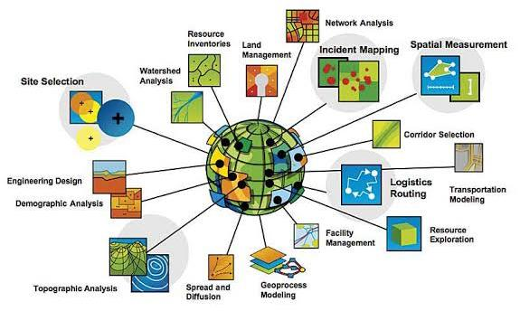
APPLICATIONS OF GIS

Slide 12
REAL WORLD
Observe
DATA
Process /
INFORMATION
Interpret
DECISION
MAKING
Filter
Decision making through GIS

