Slide 1
UNIT-I :
INTERFERENCE AND
DIFFRACTION
BY
Dr. KONICA SHARMA

Slide 2
INTERFERENCE OF LIGHT:
Interference is the phenomenon of the superimposition of one light source over the other.
Due to the superimposition of any two light sources, the resultant energy is redistributed into a position of maximum intensity and of minimum intensity.
Constructive Interference : If the crest of one wave falls on the crest of the other, constructive interference is produced.

Slide 3
INTERFERENCE OF LIGHT:
Destructive Interference : If the crest of one wave falls on the trough of the other, destructive interference is produced.
When a soap film or an oil film is viewed from a reflected light or transmitted light, it exhibits different colours.
It is due to the interference pattern produced in thin films

Slide 4
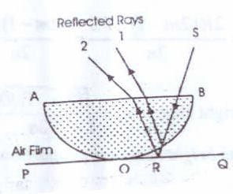
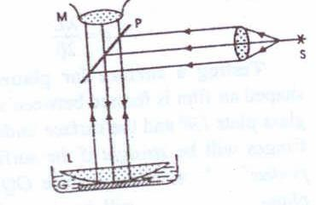
NEWTONS RING:
CONSTRUCTION :
A plano-convex lens of large radius of curvature is placed with its convex surface in contact with a plane glass plate.
Then, an air film is formed between the lower surface of the lens AOB and the upper surface of the plate POQ
The thickness of the air film is zero at the point of contact O and gradually increases from the point of contact outwards.

Slide 5
NEWTONS RING:
If monochromatic light is allowed to fall normally on this film, a system of alternate bright and dark concentric rings is formed in the air film.
They are called Newton's rings.

Slide 6
NEWTONS RING:
The thickness of air-film remains constant along a circle with its centre at O. Hence, the fringes are in the form of concentric circles.
Newton's rings are formed as a result of interference between the light waves reflected from the upper and lower surface of the air film. 1 and 2 are the interfering rays corresponding to an incident ray SR.

Slide 7
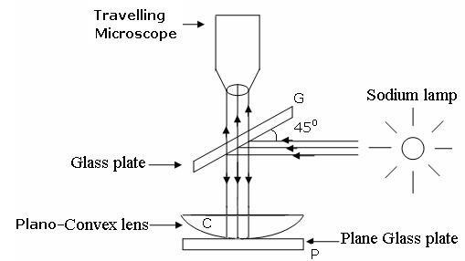
EXPERIMENTAL ARRANGEMENT:
Experimental arrangement for producing Newton’s rings by reflected light.
S is source of monochromatic light.
The light from S rendered parallel rays by a convex lens. These horizontal parallel rays fall on a glass plate G at 45, and are partly reflected from it.
This reflected beam falls normally on the lens C placed on the glass plate P

Slide 8
EXPERIMENTAL ARRANGEMENT:
Interference occurs between the rays reflected from the upper and lower surfaces of the film.
The interference rings are viewed with a microscope M focused on the air film.

Slide 9
CONDITION FOR BRIGHT AND DARK RINGS:
The optical path difference between the rays is
since µ=1
Intensity maxima Δ=m λ
Bright fringe is obtained
Intensity minima
Dark fringe is obtained

Slide 10
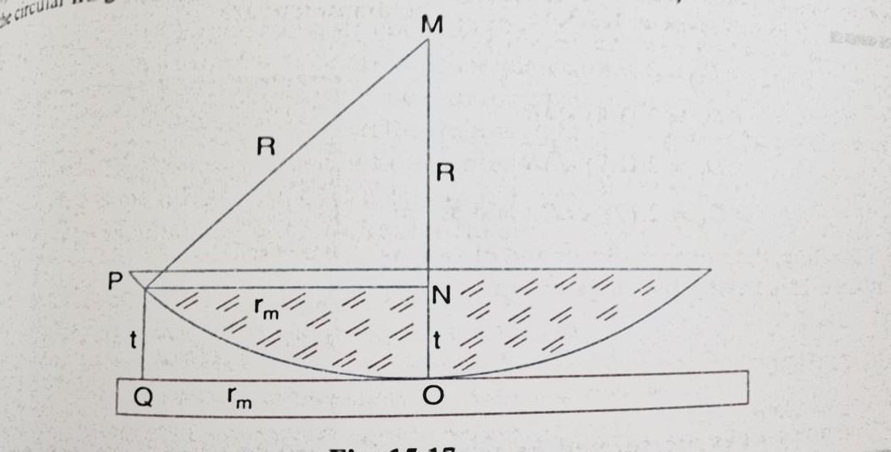
RADII OF DARK FRINGES:
R be the radius of curvature of lens
Q is the position of dark fringe
Thickness of air film at Q= PQ=t
Radius of circular fringe at Q be
OQ =rm
By Paythagorus theorem
PM²=PN²+MN²
Since R>>t 2Rt>>t²

Slide 11
RADII OF DARK FRINGES:
Condition for darkness at Q is:
2t=mλ
Radii of dark fringes ,m=1,2,3,…
Ring diameter:
Diameter of mth dark ring

Slide 12
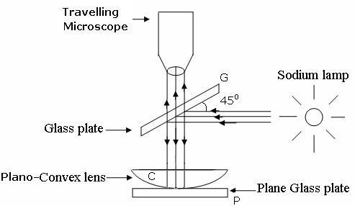
DETERMINATION OF WAVELENGTH OF SODIUM
LIGHT BY NEWTON’S RING :
Experimental arrangement: Fig. shows an experimental arrangement for
producing Newton’s rings by reflected light. S is source of
monochromatic light.
The light from S rendered parallel rays by a convex lens L1.
These horizontal parallel rays fall on a glass plate G at 45, and are partly reflected from it.

Slide 13
DETERMINATION OF WAVELENGTH OF SODIUM
LIGHT BY NEWTON’S RING:
This reflected beam falls normally on the lens L placed on the glass plate PQ. Interference occurs between the rays
reflected from the upper and lower surfaces of the film.
The interference rings are viewed with a microscope M focused on the air film.

Slide 14
PROCEDURE:
With the help of the traveling microscope the diameters of a number of dark rings are measured.
The position of the microscope is adjusted to get the centre of Newton's rings at the point of intersection of the cross-wires.
The microscope is moved until one cross wire is tangential to the 16th dark ring.
The microscope reading is taken.
Then microscope is moved such that the cross-wire is successively tangential to 12th, 8th and 4th dark rings respectively.
The readings are noted in each case.
Readings corresponding to the same rings are taken on the other side of the centre.

Slide 15
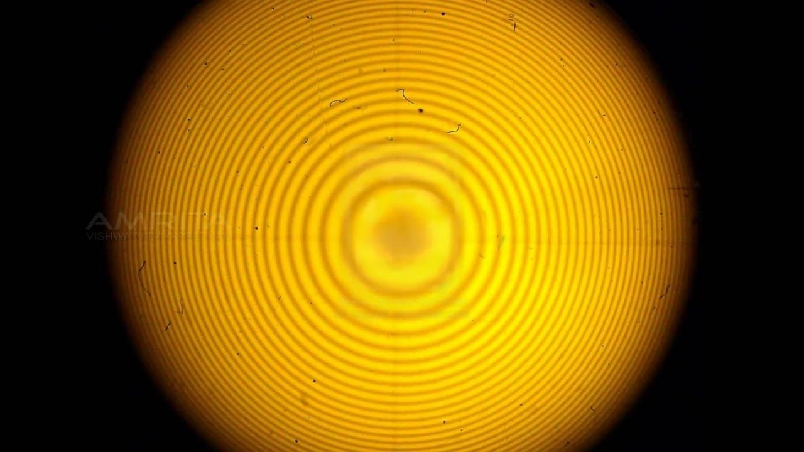
CONT…
For the (m+p)^{th} ring

Slide 16
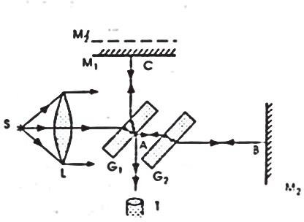
MICHELSON’S INTERFERROMETER:
Principle: Here, the two interfering beams are formed by division of amplitude.
The amplitude of the light beam from an extended source is divided into two parts of equal intensity by partial reflection and refraction.
These beams are sent in two perpendicular directions.
The two beams are finally brought together after reflection from
plane mirrors to produce interference fringes.

Slide 17
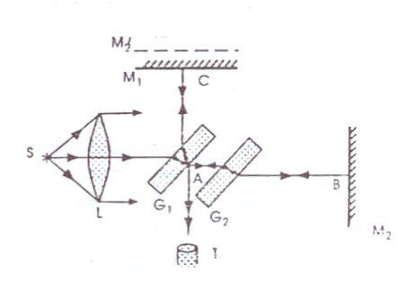
APPARATUS
: M1 and M2 are front silvered plane mirrors (The two mirrors are mounted vertically on two arms at right angles to each other.
The planes of the mirrors can be slightly tilted with the fine screws at their backs.
The mirror M2 is fixed. The mirror M1 can be moved parallel to itself by means of very sensitive micrometer screw.
G1 and G2 are two plane parallel glass plates of equal thickness.

Slide 18
APPARATUS
The plate G1 is semi silvered on the back side. Gl is a beam splitter; i.e., a beam incident on G1 is partially reflected and partially transmitted.
G1 is inclined at an angle of 45⁰ to the incident beam.
G2 is called the compensating plate.
S is a light source.

Slide 19
WORKING:
Light from the sources is rendered parallel by a lens L and falls on the glass plate G1 at an angle of 45°.
At the back surface of G1, it is partly reflected along AC and
partly transmitted along AB.
The reflected beam moves towards mirror M1 and falls
normally on it.
It is reflected back along the same path and emerges out along AT.
The transmitted ray AB falls normally on the mirror M2. It is reflected along the same path.
After reflection at the back surface of G1, it moves along AT. The two emergent beams have been derived from a single incident beam and are, therefore, coherent.
The two beams produce interference under suitable conditions.

Slide 20
FUNCTION OF G1:
The reflected ray AC passes through G1, thrice But the transmitted ray AB passes through G1, only once.
That is why a second plate G2 of the same thickness
and inclination as G1 is introduced.
Thus the function of the plate G1 is only to equalize the optical paths traversed by both the beams.

Slide 21
CIRCULAR FRINGES:
Circular fringes are produced with monochromatic light when mirrors M₁ and M₂ are exactly perpendicular to beach other.
Looking though T M₁ see directly with virtual image M’₂ of mirror M2 formed by reflection in G₁
If two arms are equal in Length,M’₂ will coincides with mirror M₁

Slide 22
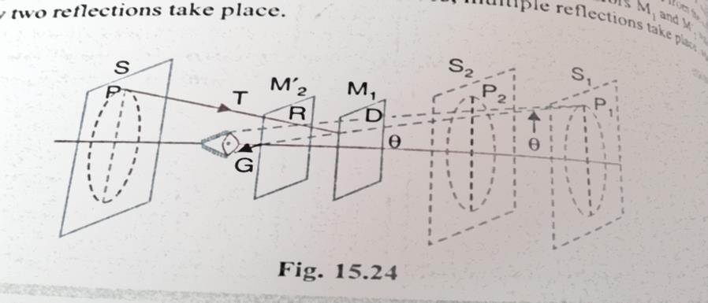
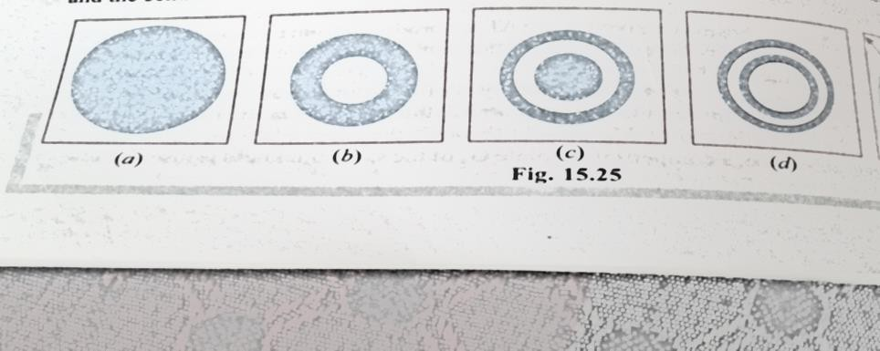
CIRCULAR FRINGES:
If M’₂ and M1 do not coincides, Then the path difference between the two coherent beams is 2d cos θ .
•
•
The condition for a bright ring is
2dcos θ+λ/2 =mλ where m is an integer.
2dcos θ is path difference between two beams

Slide 23
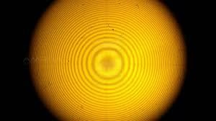

Slide 24
APPLICATIONS OF MICHELSON’S INTERFERROMETER:
1) Determination of wavelength of monochromatic light:
M₁ and M₂ are exactly perpendicular, Circular fringes are
obtained
If M₁ moved forward or backward Circular fringes appear
or disappear at the center
Now mirror is moved through known distance d and
number of fringes disappear at center is counted
If d₁ initial thickness of air film between M1 and image of M2 corresponding to bright fringe of order m₁
d₂ is final thickness of air film corresponding to bright
fringe of order m_{n} in same position.

Slide 25
APPLICATIONS OF MICHELSON’S INTERFERROMETER:
Then

Slide 26
3) THICKNESS OF THIN TRANSPARENT SHEET
Let transparent sheet of thickness t and RI μ inserted in
path of interfering beam of Michelson’s interferometer
Optical path increases becomes μμt instead of t.
The increase in optical path is (𝜇𝑡 − 𝑡) 𝑜𝑟 (𝜇 − 1) 𝑡
Since beam travels medium twice
Extra path difference between two interfering beam is 2(𝜇 − 1) 𝑡 t=
If m is number of fringes by which fringe system is displaced
2(𝜇 − 1) 𝑡 = m λ
_{𝑡 =} 𝑚λ
2(𝜇−1)

Slide 27
4) DETERMINATION OF REFRACTIVE INDEXI OF GASES:
If a tube containing a gas introduced in path of beam going towards M1
Path difference equal to 2(𝜇 − 1) 𝑙 introduced in
interfering beams
𝜇 is RI of gas and 𝑙 is length of tube
If m fringes cross the center of field of view ,
2 𝜇 − 1 𝑙 = m λ
𝜇 = ^{𝑚λ}+1
2𝑙

