Slide 1
Subject: Principles Of Human Settlements-I
Topic: Industrial And Post-industrial Age World Scenario
Presented by: Pallavi Tiwari

Slide 2
INDUSTRIAL AGE:
FACTORY TOWNS
LATTER 17TH TO 19TH CENTURY
RESPONSE TO FACTORY TOWNS:
CITY BEAUTIFUL
LATTER 19TH CENTURY
POST-INDUSTRIAL AGE:
NEIGHBOURHOOD CONCEPT
EARLY 20TH CENTURY
GARDEN CITY
CONCEPT
RADBURN MOVEMENT
CURRENT DAY:
THRUST ON WALKABILITY/ TRANSIT ORIENTED REALMS
NEW URBANISM
FORM BASED
CODE
T.O.D.

Slide 3
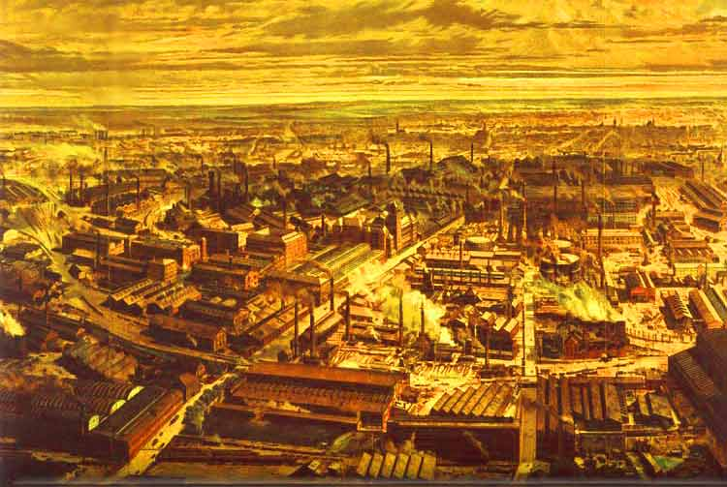
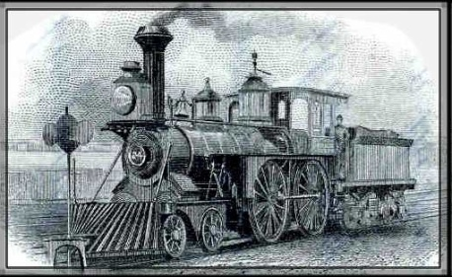
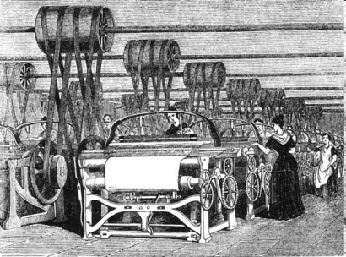
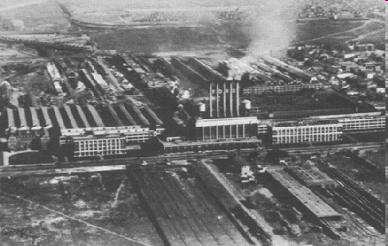
THE INDUSTRIAL REVOLUTION: THE GREAT TRANSITION
The Industrial Revolution was the time period that marked the transition into the modern era of industrialization. New inventions not only improved the lives of the common people, but also completely changed how products are made.
TIME FRAME: 17th century to First World War.
The industrial revolution was an urban-centered affair. New cities came up over agricultural fields and tiny hamlets became big cities.
Technological innovations poured forth, many with profound impacts on urban form.
Railroad tracks were driven into the heart of the city. Internal rail transportation systems greatly expanded the radius of urban settlement: horse cars beginning in the 1830s, cable cars in the 1870s, and electric trolleys in the 1880s.
In the 1880s, the first central power plants began providing electrical power to urban areas.
The rapid communication provided by the telegraph and the telephone allowed formerly concentrated urban activities to disperse across a wider field.

Slide 4
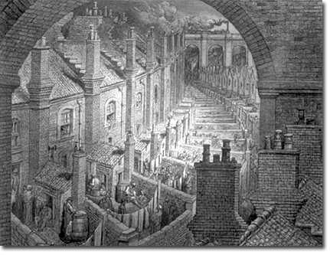
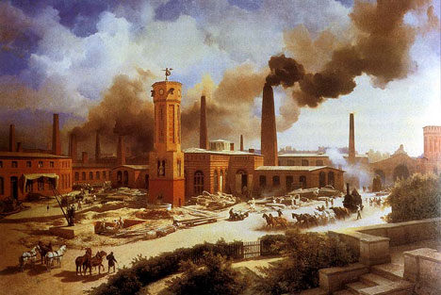
MAJOR ISSUES
In character, the new cities were radically different. The tremendous pace of growth overburdened the existing infrastructure.
Living conditions during the Industrial Revolution varied from the splendor of the homes of the owners to the squalor of the lives of the workers.
PROLIFERATION OF SLUMS: Poor people lived in very small houses in cramped streets. These homes would share toilet facilities, have open sewers and would be at risk of damp. Disease was spread through a contaminated water supply.
SPREAD OF DISEASE: The Industrial Revolution created a larger middle class of professionals such as lawyers and doctors. However, as a result of the Revolution, huge numbers of the working class died due to diseases spreading through the cramped living conditions. Chest diseases from the mines, cholera from polluted water and typhoid were also extremely common, as was smallpox.
GROWING SOCIAL VICES: Accidents in factories with child and female workers were regular. Strikes and riots by workers were also relatively common.

Slide 5
THE ADVENT OF FACTORY TOWNS
The new conditions demanded new towns solely devoted to factory production.
Because steam power needed to be near fuel supplies, industrialization often took place in coal towns.
The houses in these towns were thrown up and were built with a sharp eye towards profit.
In effect they built back to back housing that could only be slums, packed so closely with minimal sanitation of one or two lavatories in courtyards supposed to supply the residents of a whole street. Squalid conditions soon developed.
Thus, development of towns around factories and development of factories in towns had lead to the development of ‘FACTORY TOWNS.’

Slide 6
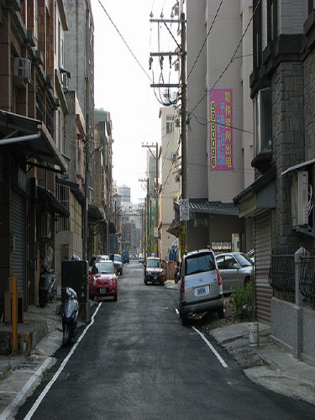
CHARACTERISTICS OF FACTORY TOWNS
Every amenity of urban life was sacrificed to the requirements of industrial production.
Railroads and ships joined the factories and the waterfronts became the industrial core of the City.
The new industrial economy brought exploitation of the poor with poverty came the slums.
New slums with row upon row of crowded worker’ houses in the shadow of the factories were added to the existing slums.
By 1870, many of the large cities like London, New York, Paris etc. had a density of more than 275 ppa. ( persons per acre) for the city as a whole and about 550 to 750 ppa. in the residential areas.
No land use standards lead to the development of buildings in a chaotic manner with no considerations for the sanitation and ventilation of the buildings.

Slide 7
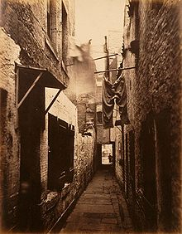
FORM AND TREND
Migration from rural to city areas
Cities were deadly places to live in.
Technological innovations poured forth, many with profound impacts on urban form.
The industrial city focused on the city center, which contained both the central business district, defined by large office buildings, and substantial numbers of factory and warehouse structures.
Both trolleys and railroad systems converged on the center of the city, which boasted the premier entertainment and shopping establishments.
The working class lived in crowded districts close to the city center, near their place of employment.
GLASGOW SLUM IN 1871

Slide 8
HIGH INCOME GROUP RESI. IN PERIPHERY
MIDDLE INCOME GRP. RESI. IN SUBURBS
SLUMS AND WORKERS RESI.
CENTRAL CORE WITH FACTORIES AND RAILWAYS YARDS
RAILWAY LINE
The form of the industrial city was distinct.
At the centre were the factories and railway yards constituting the business and industrial core.
Around them were the poor housing areas of the mass of workers.
Slums were located along the factories and railway yards.
The homes of the wealthier residents who sought to escape from the grime and noise of the central area were in the periphery.

Slide 9
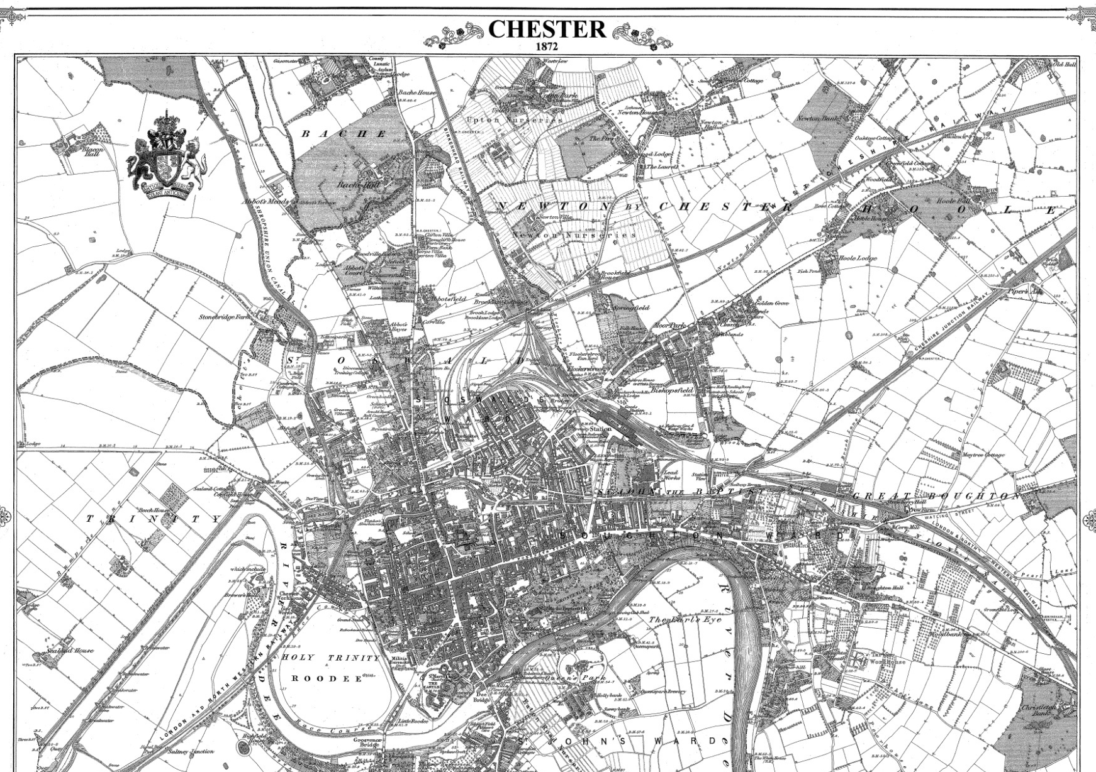
CHESTER TOWN
The town was a strategic railway junction and distribution centre, as well as a rolling stock maintenance depot.

Slide 10
Early factories were located outside of major cities along rivers which provided water power for machinery.
After steam power became widely available , factories could be located within the city in proximity to port facilities, rail lines, and the urban labor force.
But by the late nineteenth century, factory decentralization had already begun, as manufacturers sought larger parcels of land away from the congestion of the city. Gary, Indiana, for example, was founded in 1906 on the southern shore of Lake Michigan by the United States Steel Company.
The increasing crowding, pollution, and disease in the central city produced a growing desire to escape to a healthier environment in the suburbs.
The upper classes had always been able to retreat to homes in the countryside.
Beginning in the 1830s, commuter railroads enabled the upper middle class to commute in to the city center. Middle class moved out from the central cities into more spacious suburbs.
Finally, during the 1890s electric trolleys and elevated rapid transit lines proliferated, providing cheap urban transportation for the majority of the population.
The central business district of the city underwent a radical transformation with the development of the skyscraper between 1870 and 1900.

Slide 11
CITY BEAUTIFUL MOVEMENT, AMERICA
Like the British cities, the American cities were also the creatures of industrialism and all of its obnoxious procedures -- the factories, the noise, the soot, the smells, the smoke, the poison waste products, the congested tenement neighborhoods of the factory workers, and so forth.
The City Beautiful movement arose in large cities in the United States in response to the crowding in tenement districts, a consequence of high birth rates, increased immigration and consolidation of rural populations into cities.
The City Beautiful Movement, lead by the middle and upper classes, was meant to deal with these rising issues of sanitation, crime, and over-population of cities. In the height of the Gilded Age, these reformers felt the best way to deal with these issues was through consumption and creation of beauty. They felt that classic beauty of the city would inspire feelings of civic loyalty and moral rectitude in the impoverished that would help to lower crime rates.
Thus, An event rather than a city plan helped give rise to the City Beautiful movement – one of the most influential town planning models of the late 19th and early 20th centuries.
Architect Daniel Burnham led a team of leading American designers, including Frederick Law Olmsted, to create the World’s Columbian Exposition in Chicago in 1893.The temporary buildings and monuments of the ‘White City’ were constructed in neo-classical style, and flanked water features and other grand public spaces.

Slide 12
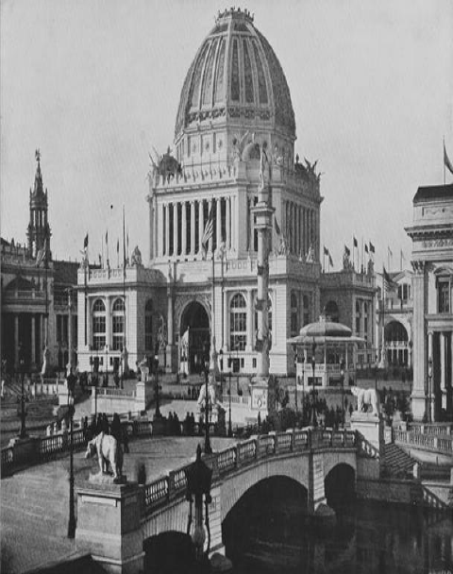
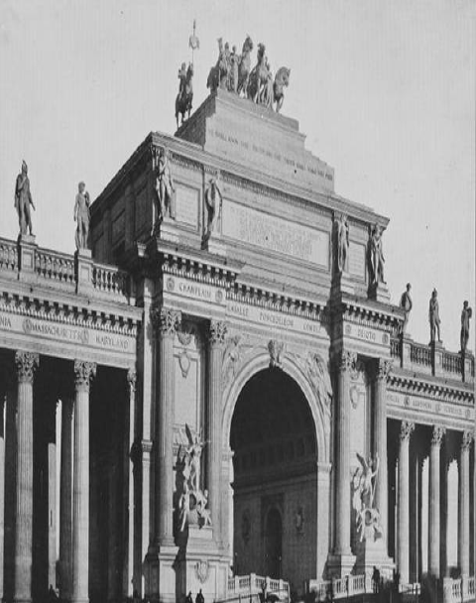
This Word Fair was a reaction against the effects the factories were having on the urban life.
A need was felt for affair which would be big, broad and beautiful in contrast to the cities which were cramped, monotonous and ugly.
‘Make no Little Plans’- was the move.
The plans were or colossal scale with monumental proportions. It was a paradox to name the fair as a
‘WHITE CITY’. The fair generated a tidal wave of City Planning.
Daniel Burnham, the chief architect of the World’s Columbian Exposition, drafted this plan for Chicago in 1908 and 1909. It provided broad arterial roads for traffic, an artistically embellished city centre, and a system of roads and parks encircling the city.

Slide 13
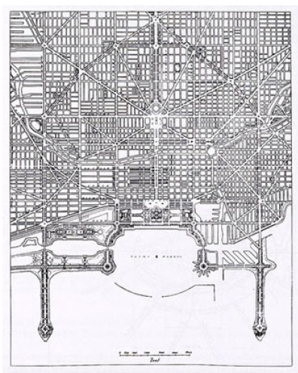
Like Vancouver’s Expo ‘86 or Disney World, it was full of temporary buildings that simulated the temples, lagoons, and palaces of ancient Greece, Rome, and 17th century France. It was full of parks and boulevards. It was, in a word, “grand.”
The particular architectural style of the movement borrowed heavily from the contemporary Beaux-Arts movement, which emphasized the necessity of order, dignity, and harmony. The movement also borrowed from classical monumental planning but differed from the true neoclassical style in that in the City Beautiful movement, the classical idiom was adopted only partially, mixed with Beaux-Arts elements, and subjugated as means to the end of creating uniformity and harmony in style.

Slide 14
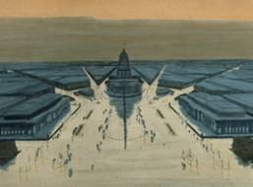
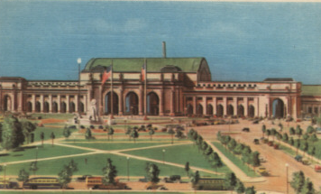
Burnham, and other architects, went on to design City Beautiful plans for Chicago, Calgary, Kitchener, Vancouver, and many other places, with a number of the plans being funded by business groups.
The key values they were operating with in trying to manage the city’s growth were symmetry, coherence, and monumentality.
Their influences went back to the way the ancient Greeks and Romans laid out their cities, to the Renaissance Italians, and to the kings of the Baroque era and beyond.
This way of planning emphasized the public realm.
The public realm consists of streets, parks (or other forms of open space, such as plazas), and public buildings.
As with what are called “urban designers” today, the practitioners of City Beautiful were concerned with how these elements fit together with private buildings into a harmonious whole.
Every City Planner became member of the ‘CITY BEAUTIFUL’ movement as advocated by Daniel Burnham

Slide 15
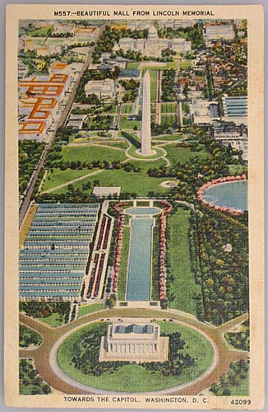
Architects Daniel Burnham and Charles McKim, and the designer of Central Park, Frederick Law Olmsted, were members. The committee reported in 1902 and recommended the redefinition of the mall to emphasize its symbolic qualities.

Slide 16
CRITICISM AGAINST THE CITY BEAUTIFUL MOVEMENT
Major redevelopment schemes for big cities were another factor in the rise of modern town planning.
But these activities were detached from general public and the plans were not confirming to the human scale.
At the first city planning conference in the U.S. (1909), the City Beautiful movement was criticized for being overly concerned with aesthetics and grandeur, while paying insufficient attention to ‘bread and butter’ issues like housing and health issues.
It was also felt that planning needed to extend beyond the public realm to private land.
Moreover, with the technological advancements, cities emerged as commercial centers and economics played a very important role in City Planning.
Hence, the need of ‘practical men’ and not ‘dreamers' were felt necessary as cities, now had become a business proposition.

Slide 17
POST INDUSTRIAL AGE INTRODUCTION- AN OVERVIEW
Daniel Bell popularized the term through his 1973 work The Coming of Post-
Industrial Society
TIME FRAME: Post – First World War to current day.
If a nation becomes "post-industrial" it passes through, a phase of society
predominated by a manufacturing-based economy and moves on to a structure of
society based on the provision of information, innovation, finance, and services.
A virtual cult of 'creatives' have sprung up embodying and often describing and
defending the post-industrial ethos.
They argue that businesses that create intangibles have taken a more prominent role
in the wake of manufacturing's decline and that in some countries, the production of
creative intangibles produces more exports than manufacturing alone.

Slide 18
New towns founded during this period were conceived as commercial enterprises. New York, Philadelphia, and Boston around 1920 exemplify the commercial city of this era, with their bustling, mixed-use waterfront districts.
Millions of rural dwellers no longer needed on farms flocked to the cities, where new factories churned out products for the new markets made accessible by railroads and steamships.
Urban economies were being woven more rightly into the national and international economies.
Technological innovations poured forth, many with profound impacts on urban form. Internal rail transportation systems greatly expanded the radius of urban settlement
The rapid communication provided by the telegraph and the telephone allowed formerly concentrated urban activities to disperse across a wider field.
By the late nineteenth century, factory decentralization had already begun, as manufacturers sought larger parcels of land away from the congestion of the city.
The increasing pressure - crowding, pollution, and disease in the central city produced a growing desire to escape to a healthier environment in the suburbs.
The central business district of the city underwent a radical transformation with the development of the skyscraper between 1870 and 1900. Skyscrapers reflect the dynamics of the real estate market; the tall building extracts the maximum economic value from a limited parcel of land.
These office buildings housed the growing numbers of white-collar employees in banking, finance, management, and business services, all manifestations of the shift from an economy of small firms to one of large corporations.

Slide 19
CHARACTERISTICS
The economy undergoes a transition from the production of goods to the provision of services.
Knowledge becomes a valued form of capital (e.g., the knowledge produced through the Human Genome Project).
Producing ideas is the main way to grow the economy.
Through processes of globalization and automation, the value and importance to the economy of blue-collar, unionized work, including manual labor (e.g., assembly-line work) decline, and those of professional workers (e.g. scientists, creative-industry professionals, and IT professionals) grow in value and prevalence.
Behavioral and information sciences and technologies are developed and implemented. (e.g. behavioral economics, information architecture, cybernetics, Game theory and Information theory.)

Slide 20
These factors which characterized the post industrial society lead to Modern city
planning which can be divided into two distinct but related types of planning:
visionary city planning- proposes radical changes in the form of the city, often in conjunction with sweeping changes in the social and economic order.
This urge to come up with radical and nearly utopian ideas in the field of planning is prompted by the surge of innovative ideas and technologies that have driven the market and economic forces in other fields like science, art, architecture, consumer products etc.
Thus, planners and architects have generated a complex array of urban patterns from which to draw ideas and inspiration.
Institutionalized city planning- is lodged within the existing structures of government, and modifies urban growth processes in moderate, pragmatic ways. It is constrained by the prevailing alignment of political and economic forces within the city.
t
The latest concepts are that of sustainable communities aiming :
• A flourishing local economy to provide jobs and wealth
• Strong leadership to respond positively to change
• Effective engagement and participation by local people, groups and businesses
• A safe and healthy local environment with well-designed public and green space
• Sufficient size, scale, density and layout to support basic amenities
• Good public transport and other transport infrastructure
• Buildings that meet different needs and minimize resource use
• A well-integrated mix of decent homes of different types and tenures
• Good quality local public services
• A diverse, vibrant and creative local culture
• A "sense of place"
• Links with wider regional, national and international communities

Slide 21
FORM AND TRENDS
The city of the Post-Industrial age may be divided into two parts:
An inner zone, coextensive with the boundaries of the old industrial city.
Suburban areas, dating from the 1920s, which have been designed for the automobile from the beginning.
The central business districts of cities have become centers of information processing, finance, and administration rather than manufacturing.
White-collar employees in these economic sectors commute in from the suburbs on a network of urban freeways built during the 1950s and 1960s; this "hub-and-wheel" freeway pattern can be observed on many city maps.
Waves of demolition and rebuilding have produced "Manhattanized" downtowns
During the 1950s and 1960s, urban renewal programs cleared away large areas of the old city, releasing the land for new office buildings, convention centers, hotels, and sports complexes.
Building surges have converted the downtowns into forests of tall office buildings.

Slide 22
FORM AND TRENDS
Surrounding the central business area lies a large band of old mixed-use and residential buildings which hose the urban poor. High crime, low income, deteriorating services, inadequate housing, and intractable social problems plague these neglected areas of urban America. The manufacturing jobs formerly available to inner city residents are no longer there, and resources have not been committed to replace them.
These inner city areas have been left behind by a massive migration to the suburbs, which began in the late nineteenth century but accelerated in the 1920s with the spread of the automobile. Freeway building after World War II opened up even larger areas of suburban land, which were quickly filled by people fleeing central city decline. Today, more people live in suburbs than in cities proper. Manufacturers have also moved their production facilities to suburban locations which have freeway and rail accessibility.
Most major cities are no longer focused exclusively on the traditional downtown. New subcenters have arisen round the periphery, and these subcenters supply most of the daily needs of their adjacent populations. The old metropolis has become a multi-centered urban region.
However, New Town and greenbelt programs in Britain and the Scandinavian countries have, to some extent, prevented formless sprawl from engulfing the countryside.

Slide 23
GARDEN CITY
Garden city – the ideal planned residential community, devised by Ebenezer Howard.
Need for the Garden City:
Major concerns for cities due to industrial revolution -
urban overcrowding & congestion,
rural depopulation,
civic democracy through self-government,
equitable tenure, and
good public health

Slide 24
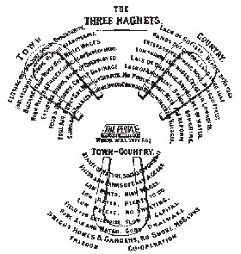
“THE THREE MAGNETS”
TOWN (Opportunity for work, high wages, and amusement)
COUNTRY (Natural beauty, low rents, fresh air, good health)
TOWN-COUNTRY (Combination of both)
Howard presented garden cities as a third magnet to urban and rural life, with none of their drawbacks and ‘all the advantages .secured in perfect combination’.
The values expressed in the third magnet capture the various social concerns he wished to address:
housing affordability,
a sense of community,
full employment,
a high amenity living environment,
access to nature

Slide 25
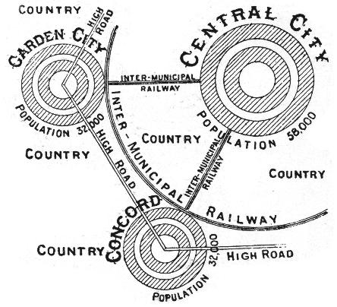
GARDEN CITY CONCEPT
Howard proposed garden city as the satellite town to the central city.
Population limited to 30,000-40,000
Garden city is not a result of the sprawl by the major central city.
Therefore a new city has to be founded in a reasonable distance of about 7 km to the others to protect the countryside.
The cities are well connected through a railway system to exchange goods.

Slide 26
MAIN FEATURES OF GARDEN CITY
It contains open spaces & gardens all around the dwelling houses &
the factory buildings,
He advocated the population to be between 30,000-40,000; such that inhabitants may live near their work place, near their shops, social places & open country.
Garden city would be the city owned by all citizens on cooperative basis. Co-operative holding of land to ensure that appreciation of land values goes to the community & not to the private individuals,
It is an independent entity having its own civic life, & affording all the daily needs with adequate space for schools, parks, playgrounds, & other functional purposes.
It is a self-contained unit having its own industries.
The principles of zoning are applied to the city & no alterations in the land use is permitted.

Slide 27
FACTORIES

Slide 28
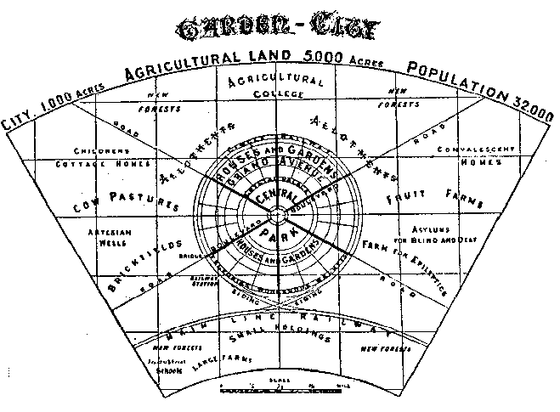
Howard’s basic idea was to plan and build new towns. Each would have about 6,000 or so acres and be able to accommodate about 30,000 citizens. In the middle of the acreage would be a cluster of residences, businesses, public buildings, and parks.
Residences would be constructed for people in all the income brackets. The neighbourhoods would be mixed, with the well-to-do and not so well-to-do living near one another. No one would own the land upon which his or her home or apartment lay. The ground rents would cover the costs of public services, infrastructure and the land. After the debt was retired, the rent monies would be reinvested in the community.
A place of prominence would be reserved for the government buildings. Interspersed throughout the urban area would be vegetable and flower gardens, wooded areas, and green parks. Surrounding the urban area and encompassing about eighty percent of the total acreage would be farmland. The farms would provide food to the citizens of the garden city. Because of the proximity of rail lines, the farms could also easily ship foodstuffs to further away markets.
Howard envisioned a network of these garden cities throughout England. Whenever the population of a city expanded beyond the optimal 30,000 people, a new city would be built. The nasty, big cities from which the people had originally fled would die and, out of their ashes, the garden city "phoenix" would rise.
PLANNER’S VISION :

Slide 29
LETCHWORTH GARDEN CITY
First garden city – built in 1903, 48 kms. From central London
Land was purchased from about 15 different owners & the area was about 1586 ha.
Additional land was added subsequently, bringing the land area to be 1851 ha.
The new town was planned by barry parker & raymond unwin for an estimated population of 35,000.
At present, letchworth forms a pleasant town situated in the country with a green belt of around 1200 ha.
It is an independent city with a complete municipal life of its own and it is a self-contained community with industries, etc for all its needs.
It is planned as the home of all kind of industries with facilities of cheap light, power, fuel & water.
It is designed to meet the requirements of workers and laborers so as to keep them healthy & efficient.
Letchworth is meant for people of all classes; the owners as well as workers.

Slide 30
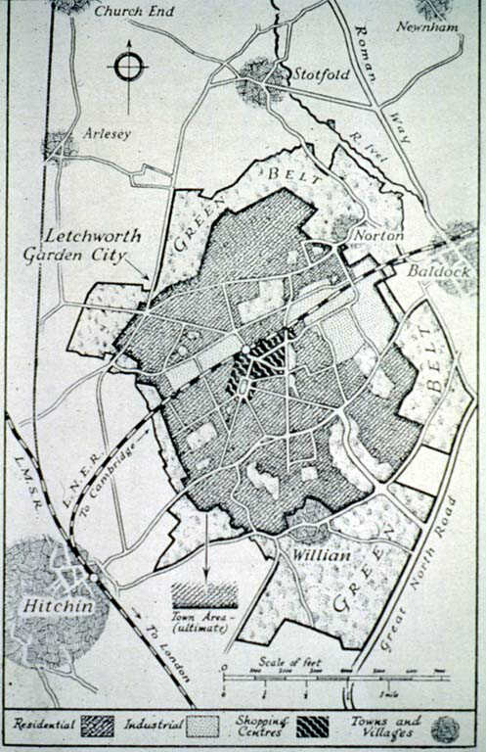
GREEN BELT
CITY CENTER (SHOPPING CENTER & IMPORTANT PUBLIC BUILDINGS
RAILWAY LINE
GREEN BELT

Slide 31
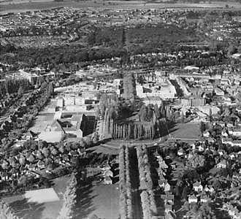
LETCHWORTH GARDEN CITY
The rest of the large space encircled by the 'Crystal Palace' is a public park, containing 145 acres, which includes ample recreation grounds within very easy access of all the people.
Running all round the Central Park (except where it is intersected by the boulevards) is a wide glass arcade called the 'Crystal Palace', opening on to the park. Here manufactured goods are exposed for sale, and here most of that class of shopping which requires the joy of deliberation and selection is done. A considerable part of it is used as a Winter Garden --the whole forming a permanent exhibition of a most attractive character, whilst its circular form brings it near to every dweller in the town--the furthest removed inhabitant being within 600 yards.
Passing out of the Crystal Palace on way to the outer ring of the town, the Fifth Avenue - lined, as are all the roads of the town, with trees--fronting which, and looking on to the Crystal Palace.
A ring of very excellently built houses, built either in concentric rings, facing the various avenues, or fronting the boulevards and roads which all converge to the centre of the town. In the town 5,500 building are of an average size of 20 feet x 130 feet--the minimum space allotted for the purpose being 20 x 100.
Parker and Unwin's preliminary plan for the First Garden City, 1903.

Slide 32
WELWYN GARDEN CITY
Welwyn Garden City was started immediately after World War I and the max. residential density was raised to 12 houses/acre, to cover the increased demand, with a population of 40-50,000 on 4536 acres.
The first houses were designed by Crickmer and built in 1920 on Handside Lane. They are of the Letchworth tradition and very simple in construction.
De Soissons' original plans had a similar relation between formal and informal, with winding roads. A large use is made of cul de sacs to make maximum use of the land with minimum service expenditure.
A much nicer overall composition aesthetically. De Soissons chose for the town's main style the red-brick Georgian architecture of surrounding Hertfordshire rather than the Letchworth tradition.
Certain aspects did give it an individual rural character. One important feature was the lack of metalled roads suitable for road traffic. The two original Garden Cities had rolled gravel roads on flint hardcore, of varying standard widths dependent on their use.
Welwyn Garden City Site Plan (1927)

Slide 33
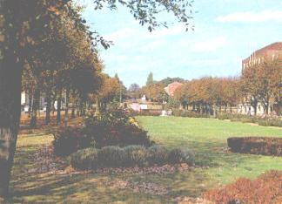
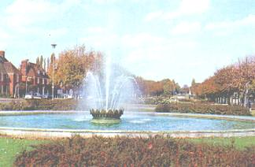
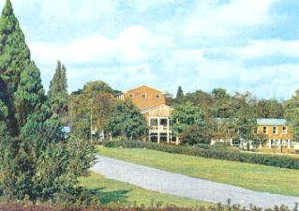
WELWYN GARDEN CITY
Most of the roads had no visible curb stones, or pavements and so the grass verges moulded into the roads in a very country manner.
At Welwyn, “there was no money for embellishments.” The roads therefore follow the contours of the land wherever possible so that the greatest amount of land could be developed at the lowest cost.
The radiating boulevards of Howard's diagrams have produced a similar symmetrical/limiting town plan. Welwyn nearly avoided the formal avenue. Only the town centre has them and its position makes it the most visually attractive part of the town. A progression away from the formal to the informal is present.
At focal points, large trees were planted in groups to make features in the roads and cul de sacs. No public houses were built; the council built a single community centre on the periphery of the town, and a single theatre held a monopoly together with the department store. Only now, and it is still in course of construction, has a possibly satisfactory amenities centre come into being.
Welwyn Garden City: Campus & Parkway

Slide 34
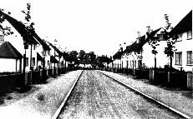
THE GARDEN CITY STYLE
The idea of the promoters of the Garden City was not to build an artistic town. But there still remains a strong resemblance of planning and architectural style aesthetically between all the Garden Cities and Suburbs.
The style has had a vast influence on the New Towns, and it is this more than anything that has affected living conditions within them.
The "style" is medieval, with strong associations with the imminent "arts and crafts cottage style". A large use is made of dormer windows, steep gabled roofs with low eves, sometimes mansard.
Strong use is made of the "inward-looking" cul-de-sac and of cottages collected around "natural" greens.
Narrow, informally winding gravel roads, between avenues of trees; the Garden City aesthetic at its best.
The axis for the town at Letchworth was established because of the positions of three old oak trees on the site; an important step for future planning. Letchworth was planned basically by the constraints of the site.
These were the reasons for the style that was evolved and had a strong influence on all town planning since. The creation of a medium between social reform of the squalid cities and the integration of nature.
First Garden City Heritage Museum, Letchworth
Letchworth: Straight curbed roads with uniform planting

Slide 35
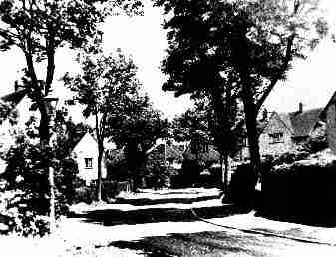
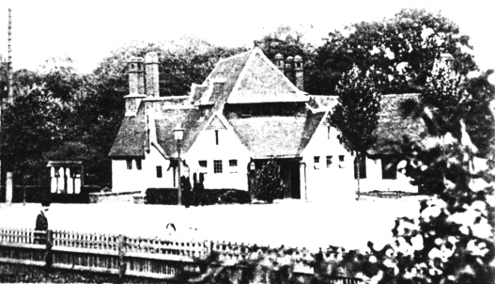
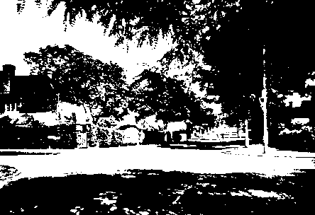
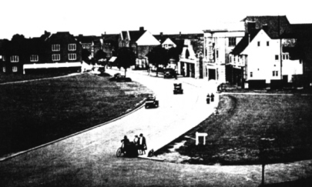
Rushby Mead, Letchworth (1908)
The Mrs. Howard Memorial Hall designed by Peter and Unwin, meeting place of the Letchworth community for many years.
Lytton Avenue, Letchworth
LETCHWORTH---Eastcheap, Cinema and Garage

Slide 36
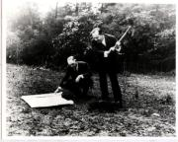
In the early 1920's, American architects Clarence Stein and Henry Wright, inspired by Howard's ideas and the success of Letchworth and Welwyn, created the city of Radburn, New Jersey.
Conceived as a community which would be safe for children, Radburn was intentionally designed so that the residents would not require automobiles.
Several urban planning designs were pioneered at Radburn that would influence later planned communities, including the separation of pedestrian and vehicle traffic, and the use of "superblocks," each of which shared 23 acres of commonly held parkland.
THE MOVEMENT COMES TO AMERICA: RADBURN, NEW JERSEY
THE NEW DEAL TOWNS
Following the economic depression of 1929, there was great demand both for affordable housing and employment. In response, three greenbelt towns were built: Greenbelt, Maryland; Greenhills, Ohio; and Greendale, Wisconsin. These towns contained many of the elements of the Garden City Movement developments, including the use of superblocks and a "greenbelt" of undeveloped land surrounding the community.
The idea spread rapidly to Europe and the United States, but it commonly resulted in residential suburbs of individually owned homes.
The congestion and destruction accompanying World War II greatly stimulated the garden-city movement, especially in Great Britain, where over a dozen new communities were developed based on Howard's idea. The open layout of garden cities has had a great influence on the development of modern city planning.
Radburn, New Jersey, 1929
The groundbreaking of Greenbelt, 1935.

Slide 37
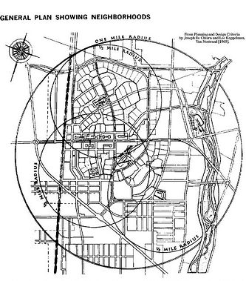
Radburn is the famously bold departure from traditional street-oriented suburban neighbour-hood planning in the United States.
Gardenesque, pedestrian-accessible, child-friendly, vehicle-free open space is the heart and the identity of the neighbourhood.
Made as a residential satelite town to New York.
Total area is 640 acres.
Concept of segregation of traffic is followed.
Planning is done in terms of whole neighbourhood area known as superblock.
Superblock are enclosed by main roads which in turn enclose the narrow lanes.

Slide 38
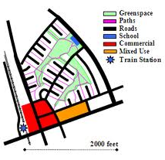
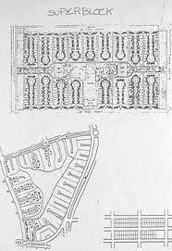
System of interconnected green spaces. Large open spaces in the centre of superblocks, on which the houses face, are joined together by pathways to form a continuous park.
Use of cul de sacs prevents through traffic from entering the residential areas. Cul de sacs are suitable only for large plots and space utilization is limited.

Slide 39
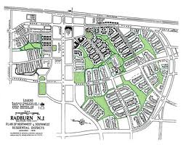

Slide 40
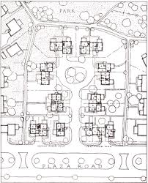

Slide 41
SUMMARY AND COMPARISON
ASPECT | INDUSTRIAL | MODERN / POST INDUSTRIAL
TIME | 17TH CENTURY TO WORLD WAR | POST WORLD WAR TILL PRESENT
CONTEXT | CHANGE FROM AGRARIAN TO MECHANICAL MEANS TECHNOLOGICAL ADVANCEMENT | BYPASSING PHASE OF SOCIETY PREDOMINATED BY A MANUFACTURING-BASED ECONOMY AND MOVES ON TO A STRUCTURE OF SOCIETY BASED ON THE PROVISION OF INFORMATION, INNOVATION, FINANCE, AND SERVICES.
SOCIETY AND ECONOMIC STRUCTURE | MIGRATION FROM RURAL – URBAN AREAS RESULTING IN HIGH INCREASE OF URBAN POPULATION INCREASE IN THE AVERAGE INCOME, RISE OF CAPITALISM, ORGANISATION OF LABOUR | THESE INNER CITY AREAS HAVE BEEN LEFT BEHIND BY A MASSIVE MIGRATION TO THE SUBURBS KNOWLEDGE BECAME AN IMPORTANT FORM OF CAPITAL

Slide 42
ASPECT | INDUSTRIAL | MODERN / POST INDUSTRIAL
MAIN FEATURES OF CITY STRUCTURE | FACTORIES AT THE CENTRE / ALONG WATER BODIES WITH POOR HOUSING AREAS NEAR THEM THE HOMES OF THE WEALTHIER RESIDENTS IN THE PERIPHERY. | NEW CONCEPTS EMERGED - GARDEN CITY, IDEAL CITY, UTOPIAN CONCEPTS, CITY BEAUTIFUL MOVEMENT LE CORBUSIER, FRANK LLOYD WRIGHT, PAOLO SOLERI, ETC DESIGNED CITIES ON PAPER. ALTHOUGH FEW HAVE BEEN REALIZED IN PURE FORM, THEY INFLUENCED THE LAYOUT OF MANY NEW TOWNS AND URBAN REDEVELOPMENT PROJECTS.
 | FOCUS ON THE CITY CENTER, WHICH CONTAINED BOTH THE CBD AS WELL AS SUBSTANTIAL NUMBERS OF FACTORY AND WAREHOUSE STRUCTURES. DEVELOPMENT OF THE SKYSCRAPER BETWEEN 1870 AND 1900 | THE CITY OF TODAY MAY BE DIVIDED INTO TWO PARTS: AN INNER ZONE, COEXTENSIVE WITH THE BOUNDARIES OF THE OLD INDUSTRIAL CITY. SUBURBAN AREAS, DATING FROM THE 1920S DESIGNED FOR THE AUTOMOBILE FACTORY DECENTRALIZATION

Slide 43
ASPECT | INDUSTRIAL | MODERN / POST INDUSTRIAL
ISSUES | THE INCREASING CROWDING, SLUMMING, POLLUTION, GROWTH IN CHILD LABOUR AND DISEASE IN THE CENTRAL CITY - FACING URBAN DECAY PRODUCED A GROWING DESIRE TO ESCAPE TO A HEALTHIER ENVIRONMENT IN THE SUBURBS. WHICH WAS FACILITATED BY THE AUTOMOBILES AND BUILDING OF ROADWAYS

Slide 44
PLANNING TODAY
MAIN TOOL: ZONING
IMPOSES A RIGIDITY TO EXISTING LAND USES
ENCOURAGES SEPARATION BY CLASS
ENCOURAGES RETAIL STRIP DEVELOPMENT
DISCOURAGES MIXED USE, PEDESTRIAN AREAS
WORLD CLASS CITY AND GLOBAL CITY
SUSTAINABLE DEVELOPMENT
PUBLIC PARTICIPATION
INCLUSIVE PLANNING

Slide 45
NEW URBANISM
PROMOTES THE CREATION AND RESTORATION OF DIVERSE, WALKABLE, COMPACT, VIBRANT, MIXED-USE COMMUNITIES WITH INCREASED USE OF TRAINS AND LIGHT RAIL, INSTEAD OF MORE HIGHWAYS AND ROADS.
PRINCIPLES
WALKABILITY
CONNECTIVITY
MIX USE & DIVERSITY
MIXED HOUSING
QUALITY ARCHITECTURE & URBAN DESIGN
TRADITIONAL NEIGHBOURHOOD STRUCTURE
INCREASED DENSITY
SMART TRANSPORTATION
SUSTAINABILITY
QUALITY OF LIFE

Slide 46
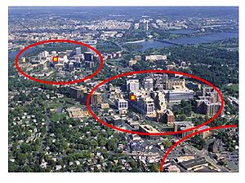
TRANSIT-ORIENTED DEVELOPMENT
COMPACT, WALKABLE, MIX USE COMMUNITIES CENTERED AROUND HIGH QUALITY TRAIN SYSTEMS. HIGHER QUALITY LIFE WITHOUT COMPLETE DEPENDENCE ON A CAR.
PRINCIPLES
WALKABLE DESIGN WITH PEDESTRIAN AS THE HIGHEST PRIORITY
TRAIN STATION AS PROMINENT FEATURE OF TOWN CENTER
A REGIONAL NODE CONTAINING A MIXTURE OF USES
HIGH DENSITY, HIGH-QUALITY DEVELOPMENT WITHIN 10-MINUTE WALK CIRCLE SURROUNDING TRAIN STATION
COLLECTOR SUPPORT TRANSIT
DESIGNED TO INCLUDE THE EASY USE OF BICYCLES
REDUCED AND MANAGED PARKING INSIDE 10-MINUTE WALK CIRCLE AROUND TOWN CENTER / TRAIN STATION
High - density areas
Low - density areas
TRANSIT STATION

Slide 47
FORM BASED CODE
MEANS OF REGULATING DEVELOPMENT TO ACHIEVE A SPECIFIC URBAN FORM. FORM-BASED CODES CREATE A PREDICTABLE PUBLIC REALM BY CONTROLLING PHYSICAL FORM PRIMARILY, WITH A LESSER FOCUS ON LAND USE, THROUGH CITY OR COUNTY REGULATIONS.
FORM-BASED CODES ADDRESS THE RELATIONSHIP BETWEEN BUILDING FACADES AND THE PUBLIC REALM, THE FORM AND MASS OF BUILDINGS IN RELATION TO ONE ANOTHER, AND THE SCALE AND TYPES OF STREETS AND BLOCKS.
FORM-BASED CODES COMMONLY INCLUDE THE FOLLOWING:
REGULATING PLAN. A PLAN OR MAP OF THE REGULATED AREA DESIGNATING THE LOCATIONS WHERE DIFFERENT BUILDING FORM STANDARDS APPLY, BASED ON CLEAR COMMUNITY INTENTIONS REGARDING THE PHYSICAL CHARACTER OF THE AREA BEING CODED.
PUBLIC SPACE STANDARDS. LIKE SIDEWALKS, TRAVEL LANES, ON-STREET PARKING, STREET TREES, STREET FURNITURE.
BUILDING FORM STANDARDS. REGULATIONS CONTROLLING THE CONFIGURATION, FEATURES, AND FUNCTIONS OF BUILDINGS THAT DEFINE AND SHAPE THE PUBLIC REALM.

Slide 48
BIBLIOGRAPY
WEBSITES:
Chester Memories by Chester Chronicle
Wikipedia
www.art.net
www.cartage.org
http://web.viu.ca/alexander2/346-08-days5&6.ppt
http://architecturalguidance.blogspot.com/
http://userwww.sfsu.edu/%7Edlegates/PowerPoint/planning/planning.ppt
http://www.kunstler.com/spch_FL_AIA.html
http://en.wikipedia.org/wiki/City_Beautiful_movement
BOOKS:
American City Planning Since 1890 by Mel Scott
Town Planning Regeneration of Cities by Ashutosh Joshi
The Urban Pattern, By Simon Eisner, Arthur Gallion, Stanley Eisner
M. Pratap Rao, Urban Planning (Theory and Practice), 2005
Rangwala, Town Planning, 2005
ISSUED PAPERS:
From the industrial revolution to Sustainability Development by Robert Freestone

