Slide 1
Subject: Principles Of Human Settlements-I
Topic: Indus Valley Civilization(2500-1900)bc
Presented by: Pallavi Tiwari

Slide 2
INDUS VALLEY CIVILIZATION(2500-1900)BC
GEOGRAPHY OF INDUS VALLEY CIVILIZATION
IMPORTANT CITY SETTLEMENTS OF CIVILIZATION
HARAPPA , MOHENJODARO , LOTHAL
NATURE OF TOWN PLANNING
NATURE OF URBANIZATION

Slide 3
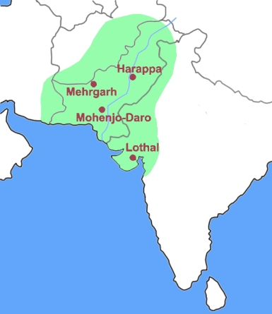
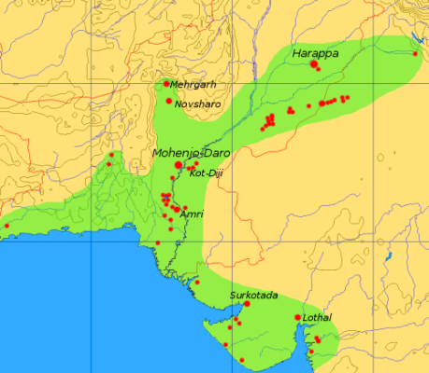
GEOGRAPHY OF INDUS VALLEY CIVILIZATION
Flourished in western part of the India around the Indus river basin.
Encompassing most of Pakistan, as well as extending into the westernmost states of India, southeastern Afganistan, and the easternmost part of Iran
The twin cities of Mohenjo-daro and Harappa formed the hub of the civilization with Lothal and other Indian sites.
The mature phase of this civilization –
Harappan Civilization, Harappa excavated in the 1920s in Punjab province of Bristish India.
Mohenjo-daro ,located in the province of Sindh , Pakistan

Slide 4
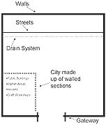
1.HARAPPA - NATURE OF TOWN PLANNING
affirms that civic organizations of the city were highly developed.
No division of the society is reflected in the layout of the city.
The city of Harappa had defensive outer walls
Outside the city walls a cluster of houses which ranged from two roomed to large buildings representing temporary rest stops for travelers and caravans.
The citadels faced the west, which acted like sanctuaries at the time of aggression and during peace they played the role of community centers.
Most of these settlements were built of bricks, chiseled stones and burnt bricks.
NATURE OF URBANIZATION
ROAD NETWORK
The streets were laid in grid iron pattern
street layout was oriented toward the cardinal directions
These streets divided the city into 12 blocks.

Slide 5
HOUSES
Basic house plans ranging from single room tenements to houses with courtyards up to 12 rooms to great houses with several dozen rooms and several courtyards.
This courtyard served the multiple functions of lighting the rooms, acting as a heat absorber in summer and radiator in winter, as well as providing an open space inside for community activities..
Nearly all houses had private wells.
The doors of the houses opened in the lanes and not on the roads.
The houses were built on plinths that rose above the street level with stairs recessed at the wall at the front door.
GRANARY
Agriculture was their primary profession.
This is evident from the availability of the granary in the city.
The granary was constructed on the high foundation of the burnt bricks.

Slide 6
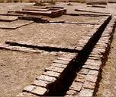
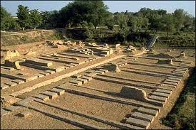
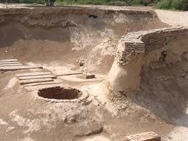
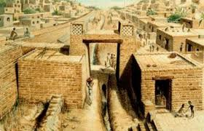
DRAINAGE
detailed account of a very good drainage and sanitary system.
Bathrooms in every house with chutes leading to drainage channels.
Drains started from the bathrooms of the houses and joined the main sewer in the street. In order to check the maintenance, inspection holes were provided.
The drains were covered and connected to the bigger sewerage outlets, which ensured the channel of dirt out of the city.
Indus valley civilization , Harappa
PUBLIC STRUCTURES
Harappans exhibit skill in town planning and in building structures, including drainage systems.
central storehouses, lines of workers dwellings, and communal bathhouses indicate the presence of a government and a regimented way of life.

Slide 7
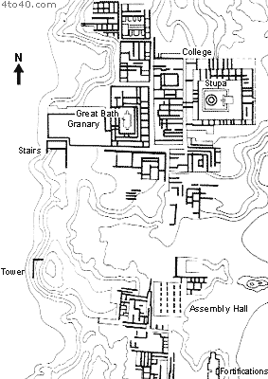
2.MOHENJODARO - NATURE OF TOWN PLANNING
Planned layout based on a grid of streets(grid iron plan), laid out in perfect patterns.
Located in two mounds ,one was (1183x546)m
and the other was (364x273)m.
Divided in 12 blocks by 9m wide street.
Physical orientation of all urban settlements shows a ‘regular orientation’.
Two principal elements-
West – Citadel built on high platform of mud and brick, with axis of north and south.
Citadel – religious and secular headquarters.
Assembly hall, large building college, Stupa
East - Lower city, built on grid iron pattern.
Great bath and granary.

Slide 8
NATUR E OF URBANIZATION
HOUSES
structures of same-sized sun dried bricks of baked mud and burned wood
Individual homes or groups of homes obtained water from wells.
Some of the houses included rooms that appear to have been set aside for bathing
Houses opened only to inner courtyards and smaller lanes.
CITY WALLS
Each city in the Indus Valley was surrounded by massive walls and gateways
Built to control trade and also to stop the city from being flooded
Each part of the city was made up of walled sections.
STREETS
city streets on a grid system,oriented east to west with well organized drain system
CULTURE AND ECONOMY
The Harappans used chisels, pickaxes, and saws.
Tools made of copper, as copper tools and weapons (found at Harappan sites)
Cotton was woven and dyed for clothing
wheat, rice, and a variety of vegetables and fruits were cultivated
Wheel-made pottery, adorned with animal and geometric motiffs

Slide 9
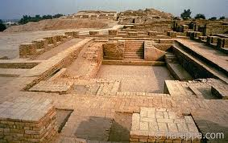
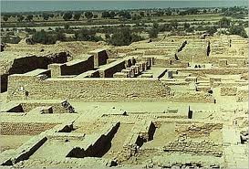
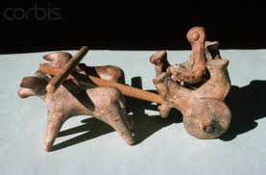
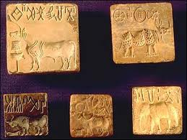
NATUR E OF URBANIZATION
LANDMARKS
Public buildings of these cities also suggest a high degree of social organization
CIVIC GRANARY
An enormous platformed , well-ventilated structure for storage.
Food was brought in by boat and carried through the broad roads by bullock cart.
System of exchange was through barter, and grain was the source of wealth on which the entire economy was founded.
THE GREAT BATH
large rectangular pool 2m deep with steps leading into it from the narrower ends.
bricks tightly packed and lined with bitumen to make the pool waterproof.
The elaborate water supply system and drainage network for the Great Bath make it one the most intriguing structures at Mohenjodaro.

Slide 10
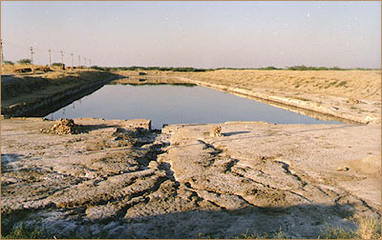
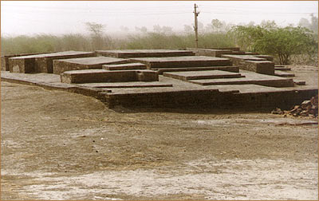
3.LOTHAL - NATURE OF TOWN PLANNING
Divided into blocks of 1-2-metre-high platforms bricks to protect against floods
The city was divided into a citadel, or acropolis and a lower town.
Acropolis- featured paved baths, underground and surface drains ;potable water well The lower town was subdivided into two sectors .
a.north-south arterial street was the main commercial area flanked by shops
b.The residential area was located to either side of the marketplace.
Lothal had an elaborate sanitary and drainage system.
HIGHLIGHTS
dockyard& warehouse to serve purposes of naval trade.
dock was built on the eastern flank of the town spanning
an area 37 m (east to west) and 22 m (north to south)
Warehouse built close to the acropolis on a 3.5m high
podium of mud bricks.
work in metallurgy, seals, beads and jewellery was the basis of their prosperity.

Slide 11
Subject: Principles Of Human Settlements-I
Topic: Indus Valley Civilization(2500-1900)bc
Presented by: Fazlur Rahman

Slide 12
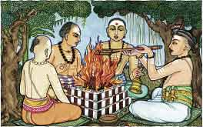
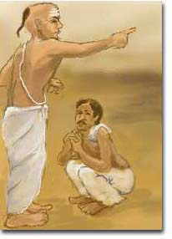
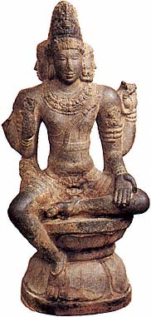
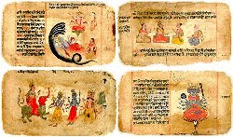
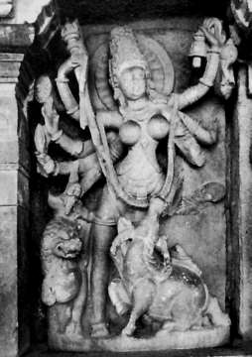
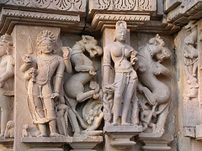
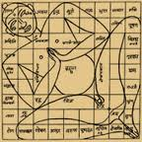
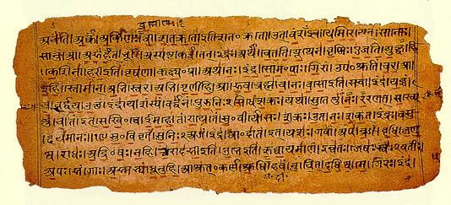
Vedic Civilisation - Aryans
contents:
Region of Civilization
Innovations
Aryan village
Time line: 1500-500 B.C:
Early Vedic period(1500 BC to 1000BC)
Later Vedic Period(1000BC to 500 BC)

Slide 13
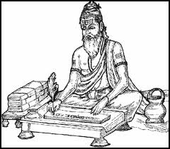
ARYANS
1800 BC-1500 BC Aryans came to South Asia
Migrated through Russia and passes in the Hindu Kush mountains
Suggests that Aryans played a role in the end of the Harappan civilization.
The Vedic Civilization flourished along the river Saraswati, centered on Indo- Gangetic plane, in a region that now consists of the modern Indian state of Haryana and Punjab
Aryan people and Indus River valley civilization eventually
blended into one culture
This culture was concentrated in both the Indus River
valley and the Ganges River valley

Slide 14
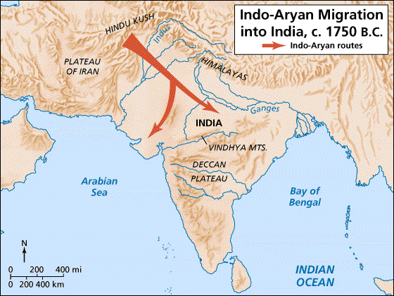
REGION OF THE CIVILIZATION

Slide 15
ARYANS INFLUENCE ON SOUTH ASIA
A New People, a New Civilization
Aryans were very different from the Indus River valley people.
Spoke the language of Sanskrit Sanskrit.
Nomads and herders (never lived in cities).
Eventually settled in Northern India.
Established many small kingdoms
LIFE OF ARYANS
CLOTHING AND HOUSING:
Clothing was initially made of animal skins and later with cotton.
The people in the Vedic period lived in wooden huts. Some homes were made of wood, but not until later, during the Epics Period.

Slide 16
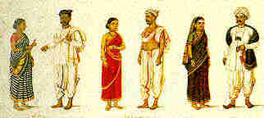
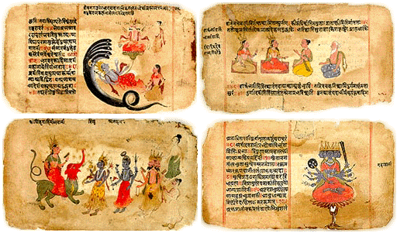
INNOVATIONS
Scripts of Ramayana & Mahabartha
Vedas
Political organization
Society and economy (Caste system )
religious mathematics & ritual mathematics - Sulba-sutras (education)
Vasthu
VEDAS:
RigVeda: It describes musical hymns which are meant to be spiritual songs enjoyed by believers meeting in the local areas.
SamaVeda: Basically meant for singing the mantras.
YajurVeda: Yajur is derived from the word 'yajus', literally respect, veneration or sacrifice'. It describes hymns in prose, and the mantras are basically used in sacrifices.
AtharvaVeda: It has mantras to be used for various special purposes

Slide 17
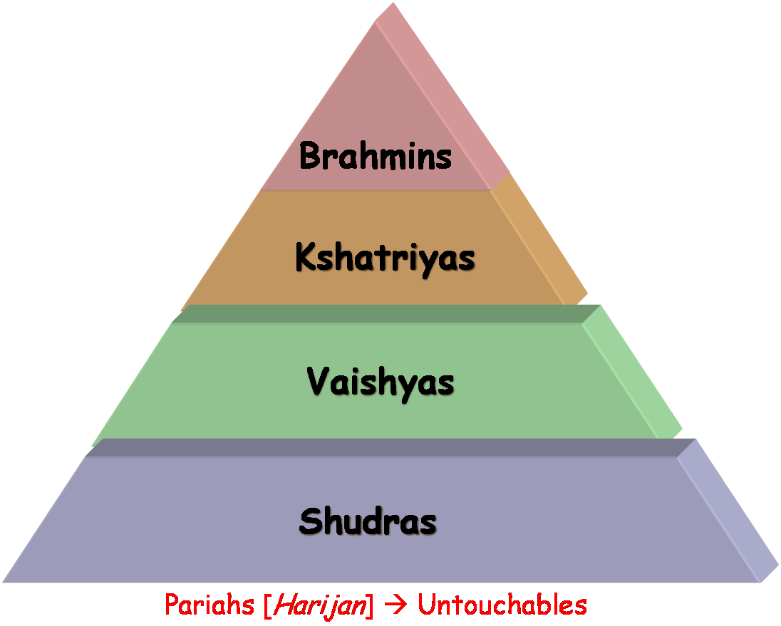
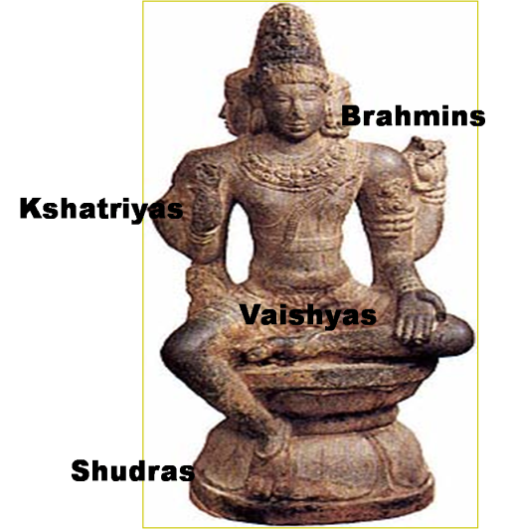
POLITICAL ORGANIZATION
SOCIETY (CASTE SYSTEM )
The grama (wagon train), vis and jana were political units of the early Vedic Aryans.
A vish was a subdivision of a jana or "krishti", and a grama was a smaller unit than the other two.
The leader of a grama was called gramani and that of a vish was called vishpati.
Society was strictly organized in a system of caste
Divided into 4 major varnas
ADMINISTRATION
Tribes settled down in villages, they began to rapidly clear the forests for cultivation.
The civil administration of the Aryan village was left to 'samitis' and ‘sabhas’, which are general body and executive committee of today.
The elected chief was to be guide by the sabhas.
WHO IS…WHO
The mouth?
The arms?
The legs?
The feet?

Slide 18
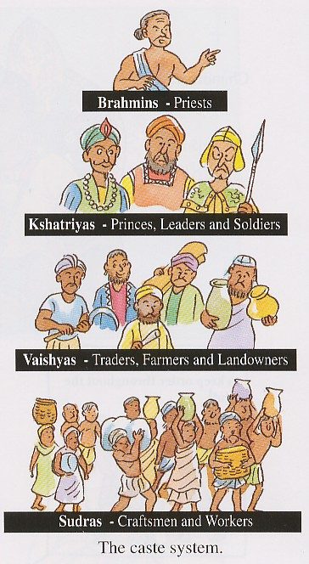
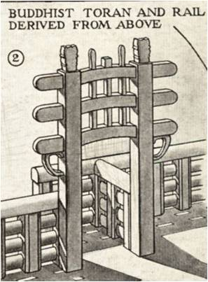
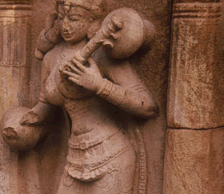
ART & ARCHITECTURE
Vedic Art was extremely elevated with Bharatnatyam, drama, sculpture ,poetry.
There are 300,00 verses of the Vedic scriptures describing them.
The buildings were constructed from solid stones, having decorated walls inlaid with gemstones.
OCCUPATION

Slide 19
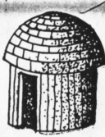
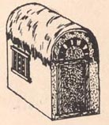
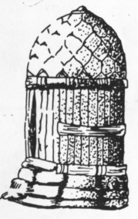
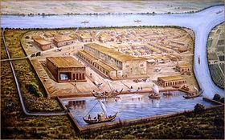
ARYAN VILLAGE
ARYAN’S RESIDENTIAL UNIT
Aryan invaders – familiar with the use of timber and able to adapt their carpentry skills easily to wooden structures.
Simpler and easier to maintain , or to rebuild in case of floods and rains.
Brick structures – symbolic to the people whom they have conquered.
The early Aryan village – conglomerate of timber and thatch huts of different types.
The Aryan hut - basic shape - circular in plan - with a thatched roof over a bamboo network of ribs.
Later elongated to become rectangular in plan, with roofing of bamboo - curved in the shape of a barrel.

Slide 20
Clusters of these huts(grama) formed a courtyard – resembles huts in Indian villages even today.
The better-off citizens roofed them with planks of wood or tiles, and used unbaked bricks for the walls
To maintain the barrel shape of the roof, a thong or string, perhaps of animal hide, was stretched across the end of the bamboo.
For protection against wild animals - a palisade fence of wood and bamboo surrounded the whole settlement.
This fence was made of upright posts(thabha) of bamboo with horizontal members(suchi) threaded into holes in posts.
Controlled entry – cattle to pass to and fro of pasturage.

Slide 21
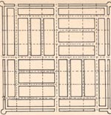
LAYOUT OF IDEAL VEDIC VILLAGE - ARTHASHASTRA
The cities of the Vedic period - rectangular in plan. Divided into four quarters by two main thoroughfares intersecting at right angles, each leading to a city gate.
One of these quarters contained the citadel and another housed the residential area.
A third quarter was reserved for the merchants, and the last for tradesmen who could display their wares.
citadel
residential
merchants
tradesmen

Slide 22
IDEAL VEDIC VILLAGE………
An ideal town was laid out as square with grid iron pattern.
The main streets – north south directions,remaining three east west directions.
A number of the living cities of today are built over ancient sites.
From these modest beginnings, early Hindu architecture gradually metamorphosed into the magnificent Buddhist stupas and the rock-cut caves at Ajanta.

Slide 23
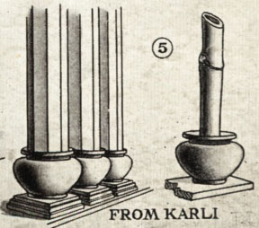
CITY OF KASINGARA NEAR MAGADHA , IN BIHAR
At one point, the fence was extended forward to form a sort of gate – Gramadwara
These forms - the barrel vaulted roof, the tie-cord, and the palisade fence and railing, formed important motifs for future Indian Architecture. Eg:Torana –Bhudhist archway.
Huts in modern Orissa -one of the poorest Indian states - carrying traces of this influence, with symbolism dating back to Vedic times.

Slide 24
CITY OF KASINGARA NEAR MAGADHA , IN BIHAR
With the conversion of the early Vedic people into agriculturalists, a growing rivalry for precious fertile land was inevitable.
Groups of small villages banded together, and small 'cities' began to take shape
Material and Construction …..
A palisade wall inevitably protected the cities and the buildings within made entirely of wood.
The Vedic carpenters developed skill in timber construction of a very high standard.
In later ages timber construction techniques were employed even though the material of construction was radically different - i.e. stone.

Slide 25
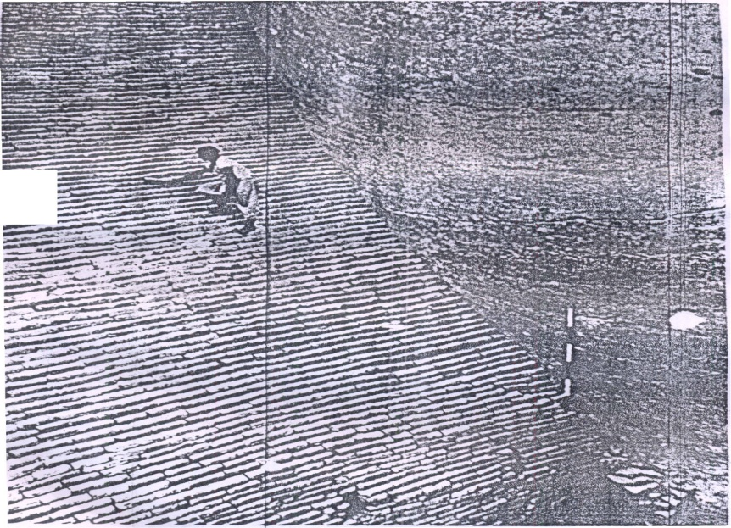
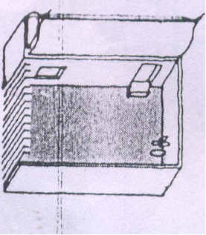
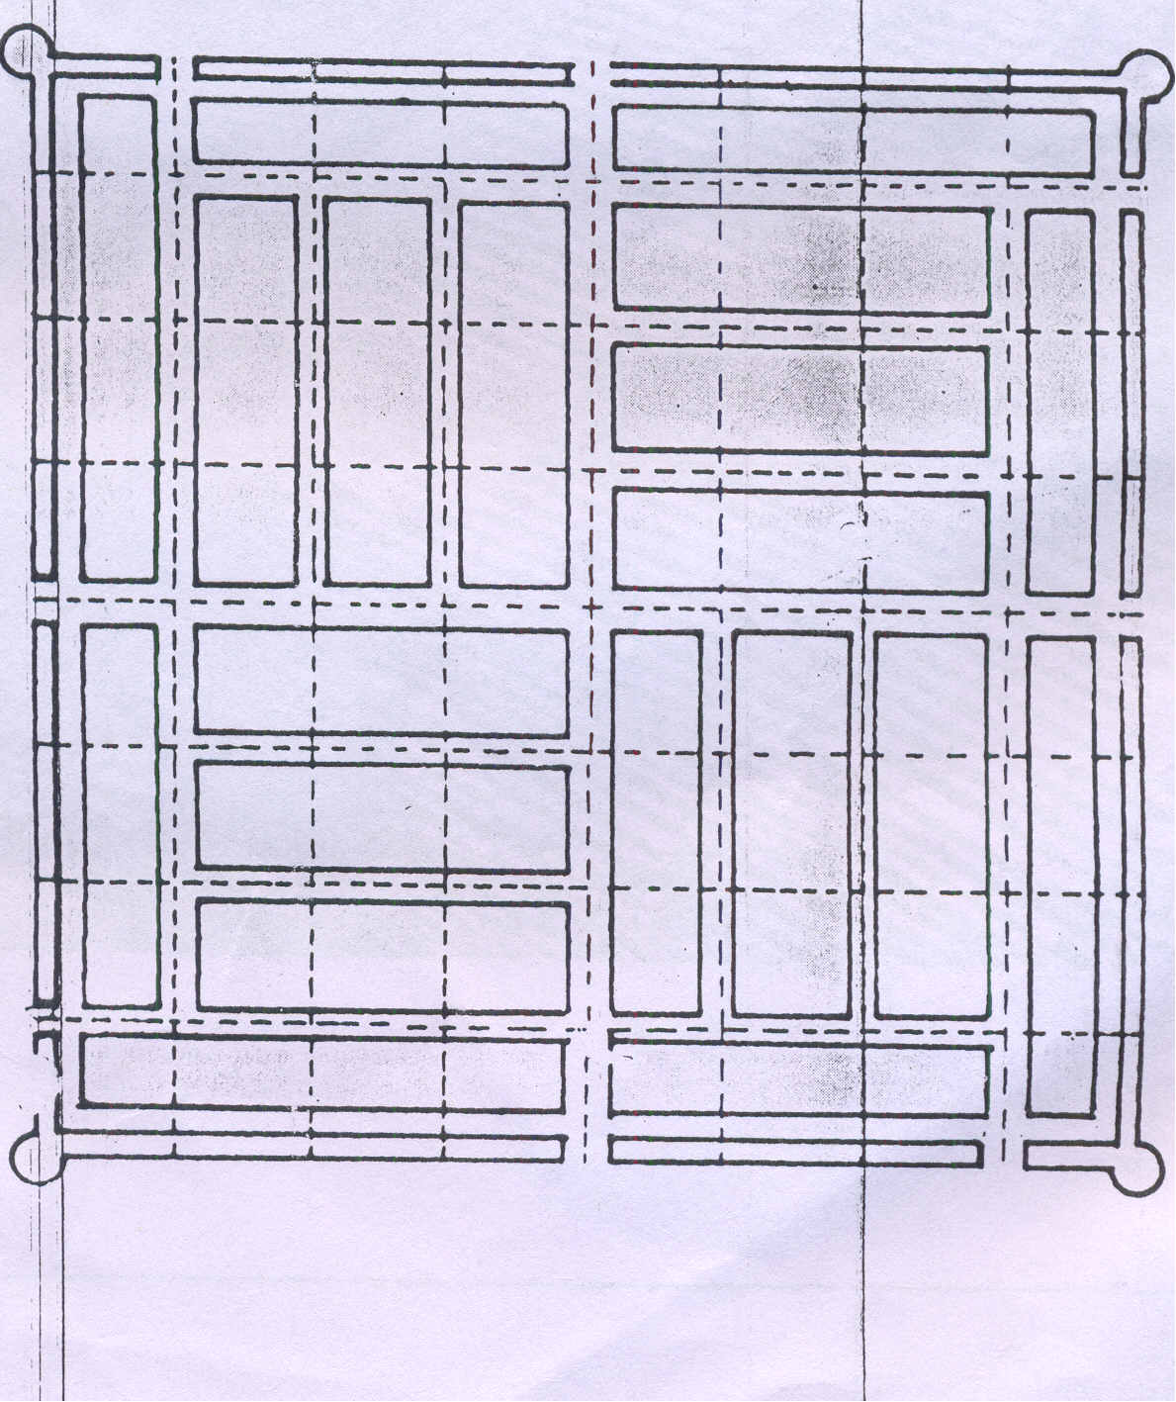
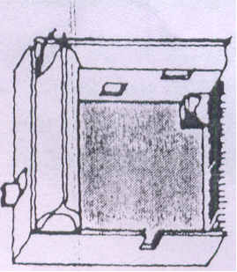
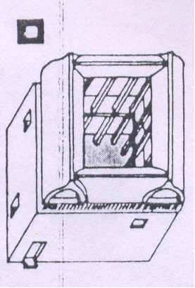
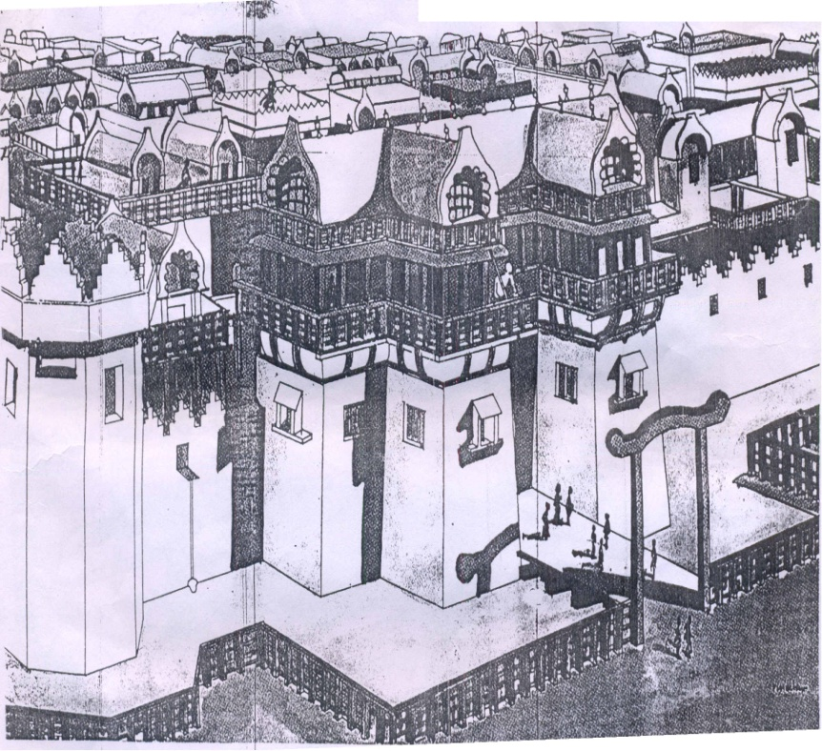
The excavated remains of the parts of Kausambi city.
Layout of an ideal Vedic town and design houses, as told in Artha shastras.
The gate and city of Kusingara near Magadha in Bihar.
Source: Buddhist and Hindu Architecture by Satish Grover

Slide 26
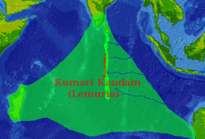
Background history
Dravidians
Most of the Ethnologists believe that Dravidians in India is a branch of Elamite race who founded the civilization at Sumeria and Indus Valley. They reached India in prehistory and evolved in India at about 15000 BC. Dravidians became the elite inhabitants of India. The Dravidian civilization was found in the prehistory. They are also called Indus Valley people as it is one of the greatest and earliest civilizations world has ever seen.
The term Dravidian civilization refers to the civilization of the ancient speakers of the proto-Dravidian languages.
Many scholars believe that before the arrival of the Indo-Aryans in the Indian subcontinent, the speakers of the proto-Dravidian languages were widespread throughout the subcontinent. This pre-Vedic civilization is often referred to as "Dravidian civilization".
"Lemuria" in Tamil nationalist mysticist literature, connecting Madagascar, South India and Australia (covering most of the Indian Ocean).
Kumari Kandam is a legendary sunken kingdom. During a violent geologic catastrophe the entire island was submerged under the water. The survivors migrated to the present Indian subcontinent and supposedly sparked the Indus Valley Civilization.
According to these modernist interpretations of motifs in classical Tamil literature — the epics Cilappatikaram and Manimekalai that describe the submerged city of Puhar— the Dravidians originally came from land south of the present day coast of South India that became submerged by successive floods, which was about 152 miles south of present day Kanyakumari. It goes on to describe the civilization with exactly 16008 streets, which was the cradle of civilization.

Slide 27
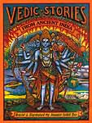
Dravidian is the name attributed to a linguistically distinct group of people in South India. Believed to be the first original settlers of ancient India, the group has maintained traditional customs and rites, while with the influence of modernity, some have developed the lifestyles of a modern society.
The Dravidian family of languages includes approximately 85 languages, spoken by around 200 million people. Among them Telugu, Tamil, Kannada and Malayalam are the members with the most speakers. There are also small groups of Dravidian-speaking scheduled tribes, who live beyond the mainstream communities. It is often speculated that Dravidian languages are native to India.
However, the major languages of the Dravidian group are: (i) Telugu (numerically the biggest of the Dravidian languages), (ii) Tamil (oldest and puresst language of the Dravidian family), (iii) Kannada and (iv) Malayalam (smallest and the youngest of the Dravidian family)

Slide 28
The Sātavāhana Empire as a dynasty which ruled from Junnar (Pune), Prathisthan (Paithan) in Maharashtra and Dharanikota or Amaravati in coastal Andhra Pradesh and over Southern and Central India from around 230 BCE onward. It lasted about 450 years, until around 220 CE. The Satavahanas are credited for establishing peace in the country, resisting the onslaught of foreigners after the decline of Mauryan empire.
Satavahanas were also called Salivahanas and Satakarnis. In the 3rd century B.C., Simukha, the founder of the Satavahana dynasty, unified the various Andhra principalities into one kingdom and became its ruler (271 B.C. -- 248 B.C.). Dharanikota near Amaravati in Guntur district was the first capital of Simukha, but later he shifted his capital to Pratishtana (Paithan in Aurangabad district).

Slide 29
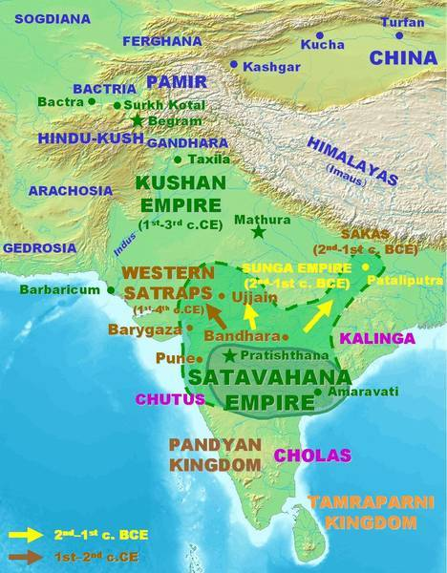

Slide 30
Origins
In the Pūrānas and on their coins the dynasty is variously referred to as the Sātavāhanas, Sātakarnīs, Andhras and Andhrabhrityas. A reference to the Sātavāhanas by the Greek traveler Megasthenes indicates that they possessed 100,000 infantry, 1,000 elephants, and had more than 30 well built fortified towns:
Next come the Andarae, a still more powerful race, which possesses numerous villages, and thirty towns defended by walls and towers, and which supplies its king with an army of 100,000 infantry, 2,000 cavalry, and 1,000 elephants.
The Sātavāhanas ruled a large and powerful empire that withstood the onslaughts from Central Asia. Aside from their military power, their commercialism and naval activity is evidenced by establishment of Indian colonies in southeast Asia.

Slide 31
Early rulers
The Satavahanas initially ruled in the area (current Telangana region and some parts of Andhra areas ) of between the rivers Krishna and Godavari, which was always their heartland. The Pūrānas list 30 Andhra rulers. Many are known from their coins and inscriptions as well.
Simuka (c.230-207 BCE)
After becoming independent around 230 BCE, Simuka, the founder of the dynasty, conquered Maharashtra, Malwa and part of Madhya Pradesh. He was succeeded by his brother Kanha (or Krishna) (r. 207-189 BCE), who further extended his kingdom to the west and the south.
Satakarni (c.180-124 BCE)
Satavahana 1st century BCE coin inscribed in Brahmi: "(Sataka)Nisa". British Museum.
His successor Sātakarnī I was the sixth ruler of the Satavahana. He is said in the Puranas to have ruled for 56 years.
Satakarni defeated the Sunga dynasty of North India by wresting Western Malwa from them, and performed several Vedic sacrifices at huge cost, including the Horse Sacrifice - Ashwamedha yajna. He also was in conflict with the Kalinga ruler Kharavela, who mentions him in the Hathigumpha inscription. According to the Yuga Purana he conquered Kalinga following the death of Kharavela. He extended Satavahana rule over Madhya Pradesh and pushed back the Sakas from Pataliputra, where he subsequently ruled for 10 years.
By this time the dynasty was well established, with its capital at Pratishthānapura (Paithan) in Maharashtra, and its power spreading into all of South India.
Kanva suzerainty (75-35 BCE)
Many small rulers succeeded Satakarni, such as Lambodara, Apilaka, Meghasvati and Kuntala Satakarni, who are thought to have been under the suzerainty of the Kanva dynasty. The Puranas (the Matsya Purana, the Vayu Purana, the Brahmanda Purana, the Vishnu Purana) all state that the first of the Andhra kings rose to power in the 1st century BCE, by slaying Susarman, the last ruler of the Kanvas. This feat is usually thought to have been accomplished by Pulomavi (c. 30-6 BCE), who then ruled over Pataliputra.

Slide 32
Victory over the Shakas, Yavanas and Pahlavas
The first century CE saw another incursion of the Sakas of Central Asia into India, where they formed the dynasty of the Western Kshatrapas. The four immediate successors of Hāla (r. 20-24 CE) had short reigns totalling about a dozen years. During the reign of the Western Satrap Nahapana, the Satavahanas lost a considerable territory to the satraps, including eastern Malwa, Southern Gujarat, and Northern Konkan, from Broach to Sopara and the Nasik and Pune districts.^{[9]}
Gautamiputra Satakarni (78-106 CE)
Coin of Gautamiputra Satakarni. Obv: King in profile. Prakrit legend "Rano Gotamiputasa Siri Yana Satakarnisa": "In the reign of Gautamiputra Sri Yana Satakarni" Rev: Hill with Satavahana symbol, sun and moon. Dravidian legend "Arahanaku gotami putaku Hiru Yana Hatakanaku".
Eventually Gautamiputra defeated the Western Satrap ruler Nahapana, restoring the prestige of his dynasty by reconquering a large part of the former dominions of the Sātavāhanas. He was an ardent supporter of Buddhism.
Gautamiputra Satakarni may also have defeated Shaka king Vikramaditya in 78 BCE and started the calendar known as Shalivahana era or Shaka era.

Slide 33
Decline of the Satavahanas
Coin of Gautamiputra Yajna Satakarni. Four or five kings of Yajna Satakarni's line succeeded him, and continued to rule till about the mid 200s CE. However, the dynasty was soon extinguished following the rise of its feudatories, perhaps on account of a decline in central power.
Several dynasties divided the lands of the kingdom among themselves. Among them were:
Western Satraps in the northwestern part of the kingdom.
Andhra Ikshvakus (or Srīparvatiyas) in the Krishna-Guntur region. (r. 220-320 CE).
Abhiras in the western part of the kingdom. They were ultimately to succeed the Sātavāhanas in their capital Pratishthānapura.
Chutus of Banavasi in North Karnataka.
Kadambas of Banavasi in North Karnataka.
Pallavas of Kanchipuram, of whom the first ruler was Simhavarman I (r. 275-300 CE).

Slide 34
Coinage
Royal earrings, Andhra Pradesh, 1st Century BCE.
The Satavahanas are the first native Indian rulers to issue their own coins with portraits of their rulers, starting with king Gautamiputra Satakarni, a practice derived from that of the Western Satraps he defeated, itself originating with the Indo-Greek kings to the northwest.
Satavahana coins give unique indications as to their chronology, language, and even facial features (curly hair, long ears and strong lips). They issued mainly lead and copper coins; their portrait-style silver coins were usually struck over coins of the Western Kshatrapa kings.
The coin legends of the Satavahanas, in all areas and all periods, used a Prakrit dialect without exception. Some reverse coin legends are in a Dravidian language in Telugu or Kannada, which seems to have been in use in their heartland abutting the Godavari, probably Kotilingala, Karimnagar district and Krishna, probably Amravati, Guntur district, Andhra Pradesh.
Their coins also display various traditional symbols, such as elephants, lions, horses and chaityas (stupas), as well as the "Ujjain symbol", a cross with four circles at the end. The legendary Ujjayini emperor Vikramditiya on whose name the Vikram Samvat is initiated might be Satakarni II a Satavahana emperor as the Ujjayini symbol also appeared on the Satavahana coins.

Slide 35
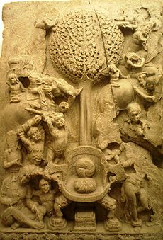
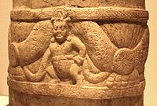
Cultural achievements
An aniconic representation of Mara's assault on the Buddha, 2nd century, Amaravati.
Of the Sātavāhana kings, Hāla (r. 20-24 CE) is famous for compiling the collection of Maharashtri poems known as the Gaha Sattasai (Sanskrit: Gāthā Saptashatī), although from linguistic evidence it seems that the work now extant must have been re-edited in the succeeding century or two. The Lilavati describes his marriage with a Ceylonese Princess.
The Satavahanas influenced South-East Asia to a great extent, spreading Hindu culture, language and religion into that part of the world. Their coins had images of ships.
[edit] Art of Amaravati
Scroll supported by Indian Yaksha, Amaravati, 2nd-3rd century CE.
The Sātavāhana kings are also remarkable for their contributions to Buddhist art and architecture. They built great stupas in the Krishna River Valley, including the stupa at Amaravati in Andhra Pradesh. The stupas were decorated in marble slabs and sculpted with scenes from the life of the Buddha, portrayed in a characteristic slim and elegant style. The Satavahana empire colonized southeast Asia and spread Indian culture to those parts. Mahayana Buddhism, which may have originated in Andhra (northwestern India being the alternative candidate), was carried to many parts of Asia by the rich maritime culture of the Satavahanas. The Amaravati style of sculpture spread to Southeast Asia at this time.
[edit] Art of Sanchi
The Satavahanas contributed greatly to the embellishment of the Buddhist stupa of Sanchi. The gateways and the balustrade were built after 70 BCE, and appear to have been commissioned by them. An inscription records the gift of one of the top architraves of the Southern Gateway by the artisans of the Satavahana king Satakarni:
Gift of Ananda, the son of Vasithi, the foreman of the artisans of rajan Siri Satakarni^{[20]}
Throughout, the Buddhist art of the Satavahanas remained aniconic, denying any human representation of the Buddha, even in highly descriptive scenes. This remained true until the end of the Satavahana rule, in the 2nd century CE.

Slide 36
Middle kingdoms of India
Timeline: | Northern India | Southern India | Indus Valley
6th century BCE 5th century BCE 4th century BCE 3rd century BCE 2nd century BCE 1st century BCE 1st century CE 2nd century 3rd century 4th century 5th century 6th century 7th century 8th century 9th century 10th century 11th century | Magadha Shishunaga dynasty Nanda empire Kalinga Maurya Empire Sunga Empire Kuninda Kingdom Western Satraps Gupta Empire Harsha Gurjara Pratihara Pala Empire Solanki Eastern Ganga dynasty Sena dynasty | Satavahana empire Pandyan Cholas Chera Kalabhras Kadamba Dynasty Pallava Chalukya Rashtrakuta Western Chalukyas Hoysala Empire | Gandhara (Persian rule) (Greek conquests) Indo-Greeks Indo-Scythians Indo-Parthians Kushan Empire Indo-Sassanids Kidarite Kingdom Indo-Hephthalites (Islamic conquests) Shahi (Islamic Empire)

Slide 37
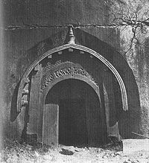
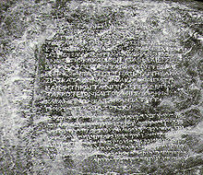
MAURYAN AGE................

Slide 38
SOCIAL ORDER DURING MAURYAN AGE
POLITICAL UNIFICATION OF INDIA
BOOST TO TRADE AND VARIOUS CRAFTS
ARTISANS WERE ORGANIZED IN CORPORATE BODIES OR GUILDS
CRAFTS BECAME SMALL-SCALE INDUSTRIES
THE TRADING NETWORKS, BOTH LAND AND MARINE SPANNED THE WHOLE INDIAN SUBCONTINENT, MESOPOTAMIA, IRAN AND THE WEST ASIA
TRADE WAS DILIGENTLY SUPERVISED BY THE STATE
MONETARIZATION - SILVER AND COPPER COINS WERE BEING USED
APART FROM COMMERCE, THERE WERE VARIED ECONOMIES LIKE
AGRICULTURE, NOMADIC PASTORALISM AND HUNTING – GATHERING
TAKEN CARE BY THE GOVERNMENT
BUILT AND MAINTAINED A NETWORK OF ROADS ALL OVER THE COUNTRY
PROVIDED PUBLIC IRRIGATION FACILITIES
SOCIAL STRUCTURE WAS MULTI-LAYERED AND COMPLEX

Slide 39
EXTENT
MAURYAN EMPIRE

Slide 40
AIMS OF HUMAN LIFE
MOKSHA
DHARMA
ARTHA
KARMA
All these fundamentals are relative and hold relevance at
various stages of ones life.
The concept based on these fundamentals acted as refrences for
design and development of the ancient Indian cities.
While there are numerous treatises such as Manusmruti, Shukra Niti,
Vaastu Shastra, etc. which dictate the forms of shelters and towns.
Kautilya’s Arthashastra is considered to be a comprehensive treaty
and addresses those entire essential fundamentals specific
to the practices of design and development of human settlements.

Slide 41
KAUTILYA’S ARTHASHASTRA
Well defined hierarchy of the urban centers and the administrative divisions.
These divisions were based mainly on the
- size of population and
were influenced by the resources available in the region and
- opportunities for economic development.

Slide 43
ADMINISTRATIVE DIVISIONS BASED ON THE SIZE OF POPULATION
The smallest division was a village consisting of each not less than a hundred families and not more than five hundred families of agricultural people with boundaries extending as far as a krósa (2,250 yards).
Further, in his policies on urbanization, Kautilya encourages migration to the countryside in order to prevent overcrowding into the cities. This ensured a control over population as well as building densities.
From the perspective of managing the divisions, Kautilya adopted clustered approach with each cluster comprising of certain number of villages.
A cluster of around eight hundred villages was to be centered by a stháníya a (a fortress of that name), four hundred villages by a drónamukha, two hundred villages by a khárvátika and sangrahana in the midst of a collection of ten villages.
Boundaries of settlements were to be denoted either by a river, a mountain, forests, bulbous plants (grishti), caves, artificial buildings (sétubandha), or by trees such as sálmali (silk cotton tree), samí (Acacia Suma), and kshíravriksha (milky trees).

Slide 45
CLASSIFICATION OF LANDUSES

Slide 46
INTRODUCTION TO THE GUPTA PERIOD
In the fourth century, the Gupta Empire was established.
The Gupta dynasty lasted from circa 320 - circa 540 B
BCE.
In the Gupta Age, the Hindu religion strengthened.
The Ajanta and Ellora caves were created in this period. Many classical art forms and aspects of Indian culture were further developed.
During the Gupta Age much progress was made in literature, science, and especially astronomy and mathematics.
Due to many new ideas, and breakthroughs in Indian civilization, historians have called Gupta India, "The Golden Age of Indian History".

Slide 47
GUPTA RULERS PROMOTED HINDUISM IN THEIR EMPIRE.
A New Hindu Empire
The Gupta dynasty took over India around AD 320.
Under the Guptas, India was again united and it prospered.
Hinduism became India’s dominant religion. However, the Gupta rulers also supported the religious beliefs of Buddhism and Jainism.
Gupta Society
Gupta society reached its high point around 375, during the rule of Candra Gupta II.
The empire had a strong economy, its people prospered, and fine works of art and literature were created.
The Gupta kings believed in the strict social order of the Hindu caste system and women’s roles were limited.

Slide 48
THE GOLDEN AGE OF INDIA
The Gupta Period was usually described as the "golden age of India" as it was a period of great military power and wealth and there was also great development in the arts and sciences.
SOME SIGNIFICANT FEATURES OF GUPTA PERIOD
NALANDA UNIVERSITY…….
Cultural Resources of NALANDA
Nalanda is primarily a archaeological site exposed during the excavations conducted by Archaeological Survey of India during 1915-37 and 1974-82.
There are references that the city was spread over an area of sixteen square kilometers of which only an area of around square kilometer is excavated.

Slide 49
The extensive remains are of six brick temples and eleven monasteries arranged on a systematic layout.
The campus has rows of magnificent stupas placed side by side forming a central monumental axis. Parallel to and on both sides of this axis were monasteries along with establishments for housing students aspiring to become monks.
The dimension and disposition of rooms within monasteries is almost identical.
The most imposing structure is Temple No. 3 at the southern extremity which was constructed in seven phases. This follows the pancharatna concept of planning consisting of a central shrine and four subsidiary ones in the corner.

Slide 50
The monasteries were imposing rectangular building
These monasteries or Viharas were planned around a central open court.
These functioned both as units of residence as well as learning.
The lower storey contained the refectory, areas of instructions and communal worship, while the upper floor built in timber was quadrangle of cells for resident students.
Each subsequent higher storey was stepped back from the previous one to create open air terraces for the cells.
These were used by more preserving students who had graduated to an advanced stage of learning.

Slide 51
REFFERENCES
Human settlements by – Chatopadhyaya.
Indian architecture by – Percy Brown
Buddhist and Hindu Architecture by Satish Grover
http://india.gov.in/knowindia/ancient_history5.php
www.wikepediaencyclopedia.com

