Slide 1
Indian Temple
Presented by: Ar. Hiba Gul

Slide 2
Khajuraho group of temples
The temples have been built from granite or sandstone, the two chief rocks found in this area upon raised platforms.
The platforms themselves stand on solid rock masses that are one of the oldest rocks on this earth.

Slide 3
The Kendariya Mahadeo temple is the finest example in Indo-Aryan temple style because of its attainment of unity in design of its components such as mandapas.
It becomes a composite design in plan and exterior profile.
It results into overall jagged profile of mostly revered Kailash.
The raised platform on which the temples stands in itself becomes dominant feature of the composition.
The great flight of steps gives one a sense of arrival in higher ritualistic sense also.

Slide 4
The sculptures are exquisite.
They show the daily lives of the kings (hunting etc),
Deities in their various forms,
Beautiful apsarases in their elegant and enticing postures
Royal motifs like lions and elephants.

Slide 5
Eastern Indian temples of Orissa
Under the ancient name of Kalinga, Orissa was the seat of great empires as far back as 300 B.C.
as the most remarkable examples of architectural achievement in all of Asia.
Although Orissa presents a fairly large variety of styles in temple building, it has nevertheless a characteristic architectural genius.
Its temples have been described as one of the most compact and homogeneous architectural groups in India.
In these the Indo-Aryan style of architecture may be seen at its best and purest.

Slide 6
Eastern Indian temples of Orissa
The design which flourished in eastern Indian state
of Orissa and Northern Andhra Pradesh are called Kalinga style of architecture.
The style consists of three distinct type of temples
namely Rekha Deula, Pidha Deula and Khakhara Deula.
Deula means "Temple" in the local language. The former two are associated with Vishnu, Surya and Shiva temple while the third is mainly with Chamunda and Durga temples.
The Rekha deula and Khakhara deula houses the sanctum sanctorum while the Pidha Deula constitutes outer dancing and offering halls.
The prominent examples of Rekha Deula are Lingaraj Temple of Bhubaneswar and Jagannath Temple of Puri.
The Konark Sun Temple is a living example of Pidha Deula.

Slide 7
The temple-building movement in Orissa, which reached its peak of excellence in the 10th and 11th centuries, stretches from roughly 650 A.D. to 1200 A.D. and illustrates more coherently than any other similar movement the growth and development of the Nagara style of architecture.
In general, all Orissan temples follow a common structural plan.
A typical temple consists of two apartments.
The deul, corresponding to the southern vimana, is the cubical inner apartment which enshrines the image, and is surmounted by a tower.
In front of this is the antarala or porch called the jaganmohan which is usually square-shaped and has a pyramidal roof.
Occasionally, one or two more mandapas, such as the natmandir and the bhogmandir, can be found in front of the jaganmohan, but these, where they exist, are almost without exception were superimposed on top of the original plan.

Slide 10
The Orissan temples have two parts namely the sanctum (deul or vimana) and the other is place from where pilgrims view the sanctum (called jagamohana).
The initial deul temples were without the jagamohana as seen in some of the older temples in Bhubaneswar, while the later temples had two additional structures namely nata-mandapa (festival hall) and bhoga-mandapa (hall of offerings).
The vimana is square in plan and the walls are variegated by ressaults .
Amalaka (also called mastaka), a stone disk with ridges on the rim is placed over the bada (tower) of the temple.

Slide 11
Bhubaneswar has the richest profusion of temples and is known as the temple town of Orissa, not only because of the large number of temples found there, but also because it is the home of the famous Lingaraja temple.

Slide 12
Lingaraja temple
The great Lingaraja temple, believed to have been built around 1000 A.D.
It stands in a cluster of sixty-five smaller shrines in a spacious compound meausring 520 feet by 465 feet
Its mighty tower (the vimana) dominates the landscape for miles around.
Constructed without mortar, this tower is 127 feet high and is divided into vertical sections.
The angles of the recesses are filled in with miniature vimanas and on the top, are figures representing a lion crushing an elephant.

Slide 13
Initially it consisted of a cella and a mandapa
Cella – 56ft square and rises about 140 ft
Mandapa is rectangular

Slide 14
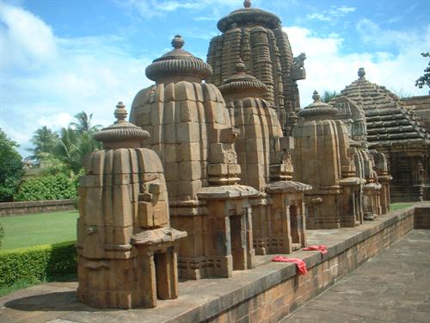
Lingraja temple
Lingaraj Temple is a Hindu temple dedicated to Harihara, a form of Shiva and is one of the oldest temples in Bhubaneswar, the capital of the East Indian state of Odisha (formerly Orissa). The temple is the most prominent landmark of the Bhubaneswar city and one of the major tourist attractions of the state

Slide 15
