Slide 1
Importance of
history in Architecture
Ar. Manish kumar

Slide 2
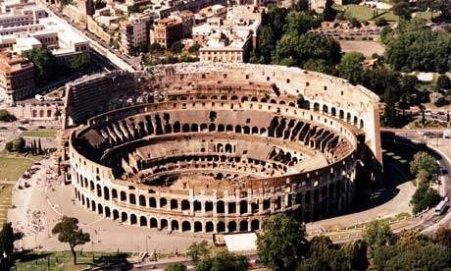
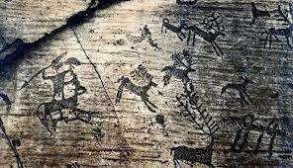
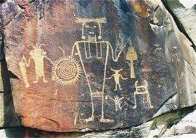
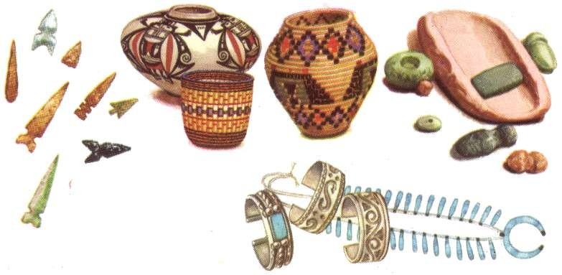
WHAT IS HISTORY?
The study of past events
These include not just written documents, but also through objects such as
bbuuiillddiinnggss,, artifacts and paintings.
Colosseum Rome
An object made by a human being

Slide 3
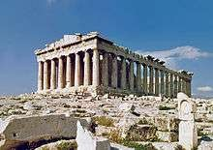
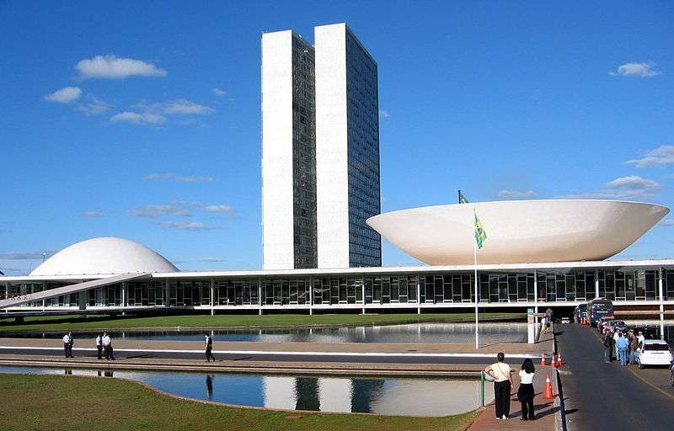
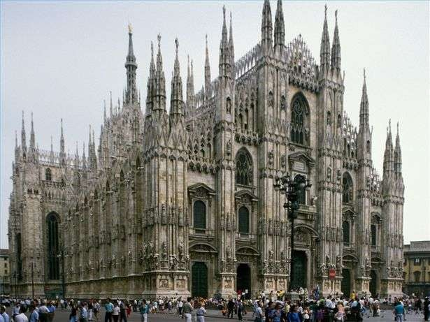
WHAT IS ARCHITECTURE ?
The art or practice of designing and constructing buildings
The style in which a building is designed and constructed, especially with regard to a specific PERIOD
P
arthenon, Greek
of Brazil,
The National Congress
Gothic Cathedrals

Slide 4
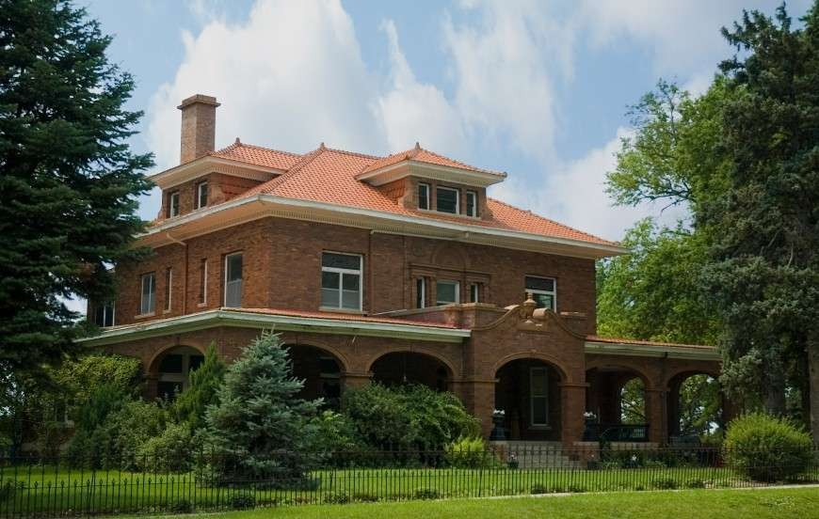
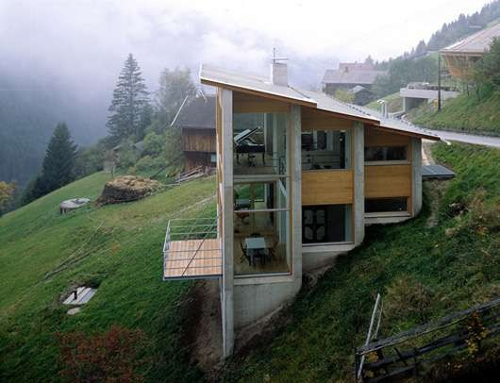
WHAT IS ARCHITECTURE ?
The art or practice of designing and constructing buildings
The style in which a building is designed and constructed, especially with regard to a specific period, PLACE
Places
Design on a hill
w
ith heavy rainfall

Slide 5
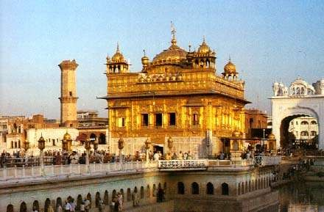
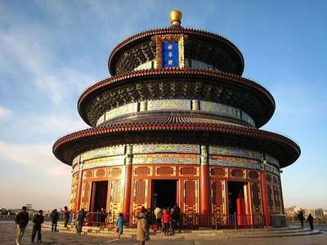
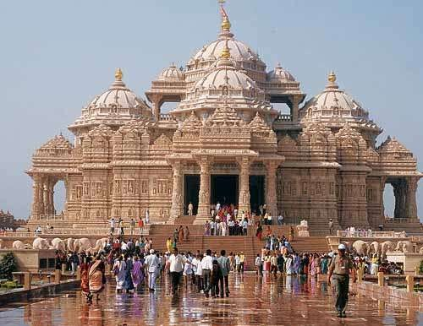
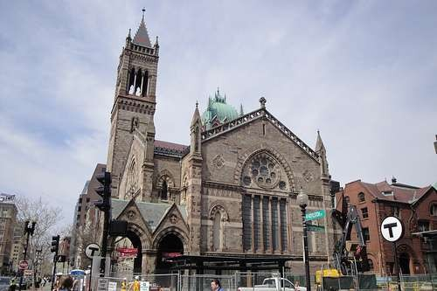
WHAT IS ARCHITECTURE ?
The art or practice of designing and constructing buildings
The style in which a building is designed and constructed, especially with regard to a specific period, place, or CULTURE:
Si
Church architecture
kh Chinese architecture
a
rchitecture
Hindu architecture

Slide 6
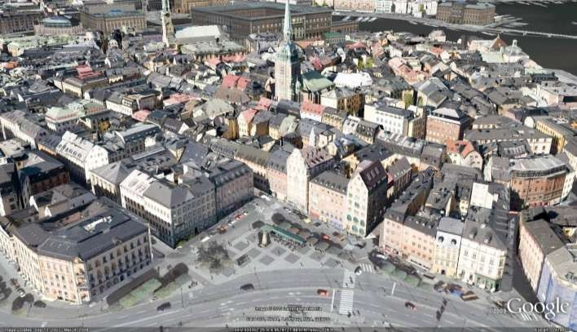
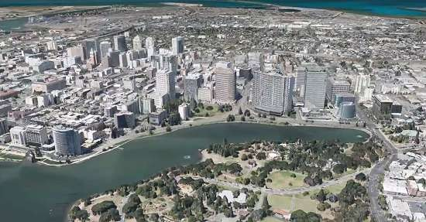
WHAT IS ENVIRONMENT ?
The setting or condition in which a particular activity is carried on.
Natural Environment
Man made Environment

Slide 7
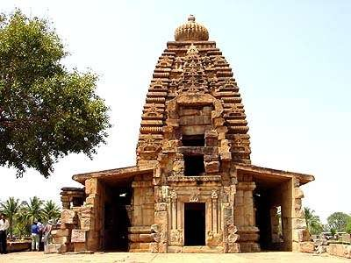
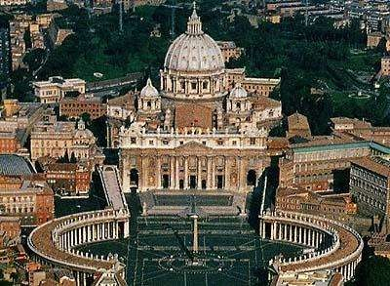
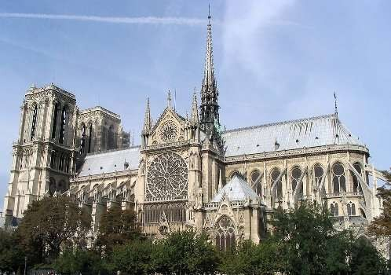
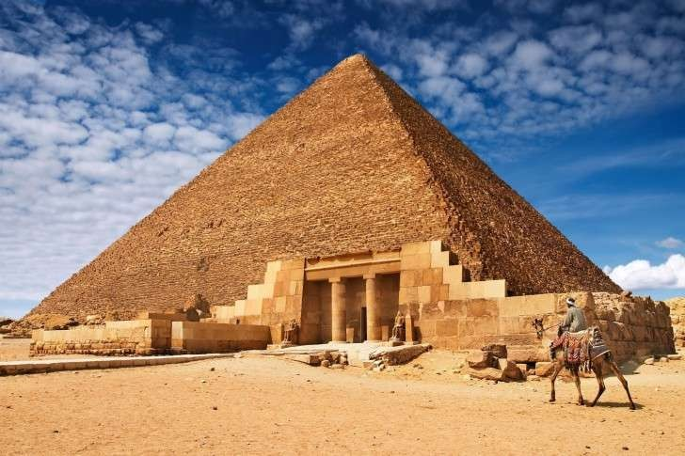
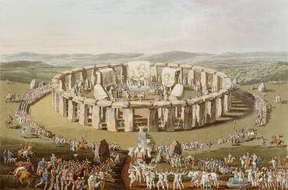
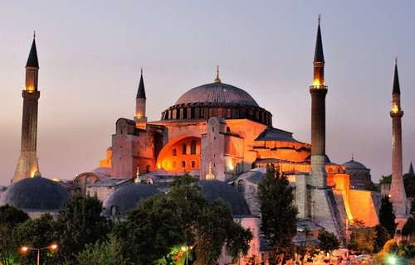
HISTORY OF ARCHITECTURE
Traces the changes in Design of various building types & functions
Traces the changes in Design of various building types & functions , Structure, Construction methods
and architectural elements
other
Through
Various Regions,
Traditions, Stylistic
trends…from The Primitive Phases till the present day.

Slide 8
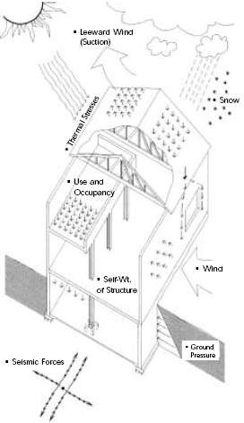
HISTORY OF ARCHITECTURE
Traces the changes in Structures
What is a Structures?
Traces the changes in
Design of various building types &
Various elements of building
And
How these elements are interrelated…
functions , Structure, Construction methods
and architectural elements
other
Purpose of Structures design ?
To make building able to stand
And
Also withstand forces which acts on it .
Through
Dead load Live load Wind force Snow force
Various Regions,
Traditions, Stylistic
Forces:
trends…from The Primitive Phases till the present day.

Slide 9
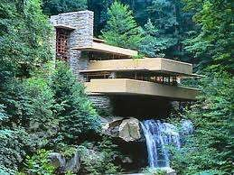
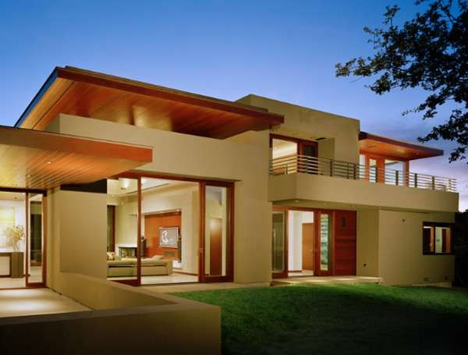
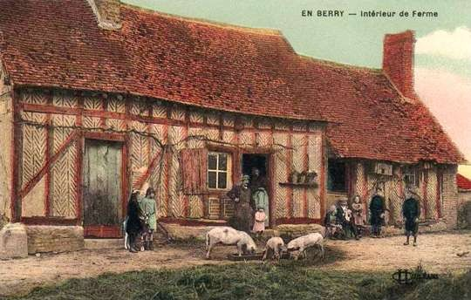
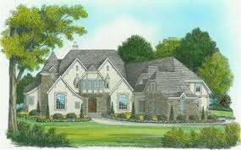
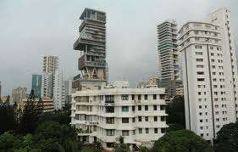
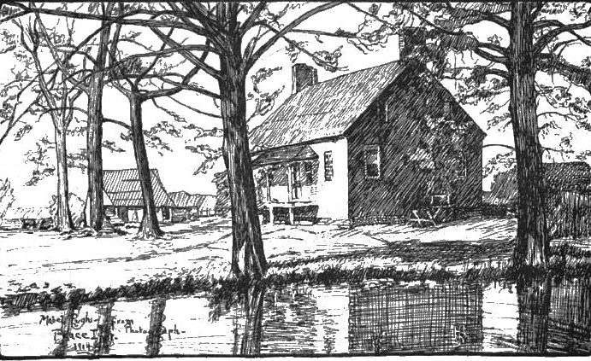
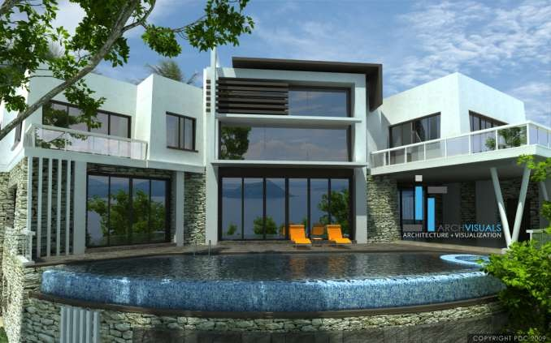
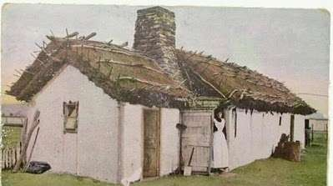
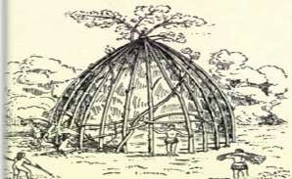
HISTORY OF ARCHITECTURE
Traces the changes in Structures
Traces the changes in Design of various building types & functions , Structure, Construction methods
and architectural elements
other
Through
Various Regions,
Traditions, Stylistic
trends…from The Primitive Phases till the present day.
SCTSrutaeonvsnesdesrb-hireuNadnta(ctkhuaertasclhafaonrd)mblearaitcivokenhssouse Falling water house , Pennsylvania

Slide 10
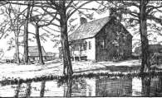
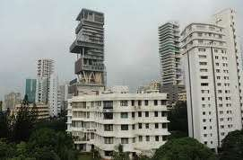
HISTORY OF ARCHITECTURE
Traces the changes in Structures
Traces the changes in Design of various building types & functions , Structure, Construction methods
and architectural elements
other
Through
Various Regions,
Traditions, Stylistic
trends…from The Primitive Phases till the present day.

Slide 11
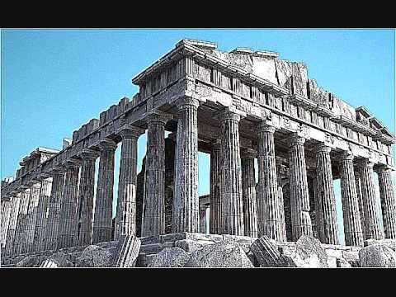
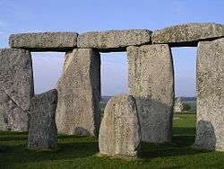
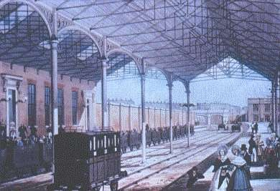
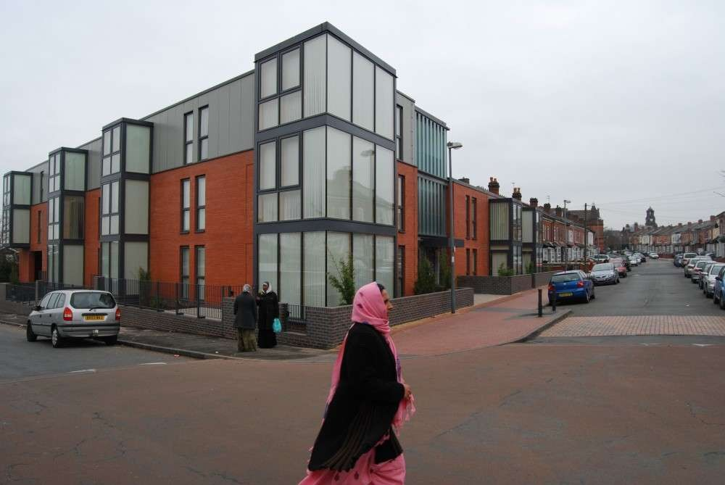
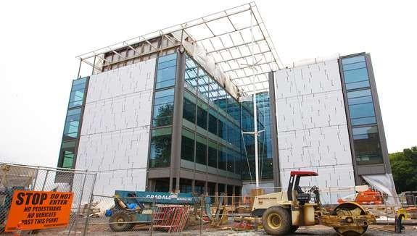
HISTORY OF ARCHITECTURE
Traces the changes in Construction Methods
Traces the changes in Design of various building types & functions , Structure, Construction methods
and architectural elements
other
Through
Various Regions,
Traditions, Stylistic
trends…from The Primitive Phases till the present day.

Slide 12
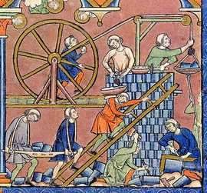
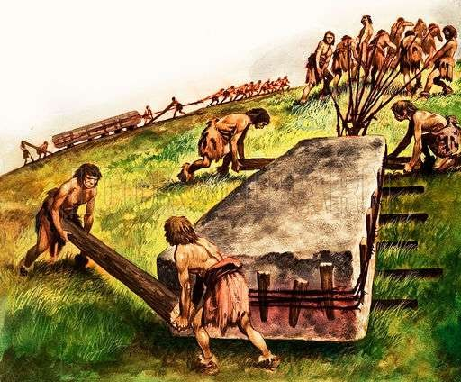
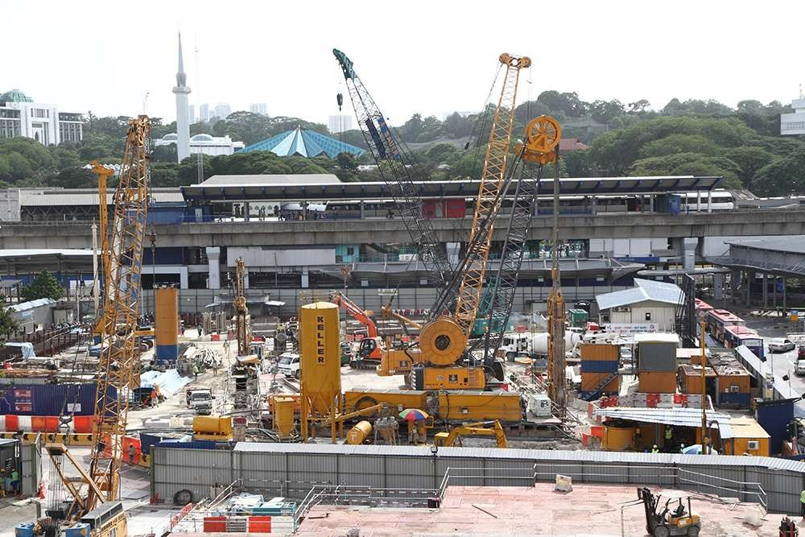
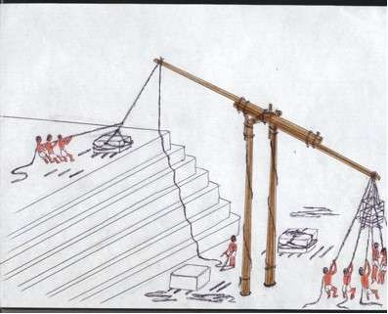
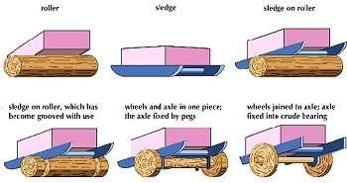
HISTORY OF ARCHITECTURE
Traces the changes in Construction Methods
Traces the changes in Design of various building types & functions , Structure, Construction methods
and architectural elements
other
Through
Various Regions,
Traditions, Stylistic
trends…from The Primitive Phases till the present day.

Slide 13
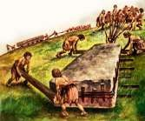
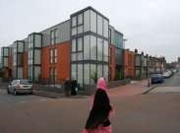
HISTORY OF ARCHITECTURE
Traces the changes in Construction Methods
Traces the changes in Design of various building types & functions , Structure, Construction methods
and architectural elements
other
Through
Various Regions,
Traditions, Stylistic
trends…from The Primitive Phases till the present day.

Slide 14
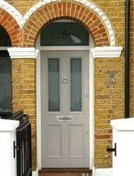
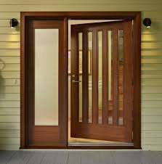
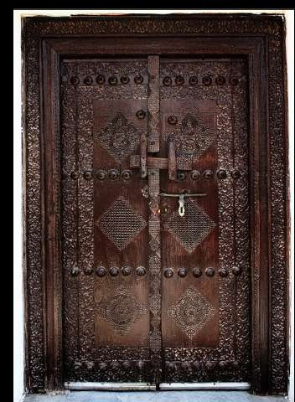
HISTORY OF ARCHITECTURE
Traces the changes in other architectural elements
Traces the changes in Design of various building types & functions , Structure, Construction methods
and architectural elements
other
Through
Various Regions,
Traditions, Stylistic
trends…from The Primitive Phases till the present day.

Slide 15
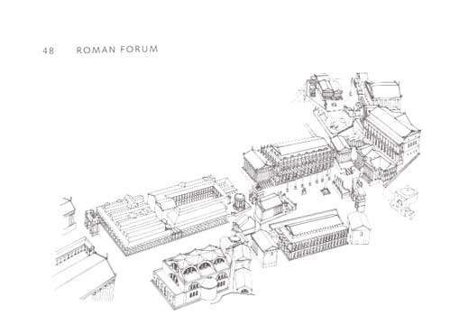
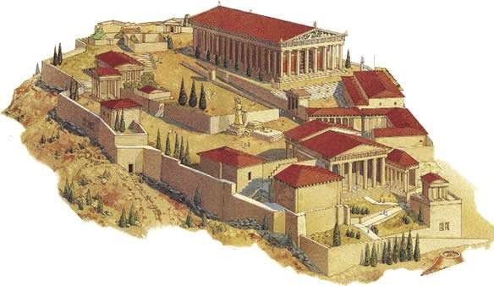
HISTORY OF ARCHITECTURE
&
BUILT
ENVIRONMENTS
Includes a
Group of
BUILDINGS
Acropolis Athens
Therefore we must understand that history of architecture doesn’t end with the single building or element but includes the surroundings as well…

