Slide 1
Islamic Architecture
Presented by: Ar. Hiba Gul

Slide 2
.
Indo islamic style is virtually divided in to three phases
The PROVINCIAL STYLE
IMPERIAL STYLE
MUGHAL STYLE
Provincial style are closely allied to Hindu Models but are simpler and lack of sculpture . These structures are closely allied to the hindu models. The dome , arch, minrates are constant feature of this style.

Slide 3
ISLAMIC ARCHITECTURE UNDER PROVINCIAL STYLE
Introduction of the Islamic architectures and their gradual developments in the Indian subcontinent region .
These Indo-Islamic architectures in India were introduced during the Islamic rules in different provinces which made tremendous growth especially in this field. These styles were neither Islamic nor Hindu but the fusion of both.
The Muslim rulers tried to reshape the Hindu architecture by adding arch, dome and minar to their constructions
Another reason behind the development of provincial style in India was the migration of experienced foreign craftsmen to the different Muslim rulers.
They were wonderful artisans and created amazing Islamic architectures and different principles of their native land mixing with Indian provincial culture.
Sometimes climatic conditions also played a major role in developing a specific provincial style.
Developed in Indian subcontinent from Punjab province and gradually expanded to the entire India.
The Provincial style reflected the continued rebellion of the provinces against the imperial style of Delhi.
The best example of this phase is in Gujart, where for almost two centuries until 1572, when Emperor Akbar finally conquered the region. The most notable structures in this phase are found in the capital, Ahmadbd. The Jami Masjid (1423) is unique in the whole of India.

Slide 4
.
jaunpur
FEATURES:
Founded by feroz shah tughlaq named as jaunpur.
Material derived from hindu temple. Tapered pylons were used.
Chamber for female by using jail to segregate from males.
Vault system was introduced.
Turrets were used to emphasize pylons.

Slide 5
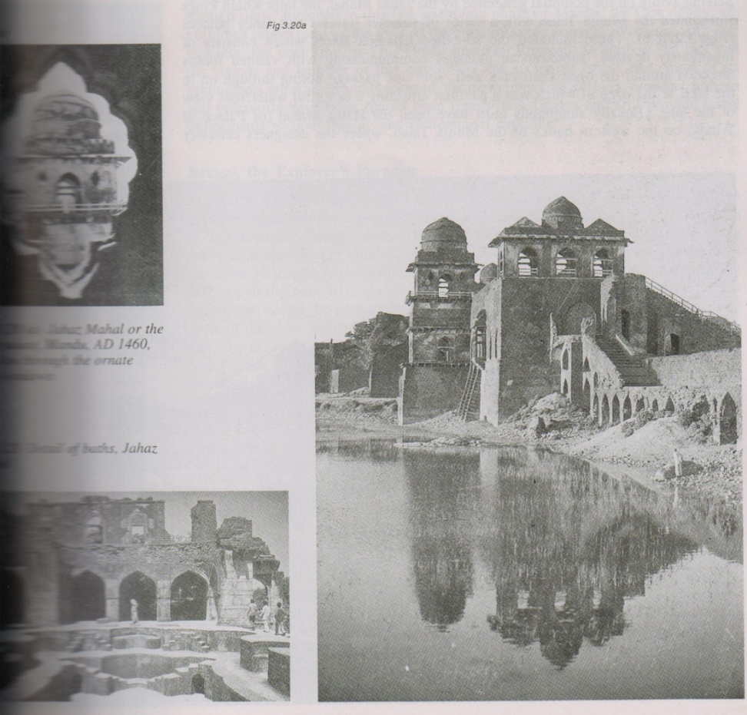
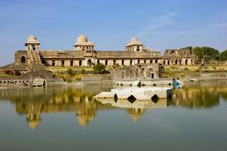
Janunpur and the Shariqi Dynasty.
The most distinctive style of Delhi was inspired by the architecture of delhi was that used in jaunpur just 36 mile of varansi. The city of jaunpur was established by Firuj Shah Tughlaq on the bank of river gomati.
THE JAHAJ MAHAL :-
The Muslim rulers preference for mandu to Dhar as a capital city was initially prompted by reason of security.
The mandu was at an elevation of 610 m above Sealevel Mahumd khilzi gave impetus to the beginning of the
second phase of building activity in mandu one of the most
popular structure of mandu the so – called JAHAZ MAHAL .
(the ship place)
The building is located between two water bodies , the kaphur talao and the munja talao.
This east west oriented 110 m long and almost 15.2 m wide
structure consists of a series of partly built apartments
and corridor over the waters of munja talao and a number
of airy and fanciful open kiosks on the broad upper terrace.
The court life fully expressed in the open air baths on the
terrace.
double storied, rectangular structure with 3 feet (0.86 meters) thick wall.
There is six gothic arched opening in the main entrance of the eastern side of the palace.
continuous chhajja(awning) supported on stone brackets.
There are three large halls in the ground floor which are separated by corridors.
The small rooms are located at the ends.
.

Slide 6
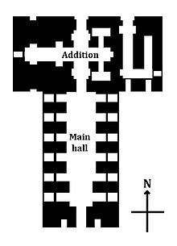
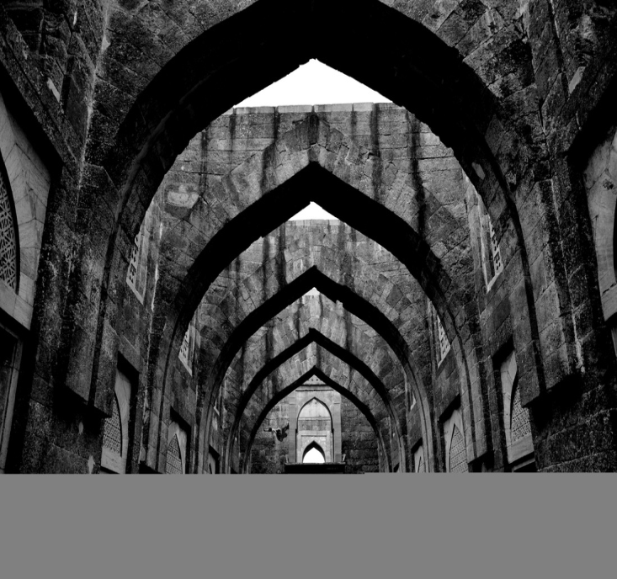
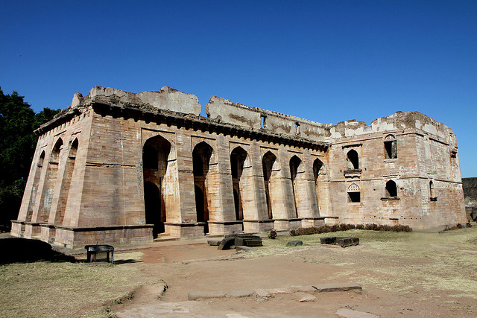
.
SWINGING PALACE
Constructed by Alp Khan who had built the city wall and this building is also called HINDOLA MAHAL.
The walls are thick and slope .
The slope of over 77 degrees gives a swinging appearance.
The six massive, sloped buttresses with deeply recessed arches that were erected to support the roof a 60’ (18.2 m) wide and 118’ (36 m )long rectangular hall.
The whole plan of the mahal thus reads as a “T” in shape.
The ‘cross bar’ and ‘stem’ are both distinct in plan and concept – one simple double height rectangular hall, the other two storeyed
typical hindu balconies and jharokhas.
Material used was sandstone.
zenana place as another storey above the main hall- 35' high.
Each of the long sided has 6 sunken arches with a doorway below and a window above.
The short side has 3 similar arches. The central one is the entrance.
The interior is a large hall 881/2' X 24 1/2' and 32' high
The flat roof rested on timber beams whose sockets are still visible, though the timber portions themselves have disappeared.

Slide 7
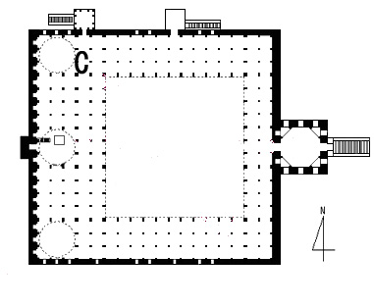
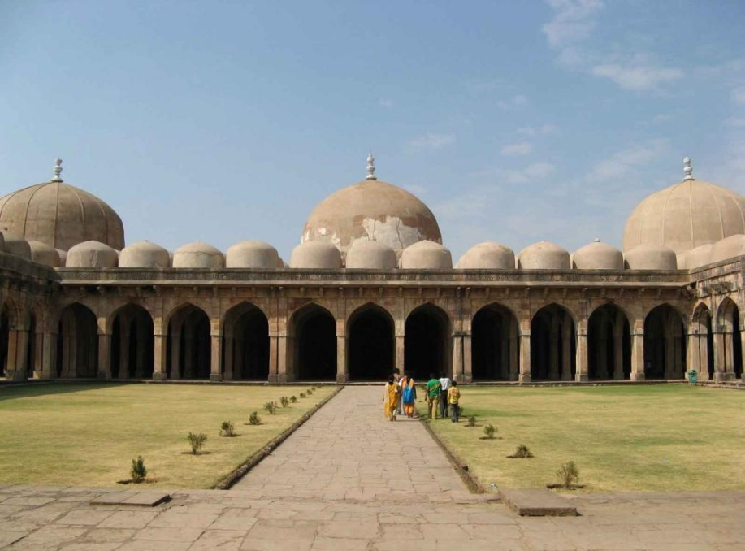
JAMI MASJID Constructed by Hoshang Shah. The courtyard is surrounded on three sides by a uniformly proportioned gallery of majestic arches, with just a hint of ogee at the apex. These arches are planted cylinderical cupolas . The domes rise vertically from their circular base going near the apex like shikhra of orissa temple. Sandstone used in this Jami Masjid At Mandu Mosque covers a square of 87.7mside with a square cort of 49.3 m, prolonged on eastern front by a projecting domed entrance hall and a wide flight of steps. There are also two subsidiary entrances to the north, one for the priests and the other a private entrance for the zenana. Being raised on a high plinth, this enables the front side of the basement to contain a series of arcaded chambers to be used as a serai. The entrance hall bears traces of exquisitely coloured borders and panels in glazed tiles. The domed gatehouse responds to the three similar domes of the sanctuary on the opposite side of the courtyard. The courtyard is surrounded by arcaded . In addition to the 3 large domes atop the sanctuary, the entire roof is covered with a symmetrical pattern of cylindrical cupolas, one over each bay of the interior, thus making 158 in all .

Slide 8
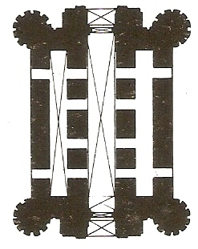
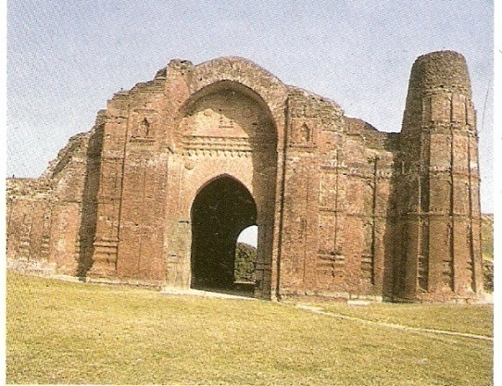
.
DAKHIOL DARWAZA
Built by Barbak Shah.
Bricks covered with plaster for ornamentation.
Terracotta was used over plaster.
Floral pattern,lantern was used.
Total height- 60’.

Slide 9
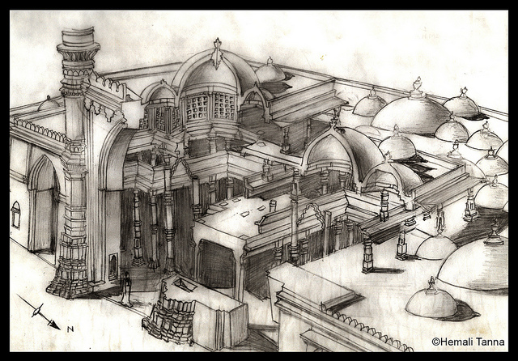
JAMI MASJID AHEMDABAD:- It completed in AD 1423 measuring 116m x 79 m In its façade there is a composition of solids and voids .
The solid , walled buttressed central triple arched composition is flanked by airy lightness of verandas.
The liwan of this masjid consists of 300tall pillars Instead of a huge plain hall.
, they build central shaft rising vertically the central volume is roofed by a large dome resting on octagonal ring of column.
The facede is filled with panels of jails.
The balconies provided a separate apartments for ladies .
the upper stories of the minrates were destroyed in earth quake. The dome & open grills made the environment cool inside. Sand stone is used for the exteriors.

Slide 10
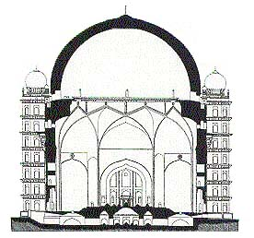
GOL GUMBAAZ AT BIJAPUR

