Slide 1
INCOME TAX

Slide 2
Agenda
Introduction
Taxation
About income tax
Income tax exemptions
Income tax deductions
Summary

Slide 3
Introduction
Tax planning is the process of analyzing a financial plan or a situation from a tax perspective. The objective of tax planning is to make sure there is tax efficiency. With the help of tax planning, one can ensure that all elements of a financial plan can function together with maximum tax efficiency. Personal Financial Planning is a systematic approach whereby an individual maximizes the existing financial resources through proper management of one's finances to best achieve his/her financial goals and objectives. By efficiency of tax planning and financial
Planning a person can save money for future investments or for future plans.

Slide 4
Taxation

Slide 5
What is taxation?
Taxation is the imposition of compulsory levies on individuals or entities by governments in almost every country of the world. Taxation is used primarily to raise revenue for government expenditures, though it can serve other purposes as well. Taxation is a system by which a government levies or imposes charges on citizens and corporate entities to finance its expenses such as defense, welfare (Education, Health Care, Infrastructure), etc. Tax is a compulsory payment to the government under any law. It can be charged by the government on goods, income, or any activity.
Tax occurs on physical assets, including property and transactions, such as a sale of stock, or a home. Types of taxes include income, corporate, capital gains, property, inheritance, and sales.

Slide 6
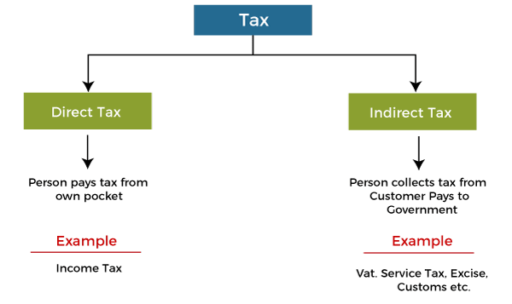
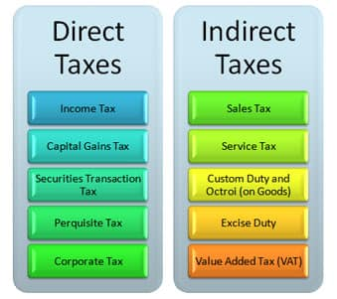
Types of taxes

Slide 7
Income Tax
Income tax is a type of tax that the central government charges on the income earned during a financial year by individuals and businesses. Taxes are sources of revenue for the government.
The Income-tax Act, of 1961 is the charging statute of Income Tax in India. It provides for the levy, administration, collection, and recovery of Income Tax. The Government of India brought a draft statute called the "Direct Taxes Code" intended to replace the Income Tax Act, of 1961 and the Wealth Tax Act, of 1957. Individual income tax is computed on the basis of income received. It is usually classified as a direct tax because the burden is presumably on the individuals who pay it.
This Photo by Unknown Author is licensed under CC BY-SA

Slide 9
As per income tax laws, filing income tax returns is mandatory for individuals whose total income during the financial year exceeds the basic exemption limit of more than the gross total income of ₹ 2,50,000 under the old regime or ₹ 7,00,000 under the new regime. A tax rebate has been introduced in the New Tax Regime on income up to Rs 7 Lakhs. This implies that you do not have to pay tax if your taxable income is below 7 lakhs under the new tax regime.
The new tax slabs under the new tax regime will be:

Slide 10
The standard deduction of Rs 50,000 has been introduced under the new tax regime for salaried taxpayers.
The highest surcharge under the new tax regime has been reduced to 25% from 37% for people earning more than Rs 5 crore. This move brings down their tax rate from 42.74% to 39%.
The new IT regime will be the default tax regime. However, taxpayers can choose the old regime.
Leave encashment for non-government employees has been increased to Rs 25 lakh from Rs 3 lakh.
TDS rate reduced to 20% from 30% on withdrawal of EPF.
New provision is introduced to allow taxpayers to update the past return and includes omitted income by additional tax payment.
Income from the transfer of digital assets such as crypto to be taxed at 30%.

Slide 11
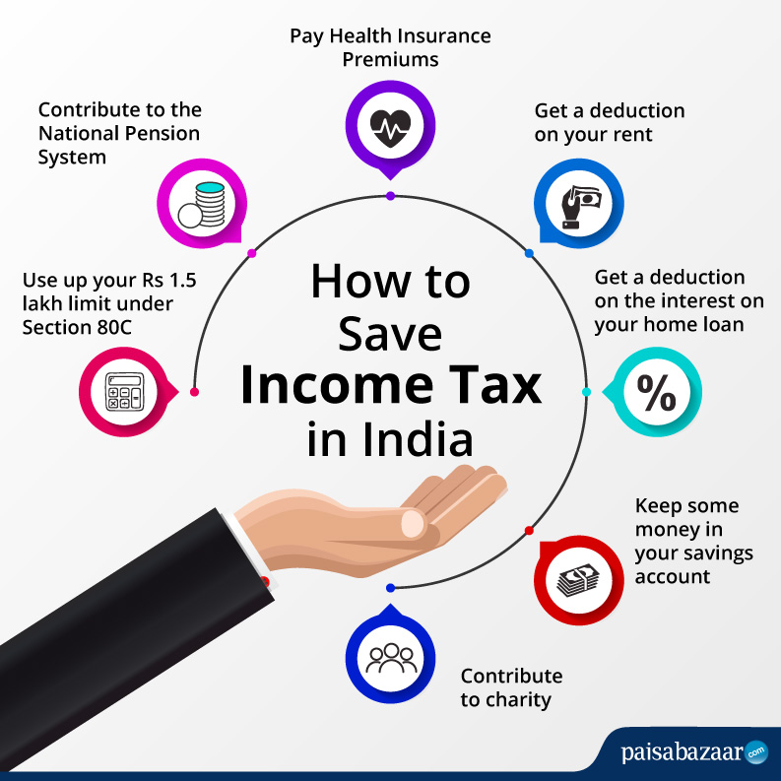
Income Tax Exemption
Section 10 of the Income Tax Act, of 1961, provides an extensive list of tax exemptions that can be claimed for reducing the tax burden. Some of them include House Rent Allowances, Hostel Allowance, Children’s Education Allowance, Leave Travel Allowances, Gratuity, etc. In the Union Budget 2023, Finance Minister Nirmala Sitharaman announced an increase in tax exemption limit of up to Rs.25 lakh for leave encashment for salaried non-government employees upon retirement.

Slide 12
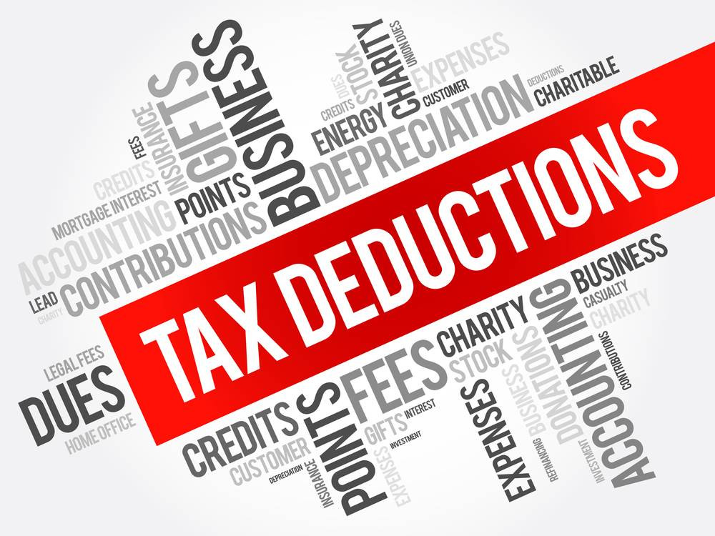
Income Tax Deduction
When you claim an income tax deduction, it reduces the amount of your income that is subject to tax. Reduced taxable income helps you save and invest money in other areas. Tax deduction first reduces the income subject to the highest tax brackets. Tax deduction refers to claims made to reduce your taxable income, arising from various investments and expenses incurred by a taxpayer. Thus, an income tax deduction reduces your overall tax liability. It is a kind of tax benefit which helps you save tax. However, the amount of tax you can save depends on the type of tax benefit you claim. The amount of standard deduction cannot exceed the salary amount. The amount of deduction will be Rs. 50,000/- or equal to the salary amount, whichever is lower. The principal amount that is paid against a loan taken for higher studies or your dream home is eligible for a standard deduction for salaried people.
Several Types of Income Tax Deductions in India
Life Insurance Premiums
Public Provident Fund (PPF)
National Saving Certificate (NSC)
Bank Fixed Deposits (FDs)
Senior Citizen Savings Scheme (SCSS)
Post Office Time Deposit (POTD)
Unit-linked Insurance Plans (ULIP)
Home Loan EMIs.

Slide 13
Summary
Under existing rules of the IT Act, any individual/business with income irrespective of the amount earned is liable to file income tax returns. But, currently, tax on income is payable only if the net taxable income for a fiscal exceeds Rs. 2.5 lakh. Despite considerable efforts for widening the tax base, still the number of taxpayers in our country is about 82.7 million people which is 6.25 percent of the over 132 crore population, which is too small for our country. (2020)

Slide 14
Thank you

