Slide 1
Human evolution
Manish Kumar

Slide 2
"Hominid" refers to members of the human family, Hominidae, which consist of all species from the point where the human line splits from apes towards present day humans.
Habitual bipedal locomotion (movement on two legs), an upright position, and a large brain that has lead to: tool use, language, and culture characterize hominids.

Slide 3
Human evolution
History
Important stages in human evolution
Theories of human evolution
‘Human Characteristics’
Are we still evolving?

Slide 4
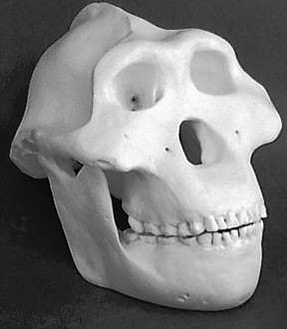
History
1856-Neander Valley
– Discovery of a skull that was not quite human

Slide 5
1859 – Darwin publishes ‘The Origin of Species’
1871- Darwin predicts that ancestors of humans would be found in Africa

Slide 6
Up till 1930s
– Humanity evolved in Europe
_{B}C D A
Bush model
1950s--1960s
– Many significant fossils discovered
A→B→C→D
Linear model

Slide 7
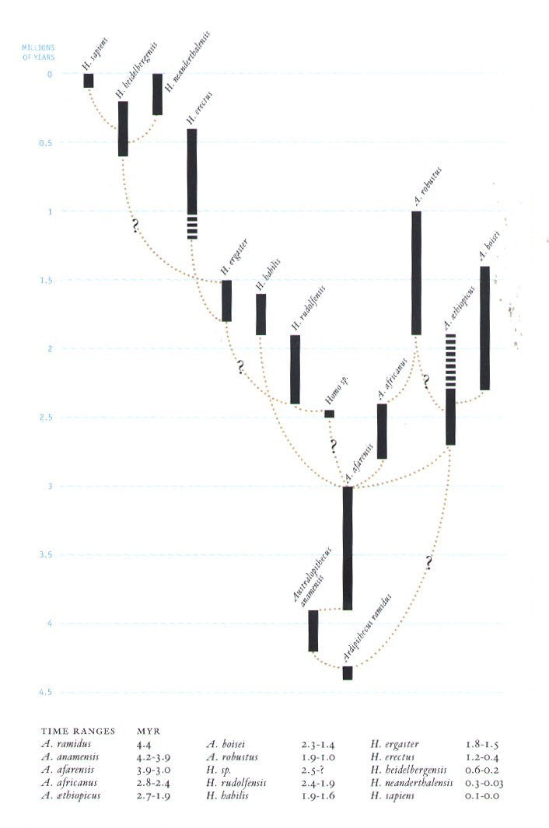
1970s – present
more fossils
molecular techniques
‘tree model’ of human evolution

Slide 8
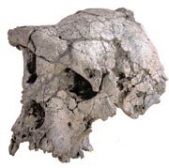
Current Controversy
6-7 m y old fossil
Earliest bipedal hominid?
Sahelanthropus tchadensis

Slide 10
Important stages in human evolution
3.2 million years ago
3 million years ago
2 million years ago
1 million years ago
200, 000 years ago
150, 000 years ago

Slide 11
"Hominid" refers to members of the human family, Hominidae, which consist of all species from the point where the human line splits from apes towards present day humans.
Habitual bipedal locomotion (movement on two legs), an upright position, and a large brain that has lead to: tool use, language, and culture characterize hominids.

Slide 13
3 mya: Homo habilis-the ‘handy man’
Habitat: open terrain
Food: Scavenged for meat
Physical characteristics:
small jaw and teeth
shorter arms
increase in brain size (because of carnivorous diet and mode of feeding)
capable of speech

Slide 14
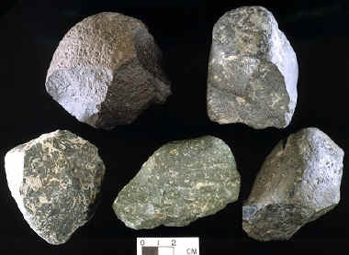
Oldowan Tools
Made tools

Slide 16
Human migration
1.9 mya humans began to leave Africa to other continents

Slide 17
2 mya: Homo ergaster
Habitat: dry -hot habitat
Food: scavenger for meat
Physical characteristics:
Tall with long limbs
Smooth and dark skin
Temperature regulation through sweating
Narrow pelvis (lead to narrow birth canal)
Mothers needed support of partner and group to raise babies

Slide 18
Homo sapiens
120, 000 ya
Physical characteristics:
Eyebrow ridge small or absent
Prominent chin
Tools --antler, bone, stone
Clothing, jewelry, artwork, musical instruments

