Slide 1
Subject: Principles Of Human Settlements-I
Topic: Human Settlements Introduction
Presented by: Pallavi Tiwari

Slide 2
CONTENTS
WHAT IS CIVILIZATION?
GENERAL CHARACTERISTICS OF CIVILIZATION.
WHAT IS SETTLEMENT?
HUMAN SETTLEMENTS AS AN EXPRESSION OF CIVILIZATION
MOHENJO-DARO
MILETUS
SHAHJAHANABAD

Slide 3
CIVILIZATION
DEFINITION: USED TO DESCRIBE A CERTAIN KIND OF DEVELOPMENT OF HUMAN SOCIETY, IT IS MORE ABOUT THE MATERIAL DEVELOPMENT.
MOREOVER, IT IS EVOLVED BY GEOGRAPHICAL SPREAD HORIZONTALLY.
GENERAL CHARACTERISTICS OF CIVILIZATIONS:
SYSTEM OF GOVERNMENT. I.E. SOME FORM OF BODY TO ADMINISTER THE RESPONSIBILITY AND HOPES FOR THE FUTURE.
SOME PHYSICAL DEVELOPMENT OR LIVING IN SOCIAL GROUPS.

Slide 4
CHARACTERISTICS OF CIVILIZATION (cont.)
SPECIALIZATION OF LABOR, IN WHICH MEMBERS OF SOCIETY PERFORMS DIFFERENT JOBS – THIS FACILITATED THE PROGRESS AS 1 PERSON WASN’T TRYING TO DO EVERYTHING.
DIFFERENT SOCIAL CLASSES. SOMETIMES BASED ON CASTE, SOMETIMES ECONOMIC STATUS, ETC.
SOME FORM OF COMMUNICATION.
CONCEPT OF A HIGHER BEING. A RELIGIOUS SYSTEMS, WHICH MIGHT INCLUDE PRIESTS AND TEMPLES.
A REGULAR FOOD SUPPLY, THAT IS NOT LIKELY TO CHANGE SUDDENLY
CONCEPT OF TIME. I.E. UNDERSTANDING OF PATTERNS LIKE SEASONS, ETC.

Slide 5
HUMAN SETTLEMENT
HUMAN SETTLEMENTS ARE PLACES – LARGE AND SMALL, URBAN AND RURAL, FORMAL AND INFORMAL - WHERE PEOPLE LIVE, LEARN, WORK AND CREATE.
IT CAN BE SEEN THROUGH VARIOUS EXAMPLES THAT SETTLEMENT FORM OR PATTERN IS AN EXPRESSION OF THE MATERIALISTIC DEVELOPMENT OF PEOPLE I.E. CIVILIZATION.

Slide 6
PEOPLE LIVED IN SOCIAL GROUPS TOGETHER
RELIGIOUS PLACE – STANDING HIGHER THAN THE REST OF THE AREA ON A MOUND
GRANARY
DIFFERENT ZONES FOR GRANARY,
INDUSTRY, CRAFTSMEN – INDICATES PEOPLE ENGAGED IN DIFFERENT ACTIVITIES - SPECIALIZATION OF LABOR
SOCIAL CLASSES – HIGHER PLACES FOR RELIGIOUS AND THE ROYAL PEOPLE
GOVT. BODY TO ADMINISTER
MOHENJO DARO

Slide 7
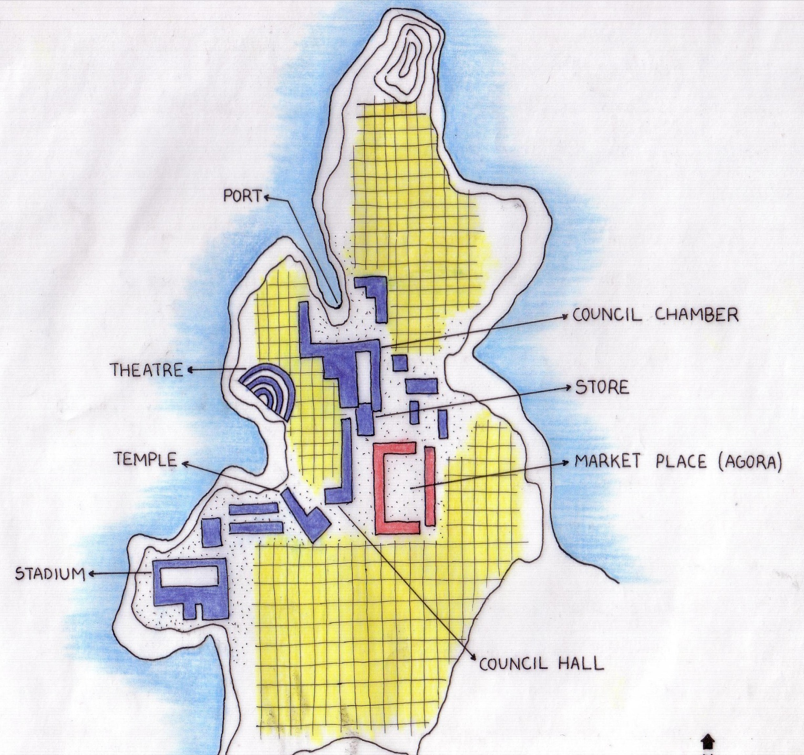
PEOPLE LIVED IN SOCIAL GROUPS TOGETHER
GOVT. BODY TO ADMINISTER
DIFFERENT USES SHOW THAT PEOPLE ENGAGED IN DIFFERENT ACTIVITIES – SPECIALIZATION OF LABOR
RELIGIOUS BUILDING
MILETUS

Slide 8
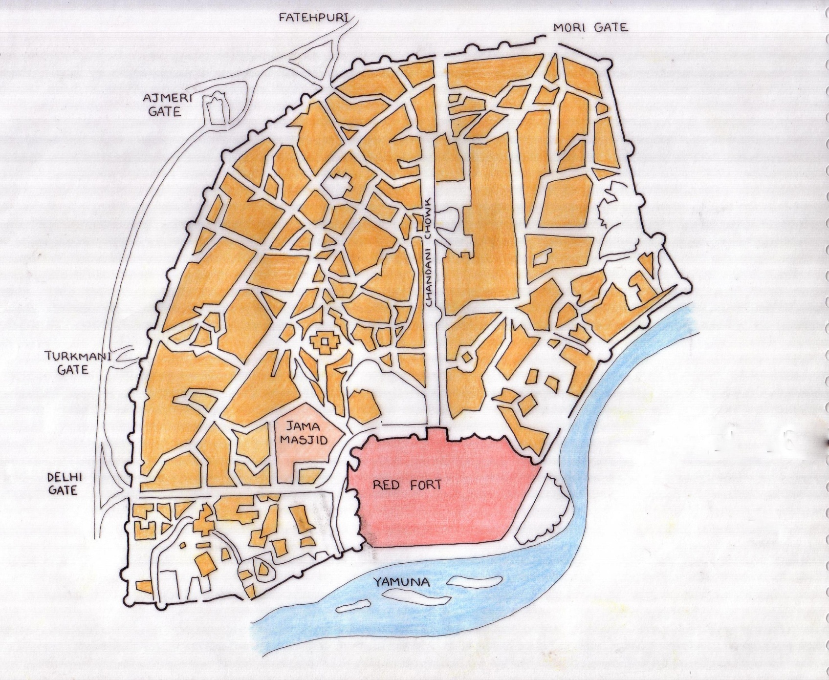
PEOPLE LIVED IN SOCIAL GROUPS
FORTIFIED CITY WITH GATES
DIFFERENT USES SHOWING PEOPLE WERE ENGAGED IN DIFFERENT ACTIVITIES
SOCIAL CLASSES – HIGHER PLACES FOR RELIGIOUS AND THE ROYAL PEOPLE (CONCEPT OF HIGHER BEING)
RELIGIOUS BUILDING POSITIONED ON HIGHER GROUND
SHAHJAHANABAD

Slide 9
CHARACTERISTICS OF CIVILIZATION | SETTLEMENT OF MOHENJO-DARO | SETTLEMENT OF MILETUS | SETTLEMENT OF SHAHJAHANABAD
1. SYSTEM OF GOVT. | √(ALTHOUGH EVIDENCE SUGGESTS THE PRESENCE OF A LEADER, IT IS FOR CERTAIN THAT A SOPHISTICATED SYSTEM OF GOVERNMENT EXISTED AT THIS TIME) | √(A FEW VARIANTS OF DEMOCRACY WERE IMPLEMENTED WHICH WERE LATER REPLACED BY THE SYSTEM OF OLIGARCHY) | √(MONARCHY)
2. PEOPLE LIVING IN SOCIAL GROUPS | √(THE SOCIAL GROUPS WERE SEGREGATED ACCORDING TO THE CLASS OF PEOPLE) | √(PRESENCE OF SPACES FOR SOCIAL CONGREGATION) | √(RESIDENTIAL AREAS WERE CLOSELY KNIT)
3. SPECIALIZATION OF LABOR | √(THE PEOPLE WERE INVOLVED IN TRADE WITH OTHER CIVILIZATIONS OF THE TIME) | √(THE PEOPLE WERE INVOLVED IN TRADE, THE ARTS AND DEFENCE) | √(THE PEOPLE WERE MOSTLY INVOLVED WITH TRADE)
4. DIFFERENT SOCIAL CLASSES | √ (PLACES WHERE PRIESTS AND THE GOVT. BODY LIVED WERE AT A HIGHER LEVEL THAN THE COMMON PEOPLE’S RESIDENCE) | √(ARTISANS AND HUSBANDMEN INFERIOR TO ARMED DEFENDERS) | √ (CLEAR DISTINCTION BETWEEN CLASSES)
6. CONCEPT OF HIGHER BEING | √ (A SPECIAL PLACE FOR RELIGIOUS BUILDINGS I.E. THE CITADEL) | √(LAND DIVIDED INTO THREE PARTS – ONE FOR SACRED USES) | √(PRESENCE OF MASJID NEXT TO THE FORT SUGGESTS PRIORITY)
7. REGULAR FOOD SUPPLY | √ (PRESENCE OF GRANARY INDICATES A WELL DEVELOPED AGRICULTURAL SYSTEM) | √ (PRESENCE OF STORE OR GRANARY) | √
THUS, IT CAN BE SEEN THAT THE HUMAN SETTLEMENT FORM IS AN EXPRESSION OF CIVILIZATION

Slide 10
REFERENCES
Hilberseimer L. (1955) The Nature of Cities, Paul Theobald Publishers, Chicago.
Chattopadhya B., B. Gupta and J. Burman History of Human Settlements ITPI, India.
http://en.wikipedia.org/wiki/Civilization
Kilian D. and M. Howells (2005) Human Settlements, South Africa Environment Outlook, Issue December, 2005
http://soer.deat.gov.za/dm_documents/Human_Settlement_-_Background_Paper_iwTDC.pdf

