Slide 1
Hoysala style
Presented by: Ar. Hiba Gul

Slide 2
Hoysala style
The merging of the Dravidian and North Indian styles created a temple that is unique, so much so that it is often classified as the Hoysala style.

Slide 3
Dravidian culture
There are excavated pillared halls and monolithic shrines known as rathas in Mahabalipuram.
Early temples were mostly dedicated to Shiva.
The Kailasanatha temple inKanchipuram and the Shore Temple built by Narasimhavarman II, rock cut temple inMahendravadi by Mahendravarman are fine examples of the Pallava style temples.

Slide 4
Dravidian culture
The five ratha temples commonly known as the Pancha Rathas or five chariots stand majestically on the southernmost extreme of Mahabalipuram.
Built by the Pallava ruler Narsimha Varman 1 (AD 630- 68) alias Mamalla in the 7th and 8th centuries, each temple is a monolith, carved out of a single rock.
The temples which are different cut out from a huge rock, sloping from south to north
These individual 'rathas' are named after the Pandava brothers Yudhistara (Dharmaraja), Arjuna, Bhima, Nakula & Sahadeva of the Epic Mahabharata and their wife Draupadi.

Slide 5
Shore Temple, Mahabalipuram
The Shore Temple is a five-storeyed structural Hindu temple rather than rock-cut as are the other monuments at the site.
It is the earliest important structural
temple in Southern India.
Its pyramidal structure is 60 ft high and sits on a 50 ft square platform.
There is a small temple in front
which was the original porch
It is made out of finely cut local granite.
Recent excavations have revealed new structures here under the sand

Slide 7
The temple is a combination of three shrines.
The main shrine is dedicated to Shiva as is the smaller second shrine.
A small third shrine, between the two, is dedicated to a reclining Vishnu and may have had water channeled into the temple, entering the Vishnu shrine.
The two Shiva shrines are orthogonal in configuration.
The entrance is through a transverse barrel vault gopuram.
The two shikharas have a pyramidal outline, each individual tier is distinct with overhanging eaves that cast dark shadows.
The outer wall of the shrine to Vishnu and the inner side of the boundary wall are extensively sculptured and topped by large sculptures of Nandi
The temple's outer walls are divided by plasters into bays, the lower part being carved into a series of rearing lions.

Slide 8
Dravidian Order - Brihadishwara Temple, Tanjore

Slide 10
Brihadeshwara temple - through the gate to the courtyard where the 60 meter tower, a feast of Dravidian architecture towers into the sky dwarfing the landscape offers a glimpse into the mind of the once invincible imperial Cholas.
Built in 11th century by Rajaraja I, it established the power of the Cholas.
Granite blocks were brought for the temple from a distance of 50 km.
The tower or vimana soars to height of 60.96 metres and the stone cupola at the top weighs 81.284 tonnes.
Long plinths were used to put the stones in place.

Slide 11
Meenakshi Temple, Madurai.

Slide 12
The temple complex is divided into a number of concentric
quadrangular enclosures contained by high masonary walls.
It is one of the few temples in Tamil Nadu to have four entrances facing four directions.
Vishwantha Nayaka allegedly redesigned the city of Madurai in accordance with the principles laid down by Shilpa Shastras relevant to urban planning.
The city was laid out in the shape of square with a series of concentric streets originating from the temple.
Ancient Tamil classics mention that the temple was the center of the city and the streets happened to be radiating out like lotus and its petals.
The complex is in a compound of 45 acres (180,000 m²)
is also the largest temple complex in India, which greets about 10,000 visitors everyday.

Slide 13
Designed as a series of concentric courtyards or PRAKARMAS
Outermost circle – edifices of a practical nature than spiritual such as account ofices, dormitories for pilgrims, kitchens, shops, maintenance workshops etc. and parking for wooden festive chariots
Inner prakarmas – pavilions or devotional songs and story telling, bathing tanks for ritual ablutions and guest houses
Innermost courts – kitchen for brahmins, pavilions or dancing girls and treasury
Actual cella – open only to priests

Slide 16
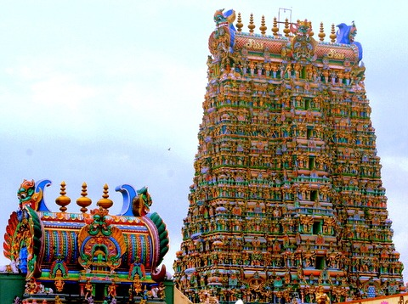
Hall of thousand pillars – 985 pillars, 240ft X250ft
Soaring gopurams – 150ft (48m) high gopuram
The tall gateways known as gopuram is of height of 45 to 50 m welcomes
The gods and goddess are painted in unique bright colors
The most amazing part of the temple is the southern gateway, which holds whooping 1500 sculptures

