Slide 1
PRESENTED BY:-
ATUL SETYA
HOSPITAL

Slide 2
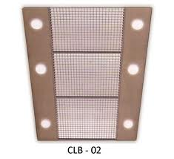
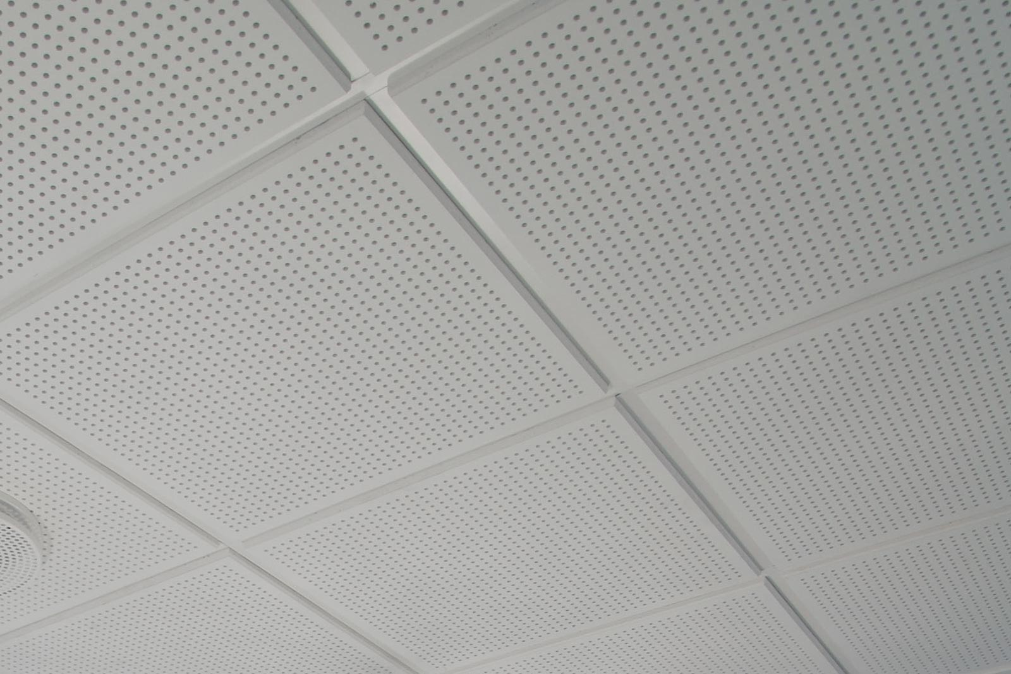
HOSPITAL

Slide 3
LABORATORY
INTRODUCTION - THE PRIMARY FUNCTION OF THE CLINICAL LABORATORY TESTS WHICH WILL PROVIDE SERVICE FOR THE PREVENTION, DIAGNOSIS AND TREATMENT OF THE DISEASES
FUNCTION – THE MAIN FUNCTION OF LABORATORY ARE
PROVISION OF COMPREHENSIVE AND ANLYTICAL TEST RESULT
ASSISTANCE IN CONFIRMING/REJECTING A DIAGNOSIS ,PROGNOSIS AND FOLLOW UP THEORY
DETECTION OF DISEASES
TRAINING AND RESEARCH
OBJECTIVES - THE MAIN OBJECTIVES OF PLANNING AND DESIGNING OF LABORATORY ARE
THE STRUCTURAL DESIGN SHOULD BE CONSISTENT WITH THE EXISTING LEVEL OF SPECIALIZATION,AUTOMATION AND SCOPE OF FUTURE EXPANSION
PLAN FOR A SAFE,COMFOTABLE AND CONTROLLED ENVIRONMENT.
BUILDING LAYOUT ENABLE FUTURE FLEXIBILITY
PROVISION SHOULD BE MADE FOR PNEUMATIC TUBE SYSTEM, EITHER FOR PRESENT OR FOR FUTURE EXPANSION .
HOSPITAL

Slide 4
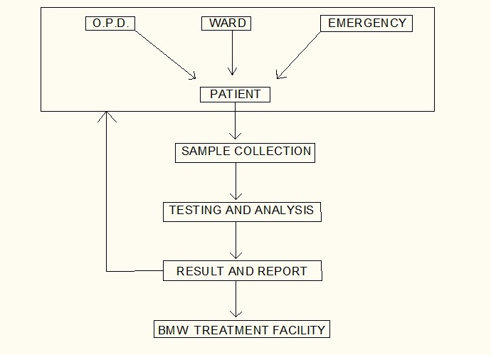
5 . SPECIAL PLUMBING AND VENTILATION AND ANTI -VIBRATION DESIGN MEASURE SHOULD BE INCORPORATED
DAYLIGHT TO BE UTILIZED MAXIMALLY
THERE SHOULD BE EASY AND DISTINCT ROUTE FOR THE DISPOSAL OF WASTE FROM THE PRINCIPAL WORK AREA
IT IS IMPORTANT TO PLAN FOR INTRA AND INTERDEPARTMENTAL RELATIONSHIP
AIR LOCK SHOULD BE PROVIDED AT THE ENTRANCE OF THE LABORATORY
CHEMICAL RESISTANT AND STAIN RESISTANT MATERIAL SHOULD BE USED IN THE WORKTOP AND WORK STATION FINISHES
HOSPITAL

Slide 5
AREAS :-
HEMATOLOGY :- OFFICE, HEMATOLOGY LABORATORY, STOOL, VIRUS EXAMINATION WITH SPECIAL CUBICAL
MICROBIOLOGY :- OFFICE , BATERIOLOGY LABORATORY, MYCOLOGY LABORATORY, INCUBATOR ROOM, COLD STORAGE, STERLIZATION ROOM,
VIROLOGY :- OFFICE, SEROLOGY LABORATORY, TISSUE CULTURE ROOM, ANIMAL ROOM
BIOCHEMISTRY :- OFFICE, BIO-CHEMISTRY LAB, PHOTOMETRY, CHROMATOGRAPHY AND ELECTROPHORESIS
IMMUNOLOGY
GROSS TISSUE
PATHOLOGY, HISTOLOGY AND CYTOLOGY :- OFFICE, HISTOPATHOLOGY LAB, CYTOLOGY LAB , SPECIMEN STORES, MICOROPHOTOGRAPHY ROOM, FNAC ROOM
PHOTOMETRY
HOSPITAL

Slide 6
WAITING AREA , EXAMINATION CUBICLES AND TOILET FOR PATIENTS
SPECIMEN AND BLOOD COLLECTION AREA HAVING WORK BENCH SPACE FOR PATEINT SEATING , HANDWASHING FACILITIES,
AUTOPSY
SPECIMEN DISPOSAL , SLUICE ROOM
STAFF LOCKER
STORAGE FCILITIES FOR REAGENTS, SUPPLIES, STAINED SPECIMEN MICROSCOPE SLIDES.
OFFICE
CULTURE MEDIA PREPARATION ROOM, STERLIZING AREA, STORAGE AREA FOR SURGICAL SPECIMEN
HOSPITAL

Slide 7
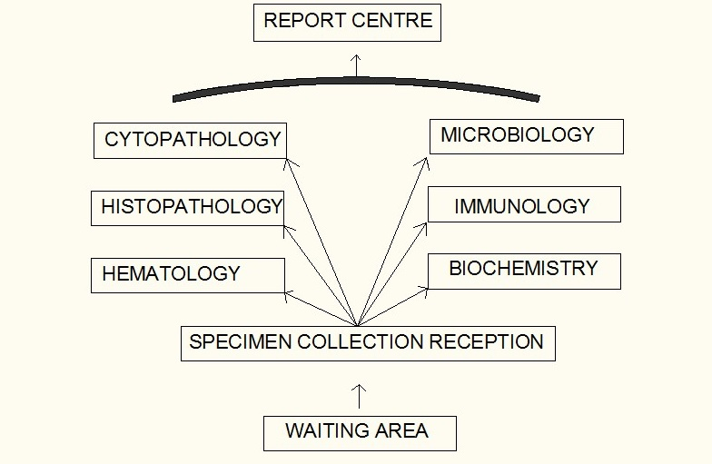
LOCATION OF LABORATORY :-
IT SHOULD BE PREFERABY SITUATED ON THE GROUND FLOOR/ FIRST FLOOR. IN CLOSE TO AMBULATORY AND ACUTE PATEINT CARE AREAS AS WELL AS INPATIENT AREAS.
THE PROCESSING AREAS OF THE LABORATORY IS NOT ACCESIBLE TO THE PATEINTS BUT THE COLLECTOR POINT FOR SPECIMEN MUST BE CONVENIENTLY LOCATED
DUE TO HIGHER VOLUME OF TEST BIOCHEMISTRY AND HEMATOLOGY LOCATED CLOSER TO SPECIMEN RECEPTION AREA AND MICROBIOLOGY IS LOCATED FARTHEST DUE TO LESSER VOLUME OF TEST
HOSPITAL

Slide 8
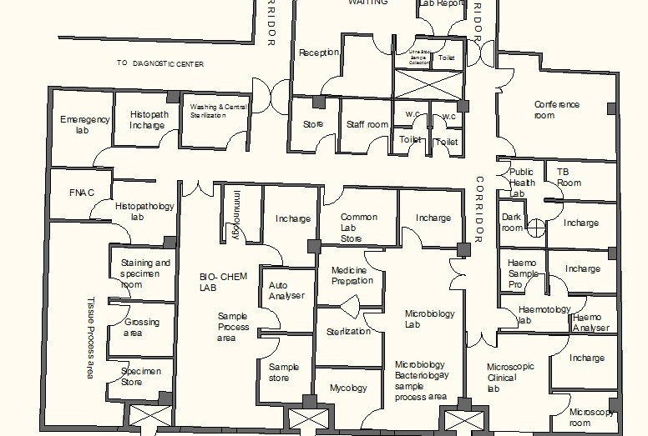
LAYOUT PLAN
HOSPITAL

Slide 9
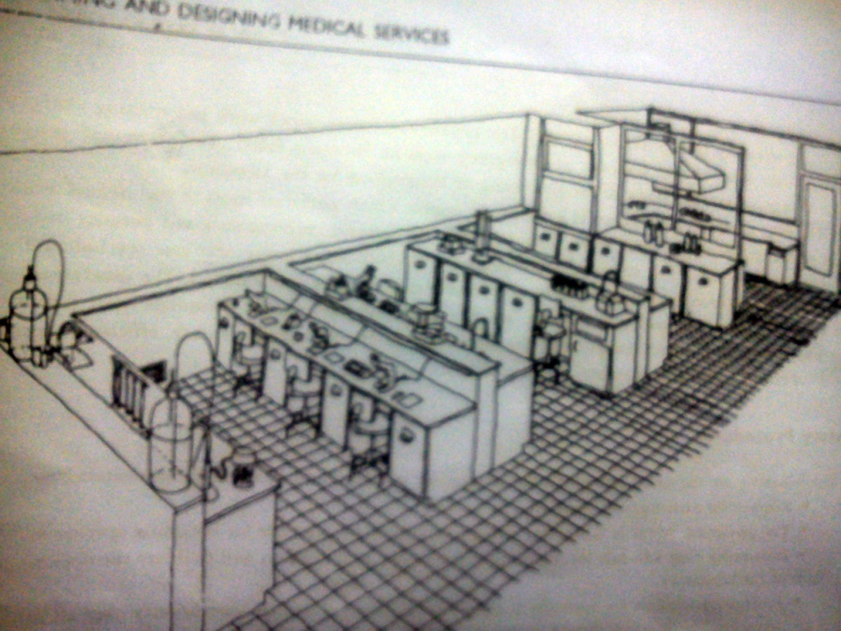
SPACE REQUIREMENT :- THE MAIN DETERMINANTS OF SPACE IN A LABORATORY ARE THE EXTENT OF AUTOMATION AND TYPE OF TECHNOLOGY USED IN IT.
A STANDING HUMAN REQUIRES 4 SQUARE FEET SPACE. WHEREAS SITTING REQUIRES 6 SQUARE FEET SPACE.
THE WORKING SPACE SHOULD BE ADEQUATE WITH MATERIAL AND EQUIPMENT.
FOR WORK STATION , THE MODULE MAY BE 10 FEET BY 20 FEET WITH WORK BENCHES 12 FEET LONG AND 30 INCHES HIGH.
HOSPITAL

Slide 10
STORAGE :- STORAGE FACILITIES INCLUDE THOSE FOR REFRIGERATION , REAGENTS AND SUPPLIES , MAINTENANCE OF PATIENTS RECORDS AND WATER PURIFICATION.
SEPRATE STORAGE FOR FLAMMABLE LIQUIDS SHOULD BE PROVIDED.
SEPRATE FACILITIES SHOULD ALSO BE PROVIDED FOR INCOMPATIBLE MATERIAL LIKE ACIDS AND BASES
SAFETY:- THERE SHOULD BE PROVISION FOR SAFETY , INCLUDING EYE FLUSHING DEVISES, EMERGENCY SHOWER, AND FIRE EXTINGUISHER
WORK STATION :- WORK COUNTER WITH SPACE FOR EQUIPMENT, MICROSCOPES, INCUBATORS, CENTRIFUGE, UNDER THE CABINET AND OVERHEAD CABINET SHOULD BE PROVIDED.
THEY SHOULD BE EQUIPPED WITH VACCUM GAS , ELECTRICAL SERVICES, SINKS AND WATER SUPPLY.
THE DRAINAGE WHERE HIGHLY CORROSIVE LIQUID ARE USED SHOULD CONSIST OF GLASS LINED IRON TRAPS AND PIPES.
COUNTER SINK FOR HANDWASHING
HOSPITAL

Slide 11
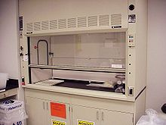
LIGHTNING :-
NATURAL LIGHT IS VERY USEFUL IN HOSPITAL.
RECEPTION AREA, STORAGE AREA REQUIRE 200 LUX
OFFICE REQUIRE 300 LUX AND WORKING SPACE REQUIRE 500 LUX
EMERGENCY BACKUP IS ALSO ESSENTIAL FOR SOME EQUIPMENTS
FUME HOOD :- THESE ARE PARTICULARLY REQUIRED IN LABORATARIES WHERE RADIOACTIVE SUBSTANCES ARE USED.
FORCED VENTILATION SHOULD BE ACCOMPANIED BY AN EXTRACTION SYSTEM.
THE FUME HOOD SHOULD BE LOCATED AWAY FROM THE TRAFFIC AREA AND DOORWAYS
HOSPITAL

Slide 12
FLOORS :-
MATERIAL OF FLOOR SHOULD BE CLEANED AND DISINFECTED EASILY
THE USE OF SEAMLESS OR SELF-LEVELING FLOORING IS DESIRABLE OPTION
ISOLATED FLOORING IS USED
VINYL AND RUBBER FLOORING IS BEST IN HOSPITAL
DOORS :- LABORATORY DOORS SHOULD NOT BE LESS THAN 1 M WIDE. SOME DOUBLE DOORS OF TOTAL WIDTH OF 1.50 M SHOULD BE CONSTRUCTED
CORRIDORS:- WIDTH OF THE CORRIDORS IS RECOMMENDED TO BE 2 TO 2.5 M TO FACILITATE MOVEMENT OF PATEINT
BENCHES :- COUNTER TOP HEIGHT (750-900 MM) VARY DEPENDING UPON THE WORK
DEPTH OF THE WALL TABLE IS 700 MM
LENGTH OF THE BENCH IS FROM 1.6 M TO 1.8 M
EACH BENCH HAVE SINK WITH FACILITY OF HOT AND COLD WATER.
HOSPITAL

Slide 13
AUTOPSY ROOM AND MORGUE :-
AUTOPSY HAS GREATLY CONTRIBUTED TO THE ADVANCMENT OF SCIENTIFIC KNOWLEDGE AND TO THE CONQUEST OF DISEASES . MEDICAL STAFF SHOULD BE INTRESTED IN THE ADVANCEMENT OF KNOWLEDGE THROUGH AUTOPSY
THE FOLLOWING FACILITIES ARE REQUIRED
AUTOPSY TABLE MADE OF STAINLESS STEEL WITH SINK AT THE FOOT END AND SHADOW LAMP FITTED OVER THE TABLE
STORAGE ROOM FOR EQUIPMENT
DOCTOR’S OFFICE FOR WRITING REPORTS, DISCUSSION etc
VISITOR WAITING ROOM
REFRIGERATED FACILITIES FOR STORING BODIES
HOSPITAL

