Slide 1
PRESENTED BY:-
ATUL SETYA
HOSPITAL

Slide 2
OUTPATIENT DEPARTMENT AND IT’S SERVICES
The OPD department is the part of the hospital that provides facilities for the diagnosis and treatment of patients
Who do not need hospitalization
It offer only basic minor services.
GENERAL FUNCTIONS
Consultations,Dignosis and trearment.
Preventive of diseases
Education, Research and training
OBJECTIVES
To provide quality, surgical, dental and nursing care to patients who come for consultation
HOSPITAL

Slide 3
LOCATION OF OUTPATIENT DEPARTMNET
The outpatient department shoul be convinienntly located adjacent or in close to vital services such as registration and medical records, admitting , emergency and social services
It should be easily accessible and rapid services should be available from the laboratories, radiology, pharmacy and physical therapy department.
Attention should be paid to circulation which should result in the smooth flow of the various traffic lines traversing the department.
Laboratory should be closed to the outpatient department, if it is located at the different floor or at a distance so it is recommended that a laboratory substation is located at the outpatient department.
The outpatient departmnent should be on the ground level , preferably with a separate entrance and edequate parking facilities.
HOSPITAL

Slide 4
FLOW CHART
RECEPTION & REGISTRATION
ADMIT
INPATIENT WARD
OUT PATIENT
RECORDS
DIAGNOSTIC & TREATMENT
PHARMACY
DISCHARGE
DISCHARGE
POST HOSPITAL CARE

Slide 5
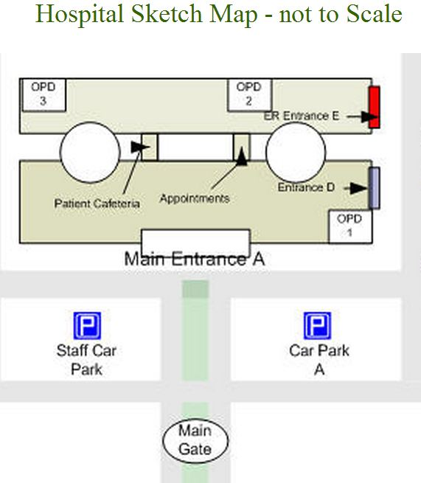
HOSPITAL

Slide 6
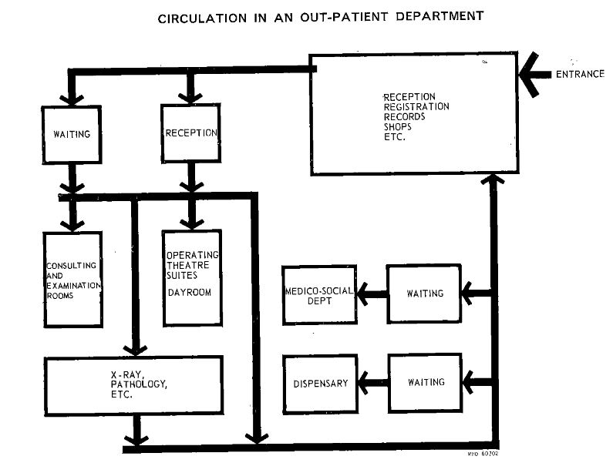
HOSPITAL

Slide 7
DESIGN
Adequate parking facilities.
Entrance located at ground level and designed to handle wheelchairs and stretchers.
Storage areas for wheel chairs and stretchers.
Lobby and lounge to provide seating acommodation for the largest number of person.
Large number of person crowding in one single please creates an impression of cold impersonality and inefficiency ,
So to improve the atmosphere sub waiting areas adjacen to the clinic or opd.
Elevators easily accessible to the lobby
If the hospital has an outpatient surgery programme , a room should be equipped for minor surgeries.
A recovery room to hold to the patients for observation after surgery should be adjacent to the minor surgery room,
and it should be visible from the nurse’s station for nurse’s superbision and observation.
Other facilities that may be provided are toilets, a place where patients could change from their street colthes to hospital gowns if necessaery, relative’s waiting area and of course , scrub and change rooms for doctors and nurses.
Doctor’s office.
HOSPITAL

Slide 8
EMERGENCY SERVICES
Over View
In planning and designing emergency services , a Designer must be aware of the fact that patients often seek emergency services for situations other than acute medical condition.
The emergency department is required to render a comprehensive range of services right from the elementary first aid and general out-patience services.
It might define an emergency as a life and death situation involving an injury or acute illness threatening life , limb or sight , a situation which warrants immediate treatment , the patient’s preception of what constitutes an emergency is often less well defined .
Clock care is every time available for unexpected injuries and emergency .
AN IMPORTANT POINT WHILE DESIGNING
Hospital planners must take cognizance of these changes in the concept , functions and demand on the emergency department and incorporate flexibility in the design of the department to handle a wide range of cases in the most economical and efficient manner in terms of space , equipment , personal and supplies .
HOSPITAL

Slide 9
EMERGENCY SERVICES
The entrance to the emergency should be sheltered to protect ambulance patients from the weather while unloading .
The ambulance entrance should be large enough to admit one or more ambulances negotiating with stretchers .
The design should facilitate good public relation .
No unsatisfactory arrangements , congestion , delays and inefficient operation due to faulty design will present a poor image of the hospital in the eyes of the emergency patients and their relatives .
A separate entrance and exit to this particular department .
Space should be clearly divide and the sub-division should be focusing and emphassing .
PHYSICAL FACILITIES AND SPACE REQUIREMENTS
Trauma care area
Medical examining area
Splintage and casting area
Observation beds
Inpatient area
HOSPITAL

Slide 10
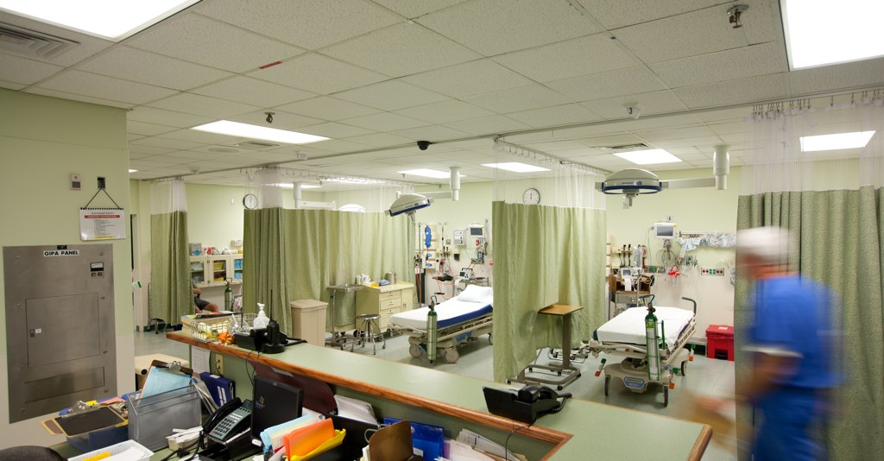
HOSPITAL

Slide 11
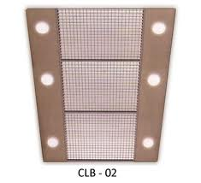
HOSPITAL

Slide 12
LABORATORY
INTRODUCTION - THE PRIMARY FUNCTION OF THE CLINICAL LABORATORY TESTS WHICH WILL PROVIDE SERVICE FOR THE PREVENTION, DIAGNOSIS AND TREATMENT OF THE DISEASES
FUNCTION – THE MAIN FUNCTION OF LABORATORY ARE
PROVISION OF COMPREHENSIVE AND ANLYTICAL TEST RESULT
ASSISTANCE IN CONFIRMING/REJECTING A DIAGNOSIS ,PROGNOSIS AND FOLLOW UP THEORY
DETECTION OF DISEASES
TRAINING AND RESEARCH
OBJECTIVES - THE MAIN OBJECTIVES OF PLANNING AND DESIGNING OF LABORATORY ARE
THE STRUCTURAL DESIGN SHOULD BE CONSISTENT WITH THE EXISTING LEVEL OF SPECIALIZATION,AUTOMATION AND SCOPE OF FUTURE EXPANSION
PLAN FOR A SAFE,COMFOTABLE AND CONTROLLED ENVIRONMENT.
BUILDING LAYOUT ENABLE FUTURE FLEXIBILITY
PROVISION SHOULD BE MADE FOR PNEUMATIC TUBE SYSTEM, EITHER FOR PRESENT OR FOR FUTURE EXPANSION .
HOSPITAL

Slide 13
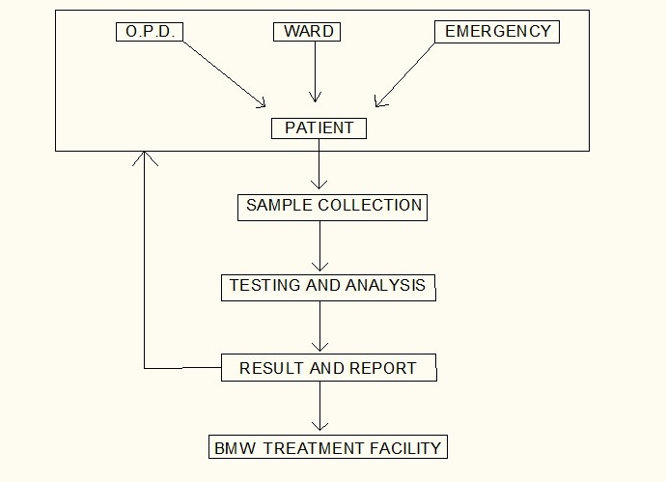
5 . SPECIAL PLUMBING AND VENTILATION AND ANTI -VIBRATION DESIGN MEASURE SHOULD BE INCORPORATED
DAYLIGHT TO BE UTILIZED MAXIMALLY
THERE SHOULD BE EASY AND DISTINCT ROUTE FOR THE DISPOSAL OF WASTE FROM THE PRINCIPAL WORK AREA
IT IS IMPORTANT TO PLAN FOR INTRA AND INTERDEPARTMENTAL RELATIONSHIP
AIR LOCK SHOULD BE PROVIDED AT THE ENTRANCE OF THE LABORATORY
CHEMICAL RESISTANT AND STAIN RESISTANT MATERIAL SHOULD BE USED IN THE WORKTOP AND WORK STATION FINISHES
HOSPITAL

Slide 14
AREAS :-
HEMATOLOGY :- OFFICE, HEMATOLOGY LABORATORY, STOOL, VIRUS EXAMINATION WITH SPECIAL CUBICAL
MICROBIOLOGY :- OFFICE , BATERIOLOGY LABORATORY, MYCOLOGY LABORATORY, INCUBATOR ROOM, COLD STORAGE, STERLIZATION ROOM,
VIROLOGY :- OFFICE, SEROLOGY LABORATORY, TISSUE CULTURE ROOM, ANIMAL ROOM
BIOCHEMISTRY :- OFFICE, BIO-CHEMISTRY LAB, PHOTOMETRY, CHROMATOGRAPHY AND ELECTROPHORESIS
IMMUNOLOGY
GROSS TISSUE
PATHOLOGY, HISTOLOGY AND CYTOLOGY :- OFFICE, HISTOPATHOLOGY LAB, CYTOLOGY LAB , SPECIMEN STORES, MICOROPHOTOGRAPHY ROOM, FNAC ROOM
PHOTOMETRY
HOSPITAL

Slide 15
WAITING AREA , EXAMINATION CUBICLES AND TOILET FOR PATIENTS
SPECIMEN AND BLOOD COLLECTION AREA HAVING WORK BENCH SPACE FOR PATEINT SEATING , HANDWASHING FACILITIES,
AUTOPSY
SPECIMEN DISPOSAL , SLUICE ROOM
STAFF LOCKER
STORAGE FCILITIES FOR REAGENTS, SUPPLIES, STAINED SPECIMEN MICROSCOPE SLIDES.
OFFICE
CULTURE MEDIA PREPARATION ROOM, STERLIZING AREA, STORAGE AREA FOR SURGICAL SPECIMEN
HOSPITAL

Slide 16
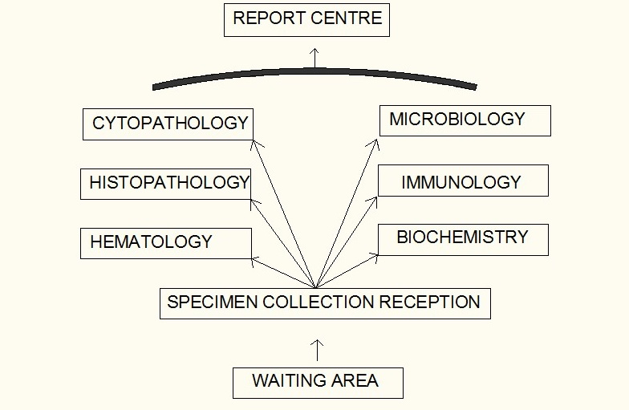
LOCATION OF LABORATORY :-
IT SHOULD BE PREFERABY SITUATED ON THE GROUND FLOOR/ FIRST FLOOR. IN CLOSE TO AMBULATORY AND ACUTE PATEINT CARE AREAS AS WELL AS INPATIENT AREAS.
THE PROCESSING AREAS OF THE LABORATORY IS NOT ACCESIBLE TO THE PATEINTS BUT THE COLLECTOR POINT FOR SPECIMEN MUST BE CONVENIENTLY LOCATED
DUE TO HIGHER VOLUME OF TEST BIOCHEMISTRY AND HEMATOLOGY LOCATED CLOSER TO SPECIMEN RECEPTION AREA AND MICROBIOLOGY IS LOCATED FARTHEST DUE TO LESSER VOLUME OF TEST
HOSPITAL

Slide 17
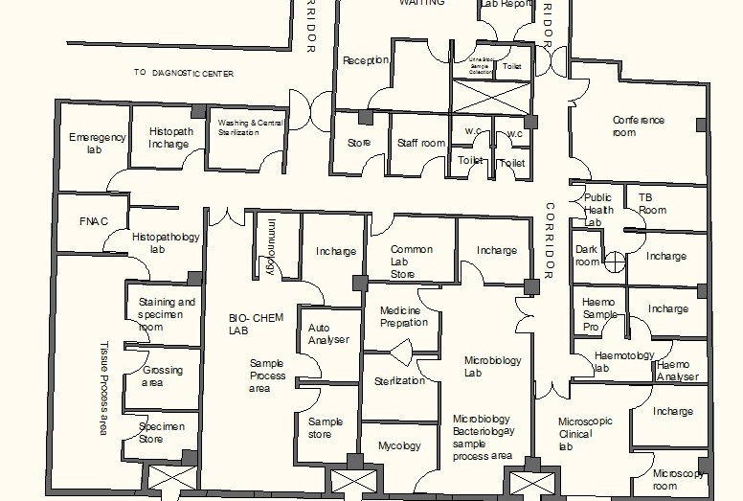
LAYOUT PLAN
HOSPITAL

Slide 18
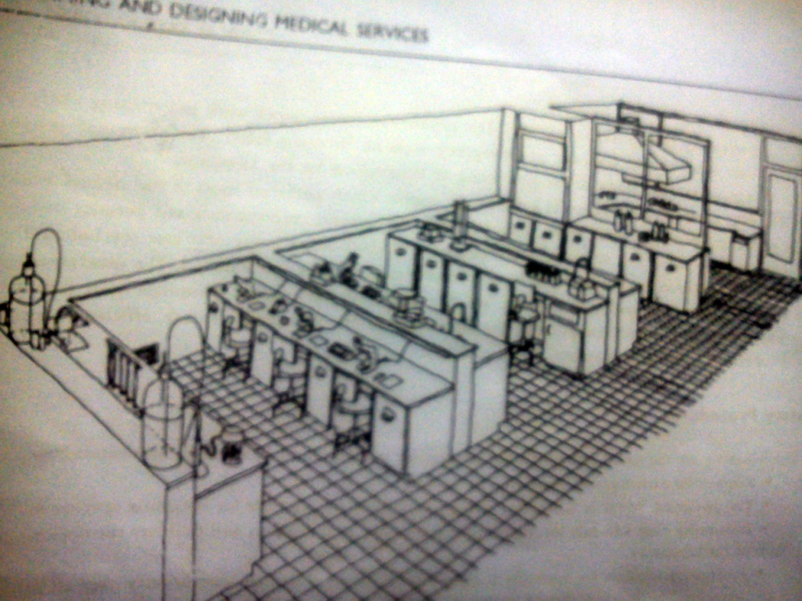
SPACE REQUIREMENT :- THE MAIN DETERMINANTS OF SPACE IN A LABORATORY ARE THE EXTENT OF AUTOMATION AND TYPE OF TECHNOLOGY USED IN IT.
A STANDING HUMAN REQUIRES 4 SQUARE FEET SPACE. WHEREAS SITTING REQUIRES 6 SQUARE FEET SPACE.
THE WORKING SPACE SHOULD BE ADEQUATE WITH MATERIAL AND EQUIPMENT.
FOR WORK STATION , THE MODULE MAY BE 10 FEET BY 20 FEET WITH WORK BENCHES 12 FEET LONG AND 30 INCHES HIGH.
HOSPITAL

Slide 19
STORAGE :- STORAGE FACILITIES INCLUDE THOSE FOR REFRIGERATION , REAGENTS AND SUPPLIES , MAINTENANCE OF PATIENTS RECORDS AND WATER PURIFICATION.
SEPRATE STORAGE FOR FLAMMABLE LIQUIDS SHOULD BE PROVIDED.
SEPRATE FACILITIES SHOULD ALSO BE PROVIDED FOR INCOMPATIBLE MATERIAL LIKE ACIDS AND BASES
SAFETY:- THERE SHOULD BE PROVISION FOR SAFETY , INCLUDING EYE FLUSHING DEVISES, EMERGENCY SHOWER, AND FIRE EXTINGUISHER
WORK STATION :- WORK COUNTER WITH SPACE FOR EQUIPMENT, MICROSCOPES, INCUBATORS, CENTRIFUGE, UNDER THE CABINET AND OVERHEAD CABINET SHOULD BE PROVIDED.
THEY SHOULD BE EQUIPPED WITH VACCUM GAS , ELECTRICAL SERVICES, SINKS AND WATER SUPPLY.
THE DRAINAGE WHERE HIGHLY CORROSIVE LIQUID ARE USED SHOULD CONSIST OF GLASS LINED IRON TRAPS AND PIPES.
COUNTER SINK FOR HANDWASHING
HOSPITAL

Slide 20
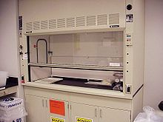
LIGHTNING :-
NATURAL LIGHT IS VERY USEFUL IN HOSPITAL.
RECEPTION AREA, STORAGE AREA REQUIRE 200 LUX
OFFICE REQUIRE 300 LUX AND WORKING SPACE REQUIRE 500 LUX
EMERGENCY BACKUP IS ALSO ESSENTIAL FOR SOME EQUIPMENTS
FUME HOOD :- THESE ARE PARTICULARLY REQUIRED IN LABORATARIES WHERE RADIOACTIVE SUBSTANCES ARE USED.
FORCED VENTILATION SHOULD BE ACCOMPANIED BY AN EXTRACTION SYSTEM.
THE FUME HOOD SHOULD BE LOCATED AWAY FROM THE TRAFFIC AREA AND DOORWAYS
HOSPITAL

Slide 21
FLOORS :-
MATERIAL OF FLOOR SHOULD BE CLEANED AND DISINFECTED EASILY
THE USE OF SEAMLESS OR SELF-LEVELING FLOORING IS DESIRABLE OPTION
ISOLATED FLOORING IS USED
VINYL AND RUBBER FLOORING IS BEST IN HOSPITAL
DOORS :- LABORATORY DOORS SHOULD NOT BE LESS THAN 1 M WIDE. SOME DOUBLE DOORS OF TOTAL WIDTH OF 1.50 M SHOULD BE CONSTRUCTED
CORRIDORS:- WIDTH OF THE CORRIDORS IS RECOMMENDED TO BE 2 TO 2.5 M TO FACILITATE MOVEMENT OF PATEINT
BENCHES :- COUNTER TOP HEIGHT (750-900 MM) VARY DEPENDING UPON THE WORK
DEPTH OF THE WALL TABLE IS 700 MM
LENGTH OF THE BENCH IS FROM 1.6 M TO 1.8 M
EACH BENCH HAVE SINK WITH FACILITY OF HOT AND COLD WATER.
HOSPITAL

Slide 22
AUTOPSY ROOM AND MORGUE :-
AUTOPSY HAS GREATLY CONTRIBUTED TO THE ADVANCMENT OF SCIENTIFIC KNOWLEDGE AND TO THE CONQUEST OF DISEASES . MEDICAL STAFF SHOULD BE INTRESTED IN THE ADVANCEMENT OF KNOWLEDGE THROUGH AUTOPSY
THE FOLLOWING FACILITIES ARE REQUIRED
AUTOPSY TABLE MADE OF STAINLESS STEEL WITH SINK AT THE FOOT END AND SHADOW LAMP FITTED OVER THE TABLE
STORAGE ROOM FOR EQUIPMENT
DOCTOR’S OFFICE FOR WRITING REPORTS, DISCUSSION etc
VISITOR WAITING ROOM
REFRIGERATED FACILITIES FOR STORING BODIES
HOSPITAL

