Slide 1
GIS & REMOTE SENSING
Subject: GIS Studio
Topic: Georeferencing
Presented by: Pallavi Tiwari

Slide 2
Georeferencing
‘To georeference’ → the act of assigning locations to atoms of information
Is essential in GIS, since all information must be linked to the Earth’s surface

Slide 3
Georeferences as Measurements
Some georeferences are metric
They define location using measures of distance from fixed places
E.g. distance from the Equator or from the Greenwich Meridian
Others are based on ordering
E.g. street addresses in most parts of the world order houses along streets
Others are only nominal
Place names do not involve ordering or measuring

Slide 4
Metric references
Essential to the making of maps and the display of mapped information in GIS
Provide the potential for infinitely fine spatial resolution (provided we have sufficiently accurate measuring devices)
From measurements of two or three locations it is possible to compute distances

Slide 5
Georeferencing systems
Placenames
Postal addresses and postal codes
Linear referencing systems
Cadastres
Latitude and longitude
Projections and coordinate systems
The Global Positioning System

Slide 6
Placenames
The earliest form of georeferencing
And the most commonly used in everyday activities
Many names of geographic features are universally recognized
Others may be understood only by locals
Names work at many different scales
From continents to small villages and neighborhoods
Names may pass out of use in time
Where was Naples, CA?

Slide 7
Postal Addresses and Postcodes
Every dwelling and office is a potential destination for mail
Dwellings and offices are arrayed along streets, and numbered accordingly
Streets have names that are unique within local areas
Local areas have names that are unique within larger regions
If these assumptions are true, then a postal address is a useful georeference

Slide 8
Where do postal addresses fail as georeferences?
In rural areas
Urban-style addresses have been extended recently to many rural areas
For natural features
Lakes, mountains, and rivers cannot be located using postal addresses
When numbering on streets is not sequential
E.g. in Japan

Slide 9
Postcodes as Georeferences
Defined in many countries
E.g. ZIP codes in the US
Hierarchically structured
The first few characters define large areas
Subsequent characters designate smaller areas
Coarser spatial resolution than postal address
Useful for mapping

Slide 10
Latitude and Longitude
The most comprehensive and powerful method of georeferencing
Provides potential for very fine spatial resolution
Allows distance to be computed between pairs of locations
Supports other forms of spatial analysis
Uses a well-defined and fixed reference frame
Based on the Earth’s rotation and center of mass, and the Greenwich Meridian

Slide 11
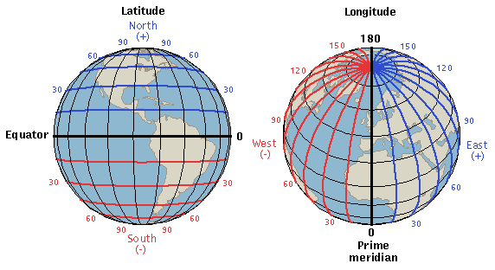
Latitude and Longitude
Latitude: is the angular distance, in degrees, minutes, and seconds of a point north or south of the Equator. Lines of latitude are often referred to as parallels.
Longitude: is the angular distance, in degrees, minutes, and seconds, of a point east or west of the Prime (Greenwich) Meridian. Lines of longitude are often referred to as meridians.

Slide 12
Because the Earth is not shaped precisely as an ellipsoid, initially each country felt free to adopt its own as the most accurate approximation to its own part of the Earth
Without a single standard the maps produced by different countries using different ellipsoids could never be made to fit together
Today an international standard has been adopted known as WGS 84 (the World Geodesic System of 1984)

Slide 13
Projections and Coordinates
There are many reasons for wanting to project the Earth’s surface onto a plane, rather than deal with the curved surface
The paper used to output GIS maps is flat
Flat maps are scanned and digitized to create GIS databases
Square and rectangular rasters are flat
The Earth has to be projected to see all of it at once
It’s much easier to measure distance on a plane

Slide 14
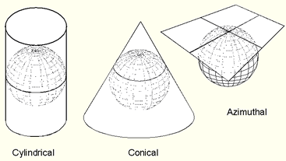
Map projections
Cylindrical - analogous to wrapping a cylinder of paper around the Earth, projecting the Earth’s features onto it, and then unwrapping the cylinder
Conical – analogous to wrapping a sheet of paper around the Earth in a cone
Azimuthal or planar - analogous to touching the Earth with a sheet of flat paper

Slide 15
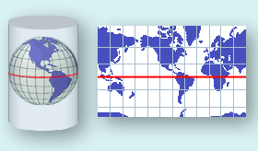
Cylindrical Projections
The Mercator projection is the best-known cylindrical projection
The cylinder is wrapped around the Equator
The projection is conformal
At any point scale is the same in both directions
Shape of small features is preserved
Features in high latitudes are significantly enlarged

Slide 16
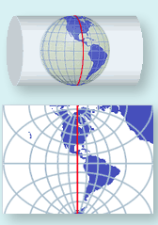
The Universal Transverse Mercator (UTM) Projection
A type of cylindrical projection
Implemented as an international standard coordinate system
Initially devised as a military standard
Uses a system of 60 zones
Maximum distortion is 0.04%
Transverse Mercator because the cylinder is wrapped around the Poles, not the Equator

Slide 17
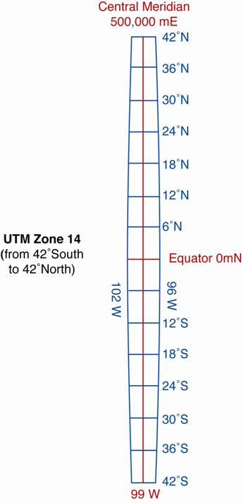
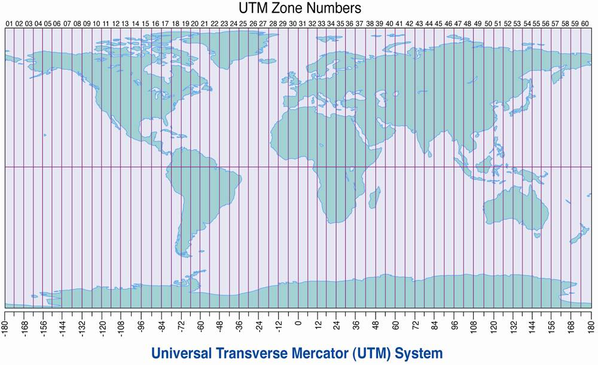
The Universal Transverse Mercator (UTM) Projection
Zones are each six degrees of longitude, numbered as shown at the top, from W to E

Slide 18
The Global Positioning System (GPS)
Allows direct, accurate measurement of latitude and longitude
Accuracy of 10m from a simple, cheap unit
Differential GPS capable of sub-meter accuracy
Sub-centimeter accuracy if observations are averaged over long periods

Slide 19
What is the Global Positioning System?
Consists of a system of 24 satellites, each orbiting the Earth every 12 hours on distinct orbits at a height of 20 200km and transmitting radio pulses at very precisely timed intervals
Position in a receiver is determined by precise calculations from:
the satellite signals,
the known positions of the satellites
the velocity of light
Position in the three dimesions (latitude, longitude and elevation) requires that at least 4 satellites are above the horizon
Accuracy depends on the number of satellites and their positions

Slide 20
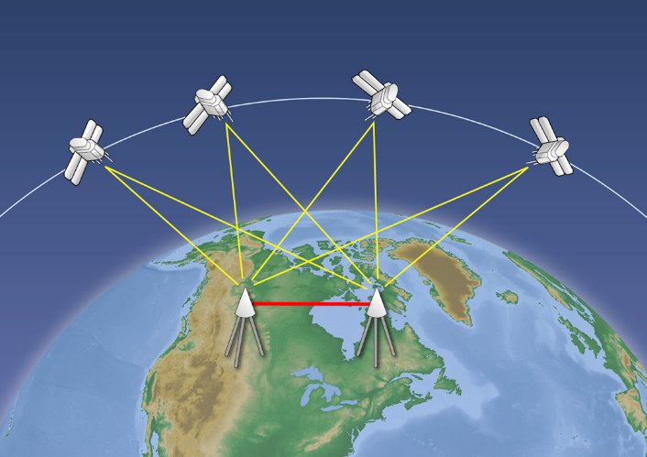
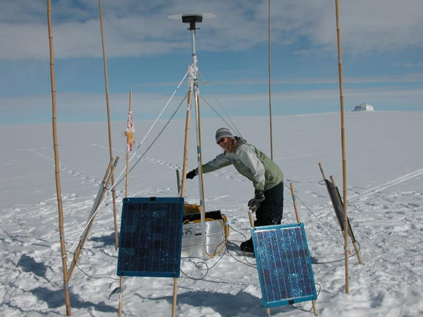
How does GPS work?
Earth is continuously circled by 24 GPS satellites
A GPS receiver listens for signals which give the satellites’ location and the exact time of sending.
Trilateration then gives them your latitude, longitude

