Slide 1
Subject: Building Services - III
Topic: Escalators
Presented by: Atul Setya

Slide 2
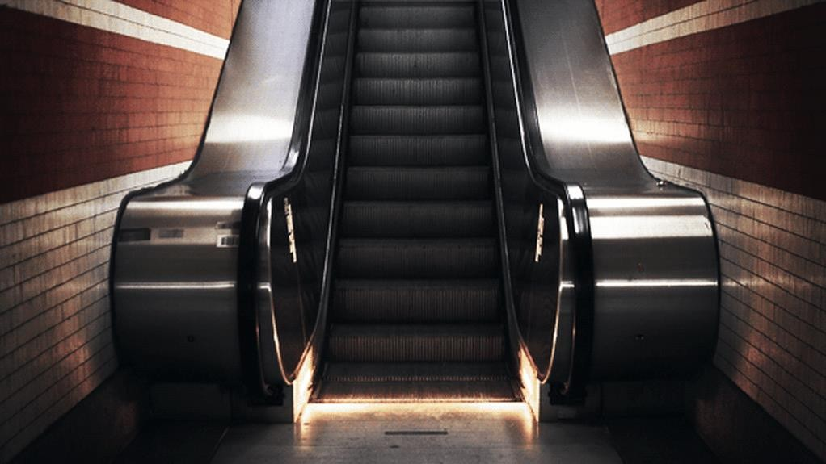
Escalator — A power driven, inclined, continuous stairway used for raising or lowering passengers.
An escalator is a
moving staircase which carries people between floors of a building or structure. It consists of a motor-driven chain of individually linked steps on a track which cycle on a pair of tracks which keep them horizontal.
Escalators are often used around the world in places where lifts would be impractical, or they can be used in conjunction with them.
Principal areas of usage include department stores, shopping malls, airports, transit systems (railway/railroad stations), convention centers, hotels, arenas, stadiums and public buildings.

Slide 3
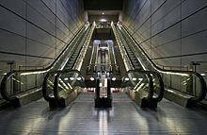
Escalators have the capacity to move large numbers of people. They can be placed in the same physical space as a staircase.
They have no waiting interval (except during very heavy traffic). They can be used to guide people toward main exits or special exhibits.
They may be weatherproofed for outdoor use.
A nonfunctional escalator can function as a normal staircase, whereas many other methods of transport become useless when they break down or lose power.
Escalators are desirable where the movement of people are in large numbers at a controlled rate in the minimum of space for example, railway stations, shopping centres/malls, airports, etc. These encourage people to circulate freely and conveniently.

Slide 4
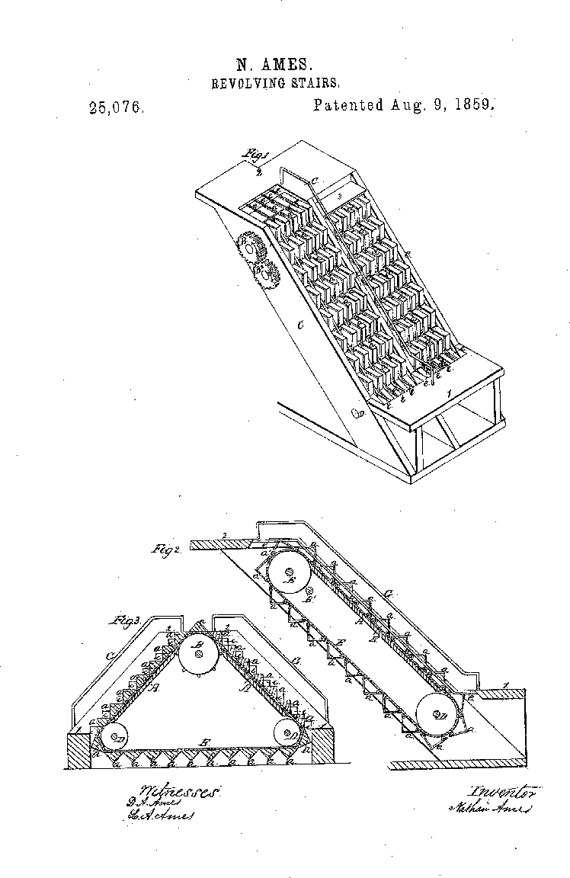
Named Escalator by Charles Seeberger in 1897 by combining the latin word for steps “scala” and elevator
The first conceptual articulation of an escalator was “An
Improvement in Stairs,” described in an 1859 U.S.
patent issued to Nathan Ames. Ames was an inventor with several patents, including a railroad switch, a printing press, and a combination knife, fork, and spoon. Ames’ patent made claim over an endless belt of steps revolving around three mechanical wheels that could be powered by hand, weights, or steam. This version of the moving
stairway didn’t gain much momentum, however, and was
never built.

Slide 5
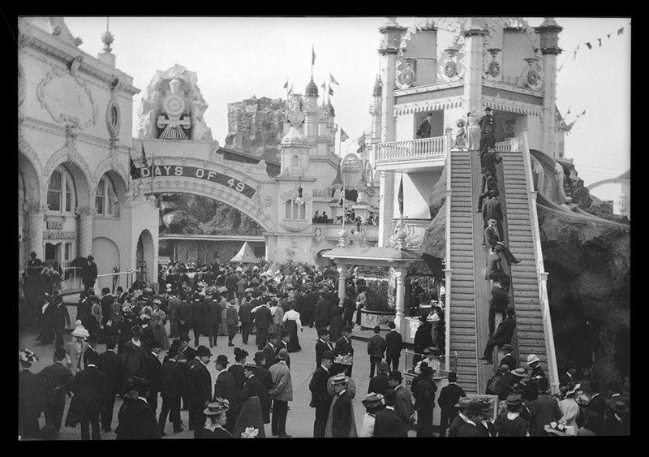
"Luna Park," Coney Island, by Eugene Wemlinger, 1909. The mechanical escalator took people to the top of the Helter Skelter, where an attendant handed out a small mat that would facilitate the downward slide. (Brooklyn Museum)

Slide 6
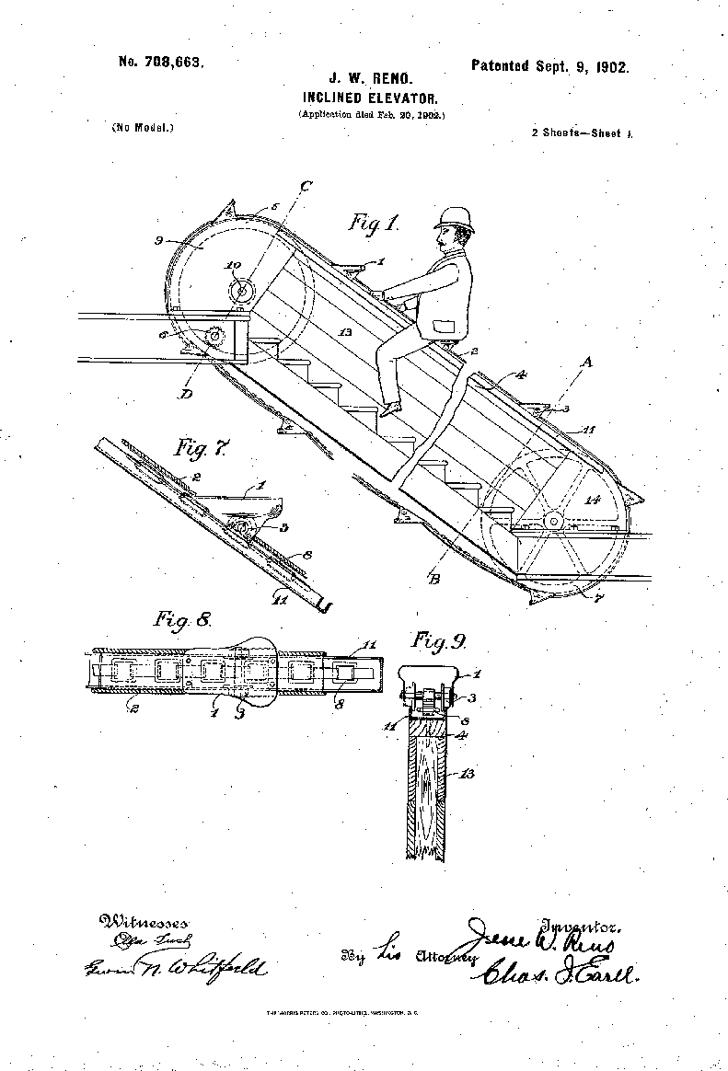
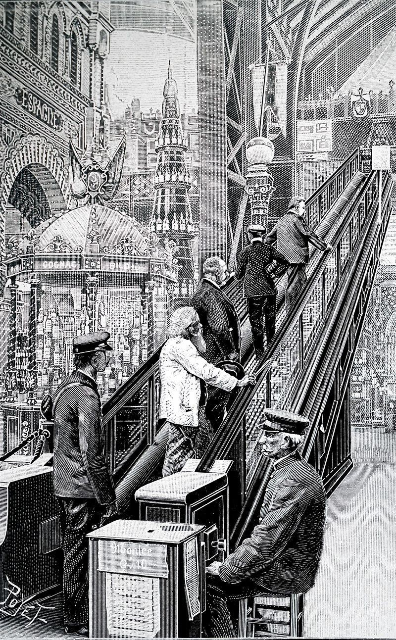
This illustration shows the escalator in use at the Paris Exposition of 1900.

Slide 7
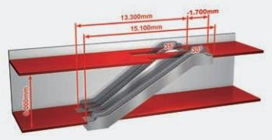
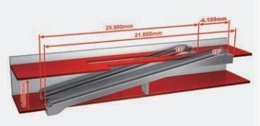
Escalators Inclinations of 30° and 35° are the common international standard for escalators.
30° Inclination - This inclination provides the highest traveling comfort and maximum safety for the user.
35° Inclination - The 35° escalator is the most space-efficient solution. However, this inclination is perceived as too steep if rises exceed 6 m – particularly in downward travel.
Moving Walks Inclinations of 10°, 11°, and 12° are the common international standard for inclined moving walks.
Users find that a 10° inclination provides the most comfortable ride.
A 12° inclination is used when space is limited.
Horizontal moving walks without transition curves can generally be provided for inclinations between 0° and 6°

Slide 8
Escalators are available with step widths of 600, 800 and 1000 mm.
The most popular step width is 1000 mm. This step width gives the user unimpeded access to the step band, even with baggage and shopping bags.
The other two step widths are used mainly for less frequented units or where space is restricted. Moving walks are suitable for transporting shopping or baggage carts.
Inclined moving walks are available with pallet widths of 1000 mm and 1100 mm.
A moving walk width of 1100 mm is generally recommended as the pallets should always be at least 400 mm wider than the shopping carts when moving walks are operated with shopping carts.
Horizontal moving walks are available with a pallet width of 1000 mm, 1200 mm and 1400 mm.
At airports, there is an increasing tendency to use 1200 or 1400 mm wide moving walks, since this width easily allows users to step around passengers with baggage carts. If a number of escalators or moving walks are to be installed in a continuous arrangement in a building, the same step or pallet width should be selected for all units in order to avoid local congestion

Slide 9
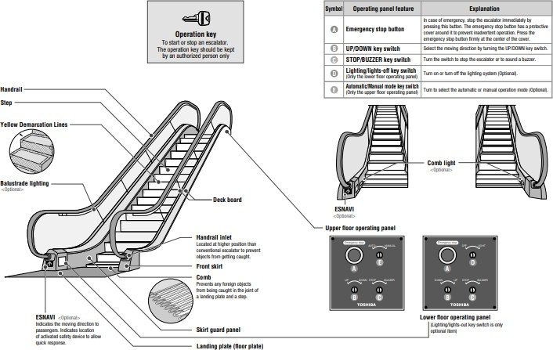

Slide 10
Landing platforms -These two platforms house the curved sections of the tracks, as well as the gears and motors that drive the stairs. The top platform contains the motor assembly and the main drive gear, while the bottom holds the step return idler sprockets. These sections also anchor the ends of the escalator truss. In addition, the platforms contain a floor plate and a comb plate. The floor plate provides a place for the passengers to stand before they step onto the moving stairs. This plate is flush with the finished floor and is either hinged or removable to allow easy access to the machinery below. The comb plate is the piece between the stationary floor plate and the moving step.
Truss -The truss is a hollow metal structure that bridges the lower and upper landings. It is composed of two side sections joined together with cross braces across the bottom and just below the top. The ends of the truss are attached to the top and bottom landing platforms via steel or concrete supports. "freestanding" escalator reveals its inner components through the transparent truss.
Tracks -The track system is built into the truss to guide the step chain, which continuously pulls the steps from the bottom platform and back to the top in an endless loop. There are actually two tracks: one for the front wheels of the steps (called the step-wheel track) and one for the back wheels of the steps (called the trailer- wheel track). The relative positions of these tracks cause the steps to form a staircase as they move out from under the comb plate.

Slide 11
Steps -The steps themselves are solid, one piece, die-cast aluminum or steel. Yellow demarcation lines may be added to clearly indicate their edges. The steps are linked by a continuous metal chain that forms a closed loop. The front and back edges of the steps are each connected to two wheels. The rear wheels are set further apart to fit into the back track and the front wheels have shorter axles to fit into the narrower front track. As described above, the position of the tracks controls the orientation of the steps View of escalator steps on continuous chain.
Handrail- The handrail provides a convenient handhold for passengers while they are riding the escalator. In an escalator, the handrail is pulled along its track by a chain that is connected to the main drive gear by a series of pulleys. It is constructed of four distinct sections. At the center of the handrail is a "slider", also known as a "glider ply", which is a layer of a cotton or synthetic textile. The purpose of the slider layer is to allow the handrail to move smoothly along its track. The next layer, known as the "tension member”, consists of either steel cable or flat steel tape, and provides the handrail with tensile strength and flexibility. On top of tension member are the inner construction components, which are made of chemically treated rubber designed to prevent the layers from separating. Finally, the outer layer—the only part that passengers. Escalator balustrades are usually made of laminated glass or as steel structures covered in sheet metal. An escalator equipped with a "bellows" handrail.

Slide 12
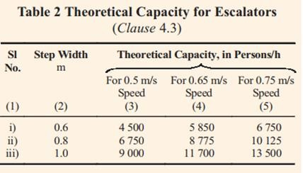
The number of persons that may be theoretically carried by the escalators in 1 h is given in Table 2 in clause 4.3 of NBC 2017 P-8 Sec-5B

Slide 13
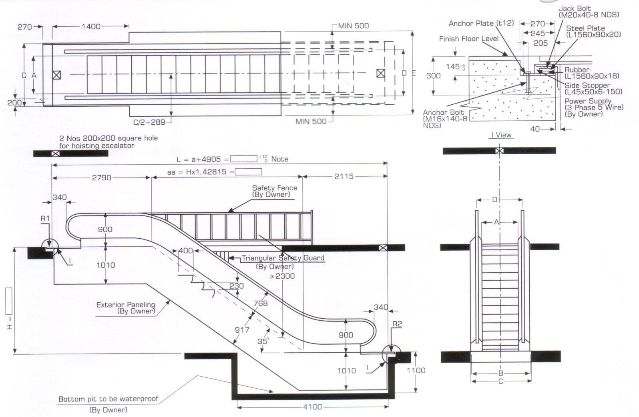

Slide 14
