Slide 1
Subject: Principles Of Human Settlements-I
Topic: Elements of City Design
Presented by: Fazlur Rahman

Slide 2
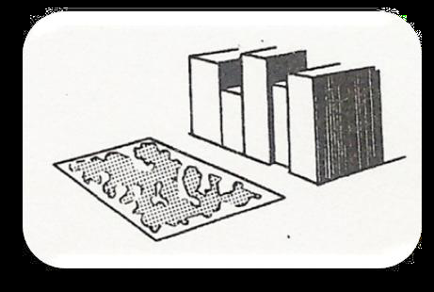
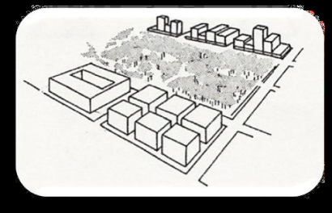
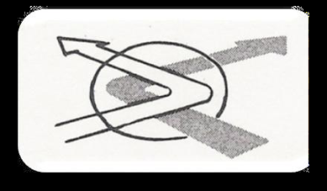
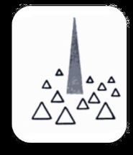
The referable physical forms of the city images.
1.Paths
•The channel along which the observer moves.
Fig : path
2.Edges
•Linear elements not used or considered as paths.
•Boundaries, linear breaks in continuity.
Fig : edges
3.Districts
•Of having 2-dimensional extent
•Of recognizable and identifying character.
Fig : districts
4.Nodes
•Strategic spots, junctions, crossing or convergence of paths, concentrations.
Fig : nodes
5.Landmarks
•External point references. Physical objects.
Fig : landmarks

Slide 3
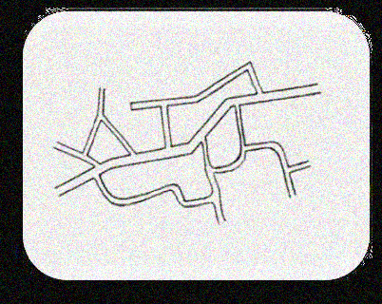
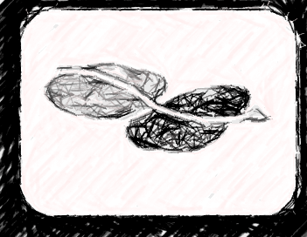
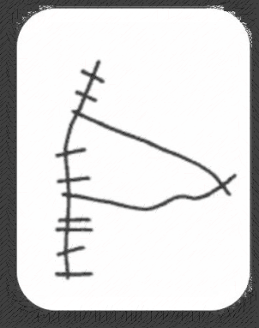
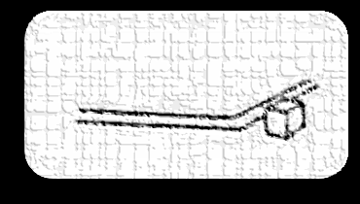
PATHS
"are the channels along which the observer customarily, occasionally or potentially moves. They may be streets, walkways, transit lines, canals, railroads"
· Identifiable and continuous
○Functional importance-concentration of special use or activity
○Spatial qualities–width or narrowness, block lengths, kinds of streets, the naming system.
○Façade characteristics –Building frontage, plantings
○Proximity to special features–as edges
○Visual exposures and prominence
○Structural character
· Directional quality
○Prolonged curve
○Strategic terminal points
○Concentration of pedestrians
○Alignment
Subtle misleading curve
Sharp separation of a path from the surrounding elements

Slide 4
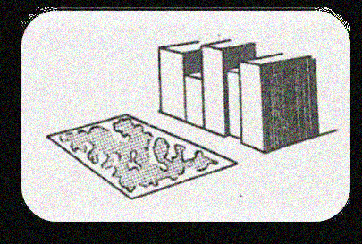
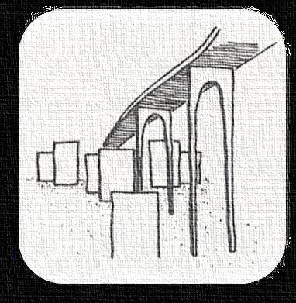
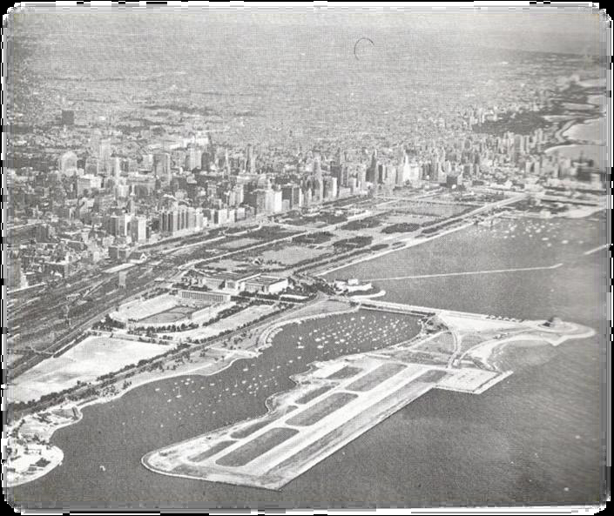
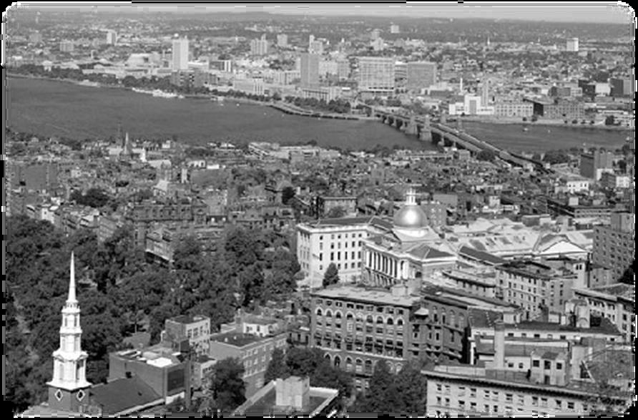
EDGES
Linear elements not considered as paths.
Boundaries, linear breaks in continuity
Overhead edges which might not be barriers at the ground level, might in the future be very effective orientation elements in a city
May also have directional qualities like paths
Fig : overhead edges
Fig : The lake front of Chicago
Fig : Boston from across the Charles river

Slide 5
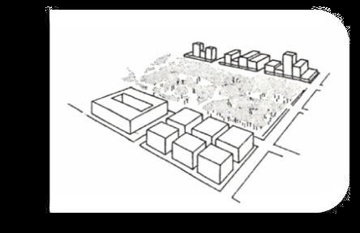
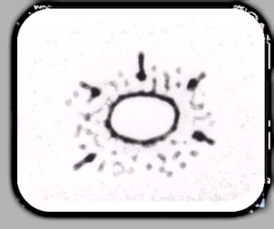
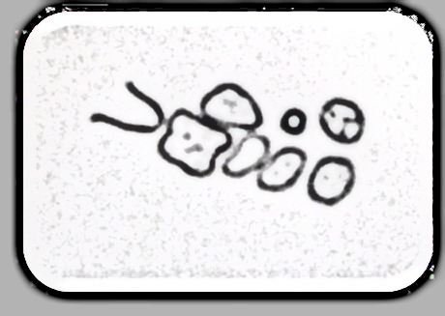
DISTRICTS
· observer can mentally go inside of, can be recognized
Internally and occasionally be used as external reference.
· Physical characteristics : texture, space, form, detail ,symbol ,building type, use, activity, inhabitants, degree of maintenance ,topography, even facade–material, modeling, ornament, colour, skyline ,especially fenestration.
· Social connotations
· District boundaries
○Edges limits a district and reinforce its identity
Hard, definite precise.
Soft or uncertain
○Hard-core, Strong node-thematic gradient which gradually
dwindles away, radiation
· Introvert and extrovert

Slide 6
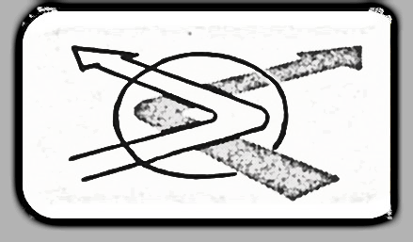
NODES
· Small points, Strategic foci,
○ Small point-Large squares ,extended linear shapes, entire central district
○ City level, national level, international level
· junctions of paths, break in transportation
○ Heightens attention and perceives the nearby elements with more than abnormal clarity
○ Transition from one transportation channel to another
○ Subway stations,
· Thematic concentrations Of some characteristics
○ Squares, plazas
· Both junction and concentration
○ Eg. City journals square–important bus and automobile transfer and a concentration of shopping.
· Where the space has some form, the impact is much stronger

Slide 7
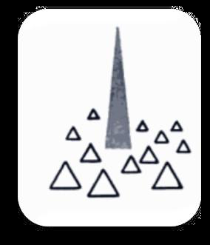
LANDMARK
“ Point of references-simple physical elements .The observer does not enter within them and are external.
· Activity association with an element like building, sign, store, mountain.
· May vary widely in scale
· Singularity- unique or memorable in the context
○ Clear form
○ Contrast with the background
○ Cleanliness in a dirty city
○ Newness in an old city
○ Jersey city medieval centre known for its little lawns and flowers as for its great size
○ Prominence of spatial location
○ Making the element visible from many locations.
○ Setting up local contrast with nearby elements ie a variation in setback and height.
○ Location at a junction involving path decision

Slide 8
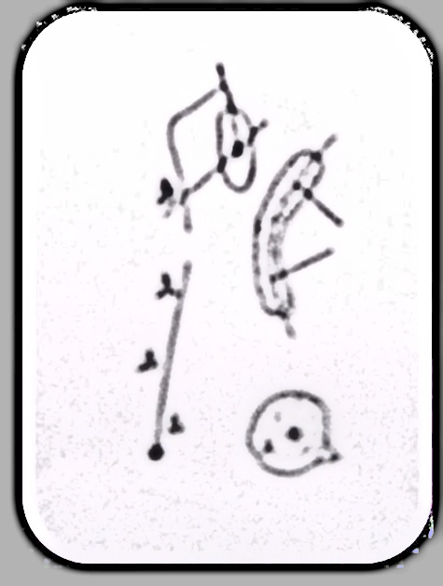
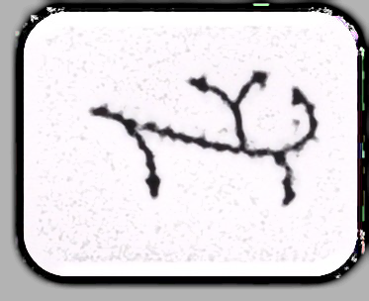
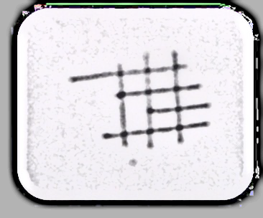
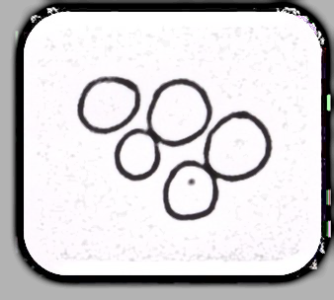
ELEMENTS OF INTERRERELATION
· Raw material of the environmental image at the city level
· Enhance each other’s power or conflict and destroy themselves
· All elements operate together in a context
· Intermediate organizations, which might be called Complexes
THE SHIFTING IMAGE
· Sets of images, series of levels- scale of area involved, viewpoint ,time of day or season.
· Mental mapping
○ Develop outward from familiar lines of movement
○ Enclosing outline
○ Repeating patterns (path gridiron)
○ A set of adjacent regions
○ A dense familiar kernel

Slide 9
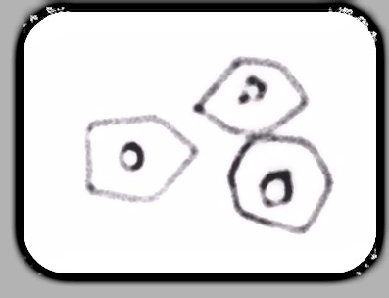
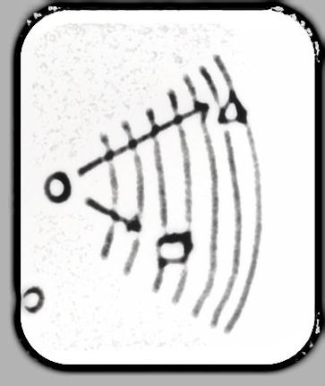
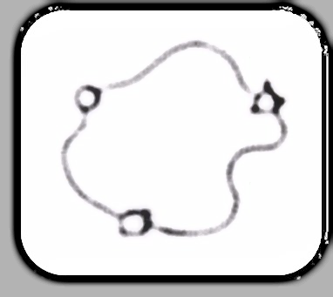
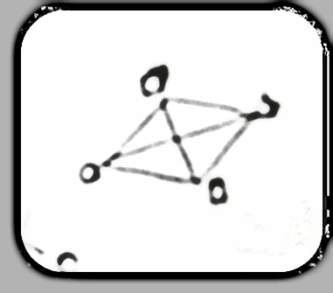
IMAGE QUALITY
· Structural quality
The various elements were free. No inter-relation
Positional, roughly related–general direction and relative distance from each other
Loose and flexible
○ Rigid; firm interconnection in all dimensions
Hierarchical.
· Continuous organization

Slide 10
CITY FORM
We have the opportunity of forming our new city world into an image able landscape: visible, coherent and clear.
The city dweller requires a new attitude and a physical reshaping of his domain into forms which entrance the eye, which organize themselves from level to level in time and space, which can stand as symbols for urban life. The for must be somewhat noncommittal, plastic to the purposes and perception of its citizens.
If the environment is visibly organized and sharply identified, then the citizen can inform it with his own meanings and connections. Then it will become a true place, remarkable and un mistakable.
· Eg: City of Florence –Highly Visible

Slide 11
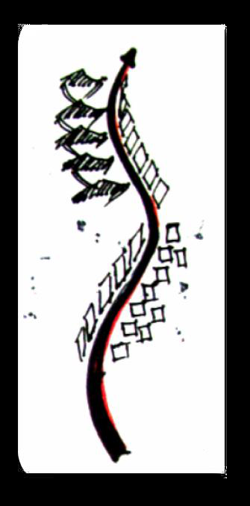
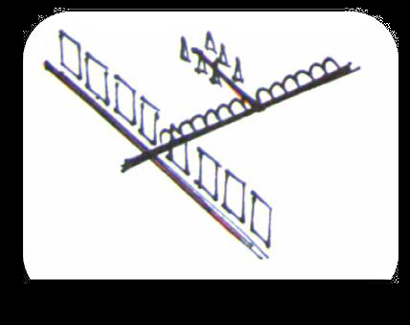
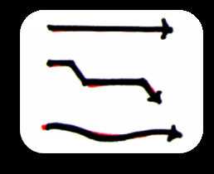
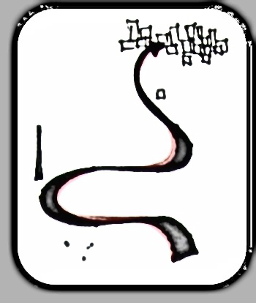
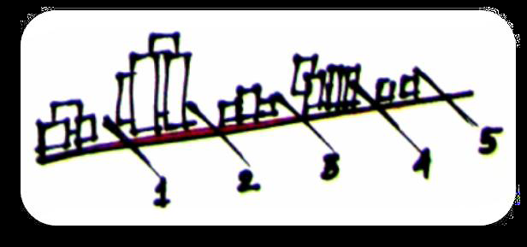
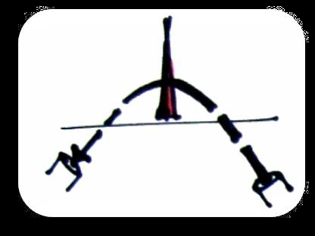
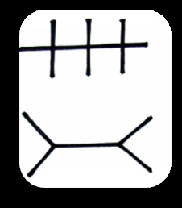
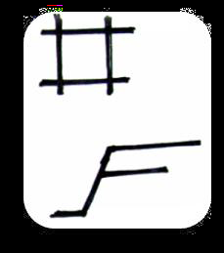
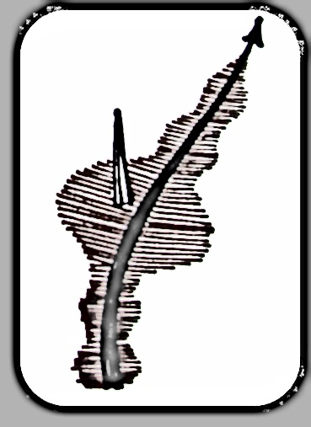
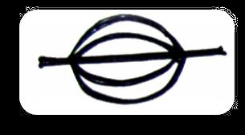
DESIGNING THE PATH
It should have a strong termini ,and by a gradient or a directional differentiation, so that it is given a sense of progression, and the opposite directions are unlike. To the path.
The line of motion should have clarity of direction.
Characters
Should be applied to give continuity to the path.
The presence of the path may be made evident by highland mark along it.
The dynamic shaping of the movement line will give it an Identity
If positions along the line can be differentiated in some measurable way, then the line is not only oriented, but scaled as well.
The events and characteristics along the path-landmarks ,space changes, dynamic sensations-might be organized as a “MelodicLine”.
Paths may be imaged as a network which explains the typical relations between all paths, without identifying a particular path.
A joint of more than two paths is difficult to conceptualize

Slide 12
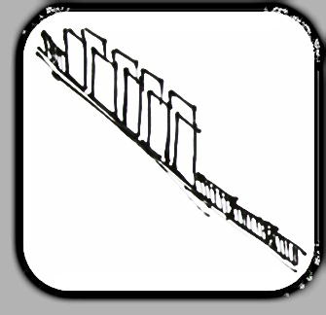
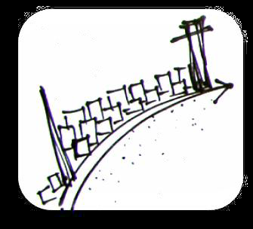
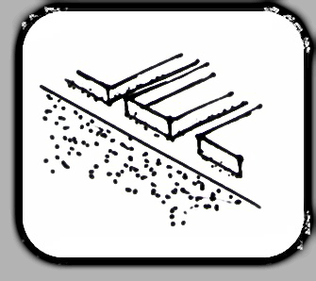
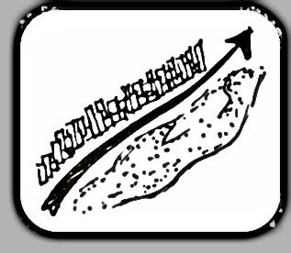
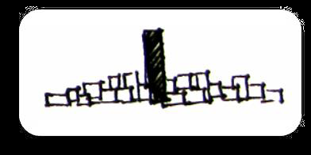
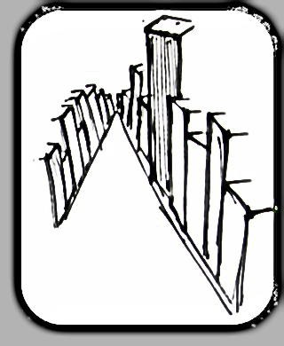
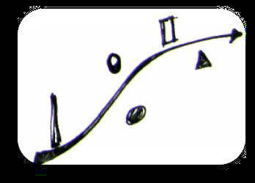
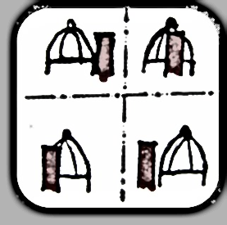
DESIGNING THE EDGES
· The edge gains strength if it is laterally visible for some distance, marks a sharp gradient of area character, and clearly joins the two bounded regions.
· When the edge is not continuous and self-closing, then it is important that its ends have definite termini, recognizable anchors which complete and locate the line.
· An edge should be more than simply a dominant barrier.
· If an important edge is provided with many visual and circulation connections to the rest of the city structure, then it become s a feature to which every thing else is easily aligned.
DESIGNING THE LANDMARK
· The essential characteristic of a viable landmark is its singularity, its contrast with its context or background.
· A landmark is not necessarily a large object; it can be a door knob as well as a dome; its location is crucial.
· Image strength rises when the landmark coincides with a concentration of association.
· The marks may also be arranged so that a whole journey is identified and made comfortable by a familiar succession of detail.
· Landmarks may be grouped together in patterns such that they indicate the direction from which they are viewed.

Slide 13
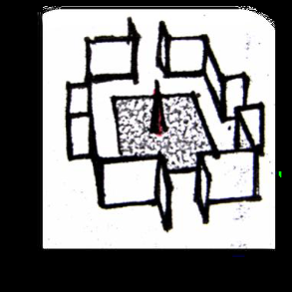
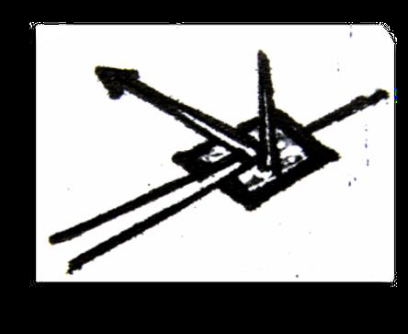
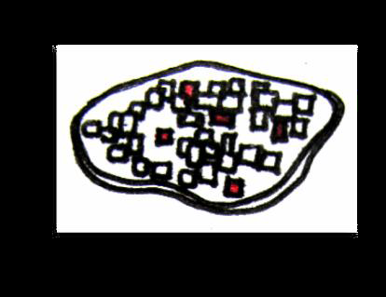
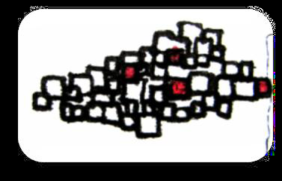
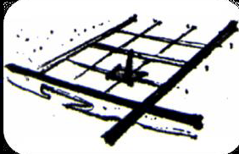
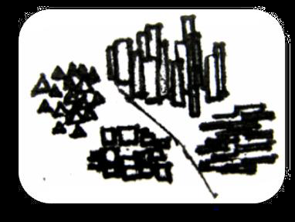
DESIGNING THE NODES
· The first prerequisite is the achievement of identity by the singular and continuous quality of the walls ,floor, detail ,lighting, vegetation, skyline etc. This makes a place distinct and unforgettable.
The node is more defined if it has a sharp, closed boundary with a foci.
· To give the node more attention ,a break in transportation point can be made to coincide with it.
· A series of nodes can be linked together by close juxtaposition or by allowing them to be intervisible.
DESIGNING THE DISTRICTS
· It is an area of homogeneous character, recognized by clues which are continuous through out the district and discontinuous elsewhere.
· Its further sharpened by the definiteness and closure of its boundary.
· A district may be structured within itself as well.
· District may join to district, by juxtaposition, intervisibility, relation to a line, or by some link such as mediating node, path or small district.

Slide 14
FORM QUALITIES
Singularity Form simplicity Continuity Dominance
Clarity of joint Directional differentiation Visual scope
Motion awareness Time series Names and meanings
THE SENSE OF THE WHOLE
· In discussing design by element types there is a tendency to skim over the interrelation of the parts into a whole.
· In such a whole, paths would expose and prepare for the districts, and link together the various nodes.
· The nodes would joint and mark off the paths, while the edges would bind off the districts ,and the boundaries would indicate their cores. It is the total orchestration of these units which would knit together a dense and vivid image, and sustain it over areas of metropolitan scale.
METROPOLITAN FORM
· Total image ability of an extensive area such as a metropolitan region would mean a dominant figure and more extensive backgrounds, focal points and connective tissue. There are two techniques suggested:
▪The entire region is organized as a static hierarchy.
▪Any given part of the region might focus on a minor node, these minor nodes being satellite to a major node, while all the major nodes are arranged to culminate in a single primary node for the region.

Slide 15
A NEW SCALE
· Poetic and symbolic as well-it should speak of the individuals and their complex society, of their aspirations and their historical tradition, of the natural setting ,and of the complicated functions and movements of the city world.
· A highly developed art of urban design is linked to the creation of a critical and attentive audience
· If art and audience grow together, then our cities will be a source of daily enjoyment to millions of their inhabitants.

Slide 16
THANK YOU

