Slide 1

Environmental Planning and Housing
(EIA Policies and Amendations)
Presented by: Ruchi Saxena

Slide 2
EIA Notification and policies
The amendment will make environmental clearance (EC) compulsory for mining of minor minerals in areas less than or equal to five hectares.
District Environment Impact Assessment Authority (DEIAA) and District Expert Appraisal Committee (DEAC) to evaluate EC proposals for small-scale leases for minor minerals.
DEAC charged with evaluating proposals for clusters of small leases, where the size of the cluster is greater than five hectares but less than 25 hectares, with no individual lease being more than five hectares.
DEIAA reports to SEIAA

Slide 3
Environment Supplement Plan - ESP for projects that have already initiated construction activity and expansion before going through an EIA process.

Slide 4
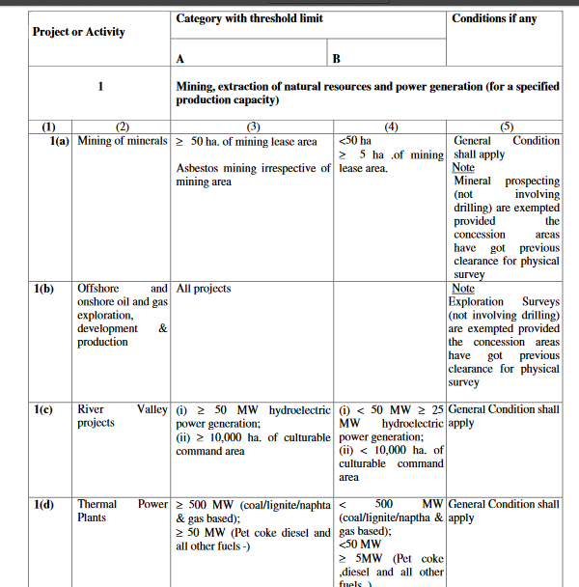

Slide 5
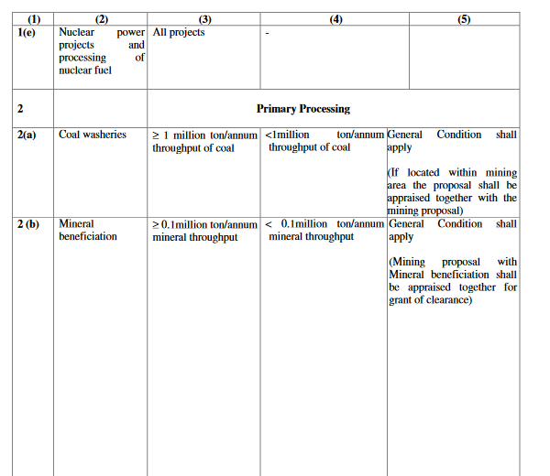

Slide 6
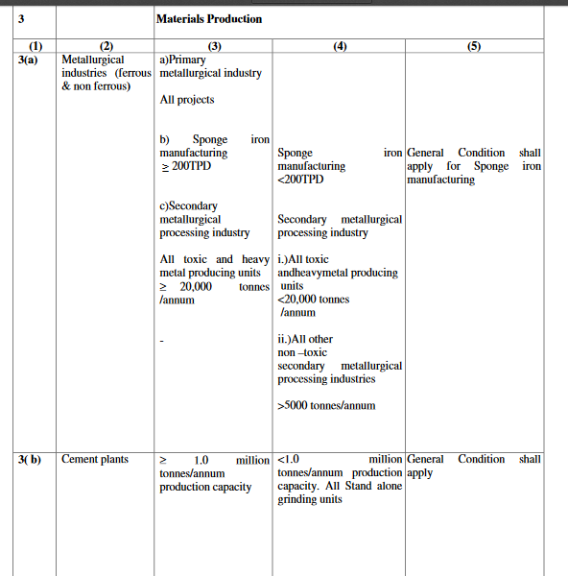

Slide 7
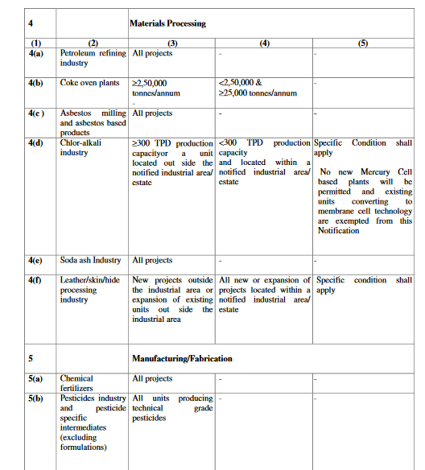

Slide 8
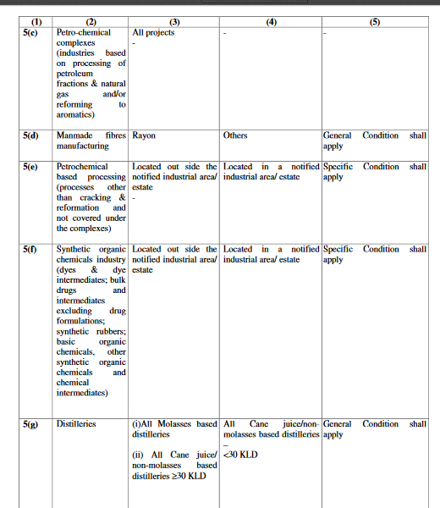

Slide 9
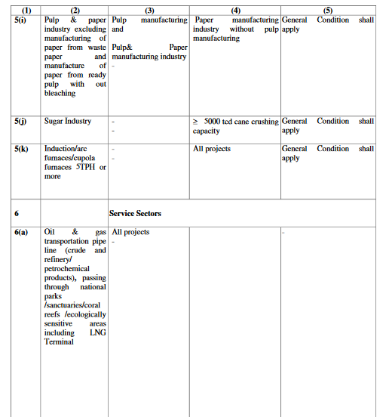

Slide 10
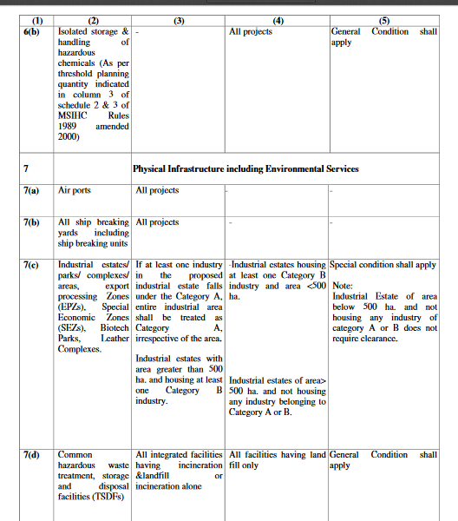

Slide 11
