Slide 1
Subject: Infrastructure and Transport Planning
Topic: Disposal
Presented by: Aditi Arora

Slide 2
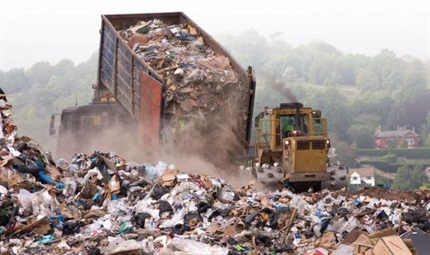
DISPOSAL
- SEPTIC TANK
- COMPOSTING
- DISPOSAL TO SEWER
- BURIAL
- DUMPING ON LAND
- SANITARY LANDFILL
- COMPOSTING
- INCINERATION
- REDUCTION AND
SALVAGE
INDIA SCENARIO
India has installed treatment capacity to treat roughly 20 per cent of excreta generated.
• Delhi has 40% of India’s installed sewage
capacity.
• But 70% of sewage capacity installed in the
city remains under-utilised.
HOUSEHOLD
DISPOSAL SYSTEMS EFFECTS IN INDIA
- Land,
- Volume,
- Groundwater pollution,
- Availability of open drains,
- Permeability of the soil.
COMMUNITY

Slide 3
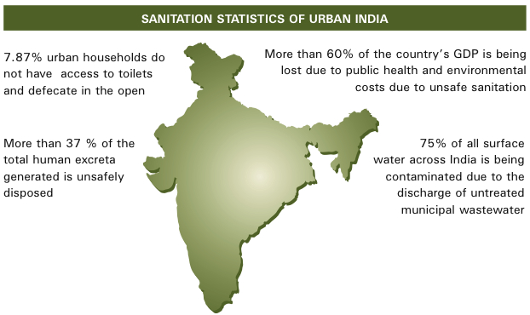

Slide 4
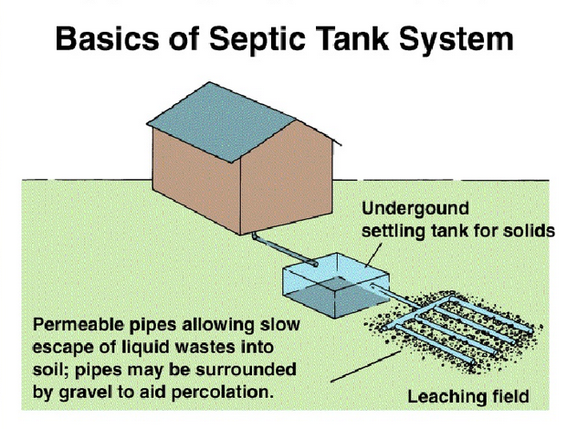

Slide 5
Decentralised Waste Water Treatment Systems Technology (DEWATS)
DEWATS applications provide treatment for both domestic and industrial sources
Systems can be designed to handle organic wastewater flows from 1-1000 m3 per day
Systems are built to be reliable, long lasting and tolerant towards fluctuations in loads
DEWATS applications do not require sophisticated maintenance
In class I and II cities of India, a sewage treatment capacity of only 6,190 million litres per day (MLD) has been installed against the total sewage generation of 29,129 MLD . Therefore, promoting decentralised waste water treatment systems both at individual and institutional levels can offset this problem to a greater extent.
DEWATS stands for “Decentralized Wastewater Treatment Systems”. DEWATS represents a technical approach rather than merely a technology package.
Primary treatment: sedimentation and floatation
Secondary anaerobic treatment in fixed-bed reactors: baffled upstream reactors or anaerobic filters
Tertiary aerobic treatment in sub-surface flow filters
Tertiary aerobic treatment in polishing ponds

Slide 7
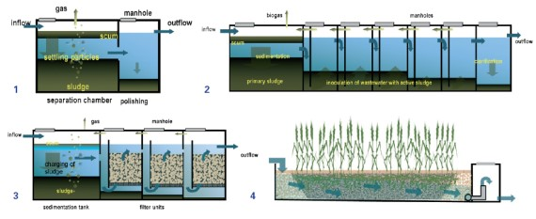
Benefits of DEWATS
• Establishment of multi-stakeholder networks to combat water pollution
• Increases implementation capacity on various levels
• Provides treatment for both, domestic and industrial wastewater at affordable price
• Fulfillment of discharge standards and compliance with environmental laws
• Wastewater pollution reduction by up to 90% from pre-DEWATS levels.
• Provides treatment for wastewater flows up to 1000 m3 / day
• Reliable and long lasting applications
• Tolerant towards inflow and load fluctuation
• Materials/ inputs used for construction are locally available
• Minimal maintenance and long de-sludging intervals
• Low operation and maintenance costs
• Resource efficiency and non-dependence on energy
• Resource recovery through wastewater re-use and biogas generation

Slide 8
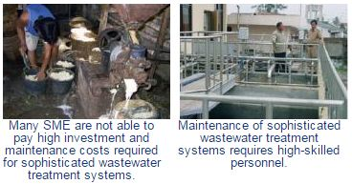
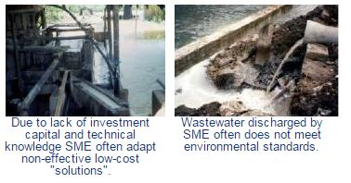
Pros and Cons of DEWATS
Type | Kind of Treatment | Used for Type of Wastewater | Advantages | Disadvantages
septic tank | sedimentation, sludge stabilisation | wastewater of settleable solids, especially domestic | simple, durable, little space because of being underground | low treatment efficiency, effluent not odourless
Imhoff tank | sedimentation, sludge stabilisation | wastewater of settleable solids, especially domestic | simple, durable, little space because of being underground odourless effluent | less simple than septic tank, needs very regular desludging
Anaerobic filter | Anaerobic degradation of suspended and dissolved solids | pre-settled domestic and industrial wastewater of narrow COD/BOD ratio | simple and fairly durable if well constructed and wastewater has been properly pre-treated, high treatment efficiency, little permanent space required because of being underground | costly in construction because of special filter material, blockage of filter possible, effluent smells slightly despite high treatment efficiency
Baffled septic tank | Anaerobic degradation of suspended and dissolved solids | pre-settled domestic and industrial wastewater of narrow COD/BOD ratio suitable for strong industrial wastewater | simple and fairly durable if well constructed and wastewater has been properly pre-treated, high treatment efficiency, little permanent space required because of being underground, hardly any blockage, relatively cheap compared to anaerobic filter | requires larger space for construction, less efficient with weak wastewater, longer start-up phase than anaerobic filter
The challenge

Slide 9
Horizontal gravel filter | Aerobic facultative anaerobic degradation of dissolved and fine suspended solids, pathogen removal | suitable for domestic and weak industrial wastewater where settleable solids and most suspended solids already removed by pre-treatment | high treatment efficiency when properly constructed, pleasant landscaping possible, no wastewater above ground, can be cheap in construction if filter material is available at site, no nuisance of odour | high permanent space requirement, costly if right quality of gravel is not available, great knowledge and care required during construction, intensive maintenance and supervision during first 1 – 2 years
Anaerobic pond | sedimentation, anaerobic degradation and sludge stabilisation | strong and medium industrial wastewater | simple in construction, flexible in respect to degree of treatment, little maintenance | wastewater pond occupies open land, there is always some odour, can even be stinky, mosquitoes are difficult to control
Aerobic pond | Aerobic degradation, pathogen removal | weak, mostly pre-treated wastewater from domestic and industrial sources | simple in construction, reliable in performance if proper dimensioned, high pathogen removal rate, can be used to create an almost natural environment, fish farming possible when large in size and low loaded | large permanent space requirement, mosquitoes and odour can become a nuisance if undersized, algae can raise effluent BOD
Delhi statistics
1 | Treated effluent supplied to CPWD for horticultural purposes in Luytens Delhi from Okhla STP | 20.0 MGD
2 | Treated Effluent supplied to Pragati Power Plant from Dr Sen Nursing Home nala and Delhi gate Nala STPs | 4.0 MGD
3 | Treated Effluent supplied to DDA for Japanese Park from Rithala STP | 8.0 MGD
4 | Treated Effluent Supplied to Minor irrigation Deptt. from Okhla STP (42 cusec),from keshopur STP (37 cusec), and from Coronation STP(70 cusec); Total 149 cusec for irrigation purposes | 80.5 MGD
 | Total | 109.5 MGD

Slide 10
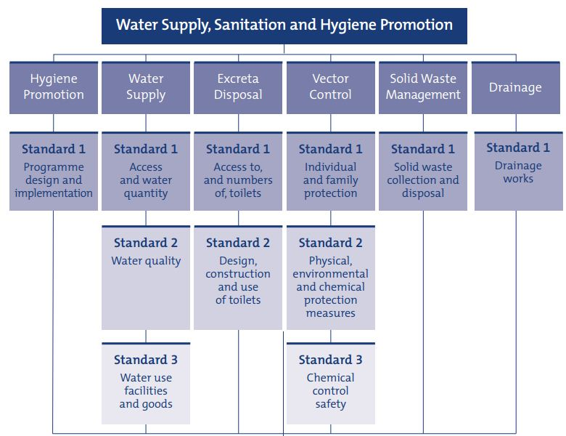
NORMS AND STANDARDS OF SANITATION

Slide 11
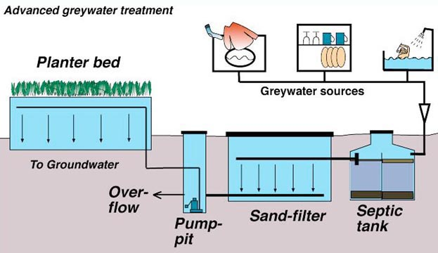
GREY WATER DISPOSAL
What is Grey water?
Grey water is all wastewater that is discharged from a house, excluding black water (toilet water). This includes water from showers, bathtubs, sinks, kitchen, dishwashers, laundry tubs, and washing machines .It commonly contains soap, shampoo, toothpaste, food scraps, cooking oils, detergents and hair. Grey water makes up the largest proportion of the total wastewater flow from households in terms of volume. Typically, 50-80% of the household
wastewater is
grey water.

Slide 12
Most grey water ends up as effluent in rivers and oceans. There are other alternatives to eliminating greywater that allow for efficient use; using it to irrigate plants is a common practice. The plants use contaminants of greywater, such as food particles, as nutrients in their growth. However, salt and soap residues can be toxic to microbial and plant life alike, but can be absorbed and degraded through constructed wetlands and aquatic plants such as sedges, rushes, and grasses.
GREY WATER RECYCLING - Most greywater should be recycled and collected using a separate plumbing system from black water. Domestic greywater can be recycled directly within the home, garden or company and used either immediately or processed and stored.

Slide 13
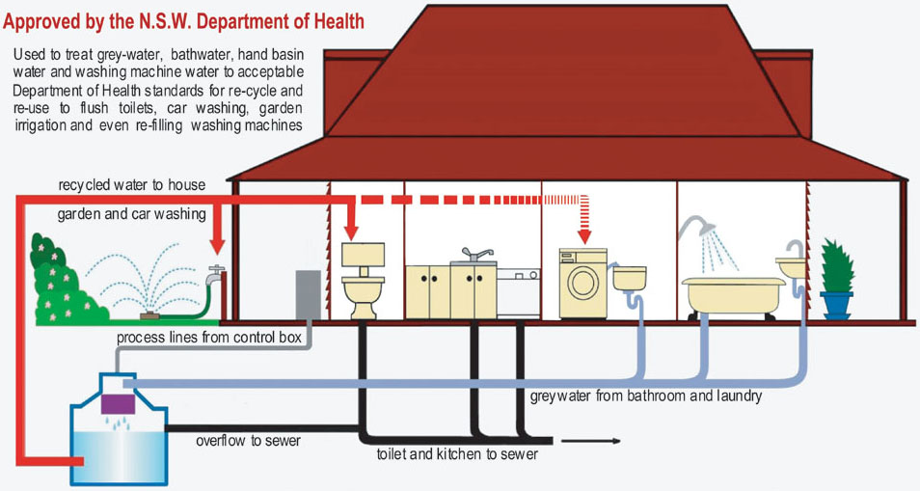
SCHEMATIC SECTION OF GREY WATER RECYCLING

Slide 14
ECOLOGICAL BENEFITS OF GREYWATER RECYCLING
Because greywater use, especially domestically, reduces demand on conventional water supplies and pressure on sewage treatment systems, its use is very beneficial to local waterways. In times of drought, especially in urban areas, greywater use in gardens or toilet systems helps to achieve some of the goals of ecologically sustainable development.
The potential ecological benefits of greywater recycling include :
Lower freshwater extraction from rivers and aquifers.
Less impact from septic tank and treatment plant infrastructure.
Topsoil nitrification.
Reduced energy use and chemical pollution from treatment.
Groundwater recharge.
Increased plant growth.
Reclamation of nutrients.
Greater quality of surface and ground water when preserved by the natural purification in the top layers of soil than generated water treatment processes.

Slide 15
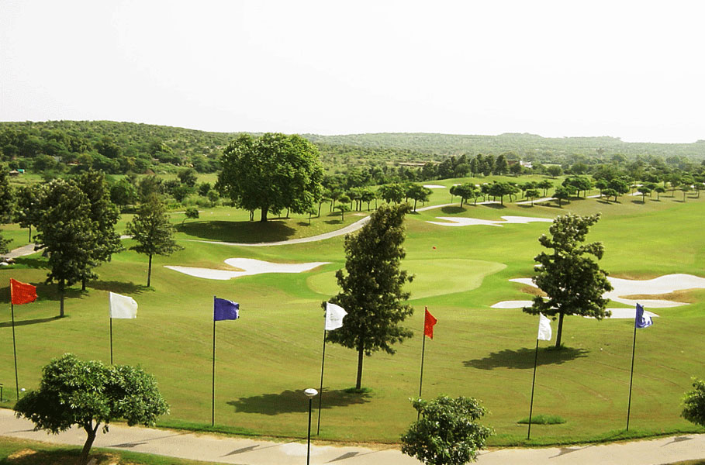
DLF GOLF COURSE AT GURGAON, NURTURED BY RECYCLED GREY WATER PRODUCED EVERYDAY BY DLF CITY

