Slide 1
Density Survey Techniques
Subject: Planning Techniques
Topic: Density Survey Techniques
Presented by: Pallavi Tiwari

Slide 2
Density : Definition
Density for physical planner is number of objects per unit area like houses, rooms, persons etc per unit area.
It implies the quantum or intensity of development or concentration of population in any geographical area.
Density has wide range of connotations depending upon the objective for which it is used.

Slide 3
Density can be
Population density
Settlement density

Slide 4
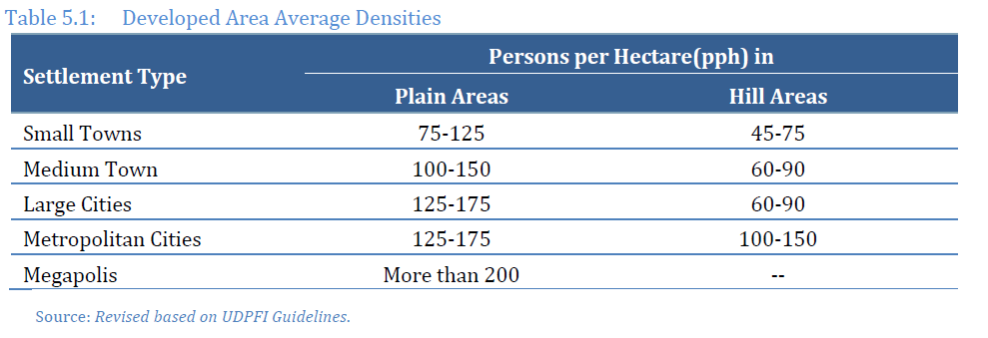

Slide 5
Objectives of measuring density
To control density – to ensure comfort
To control population to ensure available resources and infrastructures are properly used

Slide 6
Classification of density
Residential density
Over all density, or gross density
Net density
Non-residential density
FAR, FSI

Slide 7
Residential density
Density with reference to the total population and the land area.
It represents a rational measure of population concentration on land.
It is expressed as population per unit area like population per hectare,
Also expressed as Dwelling unit per hectare

Slide 8
Residential density is normally expressed in terms of
Houses per unit land (dwelling units/hectare),
Habitable rooms per unit land (rooms/hectare) (Accommodation density) and
Persons per unit land (persons/hectare) (Population Density).

Slide 10
Residential density
Gross density: the land area includes whole area of the town/ city.
Gross residential density/ gross neighborhood density : if whole of the land area is predominantly residential.
Net residential density: if the land included is housing plot, residential roads and incidental open spaces, then the density is net residential density.

Slide 11
Non-residential density
Floor Space Index (FSI): area of the total floor space of the building on any particular site divided by the area of the site including half the area of the any roads adjoining it.
Floor Area Ratio (FAR): it is expressed as the ratio of the total floor area of a building to the total plot area.

Slide 12
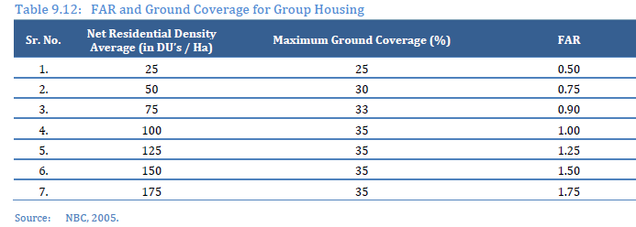

Slide 13
Population density survey
Conventional techniques
Modern techniques

Slide 14
Density survey
Density surveys are done to understand the relationship between built‐up area and population density.

Slide 15
It is taken up for assessment of infrastructure requirements, to reduce congestion, appropriate availability of land for specific activities and services required by residents for good quality of life.

Slide 16
Population density survey Conventional techniques
Demarcate sub-areas and areas of sub-areas are to be measured.
Peoples living in each blocks in the area are to be determined, can also be done by direct sampling method
Simple division of total population with the area gives population density.

Slide 17
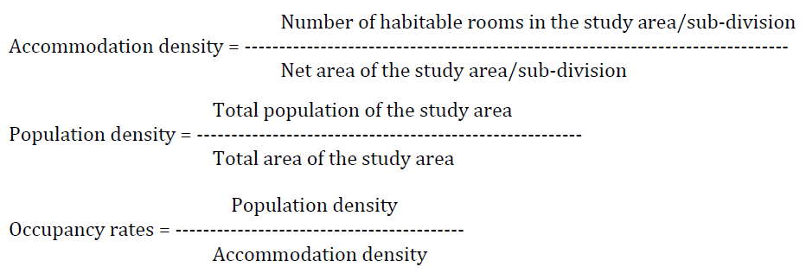
The formulas used for the calculation

Slide 19
Modern techniques
Use of aerial photography
Use of remote sensing data

