Slide 1

Subject: Principles Of Human Settlements-I
Topic: Central place theory
Presented by : Pallavi Tiwari

Slide 2
Central Place Theory
It is a geographical theory that seeks to explain the number, size and location of human settlements in an urban system.

Slide 3
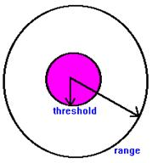
HUMAN SETTLEMENTS:-
Christaller considered the settlements as ‘Central Places’ which act as focus and provide goods and services for the surrounding area.
PRINCIPAL OF THE THEORY :-
RANGE OF SERVICE:
It is the greatest distance that customers are willing to travel to the establishment. The range of a service can be regarded as the radius of a circle centered on the establishment.
Different types of goods and services have ranges, e.g. Grocers: small range; department stores: large range
i.e. high order goods are of a large range while for the
lower order goods, they are of a small range.
Moreover, ranges of goods vary between regions and
change over time. e.g. Australian farmers travel much
further for goods than Indian farmers due to the
difference in transport technology.
Example:- Range of goods varies over time owing to
the advances in transport as people in most western
nations are now prepared to travel further.

Slide 4
THRESHOLD OF A SERVICE:
It is the minimum number of customers needed to support any service establishment that is the point at which the service establishment can begin trade profitably. (i.e. the minimum market size).
Goods and services are produced to satisfy a demand. Some goods require a larger
population than others to set up a sufficient level of demand to support a business
supplying that commodity.
Market thresholds differs from regions to regions.
Moreover, market threshold changes over time which is due to the improvement in
technology and the changes of tastes.
The frequency of purchase of goods is a basic factor in influencing market thresholds.

Slide 5
CONCEPT OF HIGH ORDER SERVICE AND LOW ORDER SERVICES :
LOW ORDER SERVICE | Low order goods which most people buy frequently will have a low threshold, since the frequency of its purchase will create a profitable market even a relatively small population. Example : Foodstuff, sugar, butter soap, shampoo, salt, oil and barber shops.
HIGH ORDER SERVICE | High order goods which are purchased infrequently will have high thresholds, since a large population will be needed to provide sufficient purchasers of it. These tend to be durable and costly commodities. Example :Motor vehicles, jewellery and most professional services.

Slide 6
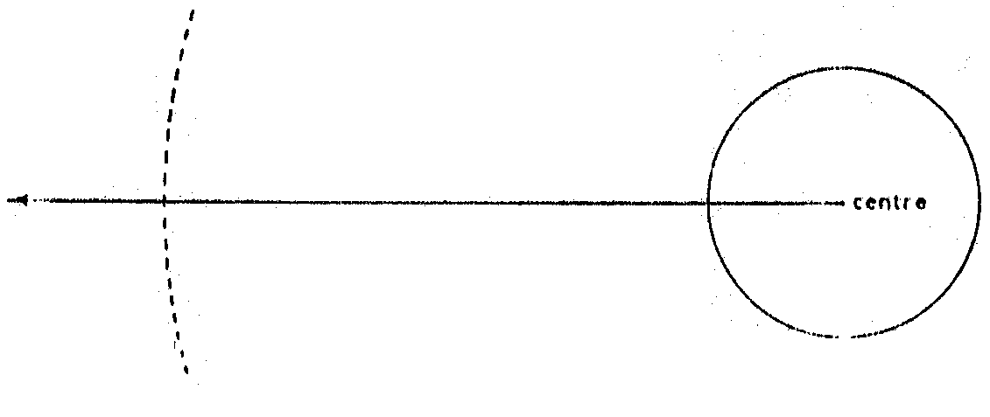
The effect is that the smaller central places serving a local population provide only the less costly and non-durable commodities, while the larger centers are able to support firms providing the more costly durable goods.
Upper Limit or Range
At this point journey to centre is not worth while in relation to need for good or service. Cost or inconvenience outweigh need or alternative centre becomes available
Lower Limit or Threshold
A population of this size (area x density of population) is required to sustain a good or service
As a result of the interactions of threshold and range that a hierarchy of central
places supplying goods and services of different orders will emerge.
According to W. Christaller, the size and spacing of central places in an urban
network maybe determined by market threshold and ranges of goods.

Slide 7
Assumptions of the theory:
An isotropic surface is relatively uniform terrain, climate and soil over the
landscape.
Population is evenly distributed and they have the same income and
the same demand for goods and services;
Transport is equally easy in all directions and transport cost is proportional to
distance and there is only one type of transport;
Central places are located on the plain to provide goods and services and
administrative functions to their immediate surrounding areas;
Consumers visit the nearest central places in order to minimize the distance
travelled;
Businessmen as economic men, maximize their profit by locating at the
place to gain largest profitable market. So centres of the same order would
be located as far as possible from one another to maximize their marketing
areas;

Slide 8
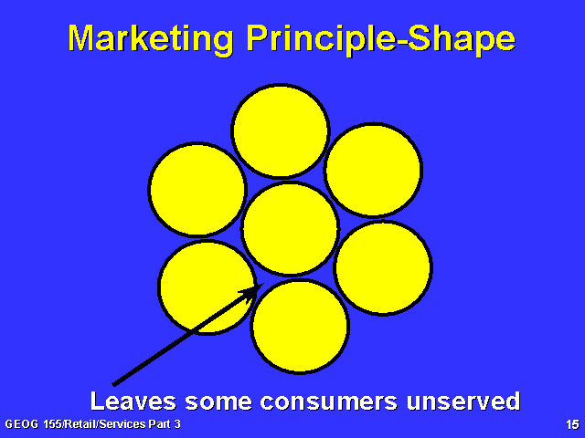
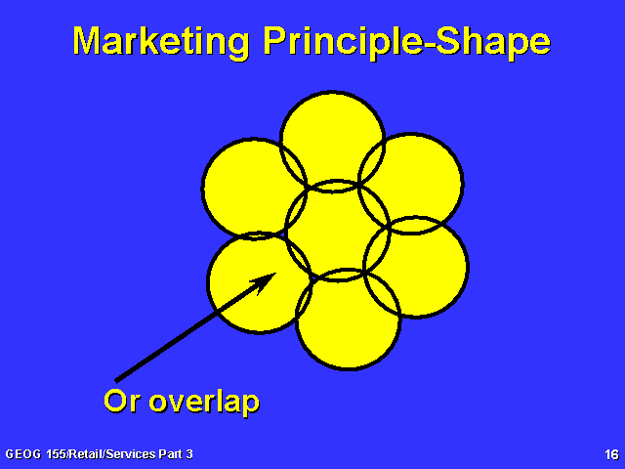
PATTERN AND SHAPE OF CENTRAL PLACES
What's wrong with circles?
What’s wrong with circles

Slide 9
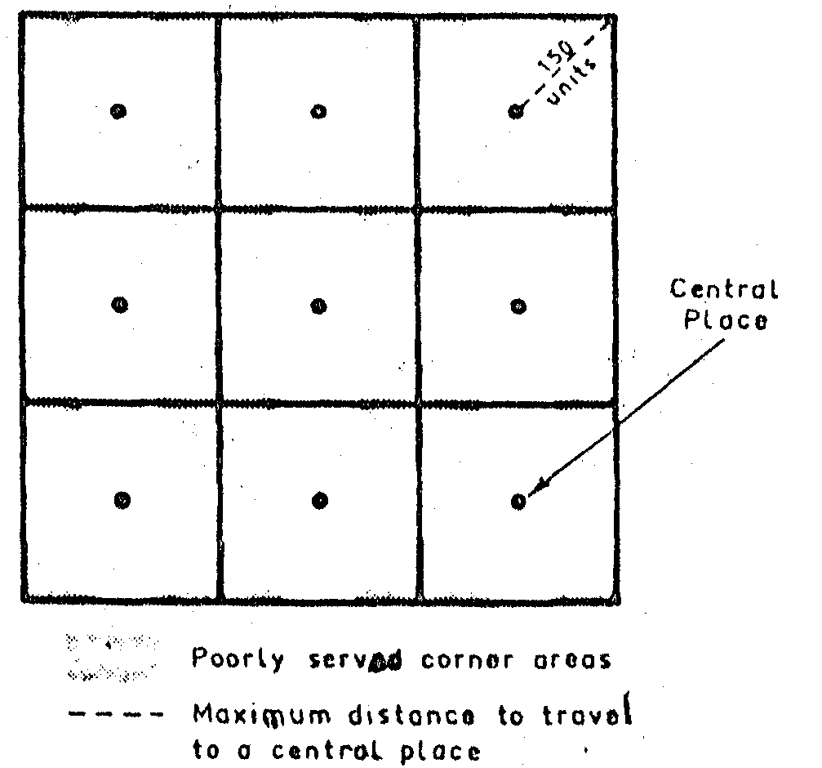
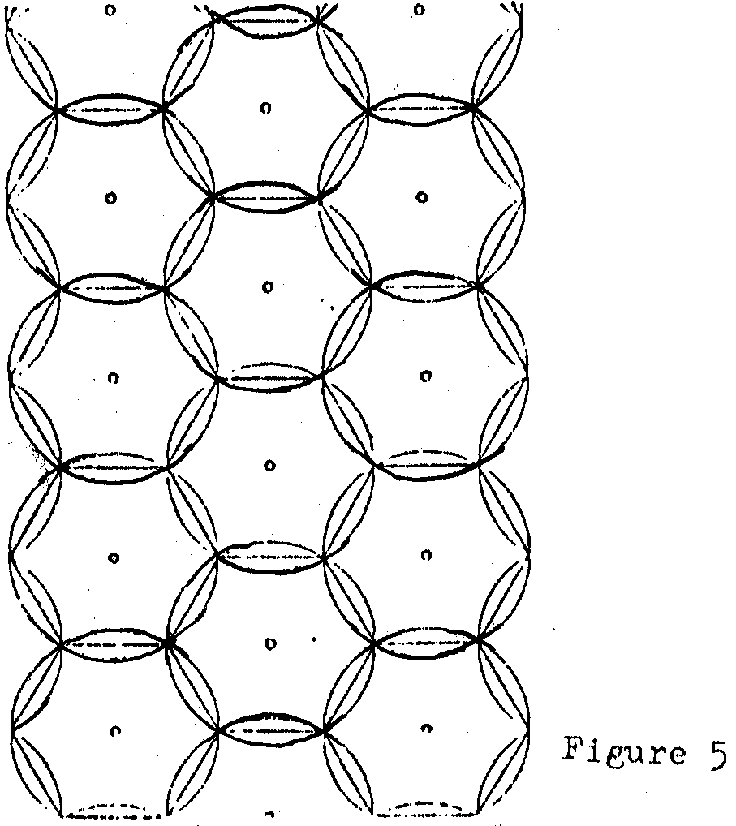
PATTERN AND SHAPE OF CENTRAL PLACES
What's wrong with squares?
What’s wrong with circles

Slide 10
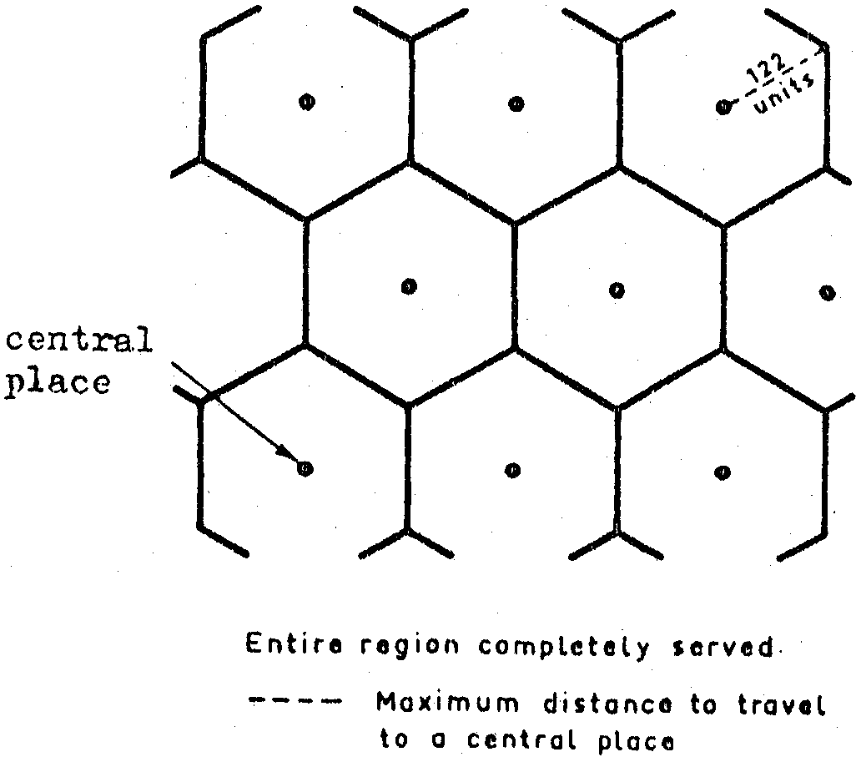
PATTERN AND SHAPE OF CENTRAL PLACES
Finally, a hexagonal shape is found out to be the ideal shape. Both the average and maximum radial distance of a hexagon are only a little greater than in a circle of similar size. It has the great advantage of completely covering a region without overlapping or leaving areas unserved.

Slide 11
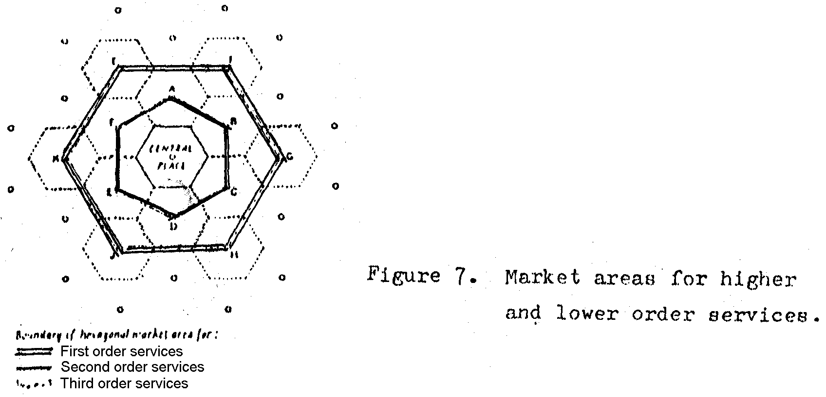
STRUCTURAL AND SPATIAL CHARACTERISTIC OF THE THEORY
First order goods/ services -smallest range and threshold;
Second order goods/ services -larger range and threshold;
Third order goods/ services -even larger range and threshold,

Slide 12
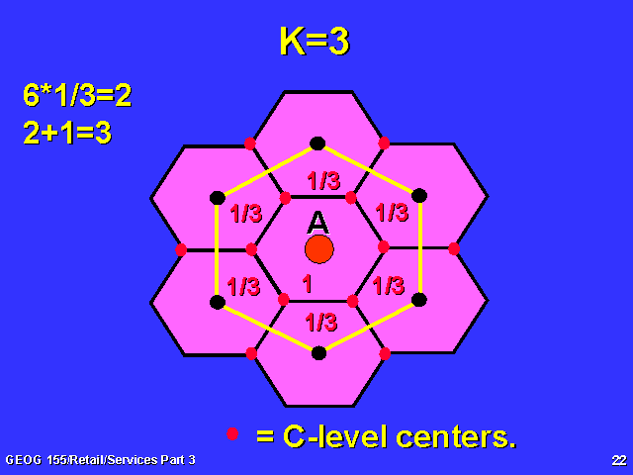
THEORIES - K=3 The marketing principle
Example -the highlighted lower order settlement (village X) will have 1/3 of is consumers go to the city (settlement A) and 1/3 will go to town Y and 1/3 will go to town Z (middle order settlements)
All the other lower order settlements (red dots) will follow the same pattern.
The high order (3rd order) settlement (A) in the middle is surrounded by medium order settlements (black dots) and lower order settlements (small red dots). These consumers are attracted in equal amounts to whichever large central place is nearby.
Y
Settlement X
Z
Why is K=3 called K=3?
Hint→ look at the numbers of consumers who visit the highest order settlement

Slide 13
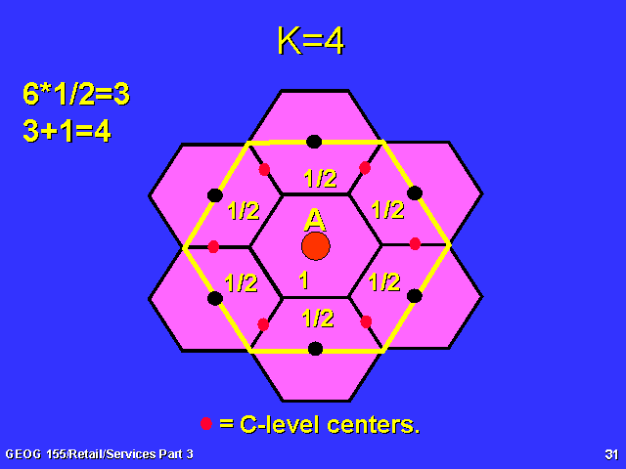
K4= The Traffic Principle
In the K=4 model the lower order settlements (red dots) only have a choice of 2 higher order settlements to visit, in order to buy goods and services.
-Half of them go to settlement A and the other half go to a medium order settlement (black dot)
How did K=4 get its name?
Why is K=4 called the Traffic Principle (model)

Slide 14
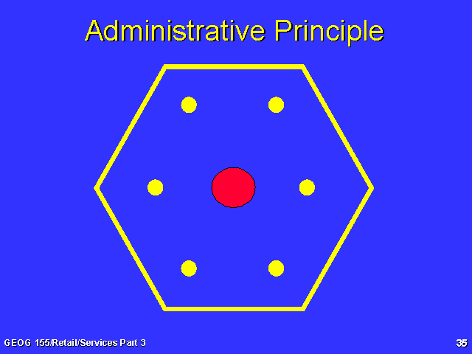
This model shows a hierarchy of control→ -Lower level settlements are arranged within the sphere of influence of the highest order settlement. This is done so that the lower order settlements can be completely controlled by higher levels.
K=7 The Administrative Principle
A high order central place is shown.
-All the low order settlements lie within the hexagonal trade area (U,V,W,X,Y)
Z
U
Y
V
Why is K7 called K7?
X
W

Slide 15
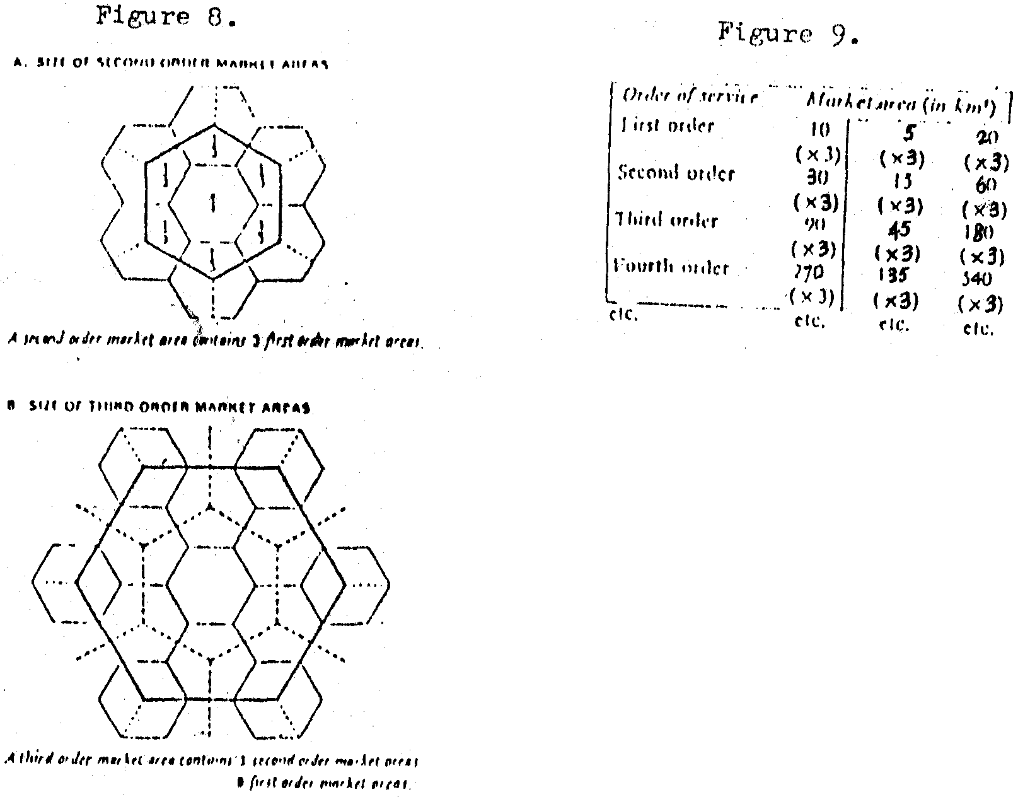
SIZE OF THE MARKET
A higher order service needs a larger market area than a lower order service because its threshold is higher. If we measure the market area in km², for example, if first order central place have market areas of 10 km² for first order service, second order central place have market areas of 10 x 3 = 30 km² for second order services.

Slide 16
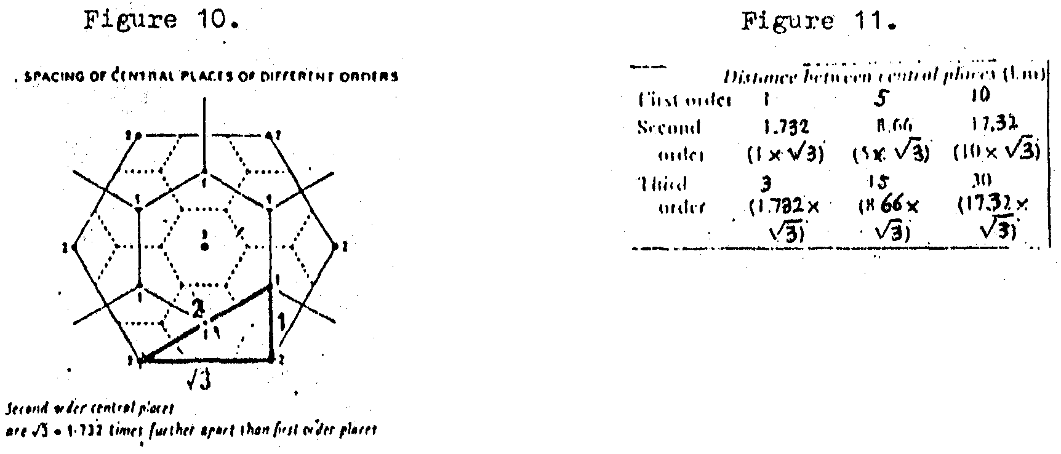
SPACING OF THE CENTRAL PLACES .
A higher order service needs a larger market area than a lower order service because its threshold is higher. If we measure the market area in km², for example, if first order central place have market areas of 10 km² for first order service, second order central place have market areas of 10 x 3 = 30 km² for second order services.

Slide 17
Settlement hierarchy
Why are there very few large settlements?
Large settlements need a very large population (threshold) to support all of their functions (services)
Large settlements provide very high order functions. Because these functions are so highly specialised there is not enough
demand to support more than a few of them

Slide 18
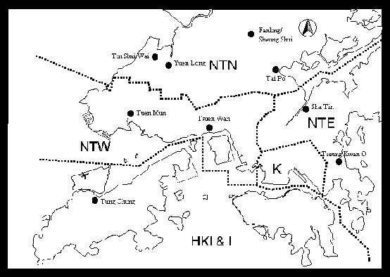
CASE STUDY : URBAN SYSTEM IN HONG KONG

Slide 19
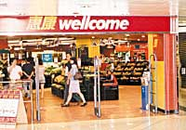
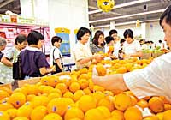
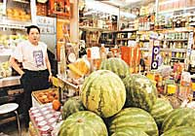
Shopping center planning in HK
METROPOLITAN CENTERS
  Catchment population: Whole HK and tourists
  Range of goods: consumer durable goods, many banks and commercial services, cinemas, theatres, restaurants, entertainment and social facilities.
  Examples: located at Central, Tsim Sha Tsui and Causeway Bay

Slide 20
Shopping center planning in HK
Regional Centers
  Catchment population: 250,000 to 1,000,000
  Range of goods: department stores/supermarkets, many ancillary services, i.e. banks, restaurants, cinemas, theatres and other social facilities
  Examples: new town centers. Typical centers may range from 50,000 to 250,000 sq.m.

Slide 21
Shopping center planning in HK
District Centers
  Catchment population: 50,000 to 250,000
  Range of goods: limited entertainment and social facilities, but significant concentrations of retail facilities and restaurants
  Examples: medium-scale shopping centers of town-wide or district significance, Wan Chai in the urban area and Kam Tin in NT. Typical centers may range from 10,000 to 50,000 sq.m.

Slide 22
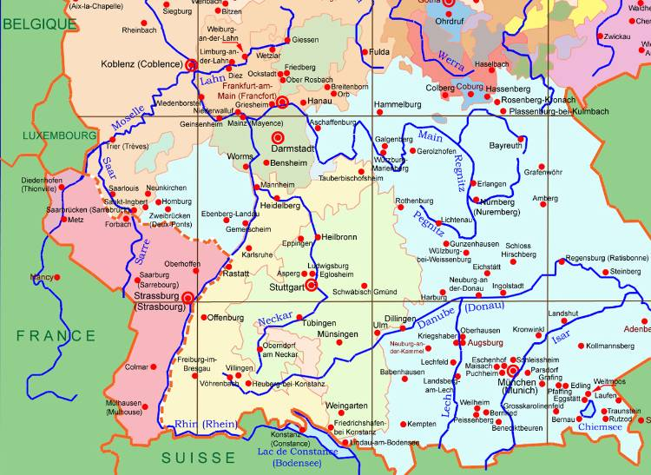
CASE STUDY : - URBAN HIERARCHY IN SOUTH-WEST GERMANY

Slide 23
CASE STUDY : - URBAN HIERARCHY IN SOUTH-WEST GERMANY
Settlement form | Distance apart (km) | Population | Tributary area size (km²) | Population
Market hamlet (Markort) Township centre (Amtsort) County seat (Kreistadt) District city (Bezirksstadt) Small state capital (Gaustadt) Provincial head capital (Provinzhaupstadt) Regional capital city (Landeshaupstadt) | 7 12 21 36 62 108 186 | 800 1,500 3,500 9,000 27,000 90,000 300,000 | 45 135 400 1,200 3,600 10,800 32,400 | 2,700 8,100 24,000 75,000 225,000 675,000 2,025,000

Slide 24
Limitations of Christaller's model
The problem lies in the basic assumptions of the model:
People do not always go to the nearest central place (they may chose a new edge of city superstore further away) So the K3 theory wouldn’t work.
Large areas of flat land rarely exist. Mountains & hills etc distort transport routes (so the K4 theory wouldn’t work)
People and wealth are not evenly distributed (if poorer people live in a certain area & their nearest high order settlement is expensive then they won’t visit it)
Governments often control where new towns are located, not market forces (i.e. not necessarily where the demand for goods and services is highest)

