Slide 1
Subject: Principles Of Human Settlements-I
Topic: C.A.DOXIADIS
Presented by: Fazlur Rahman

Slide 2
“Dimensions increase and will continue to increase for a few generation and thus the most probable future in definable terms will mean a very large increase of population and energy in the city of Anthopos(man). This is the city where the whole mankind will live or tend to live.”
C.A.DOXIADIS

Slide 3
Constantinos A. Doxiadis
Born 1913 comes from a family that played an important role in the settlement of Greek war refugees in between the two World Wars
Worked
Chief Town Planning Officer, Greater Athens Area (1937 - 1938).
Head, Department of Regional and Town Planning, Ministry of Public Works, Greece (1939 - 1945).
Major Projects
In the application of his theories on Ekistics, C.A. Doxiadis studied, programmed,planned and designed, in collaboration with his colleagues, a great number of human settlements and other development projects. These projects cover several fields, like rural settlements, agriculture and irrigation, industrial settlements, manufacturing, power and public works, commerce and tourism, transportation and communications, housing, urban renewal and developmentof new cities,etc.

Slide 4
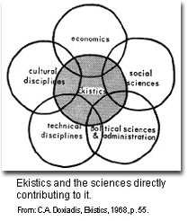
Ekistics Framework
Doxiadis posited a convenient way of organizing information and mapping out the components and relationships of the elements within the human settlements realm. He suggests to have a Classificatory System that will be a methodology to establish the hierarchical structure and links among elements of a system.
His two Classificatory Dimensions...
1. First Dimension- relative to Scale: * Lower End- the individual, the room, and the dwelling; and increases in size all the way into the... * Other Extreme- the city, the urban continent, and the "world-wide city"--which he called an Ecumenopolis
2. Second Dimension- man's five Environmental Elements: * Nature * Society * Shells * Networks * Culture

Slide 5
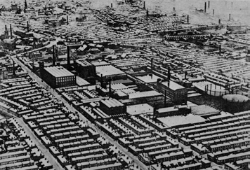
analysis
To achieve this we must clarify what we mean by cities. If we have the wrong conception -- for example, that cities are “all like the City of London, densely built, small, traditional central parts of urban areas, or like the city of
New York, multimillion people agglomerations with many skyscrapers”-- we cannot go very far.
Preston in Lancashire presents the confusion created by the random development of cities in the 19th century.
In all these cases we fail, not because the cities of the future may not be like these prototypes, but because we approach our subject with preconceived ideas about numbers of people, physical size, buildings, and styles which are a major hindrance to
the conception of the cities of the future.

Slide 6
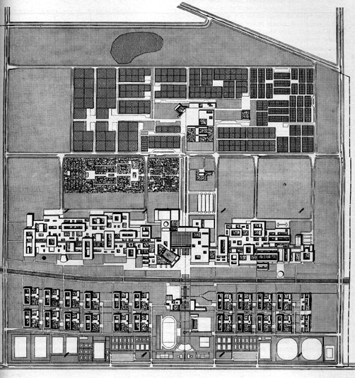
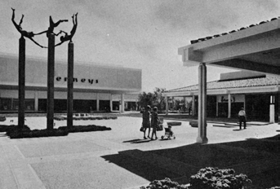
ANALYSIS
SOME OF HIS PROPOSALS INCLUDED:
Limiting all buildings to three levels or less, with permission to build higher
Separating automobile and pedestrian traffic completely.
Constructing cities as a "beehive" of cells each no bigger than 2 by 2 kilometers, the maximum comfortable distance for pedestrians.
According to Doxiadis, the greatest problem facing cities worldwide was the problem of managing growth.
He proposed several solutions
to leave room for expansion of the city core.
Central mall in a recently built shopping centre outside Los Angeles where pedestrians are able to move free of automobile traffic.
Doxiadis limited the number of roads on campus. All the educational buildings are interconnected to permit people to walk from one to the other. Courtyards provide a place for meetings between people.

Slide 7
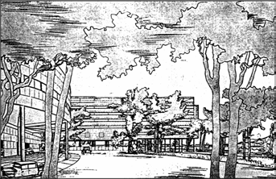
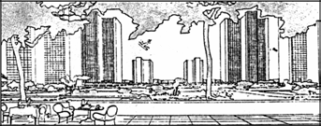
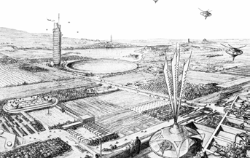
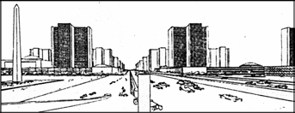
ANALYSIS
The city of the future as conceived by Le Corbusier in 1922 illustrates his belief that man should live in a human. Le Corbusier's scale was at ground level where man could walk in green areas. Green spaces are needed by man, but he must not be restricted to them.
The city of the future as conceived by Frank Lloyd Wright is a combination of built-up areas and cultivated landscapes. In part, it is a negation of the city as it does not provide for continuously built-up
areas, but for an interplay of machines and buildings

Slide 8
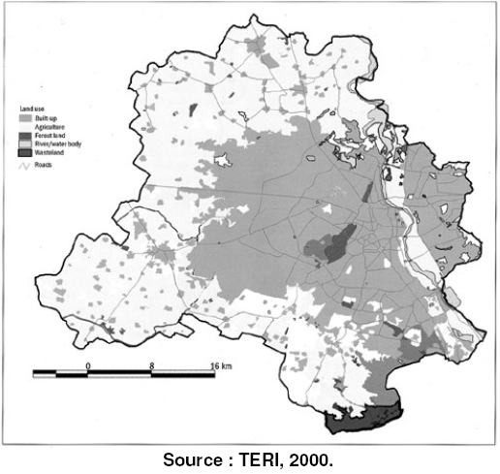
Demand for land (AN INCREASE IN DIMENSION)
The centrifugal pattern of population growth was evident since the decade 1981-1991, during which the growth was faster in the rural hinterland or the fringe of the NCT Delhi than in the urban agglomeration proper
The natural growth rates
during the same period were 2.5% annually in rural areas and 2.1 % in urban areas
The urban villages of Delhi. They carry 5-6 times more the population density than the non village areas and caters for mixed land use.

Slide 9
Demand for land (AN INCREASE IN DIMENSION)
The villages in the rural-urban interface can be put under three main phases of transformation
Pre-transition stage: where the village is close to urban extension areas and
gradually starts changing character.
Transition stage: where the village comes under the urban extension area and is characterised by very high sub-division outside laldora (the legal line dividing
built-up and agricultural lane uses in a village).
Post-transition stage: where the villages in close proximity to surrounding
planned development gets transformed and almost becomes part and parcel of
urban areas with increasing inter dependencies on each other

Slide 10
ARGUMENTS – RATHER QUESTIONS
Are dimensions actually increasing?
Is population growth a boon or a taboo to a society?
Do we really need to have control measures to curtail this growth or rather use our intellect, which puts us at par viz a viz animals and other life forms?
Why then cities still live, without succumbing to this devastating growth?

Slide 11
What lacks
Long term planning is needed to determine whether such lands are destined to become urban or not
But that ideal works only if the urban planning is for green field projects. Since most urbanisation is not green field, are our policies encouraging this integration, or is development just chaotic?
Today’s chaos may be more visible in Delhi, Mumbai, Ahmedabad, Bengaluru, Chennai, Kolkatta & Hyderabad. But more serious chaos is probably in other cities like .
Our modern day cities too can be planned in such a manner that limits are set to accommodate a certain population and the city is buffered by an equal area of countryside before another new city is created.
This equitable land distribution between the city and the village would be an inter-complementary arrangement.
Mega-cities interconnected with high speed transport with green fields in between. Integration, if at all necessary should be evolutionary and not enforced.
A city where the scale is within the horizon of the human mind. With the planner no longer planning the city since being overtaken by greedy politicians an builders, emergence of so called millennium city like Gurgaon which lack the minimum social facility is evident.
.

Slide 12
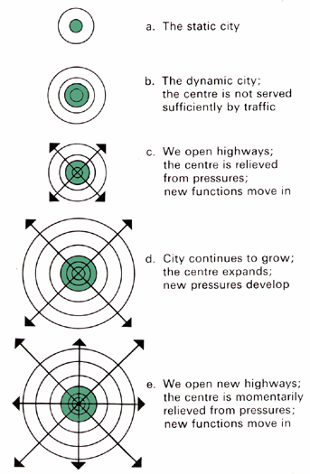
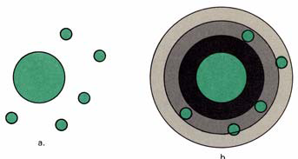
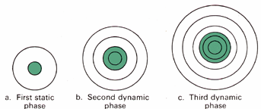
argument
The garden cities were created outside the built-up area (a) in order to avoid its
pressures, but later were absorbed by the dynamically expanding city (b).
In spite of the continuing surgery, the
dynamic city cannot be relieved of
pressures; with more roads, more
functions move in.
The centre has to grow within the built-up
area, and the dynamic city is choked to
death.

Slide 13
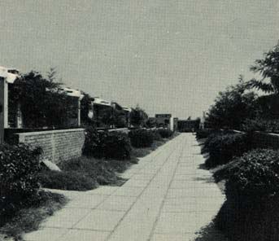
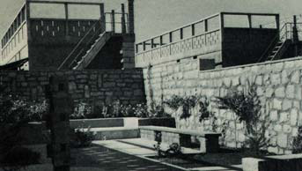
EKISTIC PRINCIPLES | DESIRABILITY OUTCOME
Maximisation of potential contacts | Each individual’s need for access to other people, work, goods, and services, is met in ways that score positively in terms of accessibility, technology and cultural appropriateness.
Minimisation of effort in terms of energy, time and cost | People can satisfy their needs (e.g. as above) without having to expend unnecessary time and energy.
Optimisation of Anthropos’ protective space when alone | People live in a human scale neighbourhood which is safe and secure, where culturally sensitive provisions meet these needs.
Optimisation of the quality of Anthropos’ relationship with the system of life | People have levels of access to opportunities, and economic and social benefit which are fair and culturally sensitive.
Optimisation in the synthesis of all principles | The humane habitat exhibits a sensitive balance in the desirability outcomes where quality of life and social justice reinforce the desirability to achieve a sustainable environment.
Human scale re-established within the
human community as in this one in Mosul,
Iraq.
Street for pedestrians only in Islamabad,
Pakistan.

Slide 14
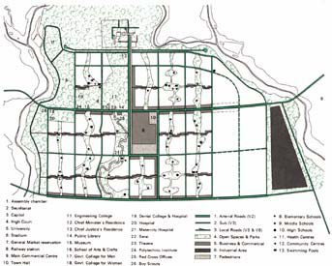
conclusion
The fact that the frame is extra-human does not mean that we cannot create a human scale within it. Man will have to create once more a human scale within an extra human frame, which has many inhuman parts.
The key to the solution is the creation of the human community as a part of a much larger city.
The problem, therefore, is reshaped as a problem of an organized Ecumenopolis, consisting of many human communities that will be its fundamental cells, interconnected by the tens, hundreds, thousands, and tens of thousands into major urban complexes that will be the parts of Ecumenopolis.
In this way, what was a natural human community can be immensely enlarged into a human city. With proper organization of transportation and telecommunications networks, the extra-human scale of the large city can be turned into a human one and the inhuman conditions now existing in many parts of the city can be eliminated.
Chandigarh, the new capita! of the Punjab
in India, designed by Le Corbusier in the
year 1950. The drawing shows the initial
master plan by Le Corbusier with the city
divided into major sectors within which
the human scale is reestablished.

Slide 15
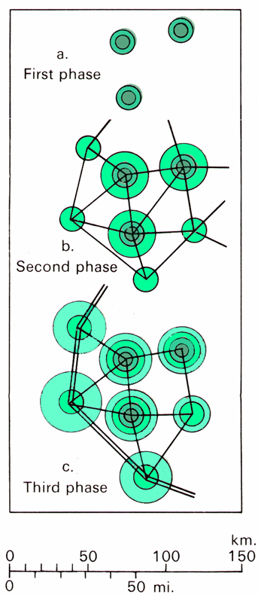
conclusion
The centre has to grow within the built-up
area, and the dynamic city is choked to
death.
More and more, man will do all the tasks that present an interest and a challenge and leave everything else to automated process.
Ecumenopolis, the unique city of man, will form a continuous, differentiated, but also unified texture consisting of many cells, the
human communities.
If, in the same system as the preceding figure, we create new arteries and new cities, we can avoid all problems of abnormal growth.

Slide 16
Reason why cities still live
Vital cities have marvelous innate abilities for understanding , communicating, contriving and inventing what is required to combat their difficulties.
Perhaps the most striking example of this ability is the effect that big cities have had on disease.
Cities were once the most helpless and devastated victims of disease, but they became great disease conquerors. All the apparatus of surgery, hygiene, public health measures, etc. which people not only in cities but also outside them depend upon for the unending wars against premature mortality are fundamentally products of big cities and would be inconceivable without big cities.
The surplus wealth, the productivity, the close-grained juxtaposition of talents that permit society to support advances such as these are themselves products of our organization into cities, and especially into big and dense cities.

Slide 17
CONCLUSION
Man doesn’t have the power to change the physical dimensions of the world and also these dimensions are in no way less to accommodate all.
Stress should be on imbibing civic sense, and education to help people use there intellect.
Dull, inert cities contain the seeds of their destruction.
But lively cities, diverse and intense contain the seeds of their own regeneration, with energy enough to carry over for problems and needs outside themselves.

Slide 18
Constantinos A. Doxiadis
Sources:
Ekistics: the science of human settlements
Ebenezer Howard, Garden Cities of To-morrow
John G. Papaioannou, The City of the Future
W. W. Wagar, The City of Man
Website
www.ekistics.org
www.doxiadis.org
www.csiss.org/classics

